Slide 1
Speaker Firms and Organization:
Presented By:
Partner Firms:
Wilson Elser Danny Vogel Attorney
The McLauchlan Law Group, LLC David C. McLauchlan Managing Partner
Thank you for logging into today’s event. Please note we are in standby mode. All Microphones will be muted until the event starts. We will be back with speaker instructions @ 09:55am. Any Questions? Please email: info@theknowledegroup.org
Group Registration Policy
Please note ALL participants must be registered or they will not be able to access the event.
If you have more than one person from your company attending, you must fill out the group registration form.
We reserve the right to disconnect any unauthorized users from this event and to deny violators admission to future events.
To obtain a group registration please send a note to info@theknowledgegroup.org or call 646.202.9344.
December 05, 2016

Slide 2
Please note the FAQ.HELP TAB located to the right of the main presentation. On this page you will find answers to the top questions asked by attendees during webcast such as how to fix audio issues, where to download the slides and what to do if you miss a secret word. To access this tab, click the FAQ.HELP Tab to the right of the main presentation when you’re done click the tab of the main presentation to get back.
For those viewing the webcast on a mobile device, please note:
These instructions are for Apple and Android devices only. If you are using a Windows tablet, please follow the instructions for viewing the webcast on a PC.
The FAQ.HELP TAB will not be visible on mobile devices.
You will receive the frequently asked questions & other pertinent info through the apps chat window function on your device.
On Apple devices you must tap the screen anywhere to see the task bar which will show up as a blue bar across the top of the screen. Click the chat icon then click the chat with all to access the FAQ’s.
Feel free to submit questions by using the “questions” function built-in to the app on your device.
You may use your device’s “pinch to zoom function” to enlarge the slide images on your screen.
Headphones are highly recommended. In the event of audio difficulties, a dial-in number is available and will be provided via the app’s chat function on your device.
December 05, 2016

Slide 3
Follow us on Twitter, that’s @Know_Group to receive updates for this event as well as other news and pertinent info.
If you experience any technical difficulties during today’s WebEx session, please contact our Technical Support @ 866-779-3239. We will post the dial information in the chat window to the right shortly and it’s available in the FAQ.Help Tab on the right. Please redial into the webcast in case of connectivity issue where we have to restart the Webex event.
You may ask a question at anytime throughout the presentation today via the chat window on the lower right hand side of your screen. Questions will be aggregated and addressed during the Q&A segment.
Please note, this call is being recorded for playback purposes.
If anyone was unable to log in to the online webcast and needs to download a copy of the PowerPoint presentation for today’s event, please send an email to: info@theknowledgegroup.org. If you’re already logged in to the online Webcast, we will post a link to download the files shortly and it’s available in the FAQ.Help Tab
December 05, 2016

Slide 4
If you are listening on a laptop, you may need to use headphones as some laptops speakers are not sufficiently amplified enough to hear the presentations. If you do not have headphones and cannot hear the webcast send an email to info@theknowledgegroup.org and we will send you the dial in phone number.
About an hour or so after the event, you'll be sent a survey via email asking you for your feedback on your experience with this event today - it's designed to take less than two minutes to complete, and it helps us to understand how to wisely invest your time in future events. Your feedback is greatly appreciated. If you are applying for continuing education credit, completions of the surveys are mandatory as per your state boards and bars. 6 secret words (3 for each credit hour) will be given throughout the presentation. We will ask you to fill these words into the survey as proof of your attendance. Please stay tuned for the secret word. If you miss a secret word please refer to the FAQ.Help tab to the right.
Speakers, I will be giving out the secret words at randomly selected times. I may have to break into your presentation briefly to read the secret word. Pardon the interruption.
December 05, 2016

Slide 5
Basic Annual Subscription – LIVE CLE Webcasts $199 (After Instant Discount) | Pro Annual Subscription – LIVE CLE & Recorded Webcasts $299 (After Instant Discount)
You get all these features: Unlimited Access to LIVE CLE Webcasts & Materials PLUS Free CLE Credit Processing Unlimited Access to Course Materials for LIVE Webcasts One-Click Registration Free Webcast Calendar Organizer with Outlook Integration $16.58 per month (Billed Annually – $199) | You get all these PRO features: Unlimited Access to LIVE CLE Webcasts & Materials PLUS Free CLE Credit Processing Unlimited Access to Course Materials for LIVE Webcasts One-Click Registration Free Webcast Calendar Organizer with Outlook Integration Unlimited Access to Recorded Webcasts & Materials $299 per year
MobileCLE.org is simple to use:
On any device, log into your mobileCLE.org account and choose a LIVE continuing legal education webcast or recorded/on-demand course using one of our many powerful search engines (by legal practice area or keywords such as Patent, FACTA, Data Privacy, eDiscovery etc.).
Register for your CLE webcast by clicking the reserve button.
On the day and time of your LIVE webcast, simply click Launch! and with 2 taps on your screen you’re earning CLE!
Practice Areas:
Administrative Law, Alternative Dispute Resolution, Antitrust, Appellate Litigation, Bankruptcy, Communications Law, Corporate Law, Employment/Labor Law, Environmental Law, Government Contracts Law, Health Law, Immigration Law, Intellectual Property Law, International Development Law, International Trade Law, Mergers and Acquisitions, National Security Law, Privacy Law, Real Estate Law, Securities Law, Sports/Entertainment Law, Tax Law, Trusts and Estates Law, and White Collar Crime
To sign up:
www.mobilecle.org
December 05, 2016

Slide 6
Partner Firms:
Wilson Elser, a full-service and leading defense litigation law firm, serves its clients with nearly 800 attorneys in 30 offices in the United States and one in London. Founded in 1978, it ranks among the top 200 law firms identified by The American Lawyer and is included in the top 50 of The National Law Journal's survey of the nation's largest law firms. Wilson Elser serves a growing, loyal base of clients with innovative thinking and an in-depth understanding of their respective businesses.
The McLauchlan Law Group LLC was founded by David C. McLauchlan, a former partner in the international law firm of Locke Lord LLP. The firm focuses on the representation of small businesses and entrepreneurs in all aspects of their business endeavors including mergers and acquisitions, aviation law, business formation and operations, contract disputes, insurance and reinsurance law, intellectual property law and the resolution of disputes through mediation, arbitration and litigation. The firm has been recognized by U.S. News & World Report as one of the Best Law Firms in Illinois.
December 05, 2016

Slide 7
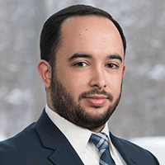
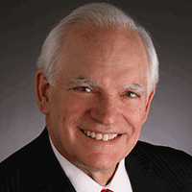
Brief Speaker Bios:
Danny Vogel
Danny Vogel is an associate in Wilson Elser’s White Plains office. He focuses his practice on product liability, general liability and insurance coverage matters. He primarily handles litigation matters and is experienced in all phases of discovery, motion practice and depositions. Fluent in several languages, Danny represents manufacturers of all sizes headquartered in the United States and abroad. He has handled cases involving a variety of products, including table saws, circular saws, boats, industrial appliances and forklifts, and cases involving alleged security guard negligence and slip and falls. The cases he handles alternate between state and federal court and are not limited to New York State.
David C. McLauchlan
Mr. McLauchlan is a highly respected business advisor, litigator and trial lawyer. He has practiced law for over 30 years and concentrates his practice in business counseling and in resolving complex business disputes through mediation, arbitration and when necessary through business litigation. David has counseled all manner of businesses both large and small and successfully resolved matters involving insurance, reinsurance, construction law, intellectual property, mergers and acquisitions, unfair business practices, aviation law, product liability, property damage and claims related to asbestos containing products and environmental coverage issues.
► For more information about the speakers, you can visit:
https://theknowledgegroup.org/event-homepage/?event_id=1887
December 05, 2016

Slide 8
The rapid and continuous growth of drone technology is paving the way for tremendous opportunities for businesses. However, these opportunities don’t come without risks. Manufacturers, distributors & retailers should mull over the various complex product liability issues which may arise along the way. Since the exponential proliferation of drone use in the marketplace will dramatically change the legal landscape of product liability, insurers, manufacturers, and service providers must be prepared for the risk exposure that concurs with this technology.
It would be wise for defense counsel to keep themselves abreast of Federal Aviation Administration regulations and developments. They should also monitor lawsuits for drone liability issues and how they are resolved.
In this two-hour LIVE Webcast, a panel of distinguished professionals and thought leaders organized by The Knowledge Group will help businesses understand the fundamental and complex aspects of Drone Product Liability. They will also provide an in-depth discussion of the best risk management practices.
Key topics include:
The Growing Drone Industry – An Overview
Drone Product Liability Exposure Risks
Product Liability Coverage
Best Risk Management Practices
Regulatory Forecasts
December 05, 2016

Slide 9
Featured Speakers:
Danny Vogel Attorney Wilson Elser
David C. McLauchlan Managing Partner The McLauchlan Law Group, LLC
December 05, 2016

Slide 10
Danny Vogel Attorney Wilson Elser
Introduction
Danny Vogel is an associate in Wilson Elser’s White Plains office. He focuses his practice on product liability, general liability and insurance coverage matters. He primarily handles litigation matters and is experienced in all phases of discovery, motion practice and depositions. Fluent in several languages, Danny represents manufacturers of all sizes headquartered in the United States and abroad. He has handled cases involving a variety of products, including table saws, circular saws, boats, industrial appliances and forklifts, and cases involving alleged security guard negligence and slip and falls. The cases he handles alternate between state and federal court and are not limited to New York State. Other projects include reviewing and revising various agreements and contracts and conducting 50-state surveys on various legal issues. In addition, Danny has drafted multiple articles analyzing the emergence of drones and the legal issues that surround them. He earned a Licenciatura and Master en Derecho, (J.D. equivalent degree) from Esade, Facultad de Derecho in Spain and his LL.M. from Fordham University School of Law in New York.
December 05, 2016

Slide 11
David C. McLauchlan Managing Partner The McLauchlan Law Group, LLC
Introduction
Mr. McLauchlan is a highly respected business advisor, litigator and trial lawyer. He has practiced law for over 30 years and concentrates his practice in business counseling and in resolving complex business disputes through mediation, arbitration and when necessary through business litigation. David has counseled all manner of businesses both large and small and successfully resolved matters involving insurance, reinsurance, construction law, intellectual property, mergers and acquisitions, unfair business practices, aviation law, product liability, property damage and claims related to asbestos containing products and environmental coverage issues. He has mediated, arbitrated and tried cases across the United States including trying cases before State and Federal Courts and in private arbitrations serving as lead trial counsel and Appellate counsel. Throughout his career he has successfully managed large litigation teams and served as a mentor and leader to numerous young litigators who are now successful partners, managing partners, and corporate law department executives. His litigation expertise and professional regard has been recognized by the Leading Lawyers Network, Illinois Super Lawyers, Best Lawyers in America and he is AV peer rated by Martindale Hubbell. He is a Fellow of the Litigation Counsel of America and a Fellow of the American Academy of Alternative Dispute Resolution.
December 05, 2016

Slide 12
Danny Vogel Attorney Wilson Elser
Disclaimer
“The opinions expressed herein are those of the author and may not reflect the opinions of Wilson Elser. Information about legal issues and legal developments is intended for informational purposes only and does not constitute legal advice.”
December 05, 2016

Slide 13
Danny Vogel Attorney Wilson Elser
Drones: Potential Product Liability Exposure
December 05, 2016

Slide 14
Danny Vogel Attorney Wilson Elser
Key Aspects of Drones
Drones come in a variety of shapes and sizes: e.g., miniature, consumer and military size.
Focusing on drones that weigh less than 55 pounds.
Wide variety of uses and applications.
1.6 million drones sold in the U.S. in 2015; 1.9 million expected in 2016.
Increase in reports of unauthorized and potential unsafe operations:
1,133 incidents in 2015
238 incidents in 2014
December 05, 2016

Slide 15
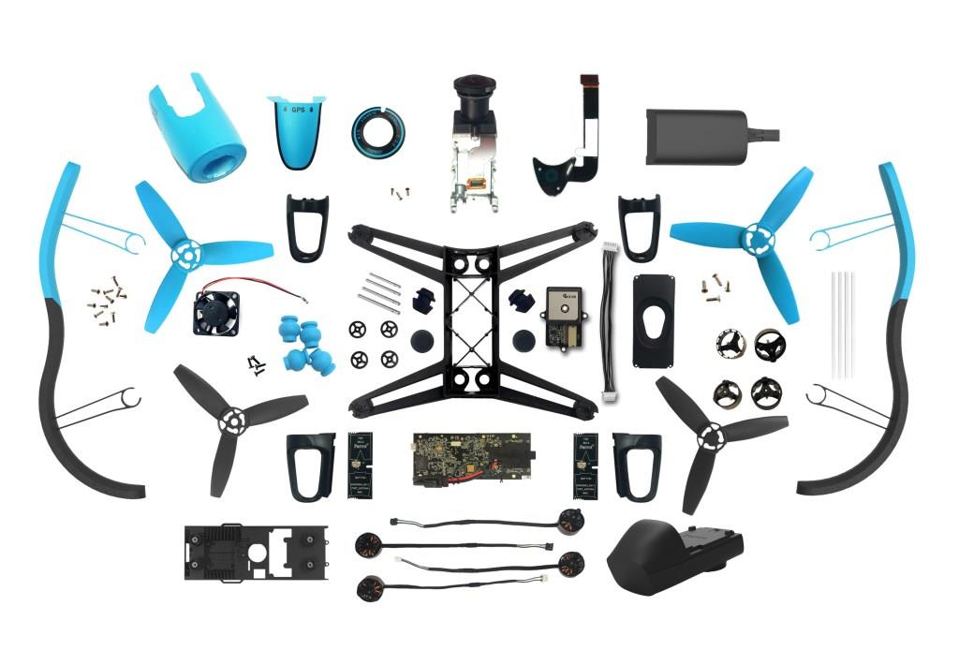
Danny Vogel Attorney Wilson Elser
Key Aspects of Drones (2)
Component parts:
Frame
Transmitters and receivers
Onboard computer
Motor(s)
Batteries
Propellers
Flight controller/remote
Camera
December 05, 2016

Slide 16
Danny Vogel Attorney Wilson Elser
Uses and Applications
Law enforcement:
surveillance, search and rescue, public safety
Construction:
Site mapping, progress monitoring, surveying.
Distribution:
Shipping and delivery
Media:
News reporting, photography, videography
Agriculture:
Crop monitoring, applying pesticide, herbicide and/or fertilizer
Internet:
Providing internet access to rural areas
December 05, 2016

Slide 17
David C. McLauchlan Managing Partner The McLauchlan Law Group, LLC
State Regulation of Drones
32 states have issued regulations
Use by law enforcement: requirement that police obtain a warrant before using UAS for surveillance.
Prohibited use in hunting or fishing: pro or con
Prohibited surveillance of schools and correctional facilities
Some states prohibit flying close to critical infrastructure or near wild fires.
Cities have also issued drone ordinances banning flights by municipal buildings but some have gone too far and suggested overall operations standards: over other’s property without permission.
Good overview at the National Conference of State Legislatures site:http:www.ncsl.org
December 05, 2016

Slide 18
David C. McLauchlan Managing Partner The McLauchlan Law Group, LLC
FAA Fact Sheet on Regulation
The FAA released a “Fact Sheet” in December 2015 to guide State & Local legislators on the permissible scope of regulation.
FAA claims pre-emption in controlling and defining airspace.
Defers to States on dealing with role in law enforcement and certain activities such as hunting and fishing.
December 05, 2016

Slide 19
Danny Vogel Attorney Wilson Elser
Product Liability Exposure
Drone operation can lead to complications with the law
Personal injury, property damage, invasion of privacy, violation of FAA regulations, etc.
Focus on product liability issues
Strict product liability claims
Manufacturing defects
Design defects
Failure to warn
December 05, 2016

Slide 20
Danny Vogel Attorney Wilson Elser
Manufacturing Defect
Manufacturing defects occur when the product is flawed due to some error during its creation.
The product departs from its intended design even though all possible care was exercised in the preparation and marketing of the product.
Relatively uncommon in product liability law due to manufacturing controls and regulatory oversight.
If a defectively manufactured product slips through the cracks, the manufacturer can be found to be strictly liable.
December 05, 2016

Slide 21
Danny Vogel Attorney Wilson Elser
Design Defect
Design defects focus on the manufacturer’s plans in creating the product.
Occurs when it is shown that there was a foreseeable risk posed by the product when the product was manufactured as intended and used for its intended purposes.
No manufacturing error in one single product; entire product line is claimed defective.
Much more common in product liability lawsuits.
December 05, 2016

Slide 22
Danny Vogel Attorney Wilson Elser
Design Defect (2)
Foreseeable risks involving drones.
“Lost-link” situations:
Where the connection between the operator and the drone is severed.
What happens to the drone in such a situation?
Autonomous anti-collision systems: allows the drone to automatically land safely, return to point of origin, avoid imminent collisions, etc.
The idea is to avoid the drone simply dropping from the sky or spiraling out of control, potentially injuring someone or damaging property.
December 05, 2016

Slide 23
Danny Vogel Attorney Wilson Elser
Design Defect (3)
“GPS Geofencing”
System that allows the drone to recognize when it is flying close to or over restricted areas.
Airports, government property.
Forcing the drone to land or return to point of origin.
User Interface/Controller Configuration
Controller needs to be effective, user-friendly.
Provide information regarding speed, altitude, weather/wind measurements, signal/connection strength.
Emergency button in case of loss of control.
December 05, 2016

Slide 24
Danny Vogel Attorney Wilson Elser
Failure to Warn
Failing to provide adequate warnings or instructions about the product’s proper use.
Operator’s manual, box and the product itself need to have warning labels to ensure visibility by the operator.
Example warnings:
Warning of possibility of “lost-link” situations.
Warning against flying near people or property.
Warning against flying over restricted airspace.
Warning against operating under the influence of drugs or alcohol.
Notice to abide by all applicable state and federal regulations.
Possible defenses: Knowledgeable user, open and obvious dangers.
December 05, 2016

Slide 25
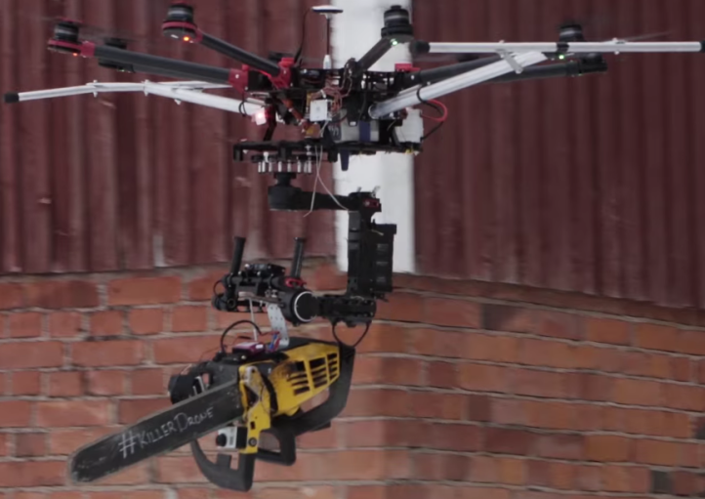
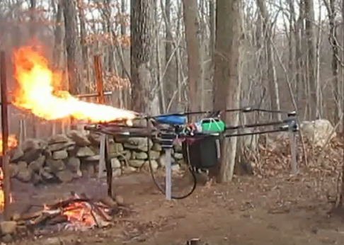
Danny Vogel Attorney Wilson Elser
Substantial Modification or Abuse
Operators may modify their drones for unintended applications.
Warnings against such modifications will provide additional support for successful defenses.
December 05, 2016

Slide 26
Danny Vogel Attorney Wilson Elser
Drone Standards
No uniform drone manufacturing standards to date.
Drones becoming increasingly complex and technologically advanced.
Manufacturers must ensure:
Meeting certain minimum safety requirements.
Showing that the product goes above and beyond the minimum.
Keeping an eye on technological developments in the field.
December 05, 2016

Slide 27
Danny Vogel Attorney Wilson Elser
Rules and Regulations
Federal Aviation Administration (FAA)
National aviation authority in charge of regulating American civil aviation.
Latest regulations went into effect late August 2016
Rapidly evolving legal landscape; manufacturers must stay on top of new developments.
Drone registration requirement.
Drones weighing between 0.5 and 55 pounds must register with the FAA.
Requires contact information and $5 fee.
Provides Certificate of Aircraft Registration/Proof of Ownership.
Penalties of up to 3 years imprisonment and/or fines up to $250,000, or civil penalties up to $27,500.
December 05, 2016

Slide 28
Danny Vogel Attorney Wilson Elser
FAA Drone Regulations
August 2016 Rules apply to the commercial use of drones weighing less than 55 pounds
Sample rules:
Maximum flight speed of 100 mph.
Maximum height/elevation of 400 feet.
Visual line of sight (drone’s camera does not satisfy this requirement).
Flight is limited to daytime use.
Flights over people not allowed unless the people are participating in the drone’s operation.
Indoor flight not allowed.
Drone operator must conduct a preflight visual and operational check to ensure the drone’s safe operation.
December 05, 2016

Slide 29
Danny Vogel Attorney Wilson Elser
FAA Drone Regulations (2)
Licensing requirements
Section 333 waiver is no longer required.
Must be at least 16 years old.
Must possess a remote pilot airman certificate.
Obtained by passing an FAA-approved test.
Privacy concerns
No rules by the FAA.
Recommended privacy guidelines as part of drone registration process.
FAA to provide guidance to local and state governments.
FAA plans to expand and modify the rules in the future to account for the rapid growth in the use of drones.
December 05, 2016

Slide 30
Danny Vogel Attorney Wilson Elser
Manufacturer Responsibilities
Operator’s manual
Extensive instructions regarding use and care of drone.
Ample warnings and safety notices.
Reference to state and federal regulations.
Notification of licensing requirements.
Design
Implement safety measures for potentially unsafe scenarios.
“lost-link”, geofencing, anti-collision systems
Analyze technological advancements in drone manufacturing.
Legal
Stay up to date on legal advancements.
December 05, 2016

Slide 31
David C. McLauchlan Managing Partner The McLauchlan Law Group, LLC
Drone Insurance
FAA rules and regulations do not require insurance for commercial operations
But “best business practices” will dictate the need for comprehensive coverage
Clients of drone operators will request proof of insurance before operations begin
Clients will demand “indemnity for operations”
Clients will ask to be named as “additional insured” under operator’s drone insurance
December 05, 2016

Slide 32
David C. McLauchlan Managing Partner The McLauchlan Law Group, LLC
Drone coverage available from a mix of major carriers and specialty carriers
The traditional aviation insurance carriers see Drone coverage as a natural extension of the coverage they already offer.
A number of “specialty carriers” have emerged to provide coverage for Drones; some however do not provide “hull coverage” and some exclude “personal injury” and “advertising injury”.
ISO has drafted forms for use by domestic carriers desiring to offer UAV cover
December 05, 2016

Slide 33
David C. McLauchlan Managing Partner The McLauchlan Law Group, LLC
Coverages Available
At least one manufacturer offers replacement coverage on their Drones (DJI)
Hull coverage is typically available from the Aviation underwriters.
The Specialty Insurers are focusing on liability coverage for Drone operations
One Insurer: Verifly, provides liability coverage by the hour through an app: the coverage is available in 45 states and coverage is activated by opening the App which depicts the planned flight area and provides coverage for quarter mile.
December 05, 2016

Slide 34
David C. McLauchlan Managing Partner The McLauchlan Law Group, LLC
Coverages to Obtain
Liability coverage for bodily injury and property damage.
Third party contractual liability coverage
“Personal Liability Coverage”: this cover will pick up invasion of privacy claims and advertising liability etc.
Existing commercial business covers typically have aviation exclusions that might be deemed to apply so you cannot assume your existing commercial policy will provide coverage.
For non-commercial operations a homeowners or renter’s policy would typically apply as it would to the operation of the typical “model airplane”.
But Underwriters will be watching this situation closely and may require a special endorsement and fee for Drone coverage to be available to the hobbyist in the future.
December 05, 2016

Slide 35
David C. McLauchlan Managing Partner The McLauchlan Law Group, LLC
Risk Assessment
Drone operator’s and their clients will need to be conscious of the risk of operations:
Proximity of manned flight and airports
People and property exposed to the operation
Experience and training of UAV vendor & operator
Flight documentation requirements
Permission and waiver for flight operations
Exposure to operations of others: need for placards and warning signs?
December 05, 2016

Slide 36
David C. McLauchlan Managing Partner The McLauchlan Law Group, LLC
Privacy Concerns
The UAV is typically outfitted with a very sophisticated high resolution camera and is capable of taking pictures from a potentially intrusive but ideal vantage point.
The airspace above 500 feet is controlled by the FAA and now they are asserting control from the surface to 400’ for drones. But the FAA did not attempt to regulate privacy in tis new regulations.
December 05, 2016

Slide 37
David C. McLauchlan Managing Partner The McLauchlan Law Group, LLC
Privacy: the sky above
In U.S. v. Causby (1946) the property rights of a homeowner were deemed to end 83 feet above the ground. In a recent state court case flying and hovering 200’ over property was deemed invasive.
Some have suggested a buffer of 350 feet for property owners with all Drone traffic squeezed into the next 50 feet to stay below the 400’ level pronounced by the FAA. But this seems unreasonable: the buffer is likely to be much lower.
December 05, 2016

Slide 38
David C. McLauchlan Managing Partner The McLauchlan Law Group, LLC
Privacy: Drone accidents
The drone accidents to date include some high level crashes into high rise buildings:
Empire State Building:
St. Louis:
One drone episode involved a drone being shot down by the father of a young daughter who was interrupted sun bathing by a visit from a drone.
L.A. King fans celebrating the teams Stanley Cup victory in 2014 knocked a drone out of the sky with a T-shirt and then pounded it into little pieces with a skateboard.
Firefighters knocked one out of the sky using high powered hoses.
Another incident: A woman sitting in an outdoor café in Tampa was visited by a Drone which first hovered near her and then followed her to her car before crashing into the roof of her vehicle..
December 05, 2016

Slide 39
David C. McLauchlan Managing Partner The McLauchlan Law Group, LLC
Privacy: Expectations
The emerging test: Did the individual have an expectation of privacy at the time?
State laws governing nuisance and invasion of privacy would apply to drone operations and the facts and capabilities and use of the equipment will dictate if the conduct is actionable.
California has passed a law that a person is liable for “physical invasion of privacy if they knowingly and without permission enter on the land of another, including their airspace for the purpose of taking a picture or sound recording.
Wisconsin makes it illegal to photograph a nude or partially nude person using a drone.
Some of the activities and accidents suggest the Drone pilot was intentionally invading someone’s privacy.
Egregious conduct will be outside of the coverage.
December 05, 2016

Slide 40
David C. McLauchlan Managing Partner The McLauchlan Law Group, LLC
Privacy Challenges
EPIC (Electronic Privacy Information Center) has filed suit to try to force the FAA to set rules protecting citizens from drone privacy intrusions.
This case is currently before the D.C. Circuit Court of Appeals and was recently argued.
Senator Ed Markey of Massachusetts has proposed the Drone Aircraft Privacy and Transparency Act which would require the FAA to enact rules regarding privacy and transparency which would apply to both private drone operators and law enforcement.
The Academy of Model Aeronautics (AMA) has put together a UAS Flight Safety Guide. In their guide they address privacy:
Strictly prohibits photography or imaging of any kind by drones where there is an expectation of privacy without express written permission from the property owners.
December 05, 2016

Slide 41
David C. McLauchlan Managing Partner The McLauchlan Law Group, LLC
Privacy Strategies
Various after-market products and “apps” are emerging to help drone pilots and operators maintain flight boundaries:
Precision Hawk: LATAS system to depict obstacles
Pocket Drone Plan: IOS app to provide weather and visibility and controlled airspace boundaries at your current location
AirMaps: app for location/airspace boundaries
December 05, 2016

Slide 42
David C. McLauchlan Managing Partner The McLauchlan Law Group, LLC
Flight Planning
Flight Planning is a key ingredient in the safety of manned flight.
Flight planning has to become a feature of all commercial drone operations.
Even hobbyist flyers will need to plan their flights when in high density areas.
Placards and Signs: “No Drone Operations Permitted” are likely to proliferate so that property owners have taken steps to prevent unwanted drone operations on their property for the benefit of invitees.
December 05, 2016

Slide 43
Contact Info:
Danny Vogel Attorney Wilson Elser
E: danny.vogel@wilsonelser.com
T: 914.872.7356
David C. McLauchlan Managing Partner The McLauchlan Law Group, LLC
E: David@McLauchlanLawGroup.com
T: 1 (312) 445-8544
December 05, 2016

Slide 44
Q&A:
Danny Vogel Attorney Wilson Elser
David C. McLauchlan Managing Partner The McLauchlan Law Group, LLC
► You may ask a question at anytime throughout the presentation today. Simply click on the question mark icon located on the floating tool bar on the bottom right side of your screen. Type your question in the box that appears and click send. ► Questions will be answered in the order they are received.
December 05, 2016

Slide 45
Basic Annual Subscription – LIVE CLE Webcasts $199 (After Instant Discount) | Pro Annual Subscription – LIVE CLE & Recorded Webcasts $299 (After Instant Discount)
You get all these features: Unlimited Access to LIVE CLE Webcasts & Materials PLUS Free CLE Credit Processing Unlimited Access to Course Materials for LIVE Webcasts One-Click Registration Free Webcast Calendar Organizer with Outlook Integration $16.58 per month (Billed Annually – $199) | You get all these PRO features: Unlimited Access to LIVE CLE Webcasts & Materials PLUS Free CLE Credit Processing Unlimited Access to Course Materials for LIVE Webcasts One-Click Registration Free Webcast Calendar Organizer with Outlook Integration Unlimited Access to Recorded Webcasts & Materials $299 per year
MobileCLE.org is simple to use:
On any device, log into your mobileCLE.org account and choose a LIVE continuing legal education webcast or recorded/on-demand course using one of our many powerful search engines (by legal practice area or keywords such as Patent, FACTA, Data Privacy, eDiscovery etc.).
Register for your CLE webcast by clicking the reserve button.
On the day and time of your LIVE webcast, simply click Launch! and with 2 taps on your screen you’re earning CLE!
Practice Areas:
Administrative Law, Alternative Dispute Resolution, Antitrust, Appellate Litigation, Bankruptcy, Communications Law, Corporate Law, Employment/Labor Law, Environmental Law, Government Contracts Law, Health Law, Immigration Law, Intellectual Property Law, International Development Law, International Trade Law, Mergers and Acquisitions, National Security Law, Privacy Law, Real Estate Law, Securities Law, Sports/Entertainment Law, Tax Law, Trusts and Estates Law, and White Collar Crime
To sign up:
www.mobilecle.org
December 05, 2016

Slide 46
ABOUT THE KNOWLEDGE GROUP
The Knowledge Group is an organization that produces live webcasts which examine regulatory changes and their impacts across a variety of industries. “We bring together the world's leading authorities and industry participants through informative two-hour webcasts to study the impact of changing regulations.”
If you would like to be informed of other upcoming events, please click here.
Disclaimer:
The Knowledge Group is producing this event for information purposes only. We do not intend to provide or offer business advice.
The contents of this event are based upon the opinions of our speakers. The Knowledge Group does not warrant their accuracy and completeness. The statements made by them are based on their independent opinions and does not necessarily reflect that of The Knowledge Group‘s views.
In no event shall The Knowledge Group be liable to any person or business entity for any special, direct, indirect, punitive, incidental or consequential damages as a result of any information gathered from this webcast.
Certain images and/or photos on this page are the copyrighted property of 123RF Limited, their Contributors or Licensed Partners and are being used with permission under license. These images and/or photos may not be copied or downloaded without permission from 123RF Limited
December 05, 2016

