Slide 1
Alternative Capital Mechanisms and Implications for the Insurance/Reinsurance Marketplace and for Dispute Resolution

Slide 2
Alternative capital growth
The economics of the P&C reinsurance business are changing
New sources of capital and new methods of risk transfer drive market changes
Non-traditional players such as hedge funds and pension funds are getting into the game
This is despite record setting industry CAT losses in 2017 & 2018
Traditional contractual terms (including trigger, scope of coverage) are different in this space thereby impacting the ground for potential disputes

Slide 3
Alternative capital growth
Alternative capital has grown to ~USD 90bn¹ and is dominated by a few players (top 10 players have a share > 80%).

Slide 4
Alternative Capital Returns
Returns, however, have recently not been as attractive

Slide 5
Alternative capital product types
Cat Bonds
A catastrophe bond is a security that transfers specific (re)insurance related risks from a sponsor to the capital markets
They are traded like any other capital market instrument; the investor receives interest payments but is liable to lose some or all of its principal investment in case the bond is triggered by an event
Industry Loss Warranties (ILW)
Industry loss warranty contracts can be constructed as either reinsurance or a derivative
They provide protection against the occurrence of a specified level of insured industry losses in a defined region
Sidecars
Sidecars are limited purpose reinsurance vehicles with a finite lifespan
They allow investors to participate directly in specific, selected parts of (re)insurance business, typically in the form of a quota share agreement
Collateralized Reinsurance
Collateralized Reinsurance is developed in parallel with cat bonds as a mechanism to facilitate risk-transfer from insurance markets to capital markets investors
It is distinct from cat bonds because there is no tradable instrument
Created to facilitate the risk-transfer process

Slide 6
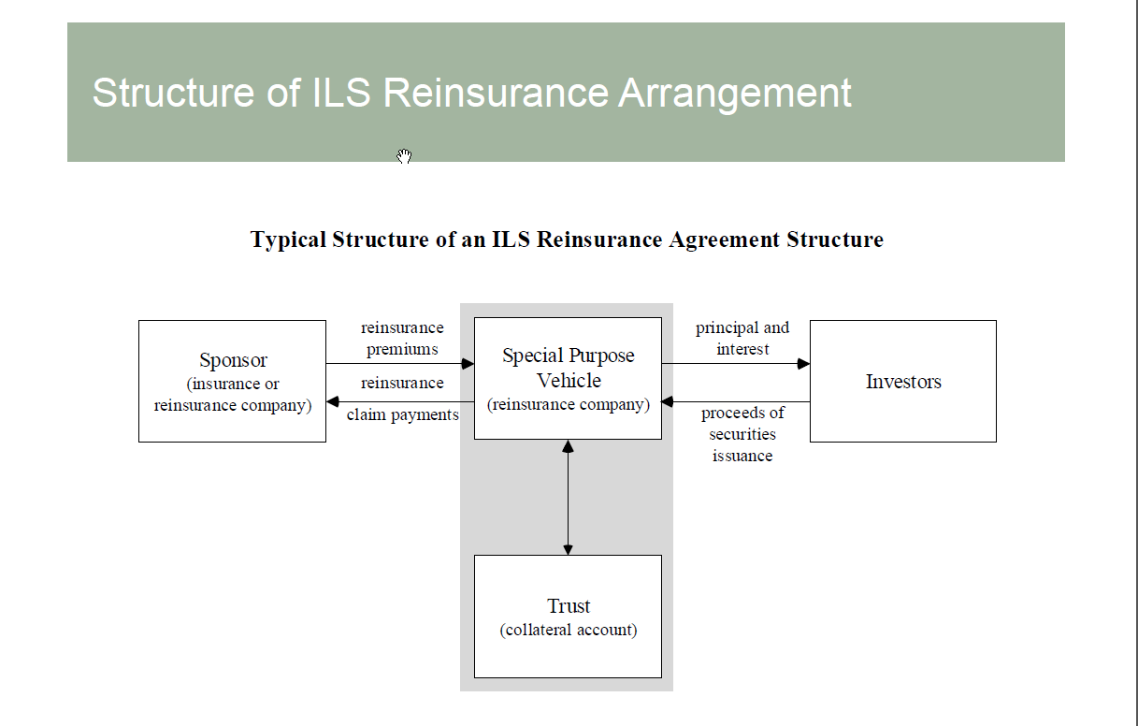
ILS Reinsurance schematic

Slide 7
ILS Definitions
“Insurance-linked securities (ILS) are products of the rapid development of financial innovation and the process of convergence between the insurance industry and the capital markets.” NAIC.
“Insurance-linked securities are broadly defined as financial instruments whose values are driven by insurance loss events. Those instruments that are linked to property losses due to natural catastrophes represent a unique asset class, the return from which is uncorrelated with that of the general financial markets.” Wikipedia.
“Insurance Linked Securities transfer a specified set of risks (insurance risks) from a sponsor to investors. ILS have payouts linked to insurance losses and it is an effective way for investors to diversify their portfolio . . .” NASDAQ.

Slide 8
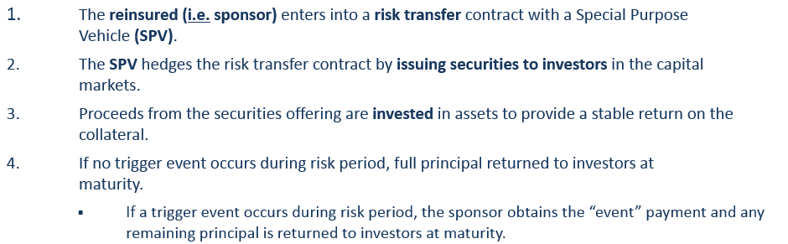
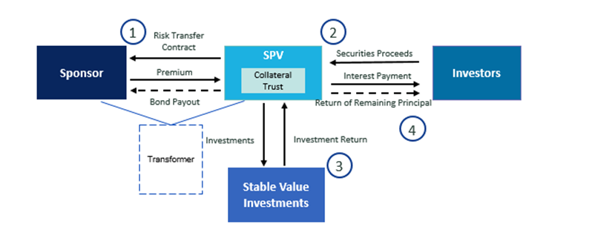
Product Basics
Typical Cat Bond Structure

Slide 9

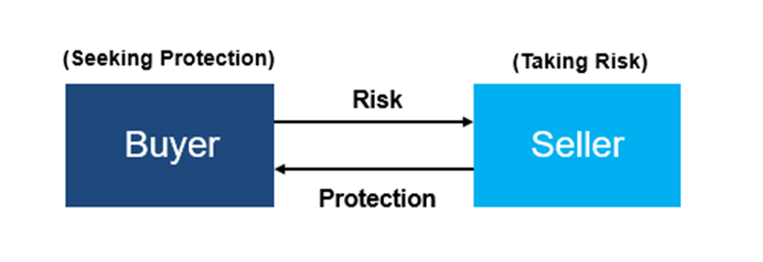
Industry Loss Warranties (ILWs) are reinsurance contracts whose pay-outs are linked to a predetermined market-wide trigger. Historically, they allowed the buyer to receive reinsurance accounting treatment, because they included a second trigger tied to the insured losses of the protection buyer.
A developing trend has been to structure derivatives that eliminate the second trigger. These catastrophe derivatives can be used by hedge funds, money managers and other investors to gain exposure to, or hedge, natural catastrophe risks.

Slide 10
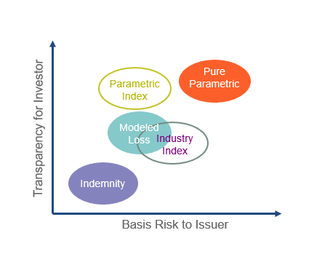
Cat Bond Trigger Types
An indemnity transaction is based on the sponsor’s losses
An industry index transaction is based on an industry-wide index of losses (i.e., Property Claim Services or “PCS” in the United States)
A pure parametric trigger is based on the reported physical event (i.e., magnitude of earthquake or wind speed of hurricane)
A parametric index is a more refined version of the pure parametric trigger -- using more complicated formulas and more detailed measuring locations
In a modeled loss transaction, losses are determined by inserting physical parameters into an escrow model which then calculates the loss

Slide 11
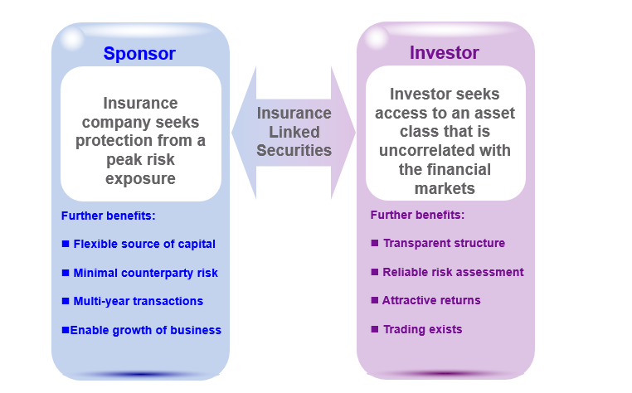
How Insurance Linked Securities (ILS) Fit In:
Motivation

Slide 12
ILW Disputes (1)
Sample Trigger:
“For each Loss Occurrence this Contract shall only pay in the event that the insurance and reinsurance industry, as a whole, has actually incurred or is estimated to have incurred gross insured losses arising from a Named Windstorm, during the Period of this Contract occurring within the Territorial Scope, as defined herein, as determined and reported in the applicable Catastrophe Bulletin by the Reporting Agency . . . Is equal to [or] greater than USD 20,000,000,000.”

Slide 13
ILW Disputes (2)
Named Windstorm:
“Named Windstorm” is defined to include a hurricane and “all ensuing losses including but not limited to . . . water damage . . . in connection with” such hurricane.

Slide 14
ILW Disputes (3)
“Cat Bulletin”:
“Catastrophe Bulletin” is defined as “any catastrophe bulletin originated and disseminated by the Reporting Agency [PCS] which identifies and assigns a number to a catastrophic event and/or gives preliminary or, subsequently resurvey estimates of incurred property losses arising from a catastrophic event.

Slide 15
ILW Disputes (4)
Sample “Event”:
Hurricane Harvey made landfall as a Category 5 hurricane on August 26, 2017. NOAA.
Over the next four days, the storm dropped “historic amounts of rainfall of more than 60 inches over southeastern Texas.” Id.
This rain “caused catastrophic flooding”, causing “water damage”, and rendering Harvey the “second-most costly hurricane in U.S. history”. Id.

Slide 16
ILW Disputes (5)
PCS Action No. 1:
On November 20, 2017, PCS issued a bulletin titled “Catastrophe Serial No. 1743: Re-Survey Estimate Of Insured Property Damage”, which estimated industry losses associated with Harvey -- not including losses incurred within the NFIP -- in the approximate amount of $15.9 billion.

Slide 17
ILW Disputes (6)
PCS Action No. 2:
On December 13, 2017, PCS issued a bulletin titled “Event Serial No. 1743: Preliminary Estimate Of Insured Losses”, which estimated NFIP losses arising from Harvey at approximately $4.6 billion.
Both of these bulletins reported damage estimates for Catastrophe Serial No. 1743 -- the serial number PCS assigned to a single Named Windstorm event: Hurricane Harvey.

Slide 18
Mariah Re
  Parties
    American Family: Issuer
    Mariah Re: Reinsurer/SPV
    PCS: Responsible for Storm Estimates and Locations
    AIR: Calculation Agent

Slide 19
Mariah Re
  One publicly reported arbitration: Nelson Re.
    Issue: whether contacts not included in modelling were covered under the reinsurance agreement.
    Ultimately withdrawn.
  Despite grandiose extrapolations, there has been only one public Cat Bond Litigation: Mariah Re.

Slide 20
Mariah Re
Nature of Dispute: Cat 42
  Severe storm in midwest and southeast.
  Storm hit metro and non-metro areas of Kansas.
  AIR calculated loss as “metro” event in Kansas -- higher value.
  Under the subject contracts, if any damage occurred in a metro county, a metro payment factor would be used.
  Initial Catastrophe Bulletin (April 5, 2011): no specific Kansas counties identified.
  Subsequent Catastrophe Bulletins: no specific Kansas counties identified.

Slide 21
Mariah Re
Nature of Dispute: Cat 42 (continued)
  November 2, 2011: Final Estimate of property damage issued (“Final Development Date”).
  November 3, 2011: PCS Revised April 5, 2011 Bulletin, and identified metro Kansas counties.
  November 23, 2011: final event report issued (“Event Report”). Cat 42 was characterized as a “metro” event in Kansas -- triggered payment obligations.

Slide 22
Mariah Re Arguments (1):
  PCS was not allowed to issue a revised bulletin after the Final Development Date -- not even one day later.
  It was inconsistent with “current business practices,” “general methodology” for estimating losses and record-keeping practices -- as adumbrated in PCS’ agreement with Mariah.
  Revised bulletin wasn’t a “true” catastrophe bulletin.
    Catastrophe bulletin defined as a bulletin that “identifies and assigns a catastrophe number” and/or “gives preliminary or . . . Resurvey estimates of insured property losses.”
    The revised bulletin did neither.

Slide 23
Mariah Re Arguments (2):
  Due to the demonstrable misconduct of AIR and PCS, American Family was prohibited from withdrawing from the trust account.
  American Family was unjustly enriched.

Slide 24
Mariah Re Decision / Takeaways
PCS/Air behaved properly, and there was no “unjust enrichment” in withdrawal of funds.
The broad discretion afforded to PCS and AIR in the parties’ contracts was determinative.
It was a mistake to require PCS to identify affected counties -- the trigger turned on a contingency not essential to PCS’ general function.

Slide 25
Disputes Implicating Capital Markets Products
Are disputes more likely under these contracts or traditional reinsurance contracts?
  Are they more amenable to fair adjudication in litigation or arbitration?
Are disputes under these contracts likely to proliferate in the future?
What should the arbitration community know about preparing for and adjudicating such disputes?

