Slide 1
Hacking Privileged and Confidential Information
ARIAS Conference - May 2019

Slide 2
Many cyber attacks target human beings – successfully
3.7 million $
cost of a successful phishing attack (against large companies with >10,000 employees)
5 years
Phishing has been the number one attack vector for over five years.
https://resources.infosecinstitute.com/category/enterprise/phishing/phishing-as-a-risk-damages-from-phishing/financial-losses/#gref

Slide 3
Phishing attacks – who are the actors?
Errors & omissions
Hacktivism / Vigilantism
Script kiddies
Cyber criminal / organised crime
Nation state or state sponsored
Impacts reputation & availability of service
Availability of service
Theft of funds & confidential data
Espionage
Level of sophistication (incl. knowhow / funding) of the attack
Notes:
There are various threat actors in cyber space, which need to be considered as threat. The groups on this graph are generally a threat, but the level of sophistication of an attack dramatically raises with the actors know-how and funding to conduct an attack:
Errors and omissions: not a “conscious” actor, but human error is one important factor in the chain of events leading to a cyber attack (examples: Phishing, Social Engineering).
Hacktivists: promote of political agenda (anti capitalism, free speech, human rights), they are weakly organised, decentralized. Often these groups conduct spontaneous attacks (e.g. taking offline or defacing websites), leading to reputational damage for a company.
Script kiddies (single persons or small criminal groups, not only juveniles): try to imitate the “real” hackers and demonstrate their knowledge (copying of commonly known attack schemes), reputation among peers (game, fun, money). Besides reputational damage, can also lead to financial damage to Swiss Re
Cyber criminals are the adversaries Swiss Re is most concerned about. Attacks are more sophisticated, supported by readily available hacking tools on the dark web. Tools built by nation states or cyber criminals get published on the web and are available to “lower-level” groups.

Slide 4
Invoices
Social networking
Security alerts
Suspicious e-mail with attachments
Voicemail attachments
Package delivery
facsimile
eFax
Phone calls
Personal warnings

Slide 5
Types of Phishing attacks
Risk Level
Phishing: Attempt to acquire information such as usernames, passwords by masquerading as a trustworthy entity.
Spear Phishing: Phishing attempts directed at specific individuals.
Clone Phishing: A legitimate, and previously delivered e-mail used to create an almost identical phishing email.
Whaling: Phishing attacks directed specifically at senior executives.
medium
high
high
very high
Notes:
Phishing
attempt to acquire sensitive information such as usernames, passwords, and credit card details (and sometimes, indirectly, money)
Communications purporting to be from popular social web sites, auction sites, banks, online payment processors or IT administrators are commonly used to lure unsuspecting victims.
Phishing emails may contain links to websites that are infected with malware.
Phishing is an example of social engineering techniques used to deceive users, and exploits the poor usability of current web security technologies.
Attempts to deal with the growing number of reported phishing incidents include user training, awareness, and technical security measures
Phishers are targeting the customers of banks and online payment services. Emails, supposedly from the IRS, have been used to glean sensitive data from U.S. taxpayers
Spear Phishing
Phishing attempts directed at specific individuals or companies have been termed spear phishing. Attackers may gather personal information about their target to increase their probability of success. This technique is, by far, the most successful on the internet today, accounting for 91% of attacks.
Clone Phishing
A type of phishing attack whereby a legitimate, and previously delivered, email containing an attachment or link has had its content and recipient address(es) taken and used to create an almost identical or cloned email.
The attachment or link within the email is replaced with a malicious version and then sent from an email address spoofed to appear to come from the original sender. It may claim to be a resend of the original or an updated version to the original.
This technique could be used to pivot (indirectly) from a previously infected machine and gain a foothold on another machine, by exploiting the social trust associated with the inferred connection due to both parties receiving the original email.
Whaling
Several recent phishing attacks have been directed specifically at senior executives and other high profile targets within businesses, and the term whaling has been coined for these kinds of attacks.
In the case of whaling, the masquerading web page/email will take a more serious executive-level form.
The content will be crafted to target an upper manager and the person's role in the company (often written as a legal subpoena, customer complaint, or executive issue).
Whaling scam emails are designed to masquerade as a critical business email, sent from a legitimate business authority.
The content is meant to be tailored for upper management, and usually involves some kind of falsified company-wide concern.

Slide 6
What are the risks we face? You play an important role in mitigating this risk
Exposure, misuse, deletion or alteration of business information may lead to a negative financial impact or reputational damage
Cyber Risk is a combination of four components
Vulnerability and control is not just about technology but also determined by the people, data handling and business processes involved
Vulnerability
x x =
Information
Threat
Cyber risk
Control
Risk appetite

Slide 7
Where the money is

Slide 8
Who will phish and why?
2,000,000 e-mails are sent for a specific phishing attempt
5% get to the end user – 100’000
5% click on the phishing link – 5’000
2% enter data into the phishing site – 100
$1,200 from each person who enters data
Potential reward: $120,000
Information Security Awareness| Phishing
8

Slide 9
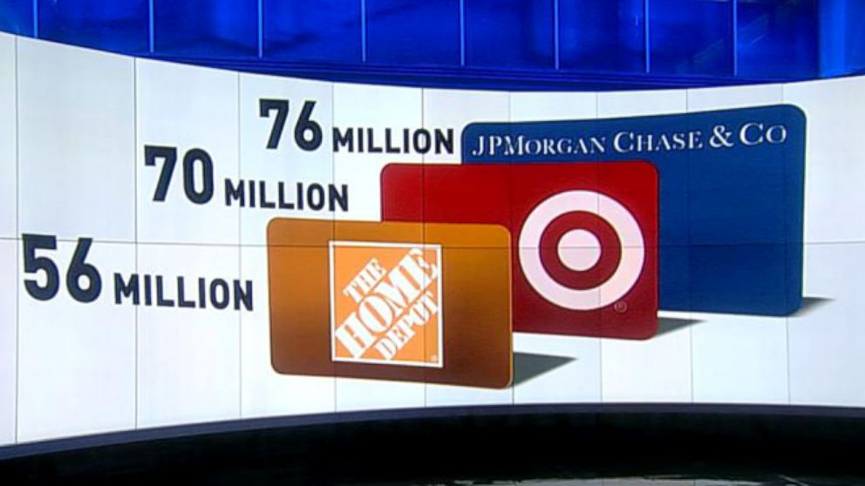
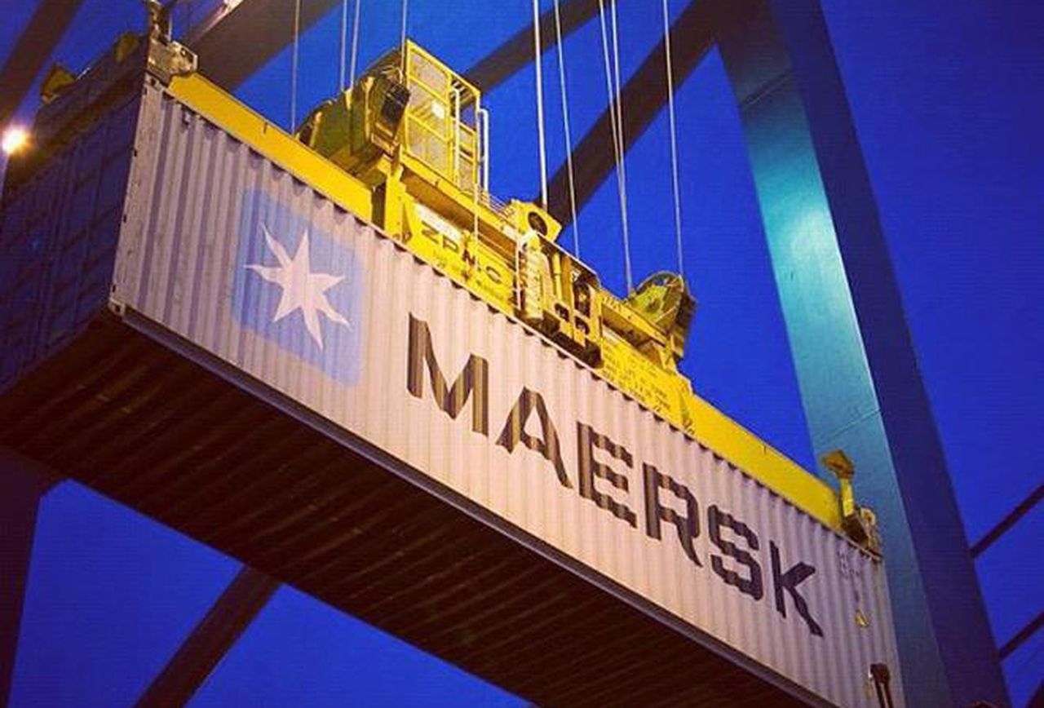
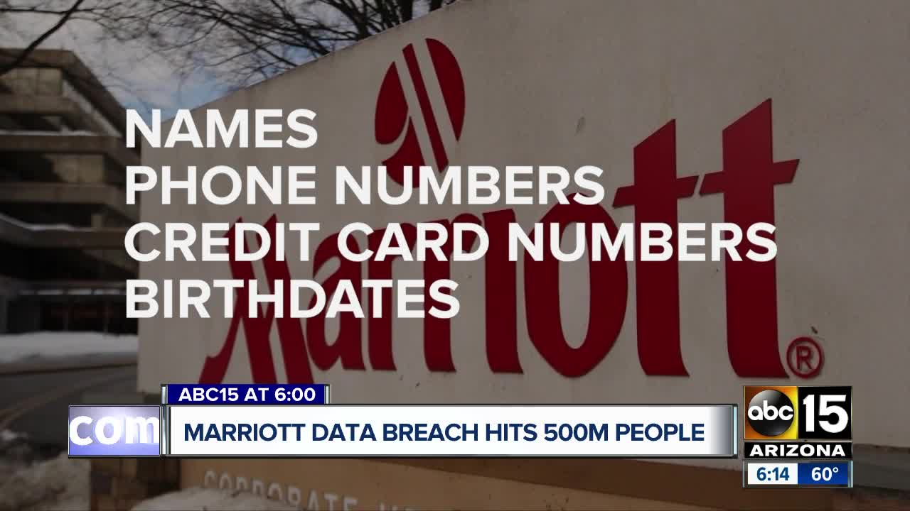
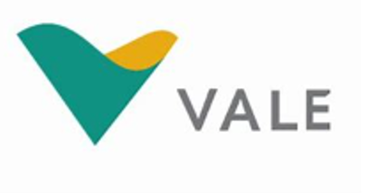
You’ve seen the headlines…

Slide 10
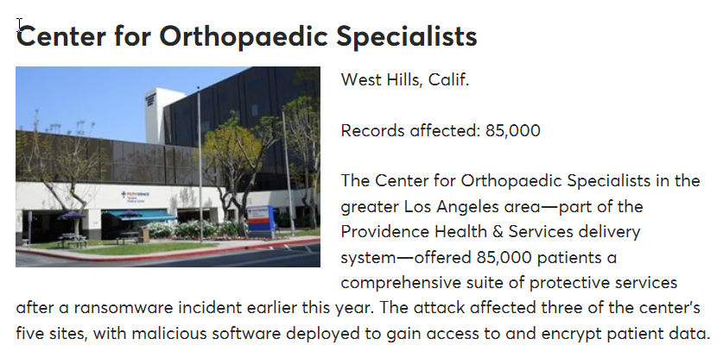
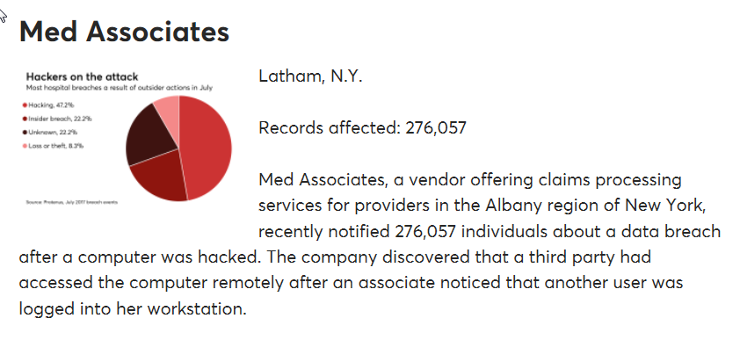
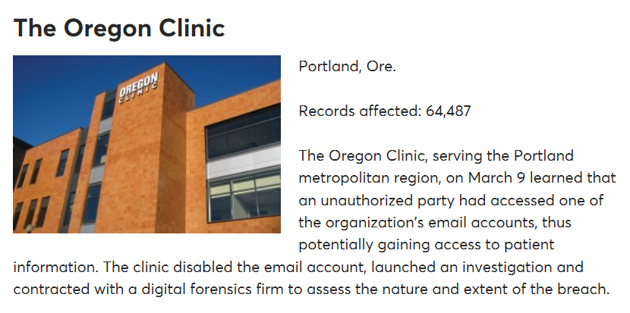
… and some less sensationalized.
* Source – HealthData Management

Slide 11
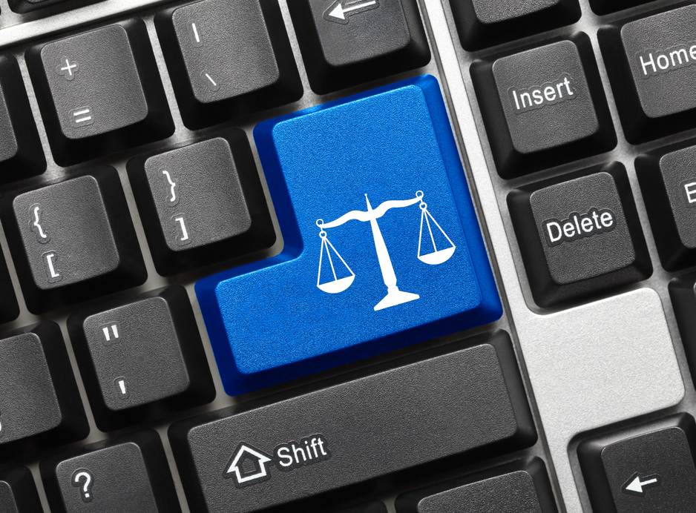
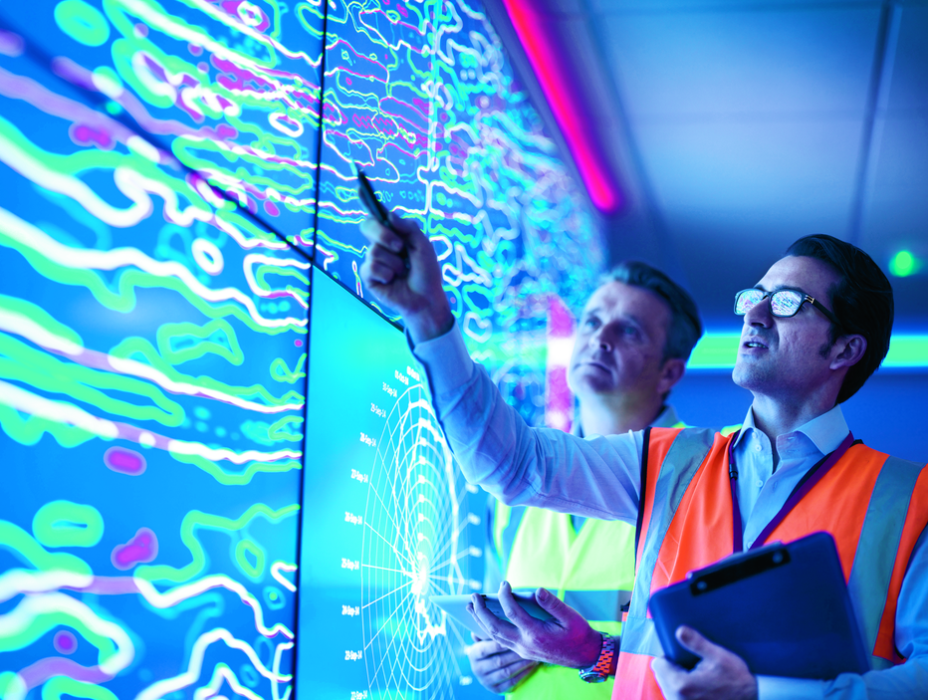
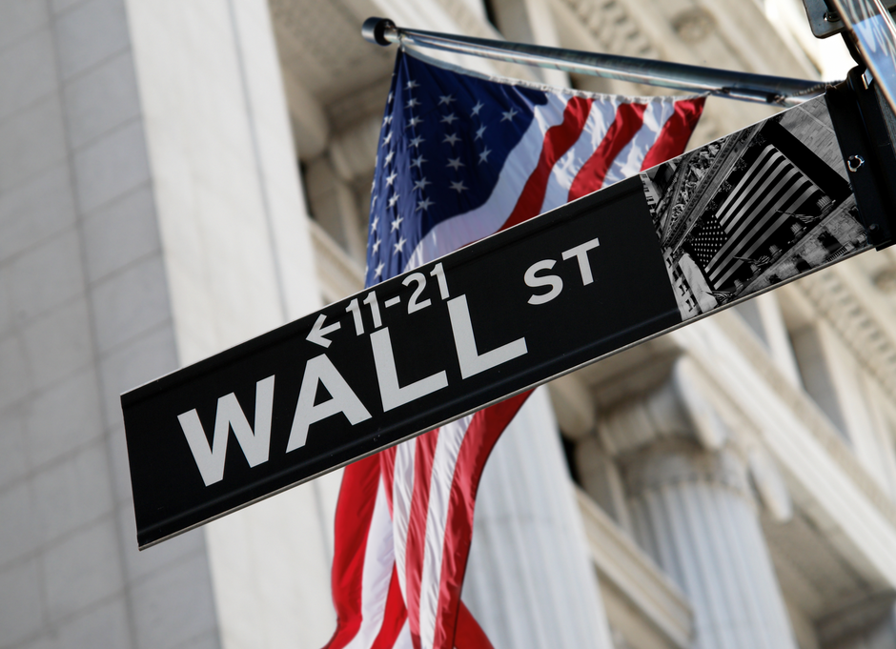
Who else gets hacked?

Slide 12
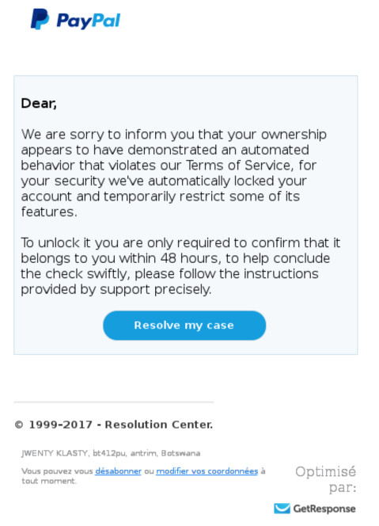
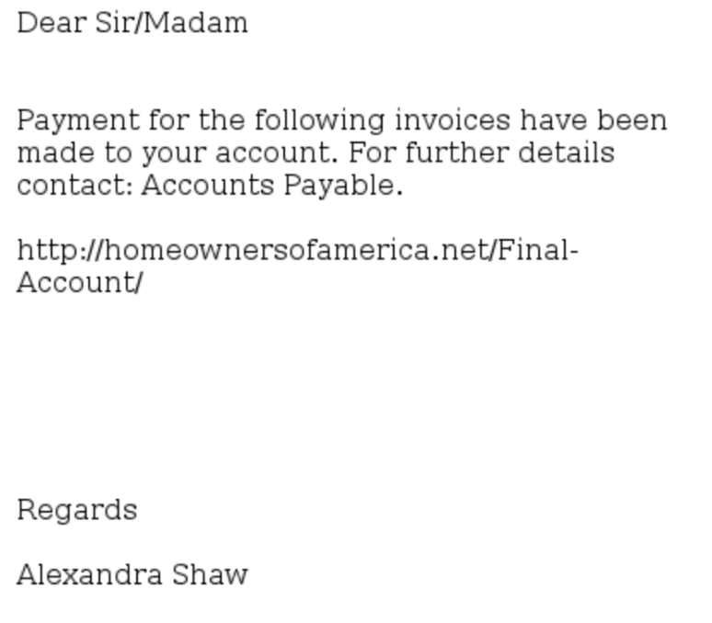
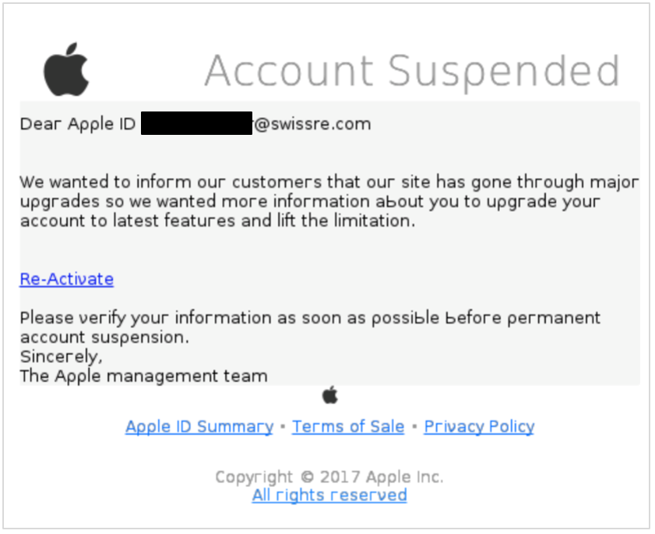
The obvious Phishing e-mails?

Slide 13
Malware (viruses, key loggers and Trojan horses)
What are the risks?
Viruses can infect and take over control of your computer (at work or at home) without you realising it.
Using an infected computer, a hacker can watch every step you make online, steal every password, modify or delete data.
Computer viruses can spread by different means.
How to do it right!
Be especially careful with portable devices (e.g. memory sticks) as they are very common carriers of viruses.
For private machines, regularly install system & software updates and use Antivirus software.
Disable the macro function when opening word/excel files. whose origin you are not absolutely sure of.
Notes:
What are the risks?
At Swiss Re we have a highly effective layered defences to protect us, but malware writers are constantly challenging us.
Viruses can infect and take over control of your computer (at work or at home) without you realising it.
Should your computer be infected, a hacker can watch every step you make online, steal every password or access, modify or delete any of your files or those belonging to the company.
Extortion attacks encrypt all files, and then demand a monetary ransom.
The most common causes of malware infected computers at Swiss Re are: 1. Malicious emails, over the corporate email channel, but particularly and primarily via private webmail accessed from the workplace computer 2. Infected or malicious web sites 3. Memory sticks, DVDs and other storage devices attached to a workplace computer
Be especially careful with portable devices as they are very common carriers of viruses. Never attach a device if you are uncertain of its content and/or origin.
Did you know that our employees’ home computers are actually the most common source of infected memory sticks encountered at Swiss Re? Please only use Swiss Re’s approved remote access and mobile working solutions like VPN/iPass and Swiss Re Virtual Workplace (SRVW).
How to do it right!
Handle e-mail attachments with care. Never open any attachments that appear suspicious or that have been sent by unknown senders.
Disable the macro function when opening Microsoft Office documents whose origin you are not absolutely sure of.
Be especially careful with portable devices (memory sticks, CDs etc) as they are very common carriers of viruses. Never attach a device if you are uncertain of its content and/or origin.

Slide 14
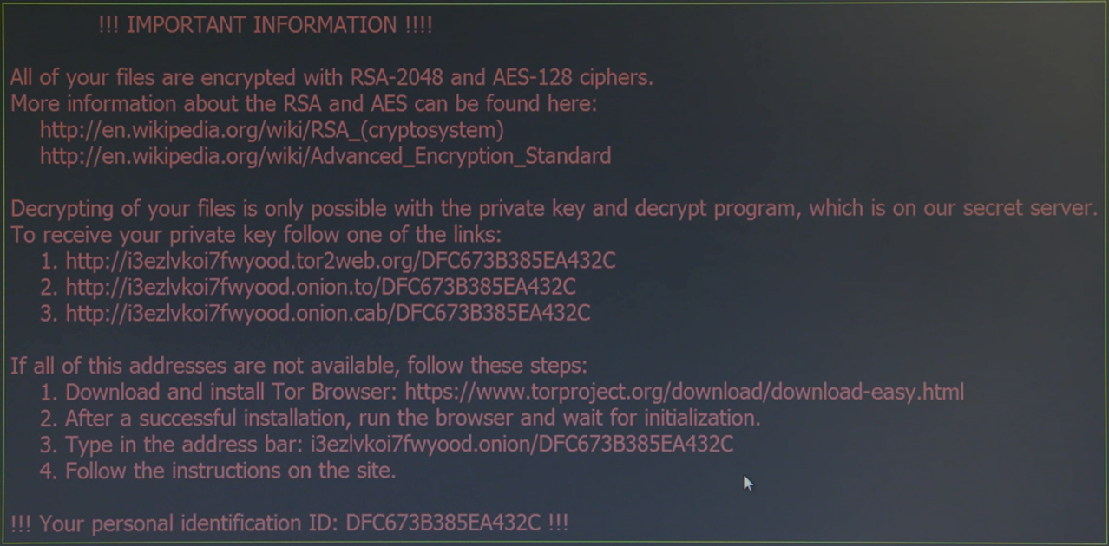
Malware (viruses, key loggers and Trojan horses) What can happen, when you click on a malicious e-mail?
14

Slide 15
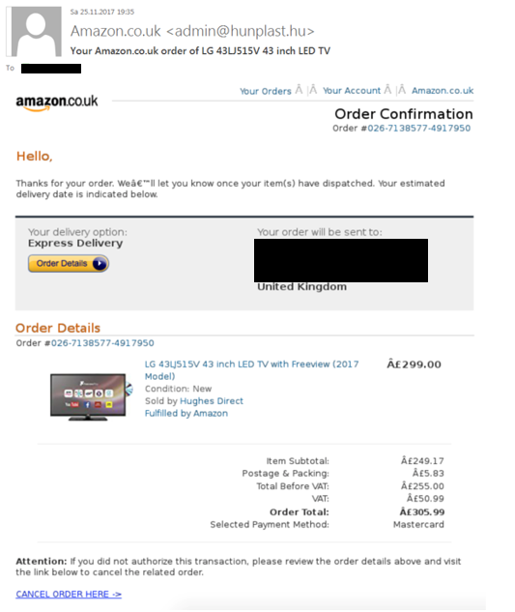
Consequences of sharing to much information?

Slide 16
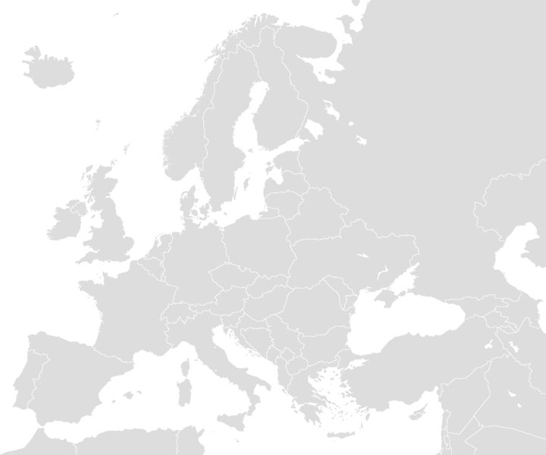
Consequences of opening an attachment?
credentials
documents
Notes:
Malicious file searches through the local hard disk.
The collected data are transferred to a server in the Ukraine.
In parallel, the malware searches the entire local hard disk for cached credentials, and sends these to a .ru (Russia) address.

Slide 17
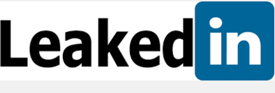
Passwords Risks of Social Media
2012 data breach of supposedly 6.5M accounts may now be over 117M.
And LinkedIn’s response has been inadequate. It has only forced a password reset for a subset of users (after 4 years!).
Do it yourself – reset your password regularly. And, make it a unique password and do not reuse your corporate password.
Better yet, use a password manager.
17

Slide 18
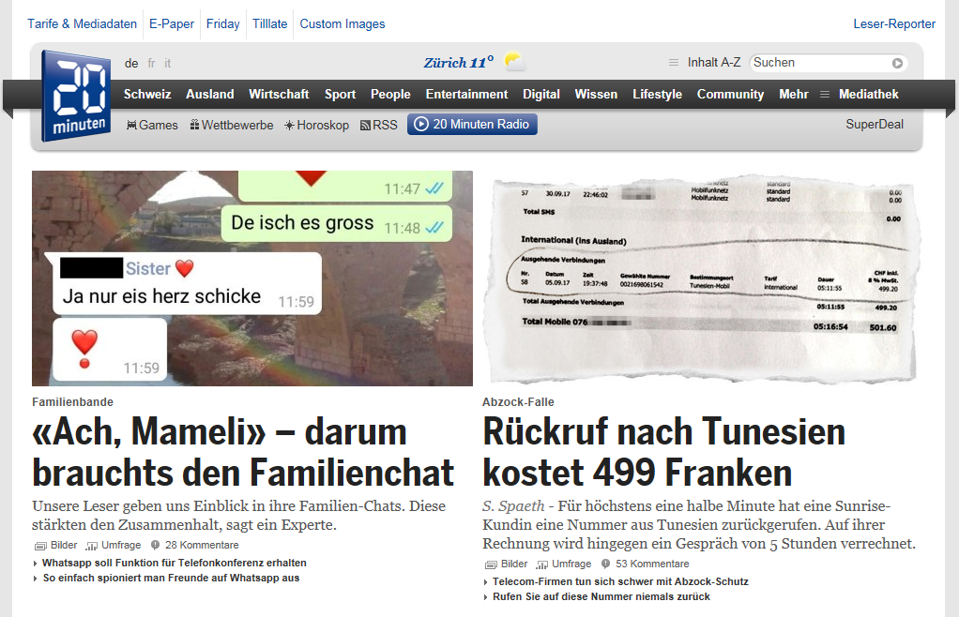
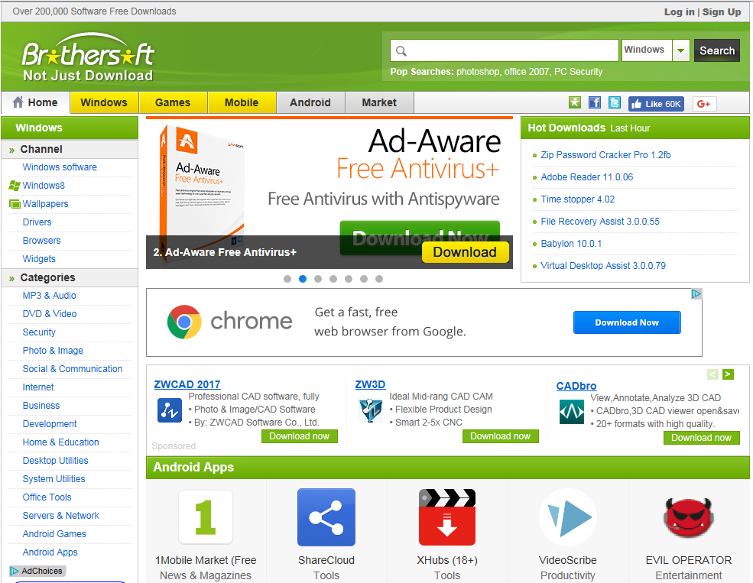
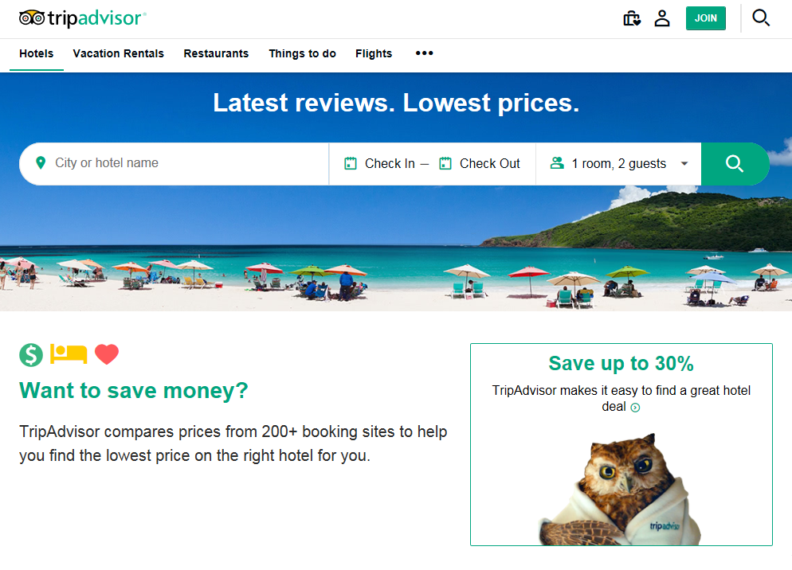
Commonly known websites with malware and other security risks
Notes:
Some websites can be infected with malware. These are recent examples of websites visited in Slovakia, that contained malware during a certain period of time.
Recently, also Switzerland has been victim of such attacks/infections. Main online newspaper has been infected with the Gozi Trojan.
The Trojan attempts to gain access to users’ bank account information and to withdraw funds. It can take up to three months before the Trojan tries to withdraw money.
Potential signs of infection include an extremely slow connection, a blue desktop or repeated requests to enter your password.
source: http://www.swissinfo.ch/eng/20-minute-attack_government-shuts-down-trojan-infected-website/42074870

Slide 19
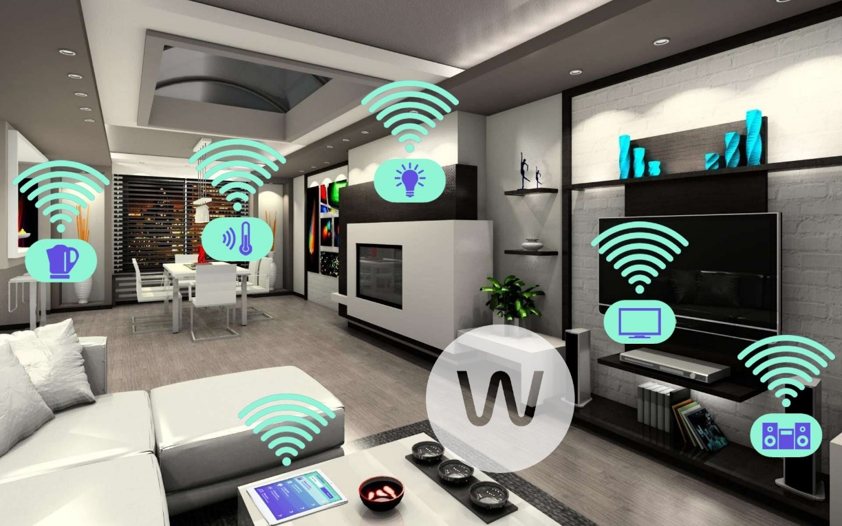
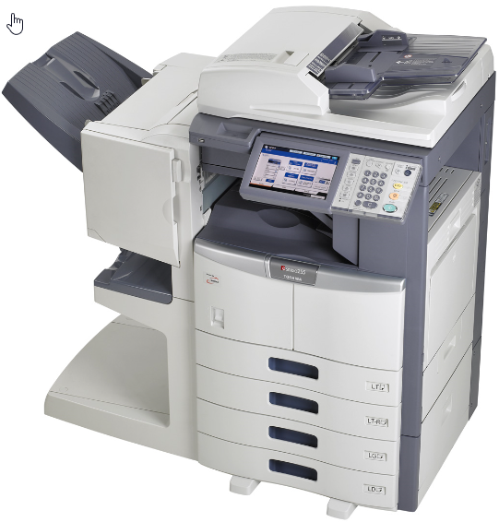
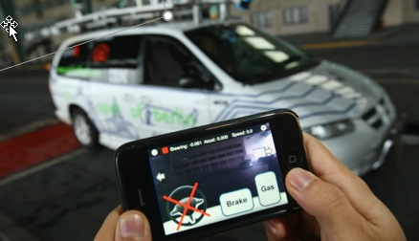
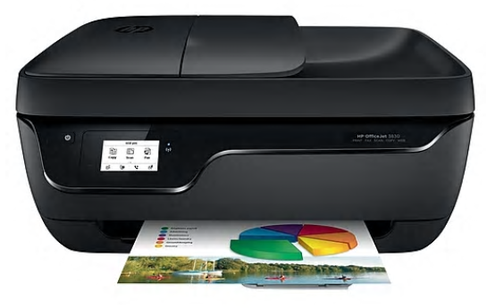
How secure is the Internet of Things?

Slide 20
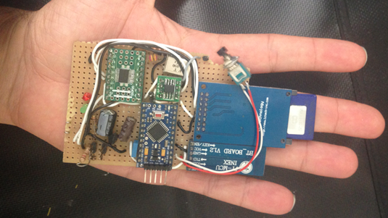
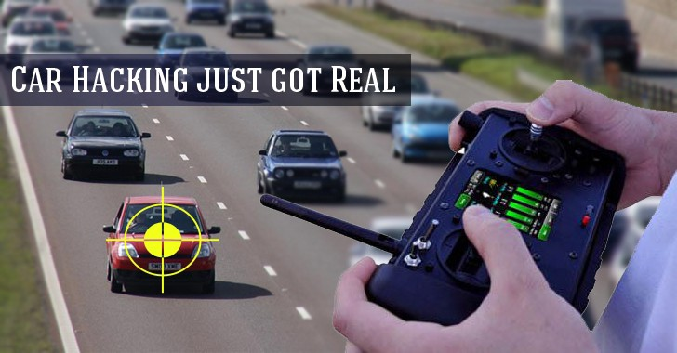
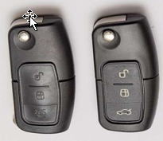
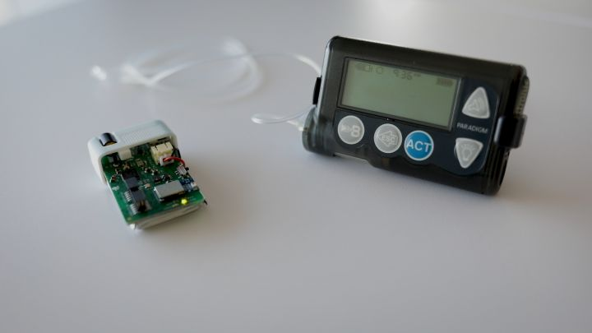
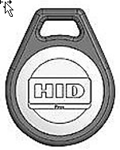
Affordable hacking tools are easily accessible

Slide 21
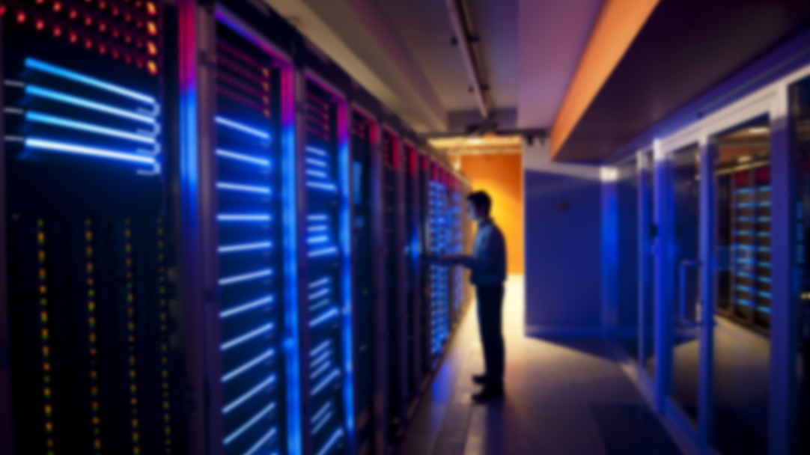
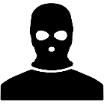
What to always keep in mind…
Cyber is a significant risk and attacks are becoming increasingly sophisticated; in addition to being targeted there now is a real risk for companies to become collateral damage
Apply software patches in a timely manner and keep your anti-virus up-to-date, ideally the day updates are released
Managing a cyber crisis is complex, involving difficult decisions with few good answers
Be suspicious if you receive an (unexpected) email asking you to download or execute a file, or to enter your personal credentials
Be careful whom you share data with – are they authorized and do they have a need to know? Ensure you handle the information appropriately to its classification
Be careful about using your e-mail, ID or password on any third party website on the internet

Slide 23
Legal notice
©2018 Swiss Re. All rights reserved. You are not permitted to create any modifications or derivative works of this presentation or to use it for commercial or other public purposes without the prior written permission of Swiss Re.
The information and opinions contained in the presentation are provided as at the date of the presentation and are subject to change without notice. Although the information used was taken from reliable sources, Swiss Re does not accept any responsibility for the accuracy or comprehensiveness of the details given. All liability for the accuracy and completeness thereof or for any damage or loss resulting from the use of the information contained in this presentation is expressly excluded. Under no circumstances shall Swiss Re or its Group companies be liable for any financial or consequential loss relating to this presentation.

