Slide 1
Unconscious Biases: The Uninvited Arbitration Guests
Ann L. Field, SVP, Willis Re
Sarah D. Gordon, Partner, Steptoe & Johnson LLP
Stacey L. Schwartz, SVP, Swiss Re (US)

Slide 2
Visualization
Heading to ARIAS but you are late
Racing to plane; greeted by flight attendant and then PA announcement by pilot
Whew, arrive in FL just in time. Want to get dinner and a good night’s sleep before the conference starts (you’re going to need it!)
At dinner, couple celebrating their anniversary with champagne, flowers, and jewelry
Arrive for first panel and actuary is there to discuss emerging coverage issues

Slide 3
Visualization - Voting
What was the pilot’s ethnicity?
What was the flight attendant’s gender presentation?
What was the actuary’s gender presentation?
Couple at dinner: Age? Opposite sex?

Slide 4
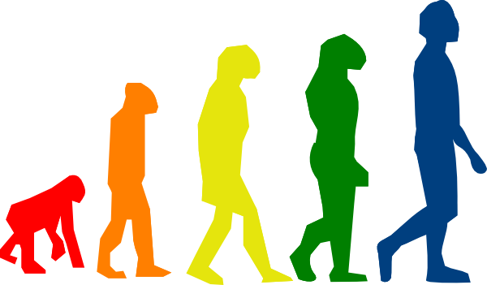
Unconscious Biases: Necessary
> 11 million bits of information sent to the brain for processing per second(!)
Human brains can only process 40-50 bits per second
Evolution: brain needed shortcuts to function, especially in fight or flight
99.9% of processing is unconscious

Slide 5
What are unconscious biases?
Learned stereotypes
Automatic
Unintentional
Deeply ingrained
Patterns of thinking
Mental shortcuts that assist us in managing the data
Often manifest in micro-inequities

Slide 6
Studies
Resumes with ethnic names
Height (males)
Hair color (females)
Police officer hiring – most desirable trait changes depending upon whether candidate is male or female

Slide 7
Bias versus “isms”
Bias – brain shortcut to process information; unconscious
Dictionary definitions of some “isms”
Racism: a belief that race is the primary determinant of human traits and capacities and that racial differences produce an inherent superiority of a particular race
Sexism: prejudice or discrimination based on sex, especially discrimination against women; behavior, conditions, or attitudes that foster stereotypes of social roles based on sex
Heterosexism: discrimination or prejudice by heterosexuals against homosexuals
Cognizant of brains shutting down under threat

Slide 8
What’s the problem with unconscious biases?
Biases can:
Prevent individuals from making the most objective decisions
Cause individuals to overlook great ideas
Undermine individual potential
Create a less than ideal workspace and/or arbitration community

Slide 9
Benefits To Addressing Unconscious Biases
Addressing unconscious biases helps us to:
Make better decisions
Find the best talent, regardless of background
Acknowledge a great idea, regardless of from whom it came
Build a workplace and community that supports and encourages diverse perspectives and contributions
Achieve the best outcome

Slide 10
Importance to ARIAS
Outside the court system so incumbent on us to maintain a fair system
Small community
Confidential proceedings
Ongoing business relationships
Why else?

Slide 11
Impact of Biases on Arbitration
Counsel selection
Panel selection
Witness perception
Counsel perception
Damages assessments
Others?

Slide 12
What can we do?
Self Assessment
Implicit Association Test
Project Implicit (www.projectimplicit.net)
Challenge our own internal biases
E.g., imagine someone different presenting information to us

Slide 13
What can we do?
Structure for success
Articulate important characteristics before seeking counsel, arbitrators, experts
Black out names, addresses, educational information on resumes; keep only highly relevant information
Ensure all candidates answer the exact same questions

Slide 14
What can we do?
Structure for success
Require diversity on arbitration panels
Mansfield Rule
Require diversity on conference panels, ARIAS Board, committees
Encourage participation and engagement by individuals with diverse perspectives

Slide 15
What can we do?
Collect data
Assess how we are doing
E.g., anonymous submission of data of panel compositions
Evaluate subtle messages
Micro-inequities/micro-aggressions
Hold everyone accountable

