Slide 1
Breakout Option 2
Round Pegs in Round Holes: Arbitrator Use of Social Media for Marketing
squirepattonboggs.com

Slide 2
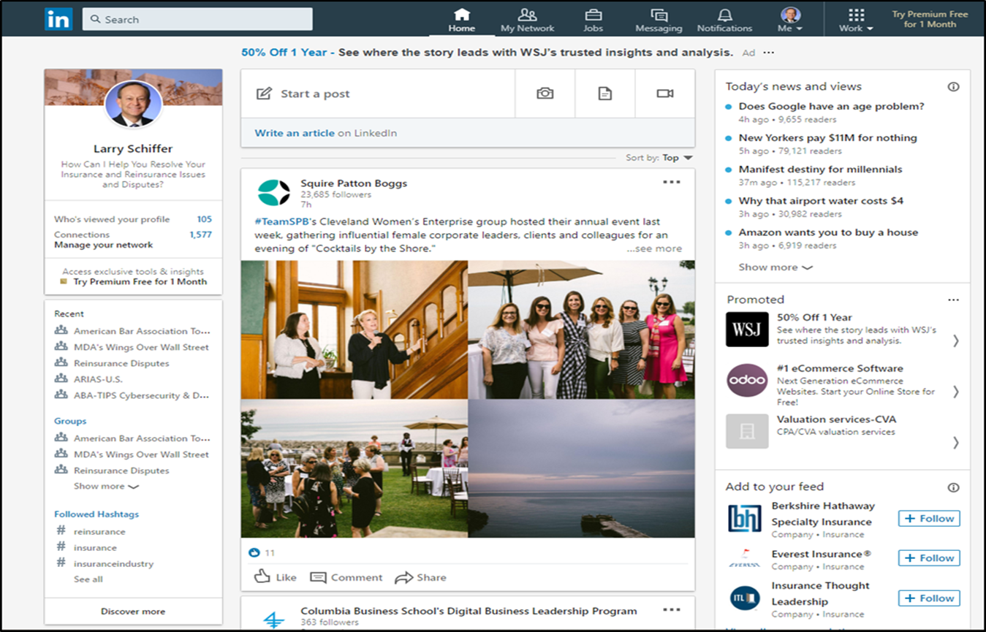
LinkedIn Home Page
squirepattonboggs.com

Slide 3
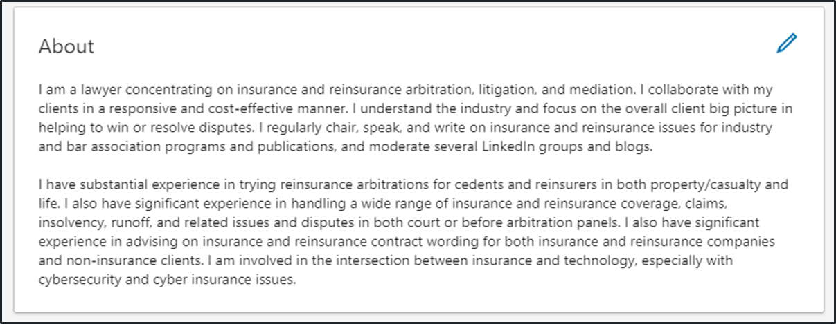
Headline and About Section of LinkedIn Profile
squirepattonboggs.com

Slide 4
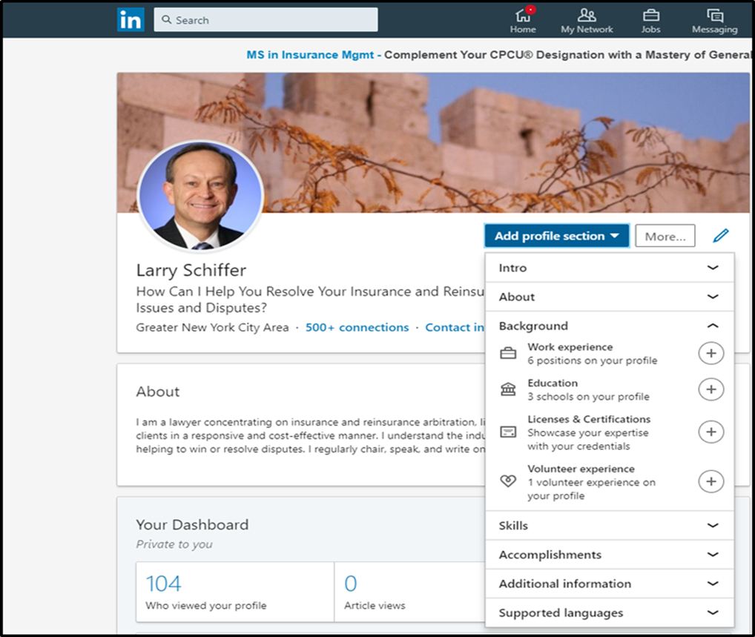
LinkedIn Profile Page
squirepattonboggs.com

