Slide 2
Cyber Snare? The Insurability of Regulatory Fines and Penalties
Kyle Medley, Partner, Hinshaw & Culbertson
Seth Goldberg, AVP, TransRe
Judy Selby, Partner, Hinshaw & Culbertson

Slide 3
Introductions
Kyle Medley
Partner
Hinshaw & Culbertson LLP
Seth Goldberg
Assistant V.P.
TransRe
Judy Selby
Partner
Hinshaw & Culbertson LLP

Slide 4
Agenda
Cyber/Privacy Laws and Regulations
Different Approaches to Coverage
Insurability of Fines and Penalties
A Framework for Evaluating Coverage

Slide 5
Cyber/Privacy Laws
General Data Protection Regulation
California Consumer Privacy Act
Biometric Privacy Laws
HIPAA
Others on the Books and on the Way

Slide 6
Enforcement
GDPR
Up to 4% of Global Turnover or €20 Million
CCPA
$2,500 for each violation or $7,500 for each intentional violation
Texas Capture or Use of Biometric Identifier Act (CUBI)
Up to $25,000 per violation
HIPPA
$100 - $50,000 per violation

Slide 7
Different Approaches to Coverage
OVERVIEW OF POLICY PROVISIONS

Slide 8
Breach and Security Events Only?
To pay Penalties and Claims Expenses, which the Insured is legally obligated to pay because of a Regulatory Proceeding first made against any Insured during the Policy Period for a Data Breach or a Security Breach.

Slide 9
Any Violation of Law?
Definition of “Claim” includes “Regulatory Action” by a “Regulatory Authority,” defined as:
“a body responsible for exercising authority over an actual or alleged or suspected breach of statutes and regulations as they currently exist and as amended with respect to the confidentiality, access, control, and use of:
i. Personally Identifiable Information; or
ii. Any third party’s information or Documents not available to the general public.

Slide 10
Equitable Relief?
Loss shall mean:
* * * * *
(3) solely with respect to a Regulatory Action:
(a) the amount paid to establish a consumer redress fund created as a result of a Regulatory Action; or
(b) any civil files or penalties imposed as a result of such Regulatory Action;
Provided, however, Loss shall not include: taxes; the return or repayment of fees, deposits, commissions or charges for goods or services; the costs incurred in the recall, re-performance or correction of services, Content, goods or services; the costs of the Insured’s compliance with or any Loss incurred as a result of an injunction or other equitable order or judgment, other than the amount paid to establish a consumer redress fund as a result of a Regulatory Action; or civil or criminal fines or penalties, other than civil fines or penalties imposed as a result of a Regulatory Action.

Slide 11
Equitable Relief?
Regulatory Penalties means monetary fines and penalties imposed in a regulatory proceeding to the extent insurable under applicable law. Regulatory Penalties will not mean any:
1. costs to comply with injunctive relief;
2. costs to establish or improve privacy or security practices; or
3. audit, reporting, or compliance costs.

Slide 12
CCPA
1798.155(b)
Any business … that violates this title shall be subject to an injunction and liable for a civil penalty of not more than $2,500 for each violation or $7,500 for each intentional violation, which shall be assessed and recovered in a civil action brought in the name of the people of the State of California by the Attorney General. The civil penalties provided for in this section shall be exclusively assessed and recovered in a civil action brought in the name of the people of the State of California by the Attorney General.

Slide 13
California Insurance Code § 533.5(a)
No policy of insurance shall provide, or be construed to provide, any coverage or indemnity for the payment of any fine, penalty, or restitution in any criminal action or proceeding or in any action or proceeding brought pursuant to Chapter 5 (commencing with Section 17200) of Part 2 of, or Chapter 1 (commencing with Section 17500) of Part 3 of, Division 7 of the Business and Professions Code by the Attorney General …, notwithstanding whether the exclusion or exception regarding this type of coverage or indemnity is expressly stated in the policy.

Slide 14
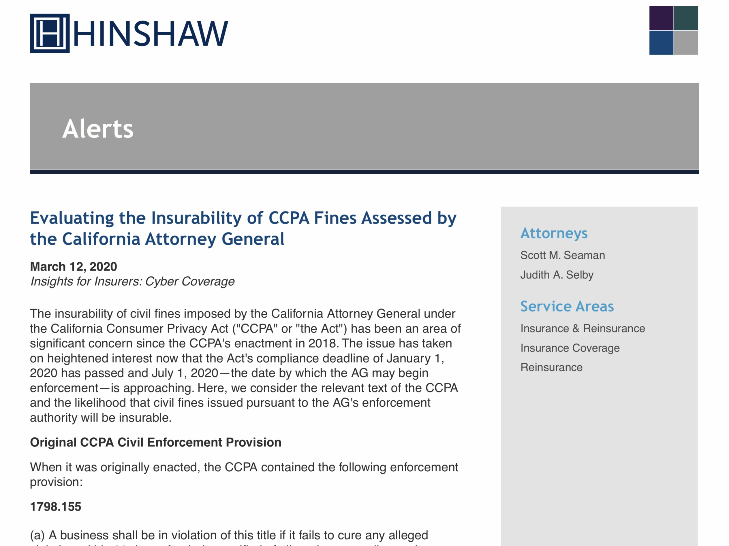
Deeper Dive into the Insurability of CCPA Fines
https://www.hinshawlaw.com/pp/alert-1271.pdf?84853

Slide 15
Coverage Determination
Framework to Evaluate Coverage

Slide 16
Framework to Evaluate Coverage
Scope of Regulatory Coverage
Scope of Information Covered by Policy
Policy Language Concerning Fines/Penalties
Choice of Law Policy Provisions
Applicable Law
Exclusions

Slide 17
Applicable Law?
“Loss” means compensatory damages, judgments, settlements, pre-judgment and post-judgment interest and Defense Costs, including without limitation:
* * *
civil fines or penalties imposed by a governmental agency and arising from a Regulatory Action, unless the civil fine or penalty imposed is uninsurable under the law of the jurisdiction imposing such fine or penalty;
* * *

Slide 18
Applicable Law?
Damages means any amounts an Insured becomes legally obligated to pay on account of any Claim, including: . . .
punitive, exemplary, or multiplied damages and awards; provided, however, that punitive, exemplary, or multiplied damages and awards shall only be included as Damages to the extent insurable under the applicable laws of any jurisdiction which most favors coverage and which has a substantial relationship to an Insured, us, this Policy, or the Claim giving rise to such Damages;

Slide 19
Common Policy Language Concerning Insurability of Fines
Fines may be covered:
where insurable by law;
as long as the most favorable applicable law permits coverage; and
except to the extent that the law of the jurisdiction imposing the fine forbids such coverage.

Slide 20
Choice of Law Framework
Does the policy have a choice of law provision?
Most Significant Relationship Test
Place of Contract Test
Government Interest Test
Other Choice of Law Tests

Slide 21
Choice of Law Considerations
Place of Incorporation, Domicile, Principle Place of Business of the Insured and/or Insurer
Place of Policy Contracting/Issuance
Principle Location of the Underlying Facts and Circumstances
Which Regulator Imposed the Fine
Forum Where the Fine would be Paid – U.S. State or Country

Slide 22
Applicable Law – Insurability of Fines/Penalties
Varies by Jurisdiction - Are regulatory/punitive fines insurable in the forum?
Consider the Nature of the Fine – i.e., Civil, Criminal, Punitive?
Consider the Nature of the Violation (Categories of Conduct)
Intentional/Willful, Fraudulent, Criminal
Strict Liability or Vicarious Liability (no specific level of fault is required)
Negligence

Slide 23
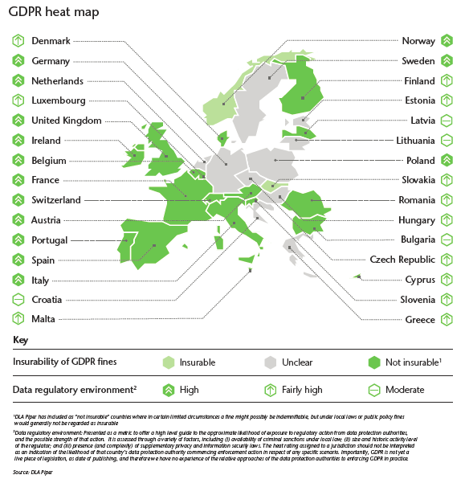

Slide 24
Q&A
THANK YOU!
Kyle Medley
kmedley@hinshawlaw.com
Seth Goldberg
sgoldberg@transre.com
Judy Selby
jselby@hinshawlaw.com

