Slide 1
Updates on Reviver Statutes, Opioid Claims, and PFAS
J.P. Jaillet, Choate
Glenn Frankel, Gen Re
Matt Schroeder, Akerman

Slide 2
What Is A “Reviver Statute”?
  A reviver statute is a state law permitting survivors of sexual abuse to bring civil lawsuits after the statute of limitations period has closed.
  The legislation “revives” claims that otherwise would be time barred.

Slide 3

Reviver Statutes – Recent Trends (1)
  Since 2019, at least 10 states have passed reviver statutes that address civil claims.
  Some states have enacted reviver statutes that apply only with respect to claims against alleged perpetrators. See RI ST § 9-1-51 (effective July 1, 2019) (Rhode Island).
  Other states have created “revival windows” -- specified periods of time -- in which new claims can be brought against anyone, including organizations that employed or supervised the alleged perpetrators.

Slide 4
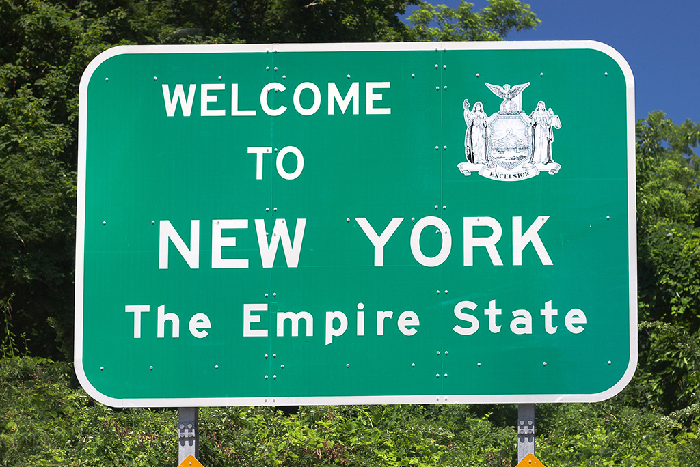
Reviver Statutes – Recent Trends (2)
In 2019, New York passed a reviver statute that initially established a one-year revival window for expired claims against perpetrators and organizations. See N.Y. C.P.L.R. 214-g.
New York has twice extended the revival window due to the COVID pandemic.
The claim filing window is currently set to close on August 14, 2021. See SB 7082.

Slide 5

Reviver Statutes – Recent Trends (3)
On January 1, 2020, California opened a three-year reviver window for the filing of previously-expired abuse claims against any type of defendant. See AB 218.
The filing deadline for revived California claims is December 31, 2022.

Slide 6

The Impact Of Recent Reviver Statutes (1)
Recent laws have led to a significant number of new abuse claims filed.
According to press reports, there were 4,800 new abuse lawsuits filed in New York alone during the first 18 months following the effective date of the N.Y. Child Victims Act.

Slide 7
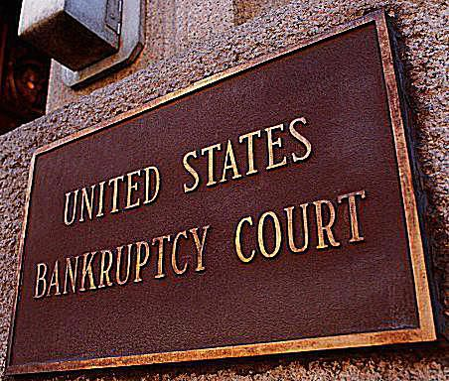
The Impact Of Recent Reviver Statutes (2)
  New abuse claims drove four Catholic Dioceses in New York into bankruptcy:
        Diocese of Rochester (2019)
        Diocese of Buffalo (2020)
        Diocese of Syracuse (2020)
        Diocese of Rockville Centre (2020)
  In the context of each of these bankruptcies, the Diocese filed adversary proceeding claims against a number of insurers seeking coverage for abuse claims.

Slide 8

The Impact Of Recent Reviver Statutes (3)
  In February 2020, the Boy Scouts of America filed for bankruptcy due to an expected avalanche of “revived” abuse claims.
        “These changes in statutes of limitations have dramatically altered the legal landscape for Abuse Claims”. In Re Boy Scouts Of America (Bankr. D. Del.), Disclosure Statement, p. 40 (ECF No. 2294) (3/1/21).
  In the bankruptcy, claimants have filed in excess of 95,000 abuse claims against the Boys Scouts.
  An insurance coverage adversary proceeding in the bankruptcy names more than 25 insurers as parties.
  In April, The Hartford announced a $650M settlement with the BSA.

Slide 9

The Impact Of Recent Reviver Statutes (4)
  In November 2020, the University of California system reached a $73 million settlement to resolve a class action related to abuse claims against a gynecologist (James Heaps) who worked at UCLA.
  According to press reports, California’s reviver statute was a key driver of the settlement amount.

Slide 10

The Impact Of Recent Reviver Statutes (5)
  In March 2021, the University of Southern California agreed to a $850 million settlement to resolve the claims of over 700 women who accused a longtime USC gynecologist (George Tyndall) of sexual abuse.
  According to press reports, the size of the settlement was influenced, in material part, by the passage of California’s reviver statute in 2019, which led to the filing of hundreds of additional claims.
  USC publicly announced that it would pay the settlement in part through insurance proceeds.

Slide 11

Recent Constitutional Challenges (1)
  In June 2020, the Utah Supreme Court held that a Utah reviver statute violated the Utah Constitution. See Mitchell v. Roberts, 2020 UT 34.
  The Court concluded that “the Utah Legislature is constitutionally prohibited from retroactively reviving a time-barred claim in a manner depriving a defendant of a vested statute of limitations defense.” Id. at ¶ 5.
  Specifically, the Court held that the due process clause of the Utah Constitution “has long been understood as a limitation on the legislative power -- a prohibition of legislative acts that retrospectively divest a person of vested rights lawfully acquired under pre-existing law”. Id. at ¶ 31.

Slide 12
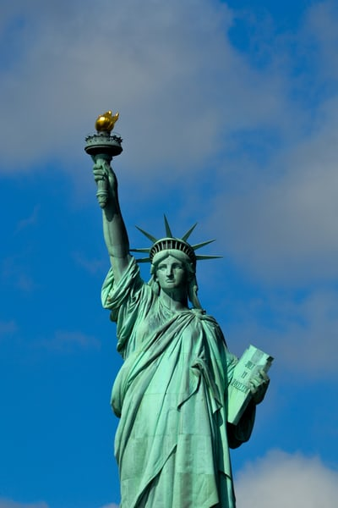
Recent Constitutional Challenges (2)
  In May 2020, a New York trial court rejected a Catholic Diocese’s constitutionality challenge to New York’s reviver law. See Doe v. Diocese of Rockville Ctr., 2020 N.Y. Misc. LEXIS 1964 (Sup. Ct. May 11, 2020).
  The Court concluded that “a claim-revival statute satisfies the Due Process Clause of the New York State Constitution if it was enacted as a reasonable response in order to remedy an injustice.” Id. at *7 (citation omitted).
  The Court then held that because “the Child Victims Act is a reasonable response to remedy the injustice of past child sexual abuse”, the law was constitutional. Id. at *15.
  The Diocese appealed the ruling before it filed for bankruptcy, where it may seek to renew its constitutionality challenge.

Slide 13
Reviver Statutes – What’s Next? (1)
  Twelve states currently have open reviver windows for filing abuse claims: Arizona, California, Connecticut, New Jersey, New York, North Carolina, Massachusetts, Montana, Oregon, Rhode Island, West Virginia, and Vermont.
  These states represent approximately one third of the U.S. population.

Slide 14

Reviver Statutes – What’s Next? (2)
  Four jurisdictions have reviver filings windows that end in 2021:
    Washington D.C. (May 2)
    New York (August 13)
    New Jersey (November 30)
    North Carolina (December 31)
  Unless these windows are extended due to COVID or otherwise, there likely will be a surge of claims in advance of each deadline.
  New reviver legislation is currently pending in least 20 states. See www.childusa.org/sol2021.

Slide 15
Revived Claims – What’s Next? (3)
  Direct-side coverage issues with respect to revived abuse claims may include:
      Voluntary payments
      Expected or intended
      Number of occurrences
      Allocation
      Abuse exclusions

Slide 16

Reviver Claims – What’s Next? (4)

Slide 17
Opioids

Slide 18
Opioids
Timeline
FDA approves OxyContin
1995
Peak use of prescription opioids¹
2010
First governmental lawsuit filed
2012
Peak of opioid-related death²
2017
Federal MDL formed in Ohio
12/5/2017
Purdue settles with State of OK for $275M
March 2019
Verdict in favor of State of OK against J&J for $572M
August 2019
Purdue files for bankruptcy
September 2019
6th Circuit overturns creation of settlement class
October 2020
https://www.cdc.gov/drugoverdose/maps/rxrate-maps.html
https://wonder.cdc.gov

Slide 19
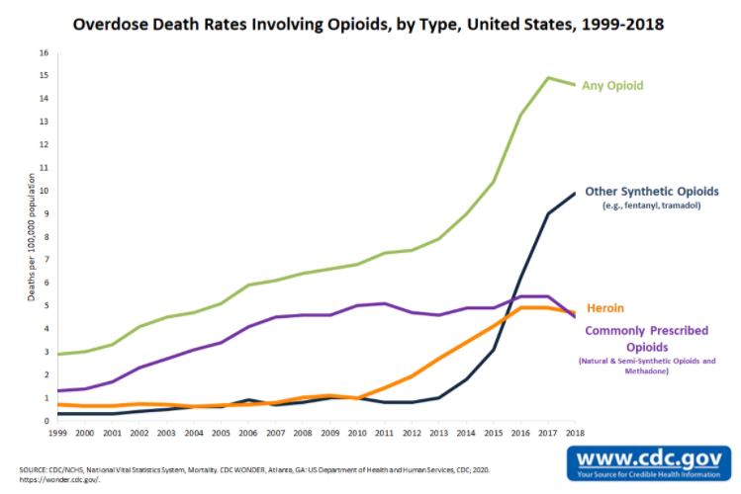
Opioids
Opioid-Related Deaths

Slide 20
Opioids
Total Number of Cases (as of January 1, 2021)
Venue | Cases Filed
MDL | 2,944
Federal Non-MDL | 123
State | 668
Total | 3735

Slide 21
Opioids
Plaintiff and Defendant Categories
Plaintiffs
Government Entities
Individuals
Third-Party Payors
Native American Tribes
Hospitals
Shareholders
Trade Associations
Not for Profit Corporations
Regulatory Bodies
County School Boards
Defendants
Manufacturers
Distributors
Pharmacy Benefit Managers
Retailers
Local Pharmacies
Pharmacists
Individual Prescribers (NP’s, Physicians, Dentists)
Hospitals/Medical Practices
Directors and Officers (of defendant companies)

Slide 22
Opioids
Government Plaintiffs’ Legal Theories and Requested Remedies
Legal Theories
Public Nuisance
Negligence
Unjust Enrichment
Civil Conspiracy (RICO)
Failure to Warn
Fraud
Requested Remedies
Damages – increased costs for:
  Healthcare
  Law Enforcement
  Social Services
  Judicial System
Injunction
Abatement

Slide 23
Opioids
Key Venues
Federal MDL
Created late 2017
Assigned to Judge Polster (ND of Ohio)
“Settle by end of the year!”
Pharmacies sought to recuse – twice!
Novel settlement class overturned
Using trials to leverage settlements
State of Oklahoma
August 2019 – verdict against J&J
  Bench trial
  $572M awarded, later amended to $465M
  Appealed
State of West Virginia
High opioid use
2001 - lawsuit vs Purdue – settled for $10M (2004)
2012 – lawsuits vs distributors
  2017 - AmerisourceBergen ($16M) and Cardinal ($20M) settled
2016 – lawsuit vs McKesson – settled for $37M (2019)
Notable Bankruptcies
February 2019 – Pernix (manufacturer)
June 2019 – Insys Therapeutics (manufacturer)
September 2019 – Fred’s Stores (pharmacy)
September 2019 – Purdue (manufacturer)
March 2020 – Rochester Drug (distributor)
October 2020 – Mallinckrodt (manufacturer)

Slide 24
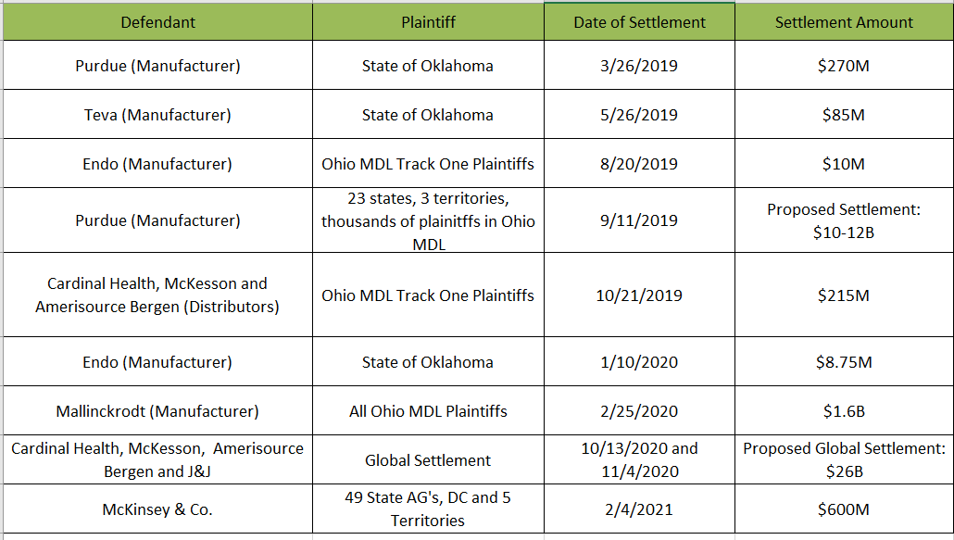
Opioids
Additional Notable Settlements

Slide 25
Opioids
Potential Coverage Defenses/Issues
Claims made and reported
Products exclusions
Opioid exclusions
No “occurrence”/expected/intended
No damages “because of” vs “for” bodily injury
No bodily injury during policy period
Known loss
Willful violation of law exclusion
Related/batch claims
Trigger
Allocation
Number of occurrences??

Slide 26
Opioids
Coverage Litigation
17 pending opioid coverage actions
Key Coverage Decisions to Date
  Insured Win
    Cincinnati Ins. v. H.D. Smith (2016 and 2019) – duty to defend/“because of bodily injury”
    Rochester Drug v. Hiscox (2020) – preliminary injunction granted requiring payment of defense costs
    Acuity v. Masters Pharm. (2020) - duty to defend/“because of bodily injury”
    Cincinnati Ins. v. Discount Drug Mart (2020)- duty to defend/“because of bodily injury”
    Rite Aid v. ACE (2020) - duty to defend/“because of bodily injury”
  Insurer Victory
    Travelers v. Actavis (2017) – no duty to defend/products exclusion and no occurrence
    Cincinnati Ins. v. Richie Enterprises (2014) – no duty to defend/“for bodily injury”
    Travelers v. Anda (2015) – no duty to defend/”for bodily injury”

Slide 27

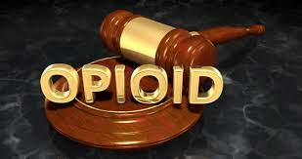
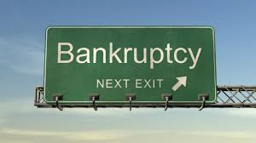
Opioids - What’s Next??

Slide 28
PFAS

Slide 29

What are PFAS?
PFAS refers to a group of roughly 5,000 man-made chemicals
  (includes PFOA, PFOS, GenX, and thousands of other chemicals)
Accumulate in the body and the environment
  Cause certain illnesses/cancers and adverse physical effects
  Do not break down in soil or water
  Found everywhere:

Slide 30
PFAS Terminology
PFAS: Per and Poly-Fluoroalkyl Substances
PFOA: Perfluorooctanoic acid
  (“per-FLOOR-oh-ock-tan-OH-ick acid”)
PFOS: Perfluorooctane sulfonic acid
(“per-FLOOR-oh-OCK-tain sul-FON-ick acid”)

Slide 31
“The only places we’re not finding PFAS are places we’re not looking”
– Heidi Grether, Director, Michigan Department of Environmental Quality
AFFF
Aerospace
Alternative energy
Automotive
Chemical manufacturing
Electronics
Food packaging
Healthcare
Pharmaceuticals
Photolithography
Landfills
Metal plating/etching
Mining
Paints, varnishes, sealants, waxes and polishes
Paper coatings
Personal care products
Performance chemicals
Plastics
Semiconductors
Stain repellants
Textiles
Wastewater treatment plants
Wire manufacturing/coating

Slide 32
PFAS Exposure
70 ppt
is equal to 70 drops of water in Olympic-size pool
110 Million Americans
  have PFAS contaminated water supplies
99% of Americans
  have PFAS in their bloodstream

Slide 33
Adverse Health Effects
  Kidney cancer
  Testicular cancer
  Ulcerative colitis
  Hypertension in pregnant women
  Thyroid disease
* This is not an exhaustive list
High cholesterol
Liver damage
Asthma
Decreased fertility
Low birthweight

Slide 34
PFAS Exposure
Water
Drinking water / Groundwater
Surface water
Rainwater
Products
Exposure to PFAS chemicals through intended use of product (Aqueous Film Forming Foam, PPE)
Dermal absorption
Employees exposed at facilities that produce PFAS or PFAS-containing products
Disposal or biodegradation of PFAS waste and consumer products (carpet, leather, cookware, etc.)
Food
Food grown in PFAS-contaminated soil and water
Food packaging
Equipment used during food processing

Slide 35
AFFF Multi-District Litigation
Who: Manufacturers of Aqueous Film Forming Foam (AFFF) and component PFAS chemicals – fire suppressant products
What: Alleged groundwater/drinking water contamination and direct product exposure
When: Began with 83 federal lawsuits from 11 states in 2018 consolidated in a federal court Multi-District Litigation (MDL)
Where: Near military bases, airports, other industrial sites, and direct exposure during fire suppression and fire safety training

Slide 36
AFFF Multi-District Litigation
Now ~1,000 consolidated lawsuits with >2,000 plaintiffs pending in South Carolina
Personal injury class actions include >250,000 people
Cases centralized for pretrial proceedings and discovery
First bellwether cases are “water agency” lawsuits (claims for water supply contamination) to be tried in early 2022

Slide 37
AFFF Multi-District Litigation
Lawsuits are divided into the following categories:
  Individual personal injury (i.e., bodily injury) : ~91%
~35% - Traditional Environmental Exposure (e.g., water pathways)
~65% - Direct Exposure (e.g., AFFF use as intended, PPE)
Personal injury lawsuits include: ~58% - Cancer Allegations
  Individual property damage: ~ 25% of BI suits allege property damage
  States / water providers / municipalities (e.g., cleanup): ~8%
  Individual or class medical monitoring: ~1%
  Percentages are by lawsuit, not individual plaintiffs

Slide 38
AFFF Multi-District Litigation
Typical Causes of Action
  Negligence
  Strict liability (failure to warn & defective design)
  Trespass
  Medical monitoring
  Public or private nuisance

Slide 39
Non-AFFF PFAS Litigation
AFFF claims are a subset of all PFAS litigation
Hundreds of non-AFFF PFAS lawsuits seek recovery for:
  Environmental Remediation (Cleanup and NRD)
  Individual and Class Action Bodily Injury
  Medical Monitoring
  Individual Property Damage
Although anticipated liabilities for AFFF litigation are significant because AFFF contains the largest concentration of PFAS chemicals, liabilities arising from non-AFFF litigation for other PFAS products likely will eclipse AFFF liabilities because of cleanup expense.

Slide 40
QUESTIONS?

Slide 41
THANK YOU

