Slide 1
Ripped From The Headlines - Insurance & Reinsurance Issues In Current Events
Laura Foggan, Crowell & Moring, LLP
Scott Seaman, Hinshaw & Culbertson LLP
Peter Kanaris, Hinshaw & Culbertson LLP
ARIAS SPRING CONFERENCE 2021

Slide 2
MASS SHOOTINGS Mass Killings/Active shooters
Laura A. Foggan

Slide 3
Mass Shootings: Definitions
Stanford University MSA Data Project: three or more persons shot in one incident, excluding the perpetrator(s), at one location, at roughly the same time. Excluded are shootings associated with organized crime, gangs or drug wars.
Mass Shooting Tracker: four or more persons shot in one incident, at one location, at roughly the same time.
Gun Violence Archive/Vox: four or more shot in one incident, excluding the perpetrators, at one location, at roughly the same time.
Mother Jones: three or more shot and killed in one incident at a public place, excluding the perpetrators. This list excludes all shootings the organization consider to be "conventionally motivated" such as all gang violence and armed robberies.
The Washington Post: four or more shot and killed in one incident at a public place, excluding the perpetrators.
ABC News/FBI: four or more shot and killed in one incident, excluding the perpetrators, at one location, at roughly the same time.
Congressional Research Service: four or more shot and killed in one incident, excluding the perpetrators, at a public place, excluding gang-related killings and those done with a profit-motive.

Slide 4
Mass Shootings in the US: 2021 Statistics*
Month | Mass shootings | Total number killed (including the shooters) | Total number wounded (including the shooters)
January | 35 | 23 | 145
February | 43 | 49 | 152
March | 48 | 70 | 188
*https://en.wikipedia.org/wiki/List_of_mass_shootings_in_the_United_States_in_2021

Slide 5
Mass Shootings: Recent U.S. Examples*
April 15, 2021 Indianapolis, Indiana Indianapolis FedEx shooting: early reports stating 9 people killed with 4 others in unknown condition after a mass shooting at a Fed Ex facility in Indianapolis Indiana. The shooter is deceased from a self-inflicted wound.
March 22, 2021 Boulder, Colorado Boulder shooting: A mass shooting occurred at a King Soopers supermarket in Boulder, Colorado, which left 10 people dead, including an on-duty police officer.
March 16, 2021 Atlanta, Georgia Atlanta spa shootings: A series of mass shootings occurred at massage parlors in the Atlanta, Georgia metropolitan area. Eight people were killed in the incidents and one person was wounded.
February 9, 2021 Buffalo, Minnesota Buffalo clinic attack: A nurse was killed and four other people were shot and seriously wounded inside of a health care clinic. The suspect, 67-year-old Gregory Paul Ulrich, was taken into police custody.
February 2, 2021 Sunrise, Florida Sunrise, Florida shootout: Two FBI agents were shot and killed and three others wounded attempting to serve a warrant. The suspect barricaded himself in his home and opened fire before shooting and killing himself.
*https://en.wikipedia.org/wiki/List_of_mass_shootings_in_the_United_States

Slide 6
Mass Shootings: Potential Liability Targets
Gun and Ammunition manufacturers
Retailers or gun shops/shows where the assailant acquired weapons (if acquired illegally).
Straw purchasers of weapons or ammunition.
Owners and operators of businesses or facilities where the shooting occurs.
Event promoters.
Security firms; Law enforcement.
Employers.
Mental health providers; organizations that fail to report disqualifying information to authorities.
Parents/relatives of the shooter.
Anyone in a position to know of or intervene in the shooter’s plan.

Slide 7
Mass Shootings: Examples of Liability Theories and Defenses
Gun Manufacturers and Sellers:
Promotion of Underground Gun Market
Failure to Prevent Unauthorized Users
False Advertising/Marketing-Related Claims
Businesses and Schools:
Negligent hiring/retention
Failure to Provide Adequate Security

Slide 8
Mass Shootings: CGL Coverage Issues and Defenses
Caused by an “occurrence”, accident
Expected or Intended issues
Criminal Act Exclusions
Assault & Battery Exclusions
Terrorism Exclusions
Products Claims/Products Hazard Exclusion
Bodily Injury and Property Damage
“As damages”
Number of Occurrences
Settlement: Multi-Claimant issues, Inadequate insurance issues

Slide 9
Mass Shootings: Property Coverage Issues
Property damage, Extra Expense.
Business Interruption (note limits on time/scope of coverage)
Criminal Act Exclusions
Number of Events/Deductibles, Limits

Slide 10
Mass Shootings: Active Shooter Coverage
Substantial variation in coverage terms.
Consider key policy terms and definitions, such as “deadly weapon protection,” “workplace violence,” or “active assailant.”
Coverage Thresholds, e.g., three or more casualties, and Coverage Caps, e.g., no coverage where casualty count exceeds 50.
Does it include costs such as risk management expenses, funerals, media relations, post-event hotlines, and counseling?

Slide 11
Riots, Civil Commotion, & Strikes
Scott Seaman

Slide 12
2020 – A Year Of Rampant Social Unrest
Unquestionably, the COVID-19 Pandemic has been the most impactful issue in the world over the 15 months. It also has been the most consuming issue in the U.S. insurance coverage world with approximately 1,600 coverage lawsuits filed to date. It will be a very expensive proposition for US insurers, even though the early results have been relatively favorable with insurers prevailing on motions to dismiss in approximately 53% of cases in state court and 93% in federal court.
It is estimated that the civil unrest will result in more than $1 to $2 billion in losses in 2020, making it the costliest civil disorder in U.S. history in nominal dollars. Rodney King riots in 1992 resulted in $775 million in damage, or $1.42 billion today.
Protests, demonstrations in approximately 140 U.S. cities in the wake of George Floyd’s death.
It is estimated that dozens of people were killed and thousands injured during riots.
Thousands of U.S. businesses experienced property damage from riots, fire, flooding from fire sprinklers, and lost revenue as a result of large-scale demonstrations.
Damage to some homes and thousands of vehicles, including law enforcement vehicles.

Slide 13
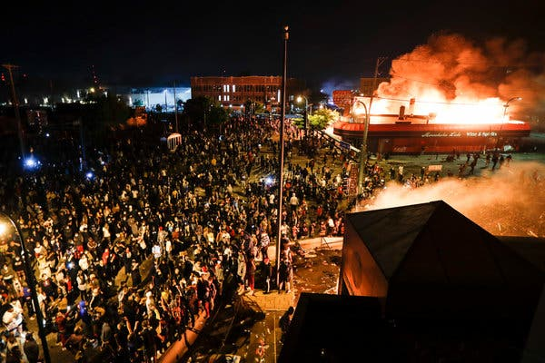
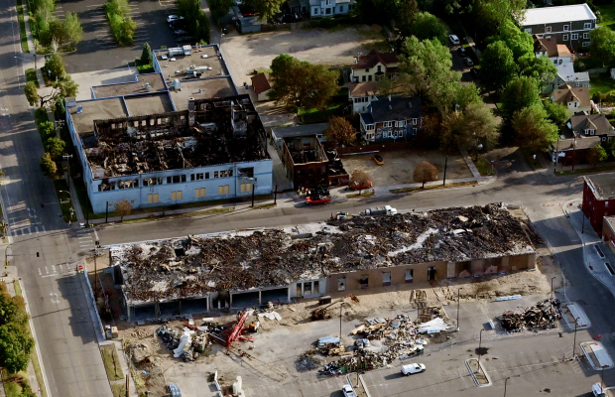
Minneapolis
At least $500 million in damage to more than 1,500 locations in the Twin Cities.

Slide 14
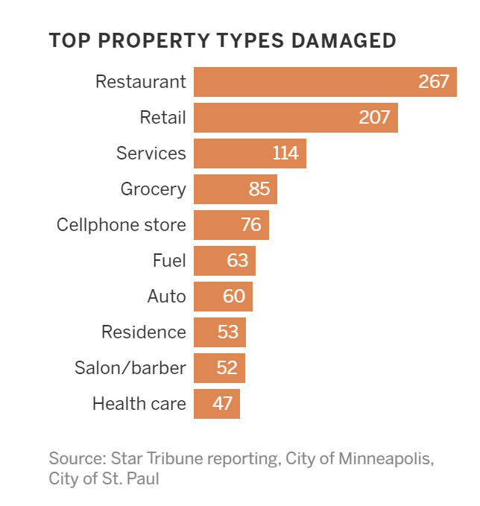
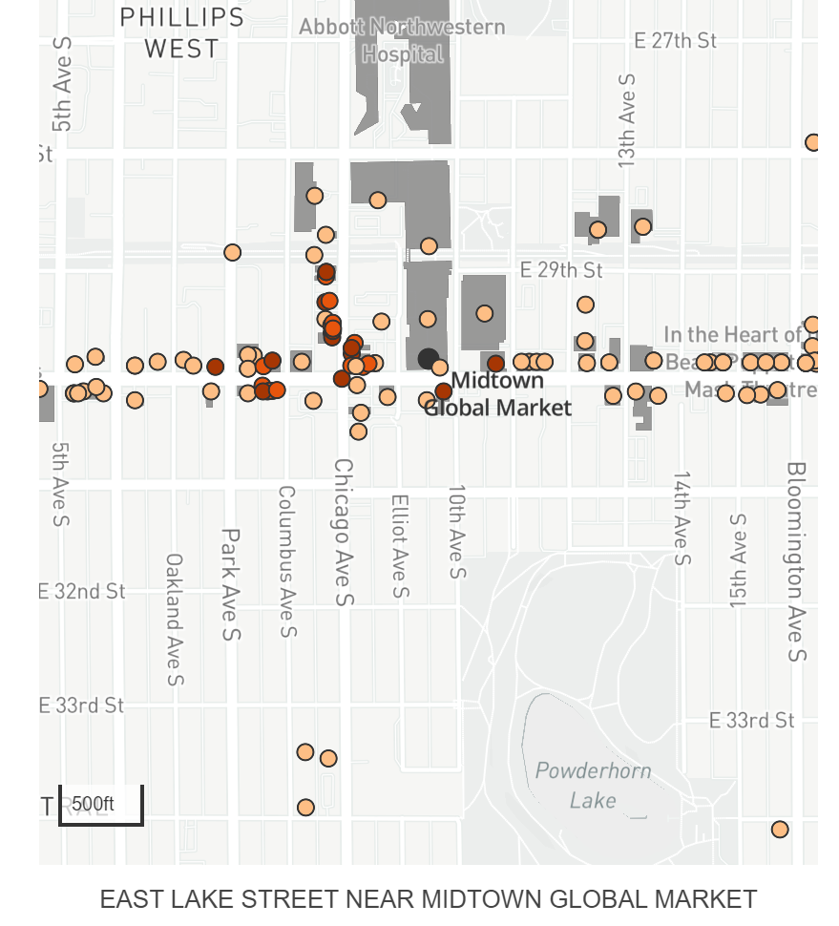
Minneapolis

Slide 15
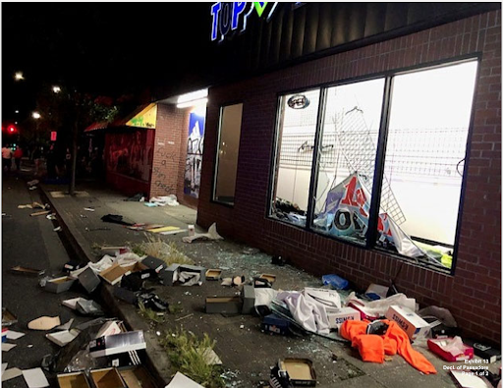
Portland
One estimate (likely low) $23 million in lost revenue and $5 million in property damage to private businesses.

Slide 16
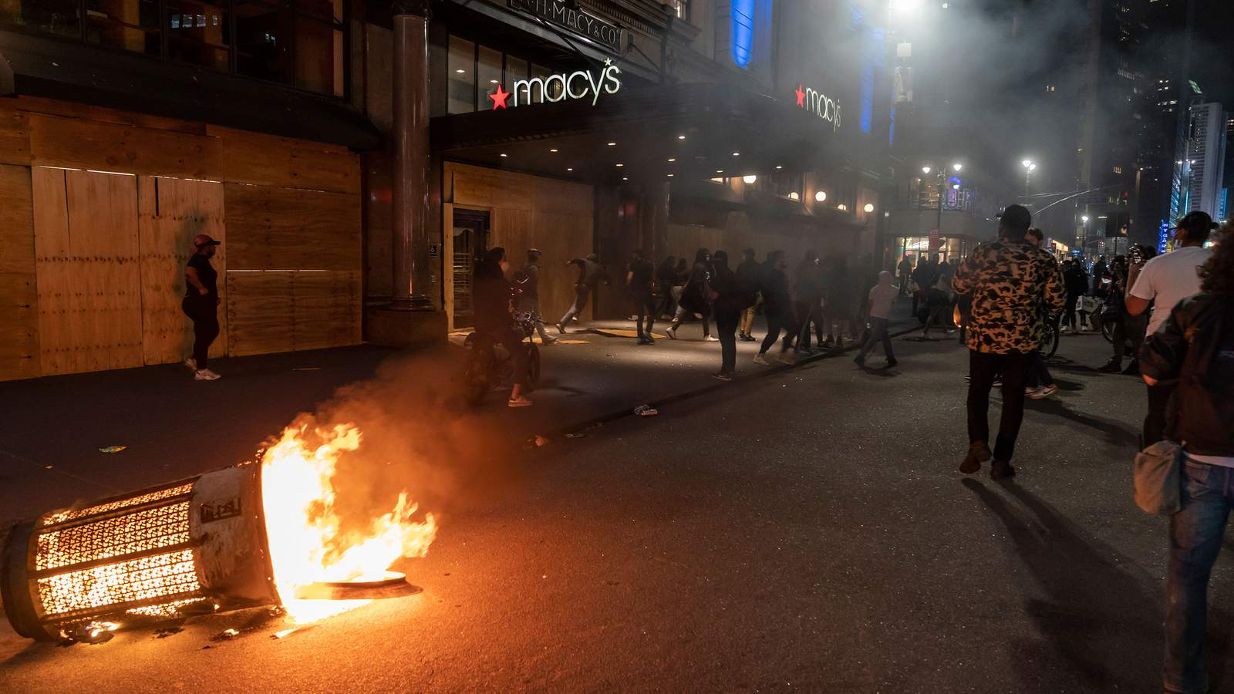
New York
Estimated tens of millions of dollars in damages to more than 450 businesses.
During 2 week period alone NYPD paid $115 million in overtime.

Slide 17
First-party Coverage Issues
Primary potential impact to property policies.
First-party claims include:
Property damage resulting from riot, looting, or demonstration,
Stolen property and merchandize,
Lost revenue resulting from riot, looting, or demonstration,
Preventative measures (fencing, barricading, security, relocation) and,
Cleanup.

Slide 18
First-party Coverage Issues
Physical damage caused by fire, riots, civil commotion or vandalism is generally covered under a standard business owners policy.
Loss of income may be covered under business income or business interruption coverage, but this is typically implicated only if there is direct physical damage to premises.
Some first-party policies contain “civil authority provisions” covering lost income and other expenses in the event law enforcement bars access to a specific area due to rioting.

Slide 19
First-party Coverage Issues
Number of occurrences also can be a significant issue: may impact total limits of liability, number of deductibles/SIRS, and attachment of excess policies.
Potential positions include:
Multiple losses at a single location (such as when a store is vandalized or looted on successive days),
Losses at multiple locations in the same city, or
Losses at locations in different cities throughout the country or some combination of the foregoing.
Policy language.

Slide 20
First-party Coverage Issues
Vacancy provisions may limit coverage when buildings have been vacant for a designated period of time — 60 days is a common period.
Causation issues – The cause of any specific loss may be unclear or subject to dispute — i.e., did the loss result from vandalism or from arson — the specific terms of the policy must be closely analyzed.

Slide 21
First-party Coverage Issues
Potentially applicable exclusions:
Property insurance policies often contain exclusions that apply to various war risks, including insurrection. In the event that an insurrection is declared in connection with riots, losses arising therefrom may be excluded.

Slide 22
First-party Coverage Issues
Be mindful of administrative rules/regulations:
NY Insurance Regulation 64 has been amended to mandate prompt processing and investigation of claims, to allow policyholders to make immediate repairs to damaged property if necessary to protect health or safety.
Illinois Department of Insurance company bulletin "Coverage Related to Business and Property Damage Losses, Including but not Limited to Those Arising Out of Vandalism and Looting.”

Slide 23
First-party Coverage Issues
Fraudulent claims.
Proof of damages and exaggerated damage submissions.
Impact of insurance operations relating to remote working.

Slide 24
Liability Issues – Potential Claims
Claims against government entities:
E.g., businesses alleging property damage or lost revenue against as a result of riots (or failure to prevent riots).
E.g., businesses alleging property damage or lost revenue as a result of law enforcement activities (road closures, barricading business complexes).
E.g., persons alleging bodily injury caused by law enforcement (pepper spraying, projectiles, tear gas).
E.g., persons alleging civil rights or similar claims (false arrest, malicious prosecution).

Slide 25
Liability Issues – Potential Claims
Numerous defenses and barriers to recovery beginning with governmental immunity.
Governmental immunity may require claimants to show willful or intentional misconduct. See 745 ILCS 10/2-202.
Some states, such as Oregon, immunize governmental entities and public officials from liability for claims “arising out of riot, civil commotion or mob action or out of any act or omission in connection with the prevention of any of the foregoing.” See ORS § 30.265.

Slide 26
Liability Issues – Potential Claims
Claims against adjacent businesses or property owners for loss of use (e.g., Business A was damaged during riot, thereby preventing adjacent Business B from operating).
Claims arising from businesses’ use of force to protect property or persons (e.g., business hires private security to protect property, and security causes injury to protestors, rioters, or bystanders).
Claims arising from businesses’ failure to perform contractual obligations due to riot (e.g., business cannot manufacture or deliver products because riots have shut down the business or prevented access to facilities or delivery routes).
Claims against the rioters/looters for the injuries and property damage they caused.

Slide 27
Liability Coverage Issues
Absence of occurrence/fortuity.
Number of occurrence(s) issues.
Lack of BI or PD (e.g., emotional distress; loss of revenue will be difficult to recover under most CGL policies).
Coverage B “offenses” (e.g., false arrest, malicious prosecution).

Slide 28
Liability Coverage Issues
Coverage A - Exclusion 2.a. Expected Or Intended

Slide 29
Liability Coverage Issues
Coverage B - Exclusion 2.d. Criminal Acts

Slide 30
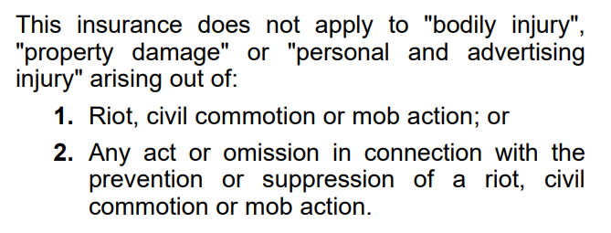
Liability Coverage Issues
Exclusion – Riot, Civil Commotion or Mob Action – Governmental Subdivisions (Form CG 22 31 07 98)

Slide 31
Liability Coverage Issues
Foremost Ins. Co. v. Putzier, 606 P.2d 987, 990 (Idaho 1980)
the “Evel Knievel case”
Rowdy crowds gathering for Evel’s event looted and destroyed nearby business owners’ equipment and goods.
Business owners sued Evel for damages.
Court held exclusion barred coverage.
Foremost shows the exclusion is plain and unambiguous, despite undefined terms.

Slide 32
Liability Coverage Issues
Exclusion – Riot, Civil Commotion or Mob Action – Governmental Subdivisions (Form CG 22 31 07 98)
Gulf Ins. Co. v. State, 607 P.2d 1016, 1018-19 (Colo. App. 1979)
Bodily injury arising from prison riot was excluded: “[T]he policy affords no coverage for bodily injury arising out of a riot…”
However, exclusion did not preclude coverage for prisoner’s claim based on insured’s failure to provide adequate medical care after the riot.
Gulf demonstrates that courts may place limitations on the scope of the exclusion.

Slide 33
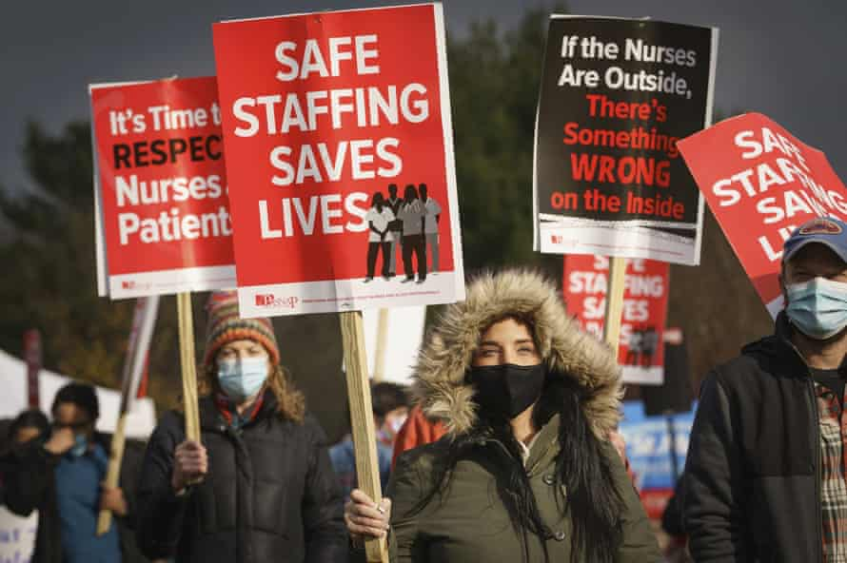
Strikes

Slide 34
Strikes
Section 7 of the National Labor Relations Act (“NLRA”) states in part, “Employees shall have the right…to engage in other concerted activities for the purpose of collective bargaining or other mutual aid or protection.”
Strikes are included among the concerted activities protected for employees by this section. 29 U.S.C. §§ 151-169.
Section 8 of NLRA prohibits employers from interfering with, restraining, or coercing employees in their exercise of rights under the NLRA, including the right to strike. 29 U.S.C. §§ 158.
Employees may sue employers for violations of the right to strike, i.e., “Unfair Labor Practices.”
National Labor Relations Board adjudicates disputes under NLRA, including Unfair Labor Practices claims. 29 U.S.C. §§ 158.

Slide 35
Strikes Are Not A Thing Of The Past
Despite weakened private-sector labor unions in recent years, many strikes continued to take place (e.g., nearly 3,000 employees at Volvo plant in Virginia, 1,100 miners at coal mine in Alabama, hundreds of nurses at Massachusetts hospital).
Biden administration aims to strengthen the rights of organized labor.
US House of Representatives passed a sweeping bill on March 9, 2021, that would amend provisions of federal labor law that in some cases have been in place since as long ago as 1947. The bill is called the Protect the Right to Organize Act of 2021 (PRO Act), but it goes far beyond protecting the right to organize.

Slide 36
Coverage For Strikes
CGL policies do not cover Unfair Labor Practices claims, absent “bodily injury,” “property damage,” or “personal and advertising injury.”
Employer’s Liability exclusion precludes coverage for “bodily injury” arising out of scope of employment (i.e., one issue is whether a striking employee is acting in the scope of employment)
Nature or purpose of the strike could impact whether various exclusions apply (e.g., “Workers' Compensation And Similar Laws”)

Slide 37
Strikes – NLRA Exclusion In EPLI Policy

Slide 38
Strikes
First-party coverage issues:
Standard business interruption coverages do not cover losses occasioned by employee strikes, absent some physical injury to business.
Some policy forms exclude losses resulting from business delays caused by “strikers.”
Some carriers offer first-party coverage forms providing business interruption coverage for employee strikes, even if no physical injury.

Slide 39
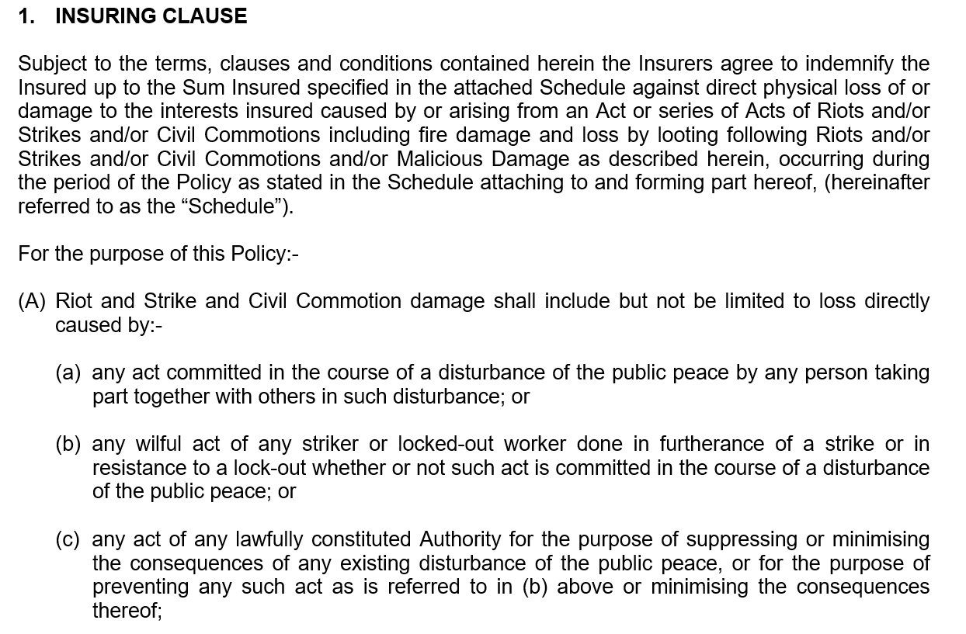
SRCC Coverage
A specific first-party coverage form for strikes, riots, and civil commotion.

Slide 40
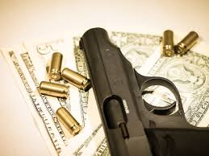
Panel Discussion
COVID-19
Riots/Civil Unrest
Freeze

Slide 41
February Freeze Fallout Facing Insurers
Peter Kanaris

Slide 42
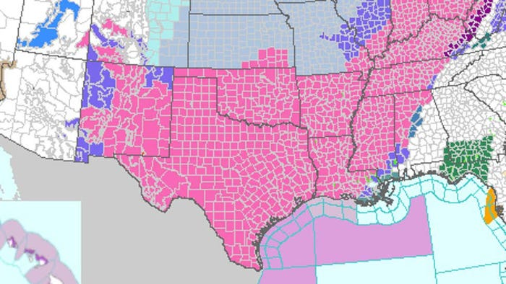
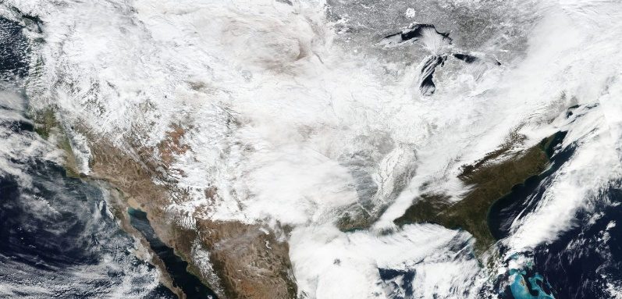
February 2021 Winter Storms
Winter Storm “Uri” – CAT 21015
2/12/2021 – 2/16/2021
Oregon, Nevada, Colorado, Texas, Oklahoma, etc.
Winter Storm “Viola” – CAT 21017
2/16/2021 – 2/20/2021
Texas, Oklahoma, Arkansas, Louisiana, Mississippi, Missouri, Illinois, Kentucky, Tennessee
February 14, 2021 National Weather Service Winter Weather Advisory for all 254 Texas Counties
February 16, 2021 satellite image from NASA

Slide 43
Fallout From Texas Winter Storms
Texas Losses estimated between $10B - $20B
Public Information Reported Claims
28,900 State Farm claims
20,000 Liberty Mutual claims
1,700 AIG claims
Majority of claims seek first-party property coverage
As of April 16, 2021:
At least 50 lawsuits filed against the Electric Reliability Council of Texas (“ERCOT”)
Majority of claims for negligence, gross negligence, wrongful death, or claims under the Texas Deceptive Trade Practices Act

Slide 44
First-Party Property Coverage Issues
Number of Occurrences
Series of losses arising from single cause or originating event
Newmont Mines and World Trade Center cases
Vacancy Limitation / Exclusion
Time Period
Valuation
Change of Temperature Exclusion
Lead-in language
Ensuing loss exception

Slide 45
Issues Related To Increased Energy Costs
Off premises power service interruption
Requirement of physical loss or damage
Preservation of property
Imminent physical loss or damage
Extra expense
Nexus between direct physical loss and costs incurred above normal
Bad business decision

Slide 46
Third-Party Coverage Fallout
Declaratory Judgment filed against ERCOT
Insurer’s argument:
No “occurrence” because there was no accident – a fortuitous, unexpected, and unintended event
Damages/losses were foreseeable, expected, and/or intended as they were a result of the exact same failures of ERCOT in 1989 and 2011

Slide 47
Reinsurance Considerations
Laura Foggan, Scott Seaman, and
Peter Kanaris

Slide 48
Panel Discussion – Reinsurance Issues
Number of loss occurrences
Aggregation
Retentions
Exclusions in facultative certificates/treaties

Slide 49
THANK YOU
The information contained in this presentation is provided for informational purposes only and is not intended to be and shall not be deemed to constitute legal advice. Any views expressed herein do not necessarily reflect the views of any of the presenters’ firms or their clients.
Laura Foggan, Crowell & Moring, LLP
Peter Kanaris, Hinshaw & Culbertson LLP Scott Seaman, Hinshaw & Culbertson LLP

