Slide 1
Great Decision Making
Unconscious Influencers and Group Dynamics in Arbitration and Mediation
May 6, 2021

Slide 2
Unconscious Bias

Slide 3
Unconscious Bias in Group Dynamics

Slide 4
Justice Scalia Explains the Problem
While computers function solely on logic, human beings do not. All sorts of extraneous factors - emotions, biases, preferences - can intervene, most of which you can do absolutely nothing about, except play upon them if you know what they are.”

Slide 5
Chuck’s Supplement To Justice Scalia
“While computers function solely on logic, human beings do not. All sorts of extraneous factors — emotions, biases, preferences — can intervene, most of which you can do absolutely nothing about except play upon them in others and avoid them yourself . . . .”

Slide 6
Six Biases That Skew Decisions
Hindsight
Good vs. Evil
Anchoring
First Impression/Confirmation
Fairness
Self-Regard

Slide 7
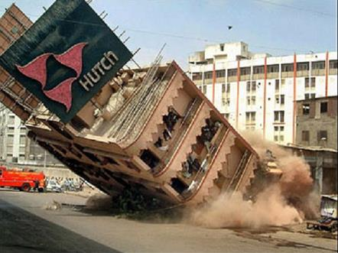
Hindsight Bias Tells Us: If It Happened, It Was Foreseeable

Slide 8
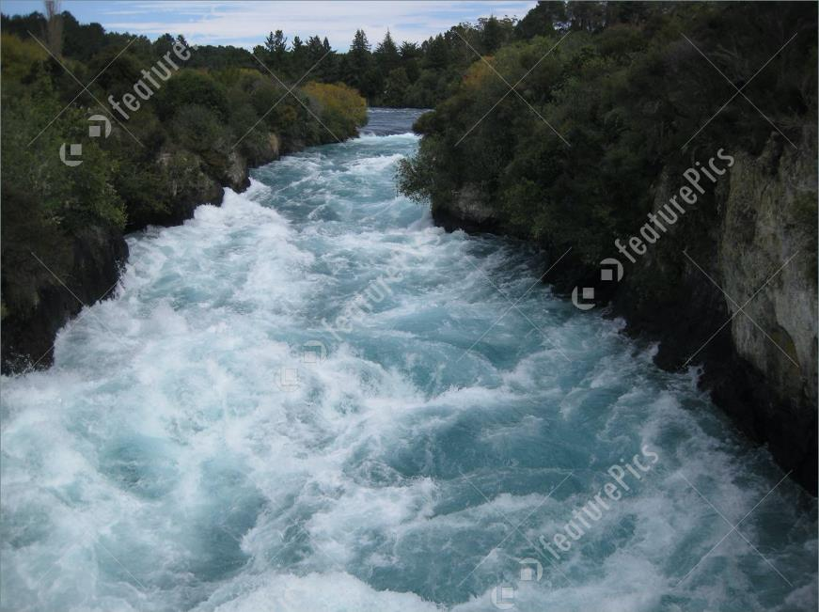
Decision Not To Build A Flood Control Project: Negligent Or Reasonable?

Slide 9
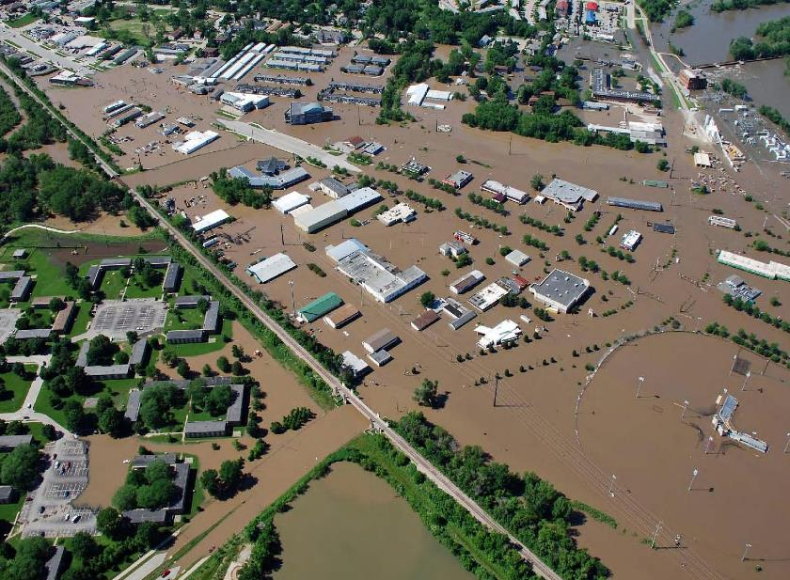
Half Of Judges Are Told There Later Was A Flood

Slide 10
Half the Judges Don’t Know About The Flood

Slide 11
Don’t Know About The Flood: 76% Say The Decision Was Reasonable

Slide 12
Know About The Flood: 57% Say The Decision Was Not Reasonable

Slide 13
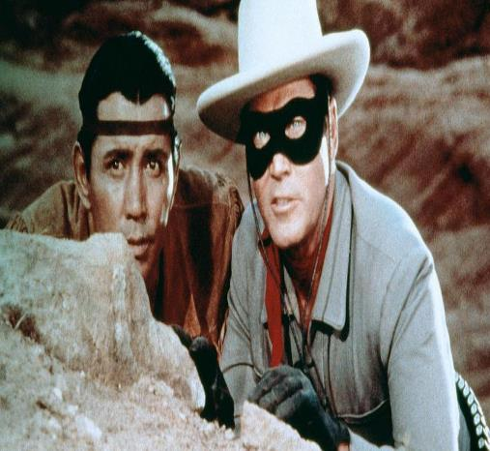
Good vs. Evil

Slide 14
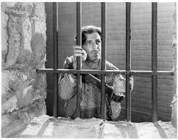
Federal Judges: Reverse War Crimes Conviction?

Slide 15
Scenario 1: Repented; Works For Reconciliation

Slide 16
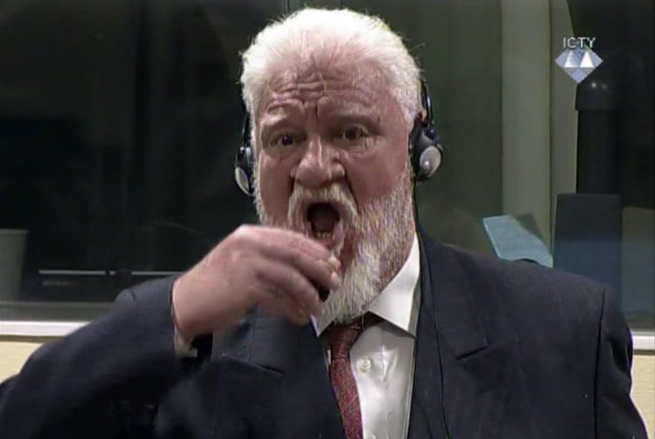
Scenario 2: Still A True Believer

Slide 17
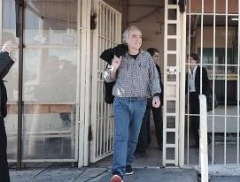
“Good Guy” Who Repented And Works For Reconciliation? 59% Reverse Conviction

Slide 18
“Bad Guy:” Still A True Believer? 87% Affirm Conviction

Slide 19
Anchoring Bias: Taking You Where You Don’t Want To Be

Slide 20
Non-Catastrophic Personal Injury Case

Slide 21
The Panel of Judges
Half Are Told: “Plaintiff Demands $10,000,000”
Half Are Told: “Plaintiff Demands A Lot of Money”

Slide 22
How Well Does the Anchor Work?
Anchor: $10,000,000
Average Award -- $2,210,000
Median Award -- $1,000,000

Slide 23
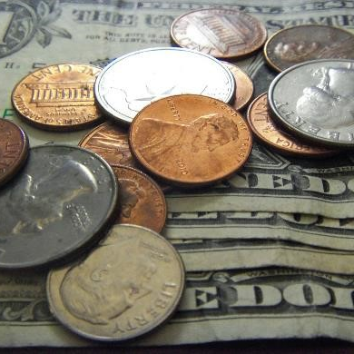
No Anchor: “Plaintiff Wants A Lot Of Money”
Average Award -- $808,000 (64% less)
Median Award -- $700,000 (30% less)

Slide 24
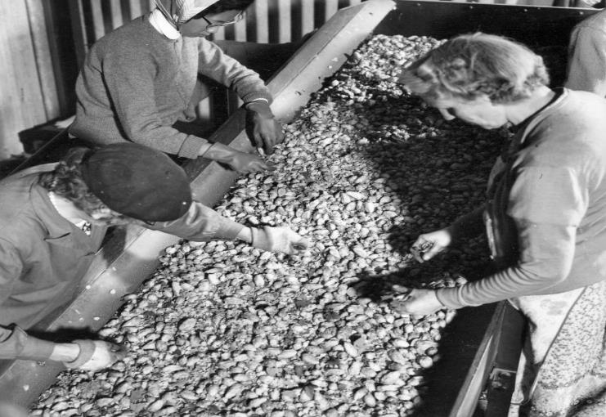
First Impression/Confirmation Bias Reinforcing Preconceptions

Slide 25
Did He Do it?

Slide 26
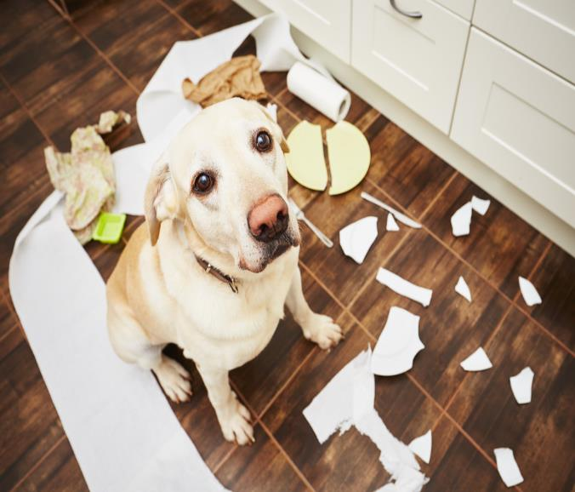
Hold On A Minute – There’s Another Suspect! Suspect #2

Slide 27
What Happened?

Slide 28
“I’m Super Fair” Bias Example: Can The Bell Be Unrung?

Slide 29
Personal Injury Case: Privileged(?) Document Is Bad For The Plaintiff

Slide 30
Half The Judges See The Document; Half Get A Description

Slide 31
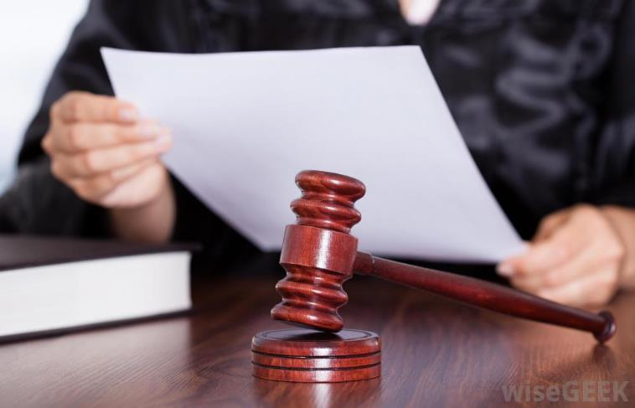
“It’s Inadmissible”

Slide 32
Judges Didn’t See The Document
55% For Plaintiff

Slide 33
Judges Saw The Document
71% For Defendant

Slide 34
Self-Regard Bias

Slide 35
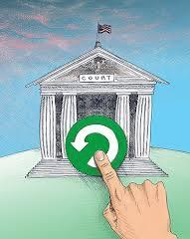
Your Honor, Are You in The Top 50%?

Slide 36
How Many Are In The Top 50%?

Slide 37
We All Think This Way
32% of employees are in the top 5%
32% of employees are in the top 5%

Slide 38
Temple University, Philadelphia, Group Dynamics Class in Psychoeducational Processes Major (PEP)
50% of Project Group was African American
We thought we would have different views based on race
It turns out our different bias were based on whether we were an undergraduate student or a graduate student
Graduate students were PEP majors and there to learn
Undergraduate students were looking for an easy class

Slide 39
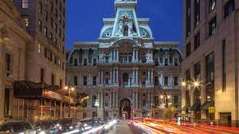
Defense of Insurance Broker in Philadelphia County

Slide 40
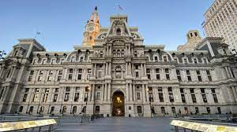
Philadelphia: You are a Local Girl
Coaching from Counsel:
Grew up straight up Broad Street in Abington
Attended Temple University in the City
Worked in the City
Live Locally
Teach the Jury on Intricate Retrospective plans
Found broker wrong, but no injury to client
Jury advised counsel that Jane Downey was believable because she was a local.

Slide 41
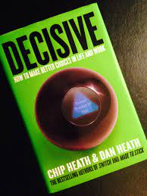
Decisive: Work of the Heath Brothers

Slide 42
Heath Brothers Approach to Problem Solving
Be Innovative-Expand your Starting Place-Avoid Narrow Framing
Think Outside the Box
Avoid Confirmation Bias-Your mind is already made up
Look for Information that Disconfirms your Hypothesis
Avoid Bias in How you Look at Information
Get as Many Data Points as you can
Actively Listen
Stop Looking for Data to Support your Bias
Challenge your First Decision-you may be Overconfident
Advice to Others-we see the Forest; Advice to Self, limited views

Slide 44
Heath Decision Making Methodology
W iden your Options
R eality Check your Assumptions
A ttain Some Distance – Look at the long term
P repare to be Wrong
The best Acquisition decisions were made when there were multiple options

Slide 46
The Necessary Components of Active Listening include:
Adopting a manner that is harmonious with the other person in terms of pacing, volume and tone of voice.
Pause before speaking to make sure the other person is done speaking
Adjusting your body postures so the other person feels comfortable (NLP)
(Watch TED talk from Amy Cuddy)
Maintaining intermittent eye contact
Paraphrasing what the other person has said, or how they are feeling
Praising or complimenting them if it feels natural
Repeating points of your conversation that surprise you
Asking questions
Clarifying vocabulary or jargon you do not understand
Making sure you speak for yourself and not the other person.
Talking about what you have observed, think or perhaps fear.
Using short clear statements to break messages into small parts

Slide 47
Group Dynamics: What to Know

Slide 48
Facts About Groups
Norming, Storming, Forming and Performing
Perfect Size Working Group is 8
Different Leadership Style for Stages of Group Dynamics
Norming: Dependency and Inclusion Leadership Style: Directive
Storming: Counter dependency and Fight Leadership Style: Coaching
Forming: Trust and Structure Leadership Style: Supporting
Work: Self-Directed Performing Leadership Style: Delegating
The stage of Group Dynamics will be very different if the Arbitrators have worked together before-Positive or Negative Bias

Slide 49
Innovation Techniques
Ways to Avoid Group Think and Gather all Available information
Ask for as much data as possible
Question the data and look for opposing data
Polling
Asking each member to argue for the other side
Submitting points anonymously so there is no stigma
Using post-it notes to organize data
Respond to all suggestions with a “Yes and….”

Slide 50
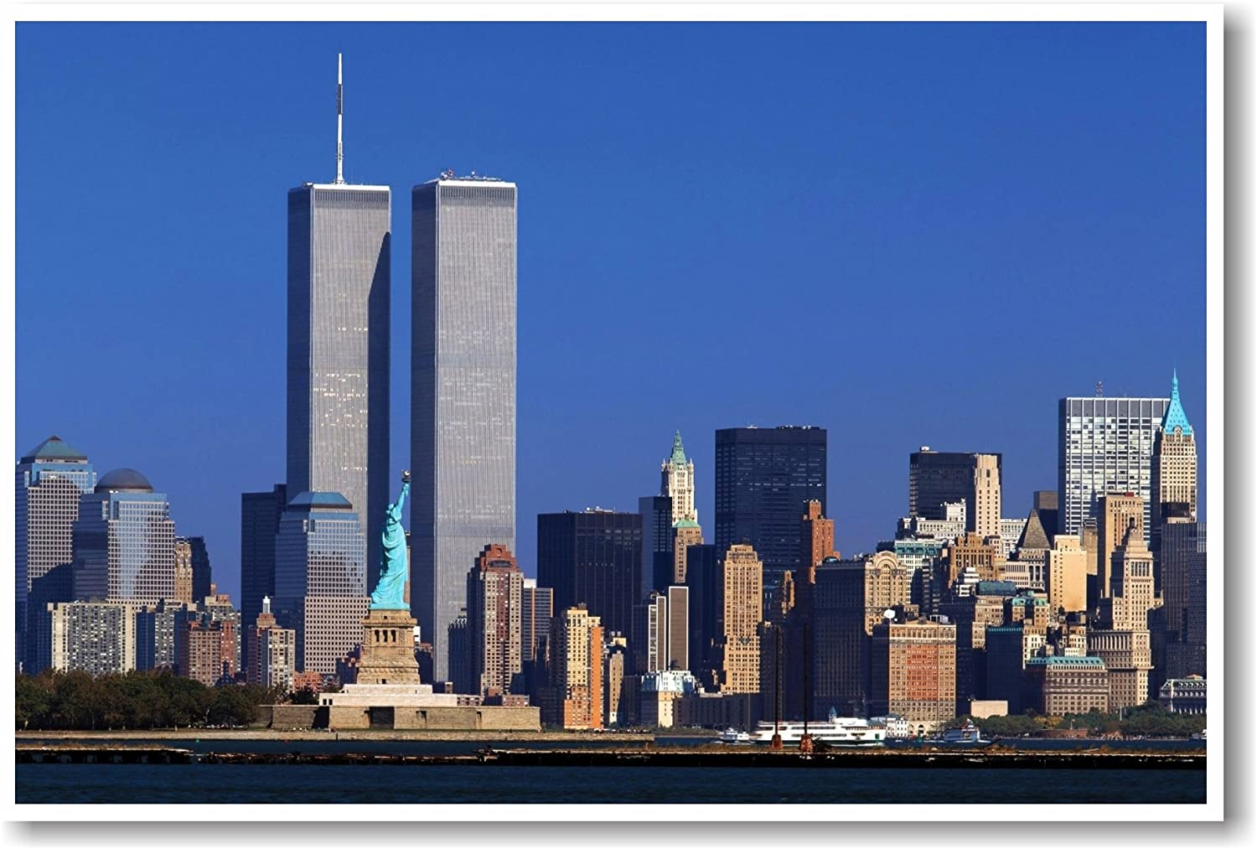
World Trade Center Attacks

Slide 51
World Trade Center Attacks- Bias affected Decision Making
Pre-Attack Bias
Silverstein-Only needed insurance limit for one tower
Underwriter-Will not write unless limits purchased for both towers
Rescorla-93 Bombing, Vista Parking Structure
Rescorla-Next Attack will come by plane (Morgan Stanley)
Bias During the Attacks
Port Authority-Only one plane
Rescorla-Continue Evacuation of second tower

Slide 52
Conclusion
Questions?
Answers?
Comments?

