Slide 1
Is There A Post-Pandemic Future For Virtual Arbitrations?
May 6, 2021

Slide 2
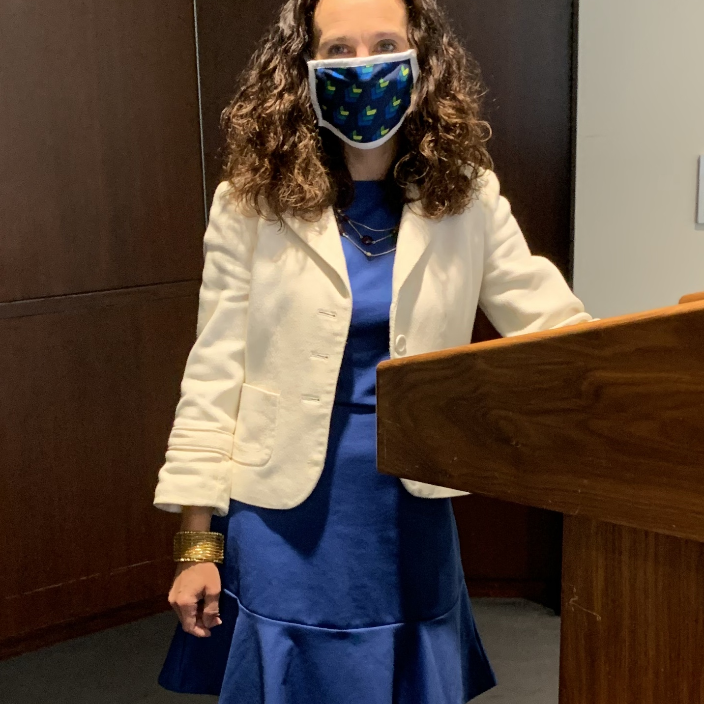
Virtual Arbitrations- They Can Work!
14 hearing days
15 witnesses
Over 1000 exhibits
Arbitration panel members, attorney teams, clients, witnesses, and court reporter all remote from each other and across the USA
Zoom platform

Slide 3
Virtual Merits Hearing Considerations
Panel authority
Key protocols
  Exhibits
  Agreements regarding who is remote from one other
  Safeguards around witnesses and testimony
Technical requirements
  Zoom vs reporting service platform
  Arbitrators’ home-office capabilities
What works and doesn’t work
Deliberation process

Slide 4
What Virtual Arbitrations Offer That In-Person Proceedings Might Not
Scheduling efficiencies
Flexibility with witness schedules and travel restrictions
Cost savings

Slide 5
The Shortcomings Of Virtual Arbitrations
Subpoenaing witnesses
  Managed Care Advisory Grp., LLC v. CIGNA Healthcare, Inc., 939 F.3d 1145, 1160-61 (11th Cir. 2019) (interpreting FAA to require subpoenaed non-parties to appear physically before an arbitrator and not remotely)
  Dodson Int’l Parts, Inc. v. Williams Int’l Co., No. 19-MC-50489, 2019 WL 5680811, at *2 (E.D. Mich. June 26, 2019) (same)
Loss of in-person “feel” of an arbitration
Witness credibility and control issues
Constraints on deliberations
But are these shortcomings fact or fiction?

Slide 6
What Is The Future For Virtual Arbitrations?
Should the presumption be that all future arbitrations will return to in-person?
Hybrid approaches
Virtual closings
Small cases vs. big cases
Does perspective matter: client vs. attorney vs. arbitrator?

Slide 7
THANK YOU
First Half Panelists: John R. Vales (Partner, Dentons US LLP); Andrea Giannetta (Senior Vice President, Group Litigation Director, Enstar); Andrew Nadolna (Mediator and Arbitrator, JAMS); Erika M. Lopes-McLeman (Senior Managing Associate, Dentons US LLP)
Second Half Panelists: Katheleen A. Ehrhart (Partner, Freeborn & Peters LLP); Peter Steffen (Partner, Freeborn & Peters LLP), Katherine Billingham (General Counsel, DUAL Commercial LLC); Mark Gurevitz (Arbitrator and Mediator, MG Re Arbitraor & Mediator Services LLC)

