Slide 1
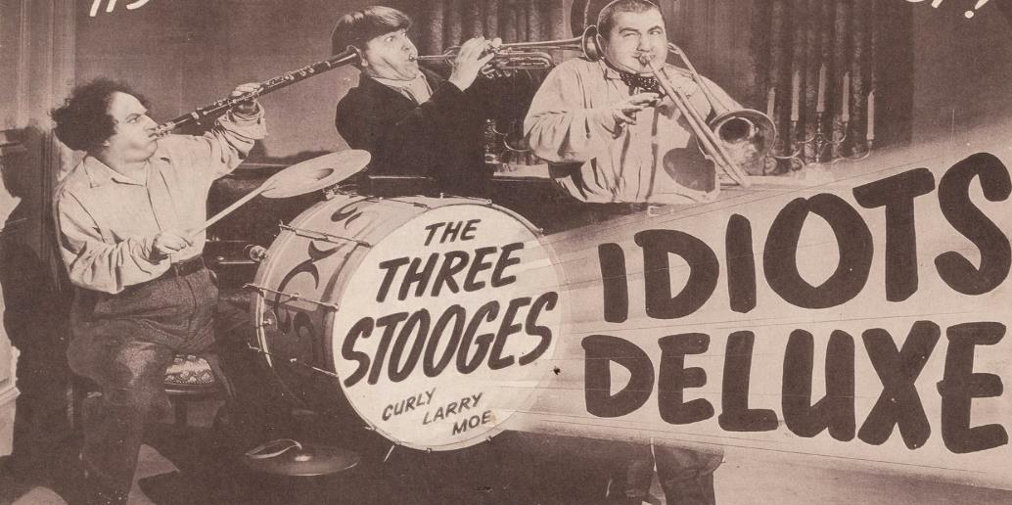
What Were They Thinking: How Judges Juries, Arbitrators (and Lawyers) Really Make Decisions
Chuck Ehrlich

Slide 2
Or: Why Do Things Go Upside Down?

Slide 3
Justice Scalia Explains The Problem
“While computers function solely on logic, human beings do not –”

Slide 4
Justice Scalia Explains The Problem
“Most of which you can do absolutely nothing about”

Slide 5
Justice Scalia Explains The Problem
“All sorts of extraneous factors — emotions, biases, preferences —can intervene”

Slide 6
Justice Scalia Explains The Problem
“Except play upon them, if you happen to know what they are.”

Slide 7
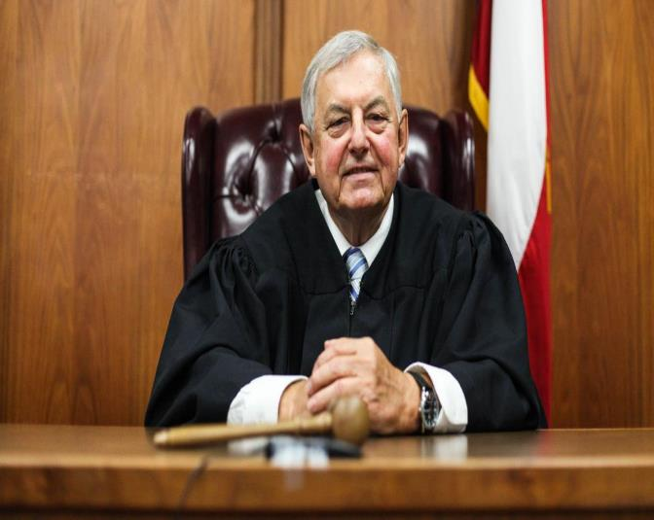
What Are These Unconscious Emotions, Biases, And Preferences?

Slide 8
And, What To Do About Them. . .

Slide 9
Hindsight Bias: It’s 20/20

Slide 10
Hindsight Bias Tells Us: If It Happened, It Was Foreseeable

Slide 11
Decision Not To Build A Flood Control Project: Negligent Or Reasonable?

Slide 12
Half Of Judges Are Told There Later Was A Flood

Slide 13
Half the Judges Don’t Know About The Flood

Slide 14
Don’t Know About The Flood: 76% Say The Decision Was Reasonable

Slide 15
Know About The Flood: 57% Say The Decision Was Not Reasonable

Slide 16
Hindsight Bias Turns The Result Upside Down

Slide 17
Super Bowl XLIX
Patriots Lead Seattle By Four Points
Seattle Ball On The Patriot One Yard Line
Thirty Seconds Left In The Game

Slide 19
Lesson: If It Went South On Your Watch, You Have The Real Burden of Proof

Slide 20
Remedy Part 1: Explain Hindsight Bias
“[We] should realize how dense and baffling is the veil of the Unknown.
Now in the full light of the after-time it is easy to see where we were
careless or clumsy.” Winston S. Churchill

Slide 21
Remedy Part 2: Make The Story Interesting

Slide 22
Remedy Part 3: Make The Story Human

Slide 23
Good vs. Evil

Slide 24
Federal Judges: Reverse War Crimes Conviction?

Slide 25
Scenario 1: Repented; Works For Reconciliation

Slide 26
Scenario 2: Still A True Believer

Slide 27
Once Again, Unconscious Bias Turns The Tables

Slide 28
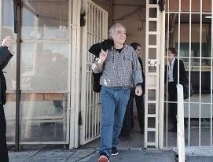
“Good Guy” Who Repented And Works For Reconciliation? 59% Reverse Conviction

Slide 29
”Bad Guy:” Still A True Believer? 87% Affirm Conviction

Slide 30
Lesson: Put Your Client In The Right

Slide 31
Again: Humanize The Client
Not “Gargantua Insurance Company”
Instead, ”the Roberta Jones Claim Team”

Slide 32
Humanizing

Slide 33
Explain the Logic Behind Your Position
Why is a one week leak covered but a two week leak is not?

Slide 34
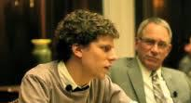
Prepare The Witnesses Mercilessly

Slide 35
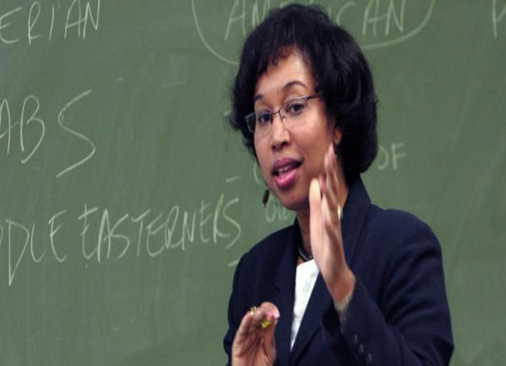
Use An Expert
The expert can tell a coherent, logical story

Slide 36
Anchoring Bias: Taking You Where You Don’t Want To Be

Slide 37
Non-Catastrophic Personal Injury Case

Slide 38
The Panel of Judges
Half Are Told: “Plaintiff Demands $10,000,000”
Half Are Told: “Plaintiff Demands A Lot of Money”

Slide 39
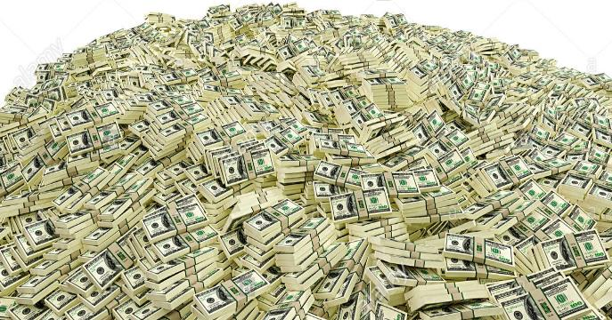
How Well Does the Anchor Work?
Anchor: $10,000,000
Average Award -- $2,210,000
Median Award -- $1,000,000

Slide 40
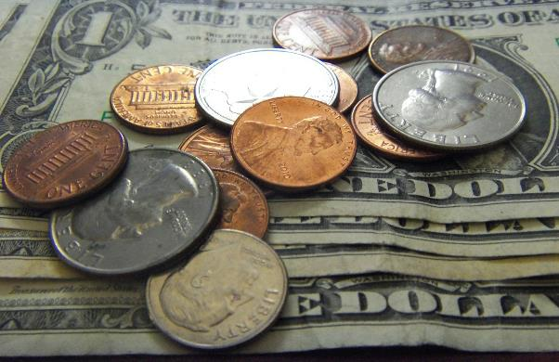
No Anchor: “Plaintiff Wants A Lot Of Money”
Average Award -- $808,000 (64% less)
Median Award -- $700,000 (30% less)

Slide 41
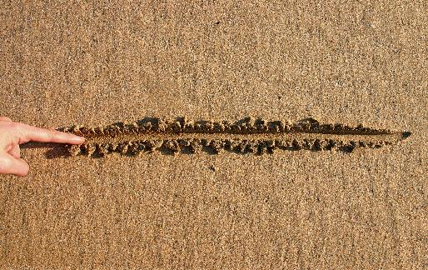
Lessons
Don’t let ”absurd” positions go unanswered
Establish your own “line in the sand.”

Slide 42
First Impression Bias aka Confirmation Bias

Slide 43
Did He Do It?

Slide 44
Hold On A Minute – There’s Another Suspect!
Suspect #2

Slide 45
What Happened?

Slide 46
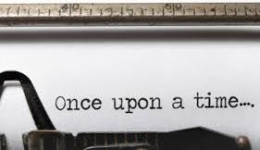
Remedy: Tell Your Story At The First Chance

Slide 47
Remedy: Be Very Careful About Holding “Good Stuff” In Reserve

Slide 48
“I’m Super Fair” Bias Example: Can The Bell Be Unrung?

Slide 49
Personal Injury Case: Privileged(?) Document Is Bad For The Plaintiff

Slide 50
Half The Judges See The Document; Half Get A Description

Slide 51
“It’s Inadmissible”

Slide 52
Judges Didn’t See The Document
55% For Plaintiff

Slide 53
Judges Saw The Document
71% For Defendant

Slide 54
Once Again, Upside Down Result

Slide 55
Remedies
If at all possible, get someone else to decide admissibility
If your trier of fact may see a bad document: Plan for the worst
Don’t trust too much in “Fairness”

Slide 56
PART II: Biases That Trip Lawyers (plus Judges and Arbitrators)

Slide 57
Self-Serving Bias

Slide 58
Your Honor, Are You in The Top 50%?

Slide 59
How Many Are In The Top 50%?

Slide 60
We All Think This Way
32% of employees are in the top 5%
94% of professors are in the top 50%

Slide 61
Result: The Feedback Loop

Slide 62
“We Are So Right!”

Slide 63
Until Things Go Upside Down

Slide 64
Confirmation Bias: Reinforcing Preconceptions

Slide 65
We Overweight The Favorable

Slide 66
And Discount The Unfavorable

Slide 67
And We Rationalize

Slide 68
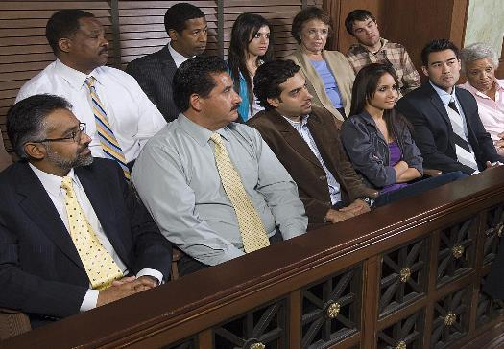
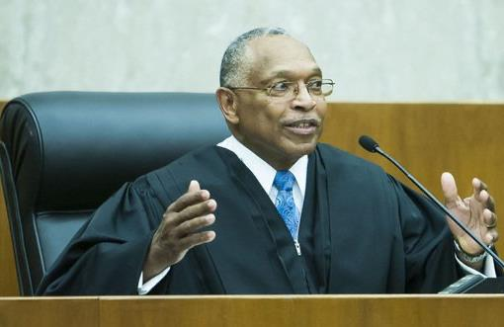
Real People React

Slide 69
Remedy: Find Your Blind Spots

Slide 70
How To Find Your Blind Spots #1 – Decision Tree

Slide 71
How To Find Your Blind Spots #2 – Get An Expert, Early

Slide 72
How To Find Your Blind Spots #3 – Mock Try Your Case

Slide 73
How To Find Your Blind Spots #4 – Do The Grandparents Test

Slide 74
Complexity Bias – That’s What We Do

Slide 75
= Boring

Slide 76
= CONFUSING

Slide 77
Strive For Simplicity

Slide 78
Lincoln Was A Lawyer: 272 Words

Slide 79
Make Your Outcome The “Right Outcome” (Scalia – “Emotions”)

Slide 80
Finally, “War of the Worlds” Bias

Slide 81
The Constant Food Fight

Slide 82
Every Issue Is Monumental

Slide 83
The Truth: A Weak Argument Is Not Criminal

Slide 84
The Truth: Crummy Answers To Interrogatories Are Not The End Of The World

Slide 86
Make It Easier

Slide 87
Build

Slide 89
Chuck’s Supplement To Justice Scalia
“While computers function solely on logic, human
beings do not. All sorts of extraneous factors —
emotions, biases, preferences — can intervene, most of
which you can do absolutely nothing about except play
upon them in others and avoid them yourself . . . .”

