Slide 1
Reinsurance of COVID-19 Claims:
The More Things Change, The More They Stay The Same
Jeff Burman, General Counsel, Fortitude Re
Christopher Foster, Partner, HFW
Corinne Kruse, VP, Head of Reinsurance Claims & Recoveries, Zurich North America
Cia Moss, Founding Partner, Chaffetz Lindsey LLP
May 6, 2021
3:40 – 4:30pm

Slide 2
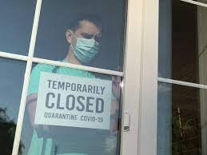
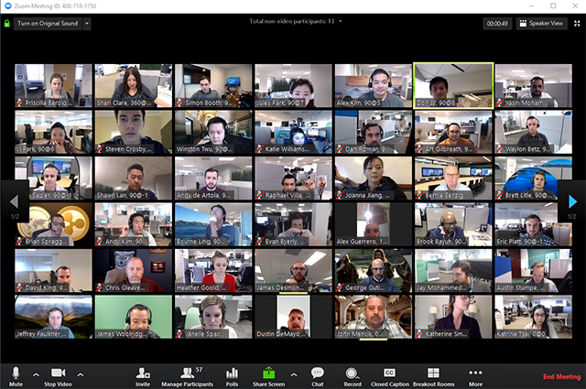
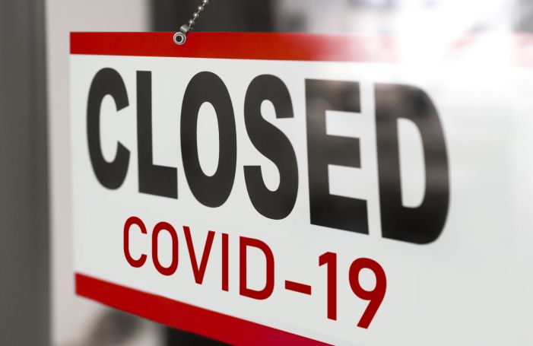

Slide 3
How Do Companies Approach This Type of Situation?
Review Reinsurance Contracts to determine possible coverage or coverage issues
Consult with LOB Department Heads to understand the potential exposure
Understand various contingencies and variables
Develop and manage communication plan
Gain knowledge from brokers, customers and other companies

Slide 4
The Position in England
Direct Coverage Update
General view that Coronavirus not physical damage, and losses caused by restrictions in any event
“Loss” means physical loss, not loss of use: TKC v Allianz
Focus therefore on non-damage BI extensions.
Standard disease extensions by list, and prevention of access/use (“POA”) clauses exclude disease reasons: Rockcliffe v Travelers

Slide 5
The Position in England
Direct Coverage Update
Some disease extensions for Notifiable Disease (“ND”); POA for “danger”/”emergency”; or hybrid of POA for ND
Majority of insuring clauses triggered by ND/danger within X miles of insured premises
Insurers’ position: losses not caused by anything within X miles, but by pandemic as a whole. Losses would have arisen regardless of disease within X miles and thus failure of “but for” causal test.

Slide 6
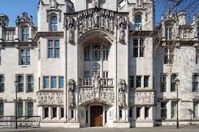
The Financial Conduct Authority vs. MS Amlin Underwriting Limited, et al. (“UK Test Case”)
Direct Coverage Update
Key Findings
“But for” test disapplied, as objectively parties would have understood disease would spread outside the area and no effective cover otherwise
Each case of Covid within country a separate and effective cause of restrictions and thus loss
“But for” test also disapplied for operation of trends clauses, overruling Orient-Express Hotels
However, no cover under POA clauses triggered by danger/emergency as required a local cause

Slide 7
The Financial Conduct Authority vs. MS Amlin Underwriting Limited, et al. (“UK Test Case”)
Direct Coverage Update
Case did not deal with, among other issues, aggregation. But in the context of the correct analysis of an occurrence in the insuring clauses, the Supreme Court used insurance/reinsurance aggregation authorities:
Per majority three:
67. The word “occurrence” . . . has a widely recognised meaning in insurance law which accords with its ordinary meaning as “something which happens at a particular time, at a particular place, in a particular way” . . . .
. . . .
69. A disease that spreads is not something that occurs at a particular time and place and in a particular way… Nor for that matter could an “outbreak” of disease be regarded as one occurrence....Still less could it be said that all the cases of COVID-19 in England (or in the United Kingdom or throughout the world) which had arisen by any given date in March 2020 constituted one occurrence. On any reasonable or realistic view, those cases comprised thousands of separate occurrences of COVID-19.
Per minority two:
323. . . . . Depending upon context, the word “occurrence” can properly be applied to happenings which do not take place at a single specified time, in a particular way and at a particular location. Thus a hurricane, a storm or a flood may properly be described as an occurrence even though each may take place over a substantial period of time, and over an area which changes over time. It is not in my view an inappropriate word to use about a pandemic disease as a whole, although I accept that it may be a pointer of some weight to an individual case analysis.

Slide 8
Test Case/Consolidated Arbitration – Pros and Cons

Slide 9
ANONYMOUS AUDIENCE POLL
Company Representatives: Would you agree to participate in a test case or consolidated arbitration?
Outside Counsel: Would you recommend that your client agree to participate in a test case or consolidated arbitration?

Slide 10
U.S. Case Law - Statistics
Direct Coverage Update
Rulings on the Merits in BI Cases (as of 4/27/21)
Motions for Summary Judgment
7 cases granting MSJ to policyholder (PA, OK, WA, NC state trial courts; N.D. Ohio)
7 cases denying MSJ to policyholder (all federal)
12 cases granting MSJ to Insurer(s) (6 state; 6 federal)
1 case denying MSJ to Insurer(s) (LA)
Key Takeaways
Federal Courts have granted approx. 93% of Insurers’ MTDs; state courts have granted 55%
Insurers have been successful in 92% of their MSJs; policyholders have been successful in 50% of their MSJs
COVID Coverage Litigation Tracker – https://cclt.law.upenn.edu/judicial-rulings/

Slide 11
U.S. Case Law – Appeals Pending
Direct Coverage Update
Over 100 cases on appeal in U.S. State and Federal Courts
No State’s highest court has considered the issue
Ohio Supreme Court has agreed to answer certified question from N.D. Ohio
“Does the general presence in the community or on surfaces at a premises, of the novel coronavirus known as SARS-CoV-2, constitute direct physical loss or damage to property; or does the presence on a premises of a person infected with COVID-19 constitute direct physical loss or damage to property at that premises?”
Highest court to consider is the 8th Circuit – Oral Argument held April 14, 2021
Insured’s “all-risk” defined “loss” as “accidental physical loss or accidental physical damage”
District Court held that virus-related closures of business do not amount to direct loss to property – no coverage. Oral Surgeons, P.C. v. The Cincinnati Ins. Co., 491 F.Supp.3d 455, 456 (S.D. Iowa 2020)

Slide 12
U.S. Case Law – Standard Clauses
Direct Coverage Update
Sample Policy Language
Business Interruption We will pay for the actual loss of Business Income you sustain due to the necessary suspension of your “operations” during the “period of restoration”. The suspension must be caused by direct physical loss of or damage to property at the described premises. The loss or damage must be caused by or result from a Covered Cause of Loss.
Covered Causes of Loss: Direct physical loss unless the loss is excluded or limited under Section I – Property

Slide 13
U.S. Case Law
Direct Coverage Update
Ungarean, DMD v. CAN, 2021 WL 1164836 (Pa. Ct. Com. Pl. Mar. 25, 2021)
Granting Policyholder Motion for Summary Judgment
“The concepts of ‘loss’ and ‘damage’ are separated by the disjunctive ‘or,’ and, therefore, the terms must mean something different from each other. Accordingly, in this instance, the most reasonable definition of ‘loss’ is one that focuses on the act of losing possession and/or deprivation of property instead of one that encompasses various forms of damage to property . . . . Applying this definition gives the term ‘loss’ meaning that is different from the term ‘damage.’”
Ungarean, DMD, 2021 WL 1164836, at *6 (emphasis added)

Slide 14
U.S. Case Law – Standard Clauses
Direct Coverage Update
Does the policy cover loss without property damage?
Pandemic Event Endorsement (SCGM, Inc. v. Certain Underwriters at Lloyd’s – S.D.Tex 2020)
Coverage for a “Pandemic Event”, defined as “the announcement by a Public Health Authority that a specific Covered Location is being closed as a result of an Epidemic declared by the CDC or WHO.”
“Epidemic” defined as “as occurrence of a Covered Disease”
Endorsement specifically enumerates 25 “Covered Diseases”
COVID-19 not included – but (SARS-CoV) listed
ISO Coronavirus Endorsements
Production Stop: “interruption, postponement or cancellation of an insured production as a direct result of the action of a Civil or Military Authority ….”

Slide 15
Reinsurance Issues
Reinsurance Issues and How Current Precedents May Guide Resolution
Is it a covered claim?
How is Occurrence defined?
“Natural Peril”?
How much is covered?
Limits/deductibles?
Can losses be aggregated?
Hours Clause?
Reinstatement?
Other Issues?
Regulatory/Judicial Changes
Follow the Settlements / Ex Gratia

Slide 16
Is it a Covered Claim?
Reinsurance Issues and How Current Precedents May Guide Resolution
Sample “Loss Occurrence” Clauses
The term “each and every Loss Occurrence” shall be understood to mean each and every loss and/or catastrophe and/or calamity and/or disaster and/or occurrence and/or series thereof arising out of one event.
All insured losses which arise directly from the same cause and which occur during the same period of time and in the same area.
All individual losses arising out of and directly occasioned by one catastrophe.
[E]ach and every accident, occurrence and/or causative incident, it being further understood that all loss resulting from a series of accidents, occurrences, and/or causative incidents having a common origin and/or being traceable to the same act, omission, error and/or mistake shall be considered as having resulted from a single accident, occurrence and/or causative incident.
An Event shall include all insured losses which arise directly from the same cause and which occur during the same period of time and in the same area. . . . Such cause is understood to be the peril which directly occasions the losses or where there are several perils which, in an unbroken chain of causation, have occasioned the losses, the peril which triggered the chain of causation.
Communicable Disease event: [Contingency Cat XL]
In the event of a communicable disease outbreak, and under the order of the World Health Organisation, the Centre for Disease Control or local government restricting the movement of people or animals resulting in the cancellation, abandonment or postponement of events, these would be aggregated and classified as one catastrophe without time or geographical limitation.

Slide 17
What is the Occurrence/Event/Cause?
Reinsurance Issues and How Current Precedents May Guide Resolution
Each Individual Case of COVID-19?
Identification of virus? Virus Outbreak?
First detectable case of COVID-19 in China in November 2019
Virus first identified in December 2019 in Wuhan, China, when the Chinese Health officials inform the WHO of a cluster of 41 patients with mysterious pneumonia
CDC Confirms First US Coronavirus Case (Jan. 21, 2020)
WHO Issues Global Health Emergency (Jan. 31, 2020)
US Declares Public Health Emergency (Feb. 3, 2020)
WHO Declares COVID-19 a Pandemic (March 11, 2020)
Government / Civil Authority Shutdowns or Orders?
Chinese authorities place the city of Wuhan under quarantine (January 23, 2020)
States start issuing Stay at Home Orders – California (March 19, 2020)
Italy Prime Minister issued national lockdown (March 9, 2020)
UK lockdowns: first (March 23, 2020), second (Oct. 31, 2020), or third (Dec. 20, 2020)

Slide 18
What is the Occurrence or Event?
Reinsurance Issues and How Current Precedents May Guide Resolution
English Law
Distinguish between event and cause based aggregation
Cause permits a wide search for aggregating factor, which can be a state of affairs.
Event synonymous with occurrence
Something happening at a particular place, time, particular way.
Use of “unities test” as guidance (cause, locality, time, human intent)
Informed observer in position of insured.
Context of policy important (see, for example, 9/11 decisions).
No need for event to be proximate cause, but not too remote.

Slide 19
What is the Occurrence or Event?
Reinsurance Issues and How Current Precedents May Guide Resolution
English Law
Issue with Supreme Court finding that pandemic cannot be an event
But distinguish Cat XL cover, which already envisages hurricanes etc can be events
No reason therefore why pandemic cannot be the relevant event
Competent authority action can be, albeit then geographically limited
What of later variations/new lockdowns?
Part and parcel of original event?
Commercial Union v Midland Mainline
IF v Silverseas

Slide 20
What is the Occurrence or Event?
Reinsurance Issues and How Current Precedents May Guide Resolution
U.S. Law
Majority view – “Cause” Test
What is the underlying “cause” (or “causes”) of the damage?
Is there a proximate, uninterrupted, and continuing cause that resulted in all of the injuries or damages?
Minority view – “Effects” Test
What are the injuries, damages, or effects resulting from the cause?
Other
What is the “liability-triggering event”? (variation of “cause” test) (TX, WV)
The “Unfortunate Event” Test (NY, CT)

Slide 21
ANONYMOUS AUDIENCE POLL
What is the Occurrence or Event?
Each Individual Case of COVID-19?
Identification of the Virus / Virus Outbreak?
WHO Issues Global Health Emergency (Jan. 31, 2020)?
WHO Declares COVID-19 a Pandemic (March 11, 2020)?
Government / Civil Authority Shutdowns or Orders?
Other?

Slide 22
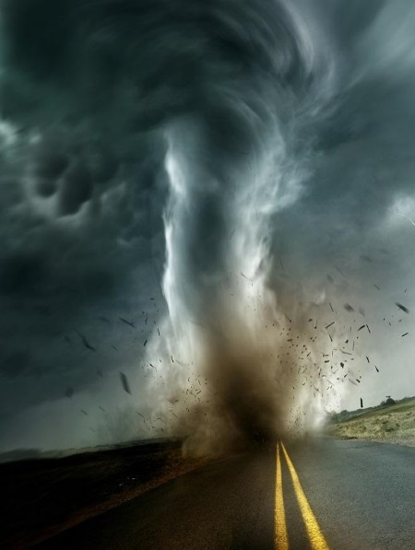
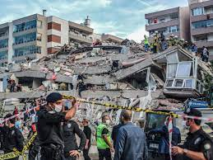
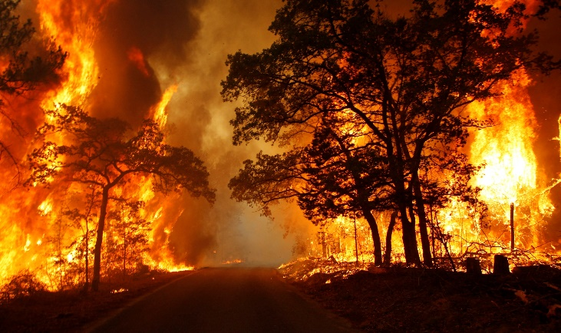
Does COVID-19 Qualify as a “Natural Peril”
Reinsurance Issues and How Current Precedents May Guide Resolution
Argument(s) For:
Virus is a naturally occurring disease
Not a “man-made” phenomenon
Argument(s) Against:
Natural perils are more akin to forces of nature like earthquakes or hurricanes
Disease is transmitted human to human
International Market practice seems to reflect this understanding

Slide 23
Does COVID-19 Qualify as a “Natural Peril”
Reinsurance Issues and How Current Precedents May Guide Resolution
U.S. Cases
Friends of Danny Devito v. Wolf, 227 A.3d 872, 888 (Pa. 2020) (COVID-19 Qualified as a “natural disaster” under PA Emergency Management Services Code as “other catastrophe which results in . . . hardship, suffering or possible loss of life.”)
Easom v. US Well Svcs, Inc., 2021 WL 1092344 (S.D. Tex. Mar. 19, 2021) (“COVID-19 also qualifies as a ‘natural’ disaster because human beings were not responsible for starting or consciously spreading the virus.”)
JN Contemporary Art LLC v. Phillips Auctioneers LLC, 2020 WL 7405262, at *7 n.7 (S.D.N.Y. Dec. 16, 2020) (reviewing various dictionary definitions of natural disaster and finding “[i]t cannot be seriously disputed that the COVID-19 pandemic is a natural disaster.”)
Casey v. Lamont, 2021 WL 1181937, at *5 (Conn. Mar. 29, 2021) (“[B]y any reasonable measure, the COVID-19 pandemic certainly fits the dictionary definition of catastrophe.”)
But see Jada Restaurant Group, LLC v. Acadia Ins. Co., 2020 WL 5362071, at *3 (W.D. Tex. Sep. 8, 2020) (“Virus” is not a “force of nature” for purpose of Tex. Ins. Code, Ch. 542)

Slide 24
Can You Aggregate Losses?
Reinsurance Issues and How Current Precedents May Guide Resolution
Sample Hours Clauses
The duration and extent of any one ‘Loss Occurrence’ shall be limited to all individual losses sustained by the Company occurring during any period of 168 consecutive hours arising out of and directly occasioned by the same event . . . .
The duration and extent of any one ‘Loss Occurrence’ shall be limited to all individual losses sustained by the Company occurring during any period of 336 consecutive hours arising out of, caused by, occasioned by or resulting from the same event and all events/perils ensuing therefrom . . . .
The duration and extent of any Loss Occurrence shall be limited to:
72 consecutive hours as regards hurricane, typhoon, windstorm, rainstorm, hailstorm and/or tornado …. 504 consecutive hours for any Loss Occurrence of whatsoever nature which does not include individual loss or losses from any of the perils mentioned . . . above.
The term “loss occurrence” shall mean all individual losses sustained by the Reinsured during any period of 168 consecutive hours arising out of and directly occasioned by the same event which, with respect to United States losses, Mexican losses and/or Canadian losses, occurs within the area of one state of the United States or Mexico or province of Canada and states or provinces contiguous thereto and to one another.

Slide 25
Can You Aggregate Losses? – Hours Clause
Reinsurance Issues and How Current Precedents May Guide Resolution
English Law / US Law
English Law
No authorities
Market practice on BI to treat hours clause as applicable to property damage, with all BI losses from such picked up during the full indemnity period.
Here more difficult as “deemed damage” continuing
Competent authority action within causal chain and not intervening cause.
All losses treated as arising at the time of such action and within hours (Test Case suggests indemnity period runs from date of first loss)?
U.S. Law
Language of reinsurance treaty
Compare Travelers Cas. & Sur. Co. v. Certain Underwriters at Lloyd’s of London, 96 N.Y.2d 583 (N.Y. 2001) with Hartford Accident & Indem. Co. v. Ace American Reins. Co., 936 A.2d 224 (Conn. 2007)

Slide 26
Other Reinsurance Issues
Reinsurance Issues and How Current Precedents May Guide Resolution
Regulatory / Judicial Changes: Proposed Legislations
2020
11 states and Puerto Rico had proposed legislation addressing BI insurance policies: CA, IL, LA, MA, MI, NJ, NY, OH, PA, RI, SC, and Puerto Rico
2021
Currently 7 states have pending legislation: NJ, NY, OR, PA, RI, TX, WA
https://www.ncsl.org/research/financial-services-and-commerce.aspx

Slide 27
Other Reinsurance Issues
Reinsurance Issues and How Current Precedents May Guide Resolution
Regulatory / Judicial Changes: Sample Language
The liability of the Reinsurer shall follow that of the Company in every case, including any regulatory changes, policy reformation or judicial interpretation.
[S]hould any arbitration panel or any judicial, regulatory or legislative entity having legal jurisdiction invalidate any term or exclusion in the Company's policy, any amount of loss for which the Company is liable because of such invalidation shall not be excluded hereunder.
In the event of any change to the legal or regulatory texts in force during the Period of this Contract, by which the Reinsurers' liability, rights and obligations are materially modified, the Reinsured and Slip Leaders hereto agree to take up for immediate discussion a suitable revision in the terms of this Contract. Failing to agree… this Contract shall then operate following the legal or regulatory texts in force at the date of inception of this Contract.

Slide 28
Other Reinsurance Issues
Reinsurance Issues and How Current Precedents May Guide Resolution
Follow the Settlements
Ex Gratia
Extra-contractual Issues
Reinstatements
Limits/Sub-limits/Deductibles
Other?

Slide 29
QUESTIONS?

Slide 30
THANK YOU
Jeff Burman, General Counsel, Fortitude Re
Christopher Foster, Partner, HFW
Corinne Kruse, VP, Head of Reinsurance Claims & Recoveries, Zurich North America
Cia Moss, Founding Partner, Chaffetz Lindsey LLP

