Slide 2
The Explosion in Ransomware Cyber Attacks and Its Impact on the Industry
Nov 3, 2021
Presented by: Jane Downey & Mary O’Leary Dronson

Slide 3
Agenda
Evolution of Cyber Insurance
Recent Ransomware Claim Examples
Colonial Pipeline
Solar Winds
CNA
Coverage details
Reinsurance Considerations

Slide 4
Evolution of True Cyber Liability Insurance
Computer crime bolt on to Bankers Blanket Bond (Fidelity) for brokers/dealers on Wall Street.
InsureTRUST Broker Steve Haase-1997 AIG Issued Internet Security Liability Policy-focus was on hacking and compliance with State Laws on Breach Notification.
Some cover found in fidelity and advertising liability coverage in the CGL but leaves many exposures uninsured.

Slide 5
Ransomware Cyber attack shuts down a major fuel pipeline system spanning from Texas to the East Coast. $4.4 M ransom payment. Some has been recovered (keeping in mind this is not inclusive of business interruption or extra expense). The FBI confirmed that the culprit is a strain of ransomware called DarkSide, believed to be operated by a Russian cybercrime gang referred to by the same name.
Colonial Pipeline – 5/8/2021

Slide 6
Solar Winds – 12/13/2020
Advanced persistent threat (APT) actors infiltrated the supply chain of SolarWinds, inserting a backdoor into the product.
As customers downloaded the Trojan Horse installation packages from SolarWinds, attackers were able to access the systems running the SolarWinds product(s).
The SolarWinds attack remains one of the most far-reaching and widly publicized cyber espionage events to date.

Slide 7
CNA – 3/21/2021
$40M ransom payment paid (not inclusive of business interruption or extra expense costs)
Crippled CNA’s ability to conduct business
Major US insurer confirmed it was a victim of a ransomware attack.

Slide 8
Today’s Cyber Liability Insurance Coverage
Breach Response: Notified Individuals; Legal, Forensic, PR and Crisis Management; Additional Breach Response Limit
First Party Loss: Business Interruption (BI) Security Breach; BI System Failure; Dependent BI Security Breach; Dependent BI System Failure; Cyber Extortion Loss; Data Recovery Costs
Liability: Data & Network Security; Regulatory Defense & Penalties; Payment Card Liabilities & Costs; Media Liability
E-Crime with Criminal Reward Coverage: Fraudulent Instructions; Funds Transfer Fraud; Telephone Fraud

Slide 9
Reinsurance Considerations
Increase in Demand
Bigger Premiums
Larger losses
Risk transfer

Slide 10
Reinsurance Treaty Basic Wording
“Loss Occurrence” means the sum of all individual
losses directly occasioned by any one disaster, accident or loss arising out of a single covered event.
The duration and extent of any one Loss Occurrence shall be limited to all individual losses sustained by the Company occurring during any period of 72 consecutive hours arising out of and directly occasioned by the same event.

Slide 11
Reinsurance Treaty Basic Wording
This type of treaty covers both 1st party and 3rd party liability.
The clash cover is provided for instances when there is a cyber loss to more than one policyholder.
The Loss Occurrence definition is utilized as the aggregating language for that clash cover.

Slide 12
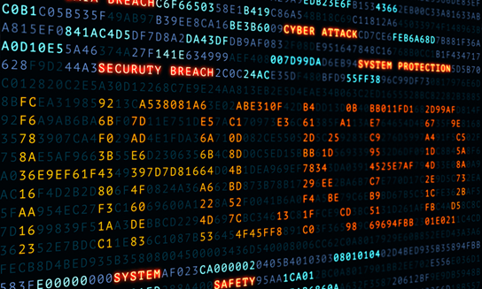
Business Insurance Breaking News 10/26/21
(Reuters) — The U.S. State Department plans to establish a bureau of cyberspace and digital policy in the face of a growing hacking problem, specifically a surge of ransomware attacks on U.S. infrastructure.
A State Department spokesman said a Senate-confirmed ambassador at large will lead the bureau.
Hackers have struck numerous U.S. companies this year.
One such attack on pipeline operator Colonial Pipeline led to temporary fuel supply shortages on the U.S. East Coast. Hackers also targeted an Iowa-based agricultural company, sparking fears of disruptions to Midwest grain harvesting.
Two weeks ago the Treasury Department said suspected ransomware payments totaling $590 million were made in the first six months of this year. It put the cryptocurrency industry on alert about its role fighting ransomware attacks.
The spokesman said the State Department will also establish a new special envoy for critical and emerging technology “to lead the immediate technology diplomacy agenda.”

Slide 13
Questions?

