Slide 2
Gaining Deliberation Insight: Understanding What Really Goes On Behind The Curtain and Why It Matters
November 3, 2021

Slide 3
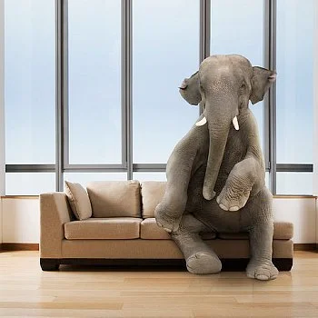

Slide 5
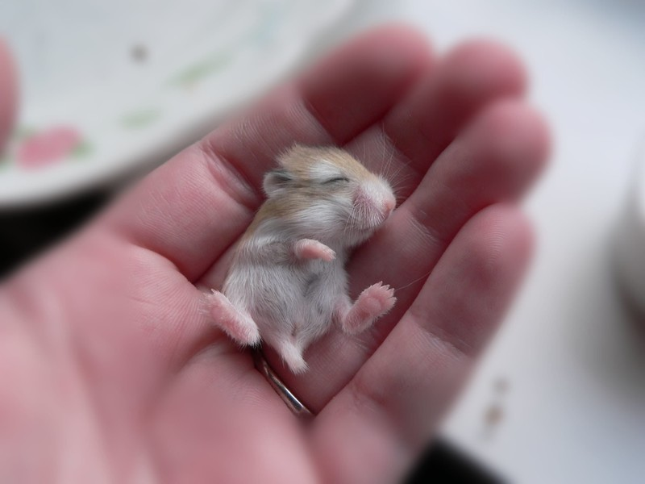

Slide 6
