Slide 1
#ARIASUS • www.arias-us.org

Slide 2
NEW ARBITRATOR FORUM
November 2, 2021

Slide 3
DISCLAIMER
The content of these materials is not intended as legal advice and you should not consider it as such. This content may not reflect the views of the speakers, or their firms, organizations or clients, and should not be attributed to them.
The information provided is subject to change without notice, and use of these materials is at your own risk. The materials are provided without representation or warranty regarding the accuracy or completeness of these materials or whether the materials are reliable, up-to-date or applicable to any particular situation. We expressly disclaim all liability for actions taken or not taken based on the materials or for any resulting damages.
The use of any trademark, copyright, or individual or company name or image in this presentation is for education purposes only and does not imply any association, sponsorship or endorsement by that individual or company. All trademarks and copyrights are the sole and exclusive property of their original owners.
ARIAS•U.S. 2021 Fall Conference | Nov 2-3, 2021 | New York, NY | www.arias-us.org

Slide 4
New Arbitrator Forum:
Getting, Vetting and Setting Into Appointments
Suzanne Fetter, Arbitrator
Ann Field, Aon
Peter Gentile, ARIAS•U.S.
Catherine Isely, Porter Wright Morris & Arthur LLP
Mark Megaw, ARIAS•U.S
ARIAS•U.S. 2021 Fall Conference | Nov 2-3, 2021 | New York, NY | www.arias-us.org

Slide 5
GETTING OPPORTUNITIES
ARIAS•U.S. 2021 Fall Conference | Nov 2-3, 2021 | New York, NY | www.arias-us.org

Slide 6
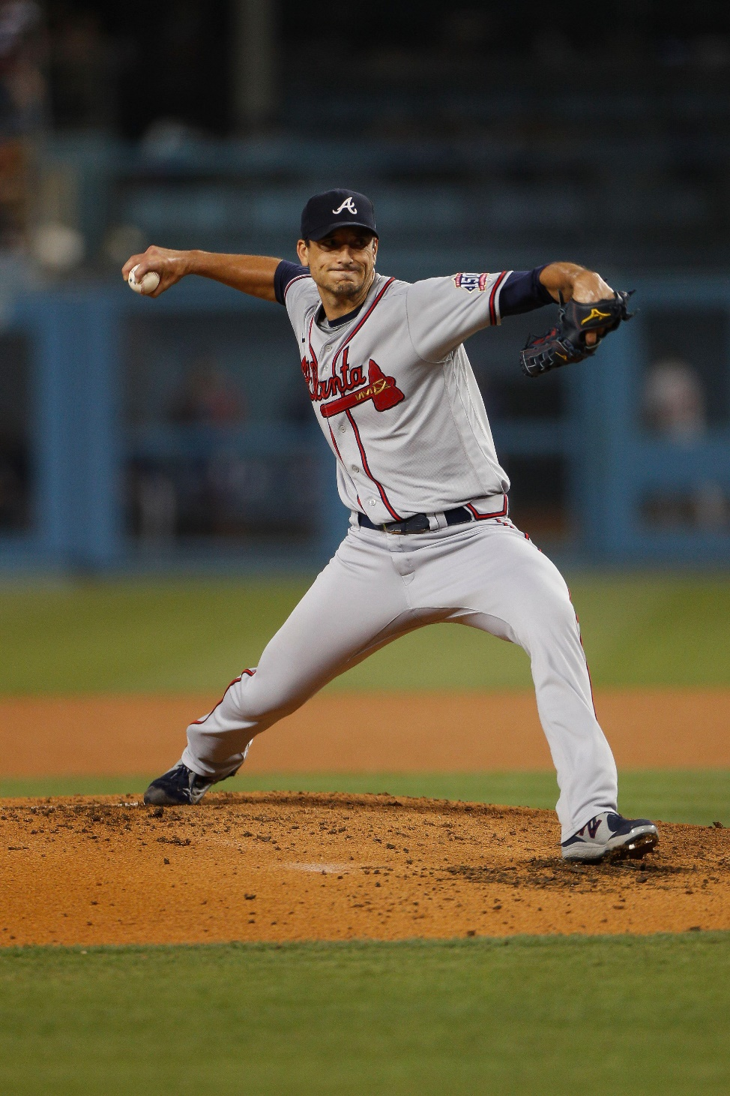
PROJECTING SKILLS
UPDATE HEADSHOT AND BIOGRAPHY
HIGHLIGHT EXPERTISE
VOLUNTEER FOR ARIAS-SPONSORED EVENTS AND PUBLICATIONS
STUDY ARIAS QUARTERLY
FIND A MENTOR!
ARIAS•U.S. 2021 Fall Conference | Nov 2-3, 2021 | New York, NY | www.arias-us.org

Slide 7
ARIAS•U.S. 2021 Fall Conference | Nov 2-3, 2021 | New York, NY | www.arias-us.org
THE CHALLENGE
PERSUASIVE
ETHICAL
ENGAGED
ORGANIZED
STRATEGIC
QUALIFIED
ARIAS•U.S. 2021 Fall Conference | Nov 2-3, 2021 | New York, NY | www.arias-us.org

Slide 8
THE CHALLENGE
ETHICAL
PERSUASIVE
QUALIFIED
EXPERIENCE
AND
REPUTATION
STRATEGIC
ORGANIZED
ENGAGED
ARIAS•U.S. 2021 Fall Conference | Nov 2-3, 2021 | New York, NY | www.arias-us.org
ARIAS•U.S. 2021 Fall Conference | Nov 2-3, 2021 | New York, NY | www.arias-us.org

Slide 9
THE CHALLENGE
ETHICAL
PERSUASIVE
QUALIFIED
EXPERIENCE
AND
REPUTATION
SUBJECT MATTER EXPERTISE
STRATEGIC
ORGANIZED
ENGAGED
ARIAS•U.S. 2021 Fall Conference | Nov 2-3, 2021 | New York, NY | www.arias-us.org

Slide 10
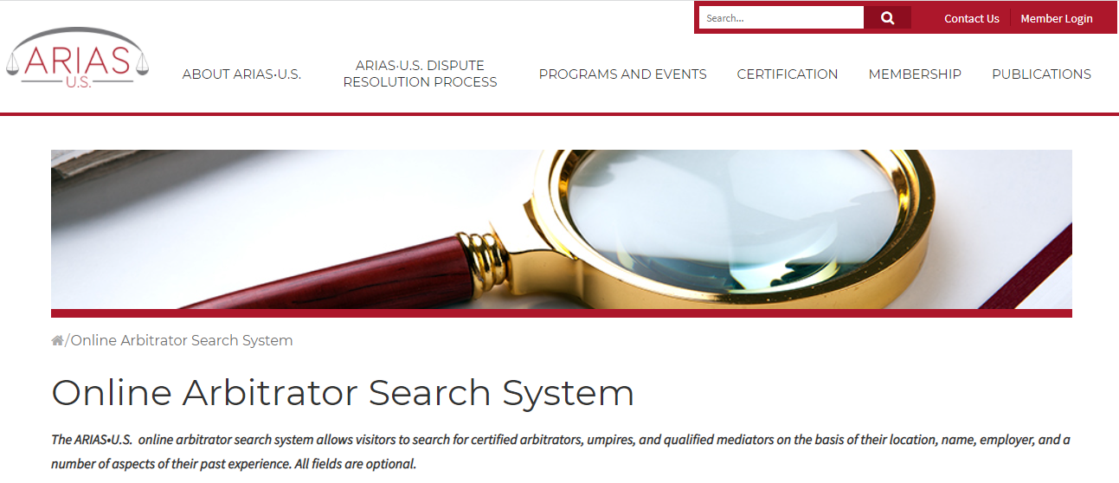
Show what you know
Online Arbitrator Search System
ARIAS•U.S. 2021 Fall Conference | Nov 2-3, 2021 | New York, NY | www.arias-us.org

Slide 11
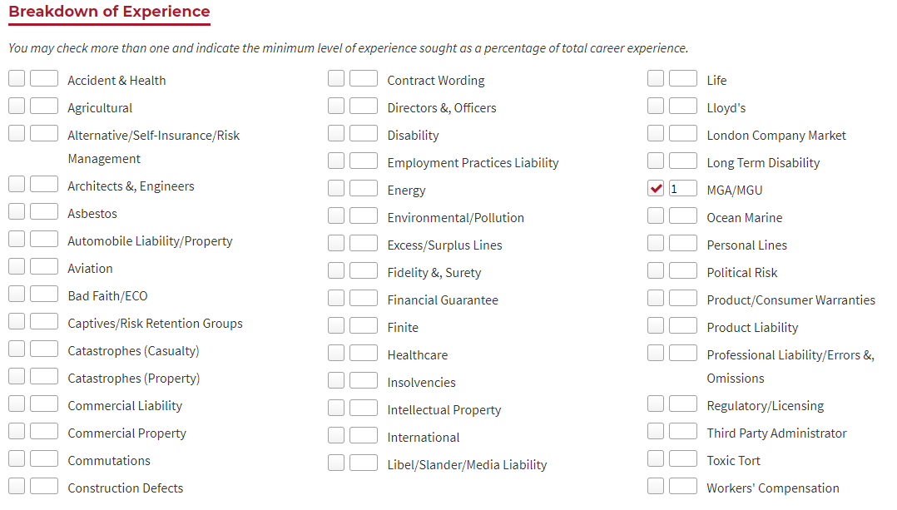
Your search returned 76 results.
ARIAS•U.S. 2021 Fall Conference | Nov 2-3, 2021 | New York, NY | www.arias-us.org

Slide 12
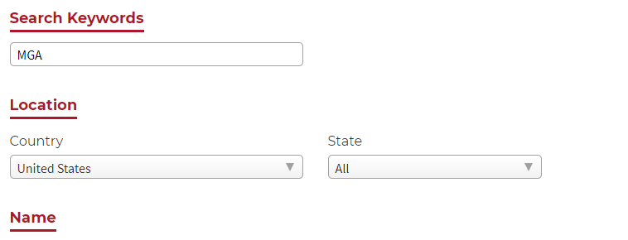
Your search returned 7 results.
ARIAS•U.S. 2021 Fall Conference | Nov 2-3, 2021 | New York, NY | www.arias-us.org

Slide 13
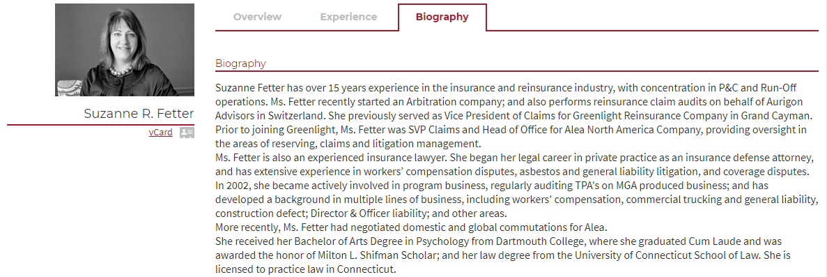
ARIAS•U.S. 2021 Fall Conference | Nov 2-3, 2021 | New York, NY | www.arias-us.org

Slide 14
ARIAS•U.S. 2021 Fall Conference | Nov 2-3, 2021 | New York, NY | www.arias-us.org

Slide 15
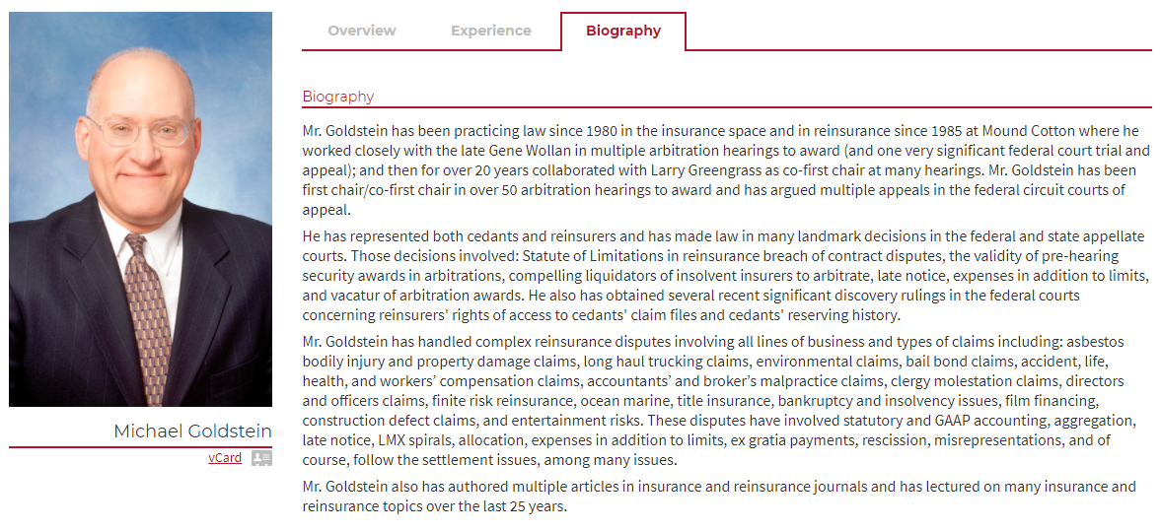
ARIAS•U.S. 2021 Fall Conference | Nov 2-3, 2021 | New York, NY | www.arias-us.org

Slide 16
PROJECTING CORE SKILLSETS
KNOW EVIDENTIARY RULES AND ARBITRATION
SERVE AS AN EXPERT
NOTE YOUR EXPERIENCE WITH SUB-LINES OF BUSINESS (e.g., WORKERS’ COMP)
SEE CANON III: COMPETENCE
ARIAS•U.S. 2021 Fall Conference | Nov 2-3, 2021 | New York, NY | www.arias-us.org

Slide 17
Canon IX:
Arbitrators shall be truthful in advertising services offered and their availability …
…a person may indicate a general willingness to serve as arbitrator and may not solicit a particular appointment.
Arbitrators shall make only…truthful statements about their skills and qualifications…
ARIAS•U.S. 2021 Fall Conference | Nov 2-3, 2021 | New York, NY | www.arias-us.org

Slide 18
MARKETING AS AN UMPIRE
ARIAS•U.S. 2021 Fall Conference | Nov 2-3, 2021 | New York, NY | www.arias-us.org

Slide 19
Practical tip: If you are hoping to be an umpire, it is dangerous to market based on your view of issues.
Spot the issue: Imagine an umpire candidate who writes an article that advocates for “full transparency in discovery.” Sounds laudable.
ARIAS•U.S. 2021 Fall Conference | Nov 2-3, 2021 | New York, NY | www.arias-us.org

Slide 20
Umpire marketing
Have you subconsciously locked yourself into a view?
The questionnaire will ask about articles.
Could facts impact your analysis?
ARIAS•U.S. 2021 Fall Conference | Nov 2-3, 2021 | New York, NY | www.arias-us.org

Slide 21
Vetting The Opportunity
Address Conflicts of Interest at the Outset of an Arbitration
Protect Confidentiality of Parties and Issues
ARIAS•U.S. 2021 Fall Conference | Nov 2-3, 2021 | New York, NY | www.arias-us.org

Slide 22
Keep good records
Consider all information that you may need some day
Prepare master worksheet
Maintain clean and consistent data
Umpire questionnaire arrives, Duplicate data in a separate sheet
Do periodic back-ups just in case
Keep it handy
Keep it updated
ARIAS•U.S. 2021 Fall Conference | Nov 2-3, 2021 | New York, NY | www.arias-us.org

Slide 23
Keep Good Records
Categories of Information to Track
Caption | Petitioner | Petitioner Parent Company | Respondent
Respondent Parent Company | Insurance or Reinsurance | Resolute? y/n | Questionnaire lists additional affiliates
Date Retained | Petitioner’s Arbitrator | Umpire | Respondent’s Arbitrator
OM Date | Hearing Date | Date Terminated | If Arb’r, Retained by What Firm and Which Attorneys?
Name of Petitioner’s In-House Representative(s)? | Name of Respondent’s In-House Representative(s) | Expert Witnesses/Key Witnesses | Final Award Issued? y/n
Case Completed at What Stage? | If Hearing, How Many Days? | Main Issues | Total Fees Earned
ARIAS•U.S. 2021 Fall Conference | Nov 2-3, 2021 | New York, NY | www.arias-us.org

Slide 24
Keep Good Records
Umpire questionnaire arrives, Duplicate data in a separate sheet
Petitioner | Respondent | Date Retained | Petitioner’s Arbitrator | Umpire | Respondent’s Arbitrator | Petitioner’s Attorney | Petitioner’s Attorney #2 | Petitioner’s Law Firm | Respondent’s Attorney | In-house Petitioner | In-house Respondent | Date Terminated | Final Award Issued?
Celebrated Ceding Company |  | 1/22/11 | Peter Gentile | Ann Field | Suzanne Fetter |  |  |  |  |  |  | 11/1/11 | No
 | Realistic Re | 3/1/12 |  | Ann Field |  |  |  |  |  |  | Cara Richardson | 6/15/12 | Settled before OM
Celebrated Ceding Company |  | 8/21/13 | Suzanne Fetter | Ann Field |  |  |  |  |  |  |  | 12/18/14 | No
 | Realistic Re | 10/23/14 |  | Ann Field | Peter Gentile |  |  |  |  |  |  | 5/9/15 | Yes
Celebrated Ceding Company |  | 1/29/15 | Ann Field | Mark Megaw |  |  |  |  |  |  |  | 9/8/16 | Yes
 |  | 2/20/19 | Ann Field |  |  | Catherine Isely | Teresa Snider | Porter Wright |  |  |  | pending | n/a
ARIAS•U.S. 2021 Fall Conference | Nov 2-3, 2021 | New York, NY | www.arias-us.org

Slide 25
SETTING INTO YOUR ROLE
ARIAS•U.S. 2021 Fall Conference | Nov 2-3, 2021 | New York, NY | www.arias-us.org

Slide 26
Serving as the umpire
Preparing for the Organizational Meeting
During the Organizational Meeting
Scheduling
During the Hearing
ARIAS•U.S. 2021 Fall Conference | Nov 2-3, 2021 | New York, NY | www.arias-us.org

