Slide 2
May It Please The Panel:
Thoughts on Enhancing Submissions by Counsel In Connection with Arbitration Hearings
Wednesday, November 3, 2021
#ARIASUS • www.arias-us.org

Slide 3
May It Please The Panel
Thoughts on Enhancing Submissions by Counsel In Connection with Arbitration Hearings
Wednesday, November 3, 2021

Slide 4
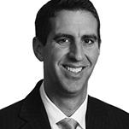
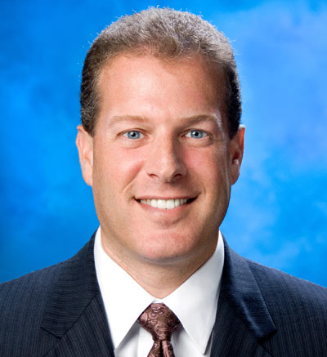
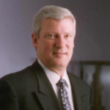
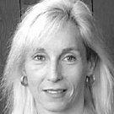
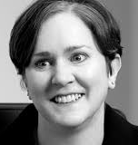
Meet Today’s Moderator & Panelists
May It Please the Panel: Thoughts on Enhancing Submissions by Counsel In Connection with Arbitration Hearings
Jack Vales
Partner, Dentons US LLP
Lloyd Gura
Partner, Mound Cotton
Bob Hall
ARIAS•U.S. Certified Arbitrator
Diane Nergaard
ARIAS•U.S. Certified Arbitrator
Cia Moss
Founding Partner,
Chaffetz Lindsey
Moderator
Panelist
Panelist
Panelist
Panelist

Slide 5
Breaking the Mold
May It Please the Panel: Thoughts on Enhancing Submissions by Counsel In Connection with Arbitration Hearings
What Are Some Potential Changes to the Ordinary Structure for Attorney Submissions?

Slide 6
The Arbitrators Speak
May It Please the Panel: Thoughts on Enhancing Submissions by Counsel In Connection with Arbitration Hearings
What Practices Should Counsel Follow or Avoid in Their Submissions?

Slide 7
Counsel Responds
May It Please the Panel: Thoughts on Enhancing Submissions by Counsel In Connection with Arbitration Hearings
What Practices by Arbitrators Enhance or Detract from the Presentation of Counsel Arguments?

Slide 8
Thank you for participating!

