Slide 1
2023 SPRING CONFERENCE
REPRESENTATIONS & WARRANTIES INSURANCE (“RWI”)

Slide 2
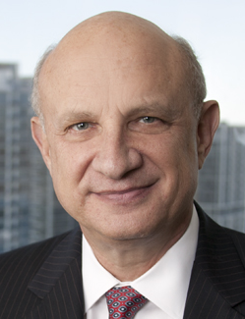
Marc Sherman, CPA, Esq
Bruce Berman, Esq.
Partner Alvarez & Marsal Washington DC office. Marc heads the reps & warranties area at A&M and spends 100% of his time advising on Reps & Warranties underwriting and claims globally and has consulted on hundreds of matters across the globe.
Shareholder Carlton Fields Miami office. Bruce is a corporate litigator representing insurers in RWI disputes in arbitrations and in court. He has tried two substantial arbitrations through final awards, is heading the defense of the Novolex case in New York State Supreme Court, and is currently a party-appointed arbitrator in a pending RWI case.

Slide 3
REPRESENTATIONS & WARRANTIES INSURANCE “RWI”
TODAY’S AGENDA
A primer on RWI, its evolution and underwriting
The RWI claims process
Litigating RWI claims in arbitration
Q&A

Slide 4
REPRESENTATIONS & WARRANTIES INSURANCE “RWI”
A Primer on RWI, its Evolution and Underwriting
What is Representations & Warranties Insurance
RWI vs W&I
Who is using it
Underwriting and its implications on disputes

Slide 5
REPRESENTATIONS & WARRANTIES INSURANCE “RWI”
The RWI Claims Process
Filing a claim
The claims adjustment process
Conclusion of the claims process
What is next?

Slide 6
REPRESENTATIONS & WARRANTIES INSURANCE “RWI”
Litigating RWI Claims in Arbitration
Dual tracked? w/continuing claim adjustment w/parallel fraud case against seller
Scope of arbitration (review or de novo?)
Number of arbitrators; selection; challenges

Slide 7
REPRESENTATIONS & WARRANTIES INSURANCE “RWI”
Litigating RWI Claims in Arbitration
Hearings: Procedural Considerations
Hearings: Substantive Issues
Post award issues

Slide 8
REPRESENTATIONS & WARRANTIES INSURANCE “RWI”
Q&A

