Slide 1
#ARIASUS • www.arias-us.org

Slide 2
Climate Change: Insurance and Insurance-Linked Securities Disputes
May 17, 2023
Amy J. Cassidy, Nicolaides Fink Thorpe Michaelides Sullivan LLP
David A. Coon, Selendy Gay Elsberg PLLC

Slide 3
General Discussion – Every Case Is Fact Specific This presentation expresses the opinions of the author/presenter and does not necessarily reflect the views of Nicolaides Fink Thorpe Michaelides Sullivan LLP, Selendy Gay Elsberg PLLC, or their clients.

Slide 4
Climate Change Science

Slide 5
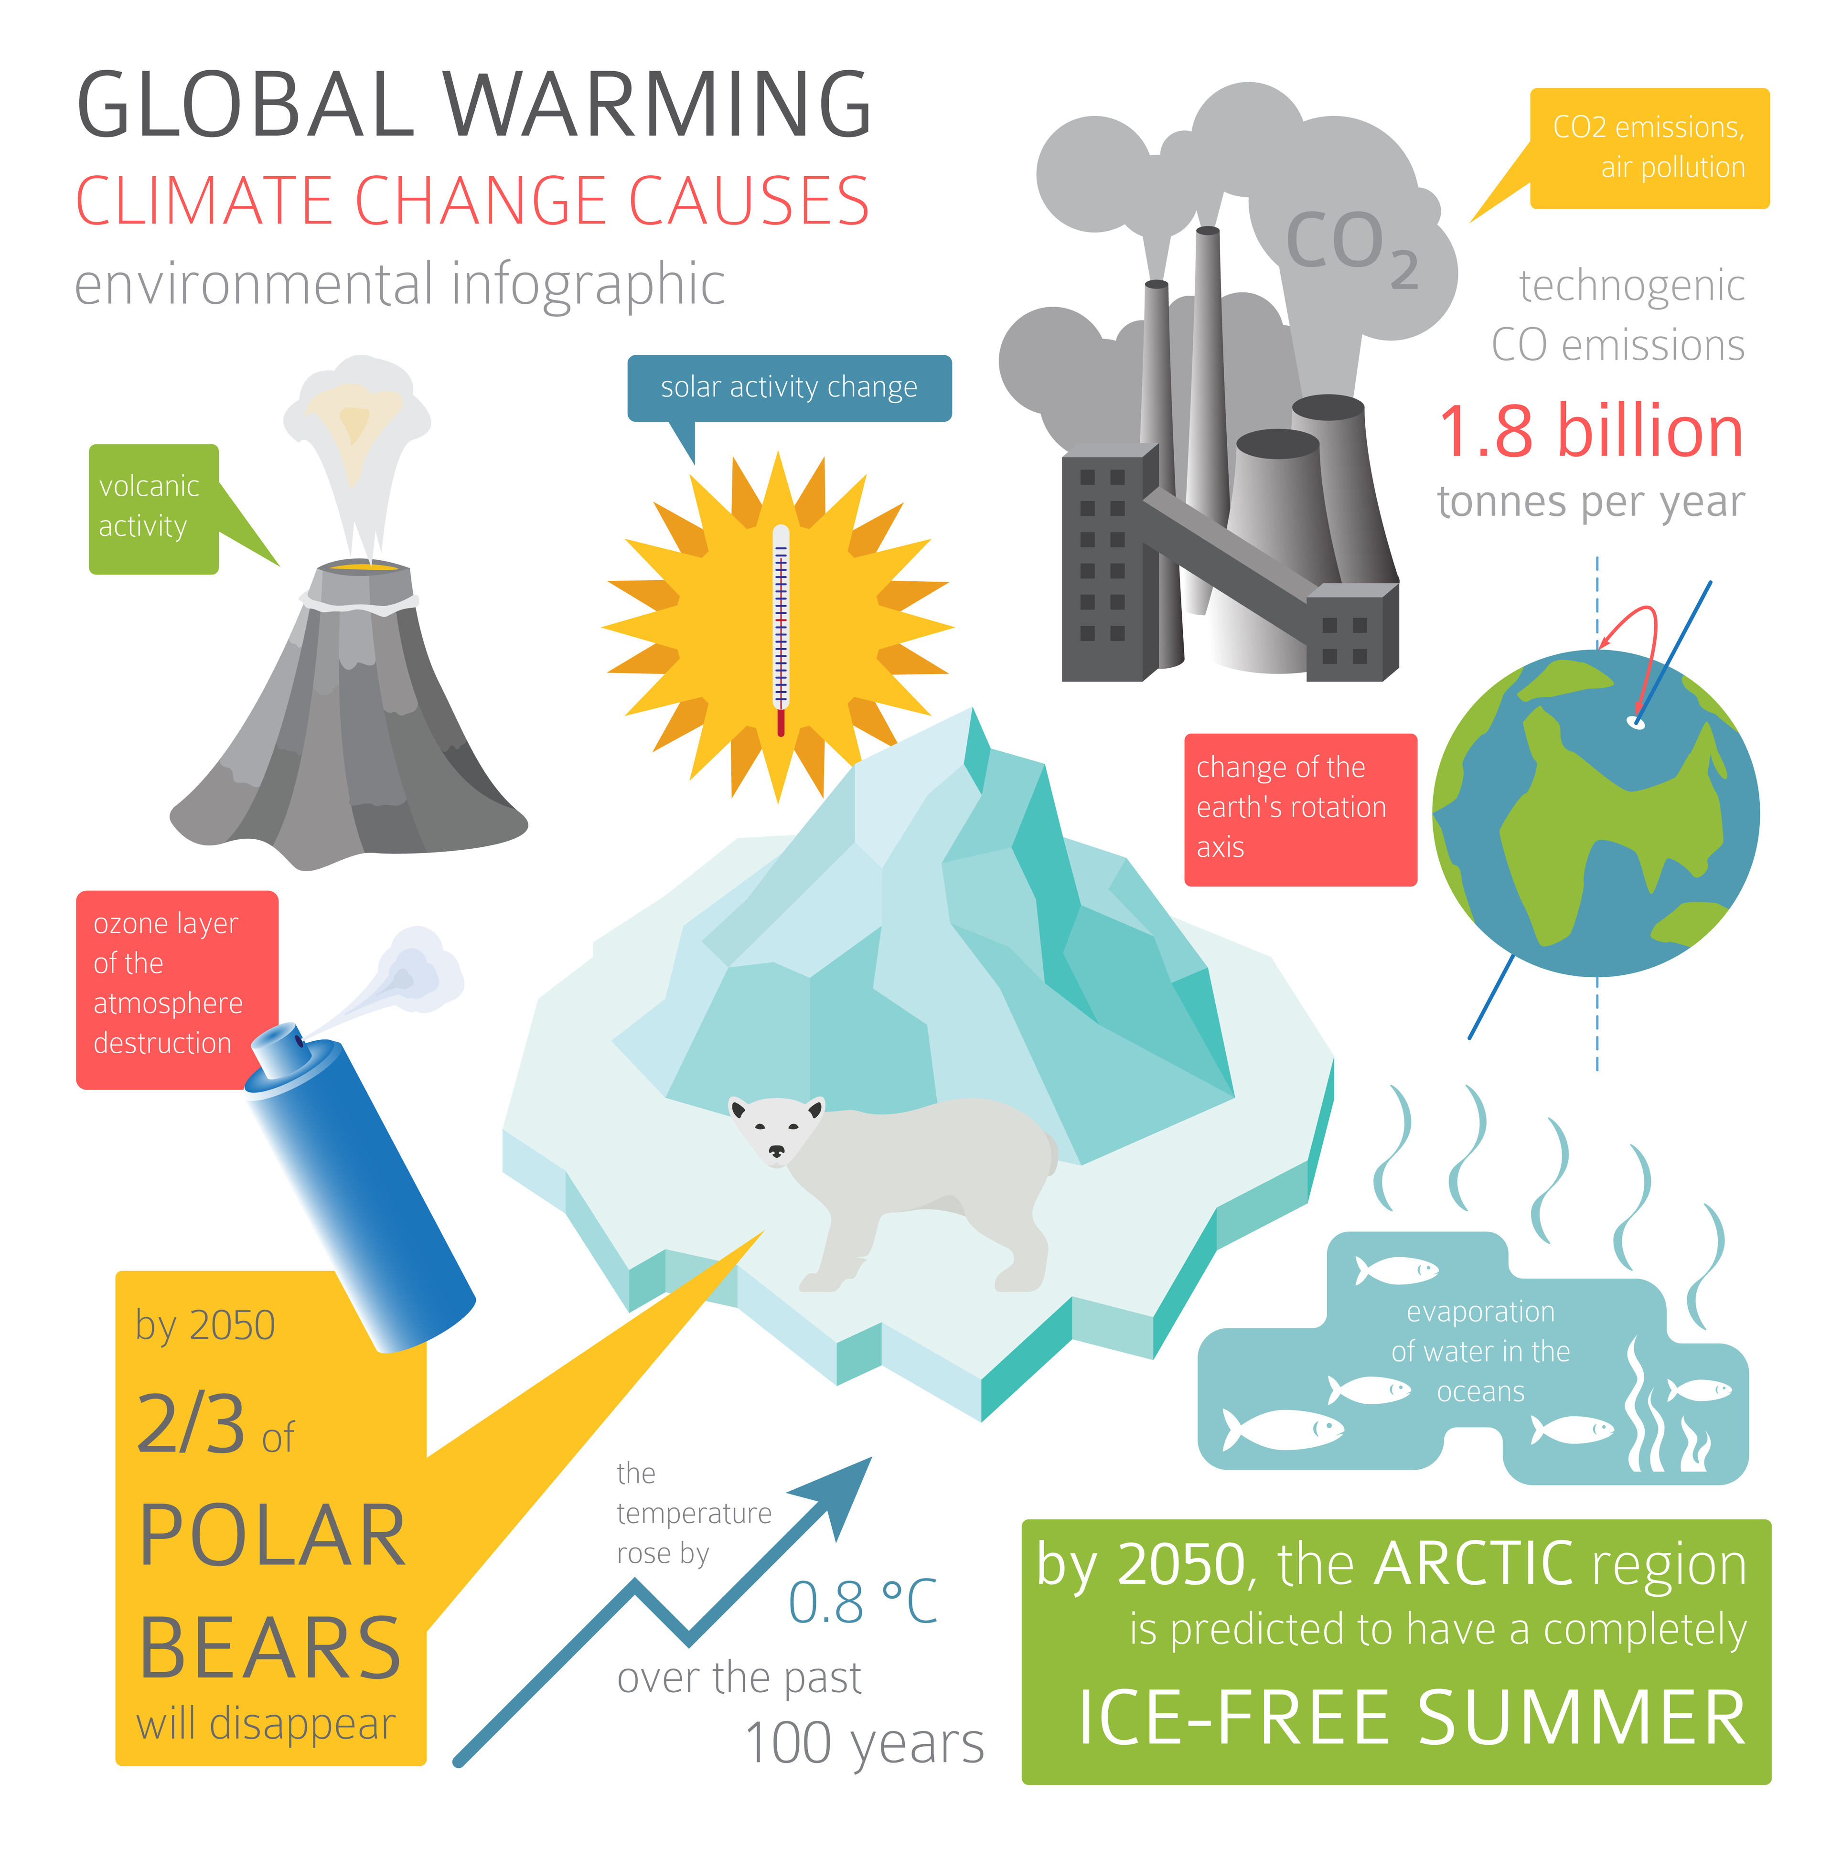
Climate Change
Photo by a7880ss/Adobe Stock; used with permission.
CLIMATE CHANGE = broad range of global phenomena created predominantly by fossil fuels
(including global warming, sea level rise, ice mass loss, shifts in flower/plant blooming, and extreme weather events)
— NASA

Slide 6
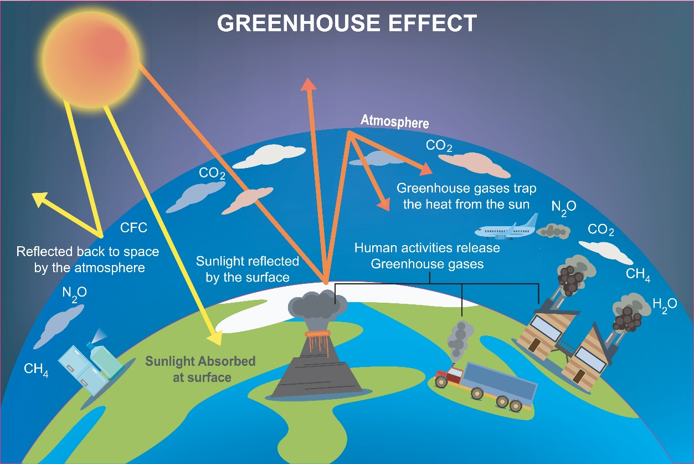
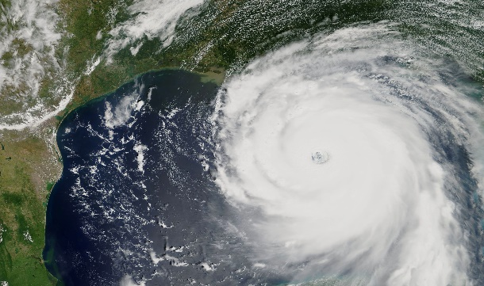
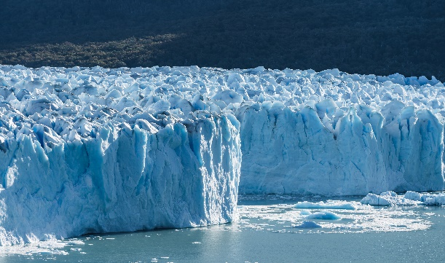
Climate Change Science
Photo by Nandalal/Adobe Stock; used with permission.
Burning fossil fuels (oil, natural gas, and coal) adds excess greenhouse gases to Earth’s atmosphere, preventing heat from escaping into space and increasing temperatures.
This leads to sea level rise, ice mass loss, and extreme weather events like hurricanes.
Photo by lavizzara/Adobe Stock; used with permission.
Photo by Nuthawut/Adobe Stock; used with permission.

Slide 7
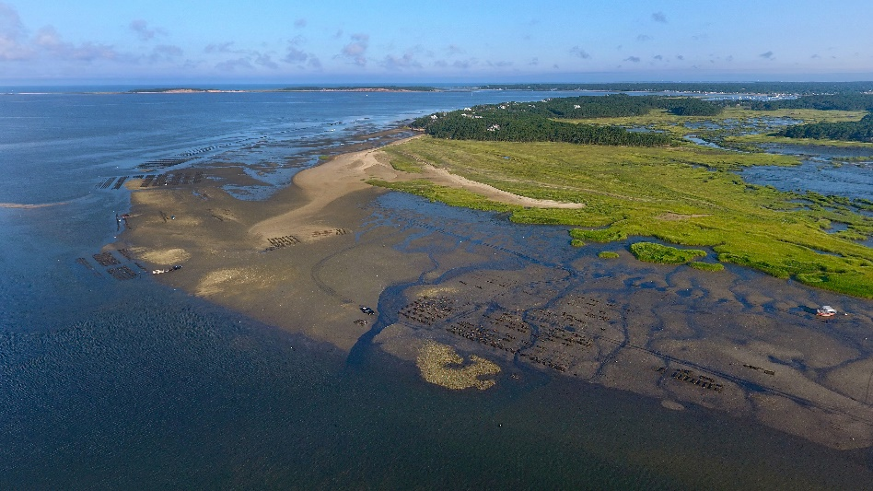
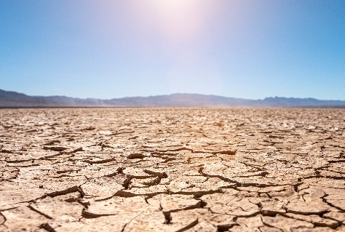
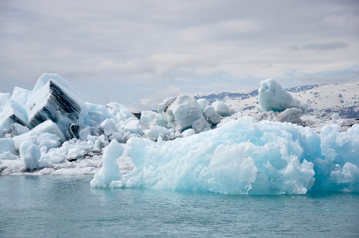
Acceptance of Climate Change Science
Photo by Christopher Seufert/Adobe Stock; used with permission.
Based on scientific evidence and/or the absence of a dispute, courts generally accept:
Greenhouse gasses contribute to global warming
The mechanism of this contribution is “the greenhouse effect”
Human emissions and combustion of fossil fuels are intensifying the greenhouse effect
Climate change has negative impacts
Photo by AA+W/Adobe Stock; used with permission.
Photo by Lost_in_the_Midwest/
Adobe Stock; used with permission.

Slide 8
Legal Backdrop of Current Climate Change Litigation

Slide 9
History of Climate Change Litigation
MASSACHUSETTS v. EPA
2007: U.S. Supreme Court confirms EPA’s authority to regulate greenhouse gas emissions as “air pollutants” under Clean Air Act
Massachusetts v. E.P.A., 127 S. Ct. 1438 (2007)
2007 | 2008 | 2009 | 2010 | 2011 | 2012 | 2013 | 2014 | 2015 | 2016 | 2017

Slide 10
History of Climate Change Litigation
2009: EPA declares mix of six greenhouse gasses “air pollution” under Clean Air Act
carbon dioxide (CO2)
methane (CH4)
nitrous oxide (N2O)
hydrofluorocarbons (HFCs)
perfluorocarbons (PFCs)
sulfur hexafluoride (SF6)
Endangerment and Cause or Contribute Findings for Greenhouse Gases Under Section 202(a) of the Clean Air Act, 74 Fed. Reg. § 66,496 (final rule, Dec. 15, 2009)
2007 | 2008 | 2009 | 2010 | 2011 | 2012 | 2013 | 2014 | 2015 | 2016 | 2017

Slide 11
History of Climate Change Litigation
AEP
2011: U.S. Supreme court holds that Clean Air Act and EPA’s enforcement authority displaced federal common law nuisance claims
American Electric Power Company, Inc. v. Connecticut, 131 S. Ct. 2527 (2011) (“AEP”)
2007 | 2008 | 2009 | 2010 | 2011 | 2012 | 2013 | 2014 | 2015 | 2016 | 2017

Slide 12
History of Climate Change Litigation
KIVALINA
2012: Ninth Circuit extends AEP's displacement ruling to requests for damages as opposed to injunctive relief
Native Village of Kivalina v. ExxonMobil Corp., 696 F.3d 849 (9th Cir. 2012) (“Kivalina”)
2007 | 2008 | 2009 | 2010 | 2011 | 2012 | 2013 | 2014 | 2015 | 2016 | 2017

Slide 13
The Emerging Tort of Public Nuisance
Tobacco Revolution (Mid-1990s)
Produced largest settlement in American tort history ($246 billion)
Firearms (Early 2000s)
Courts largely reject public nuisance claims against firearms manufacturers
Lead Paint (2000 to Present)
Affirms public nuisance applicability against lead paint producers
Opioids (2017 to Present)
Split re whether conduct of opioid manufacturers and distributors constituted a public nuisance – Compare State of Oklahoma v. J&J (Nov. 2021) (Oklahoma Supreme Court reversed $465 million verdict, finding no public nuisance); with Ohio Counties v. CVS, Walgreens, Walmart (Aug. 2022) ($650.6 million verdict for plaintiffs)

Slide 14
Current Climate Change Litigation

Slide 15
Current Cases Filed Starting in 2017
California (July 2017)
Cities and counties begin filing lawsuits in California state courts against fossil fuel companies
Oakland and San Francisco allege public nuisance against small group of industry defendants and seek abatement fund
Richmond, Marin, San Mateo, Santa Cruz (City & County), and Imperial Beach allege public nuisance and other causes of action against up to 37 industry defendants and seek punitive damages, equitable relief, and disgorgement of profits

Slide 16
Cases Continue to be Filed
Public Nuisance Litigation – Outside California
State and local governments outside California file lawsuits against fossil fuel companies
City of New York, NY
Boulder, CO
King County, WA
State of Rhode Island
City of Baltimore, MD
District of Columbia
Honolulu, HI
Maui, HI
Hoboken, NJ
State of Delaware
State of Connecticut
Charleston, SC
Annapolis, MD
Anne Arundel County, MD
Minnesota
State of Vermont
State of New Jersey
State of Puerto Rico (11/22/22)
One industry group also files suit – Pacific Coast Federation of Fishermen’s Associations (CA)
One nonprofit group also files suit – Beyond Pesticides (DC)

Slide 17
Status of Underlying Cases
New York case filed in federal court was dismissed; affirmed by Second Circuit
King County case voluntarily dismissed
Other than newly-filed cases, rest remanded and/or stayed awaiting U.S. Supreme Court’s decision on petitions for certiorari
Supreme Court denied petitions on April 24, 2023

Slide 18
Climate Change Claims
General Allegations
Defendants’ products cause GHG emissions that contribute to the increase in overall temperature of the earth’s atmosphere, and result in climate-related effects
Defendants knew their products caused harm but concealed this information for financial gain
Failed to inform or warn consumers about the foreseeable effects of their fossil fuel products
Falsely claimed through advertising campaigns that their businesses were substantially invested in lower carbon technologies and renewable energy sources when they were not
Causes of action generally include public nuisance, private nuisance, strict liability, negligence, failure to warn, and trespass
Allege various damages and seek equitable remedies

Slide 19
Coverage Issues re Climate Change Claims

Slide 20
Coverage Issues Include…
Fortuity (including occurrence, expected/intended)
Damages, because of damage/injury, in the policy period
Exclusions (e.g., pollution, products)
Declaration of Integrated Occurrence during Annual Period (Bermuda Form policies)

Slide 21
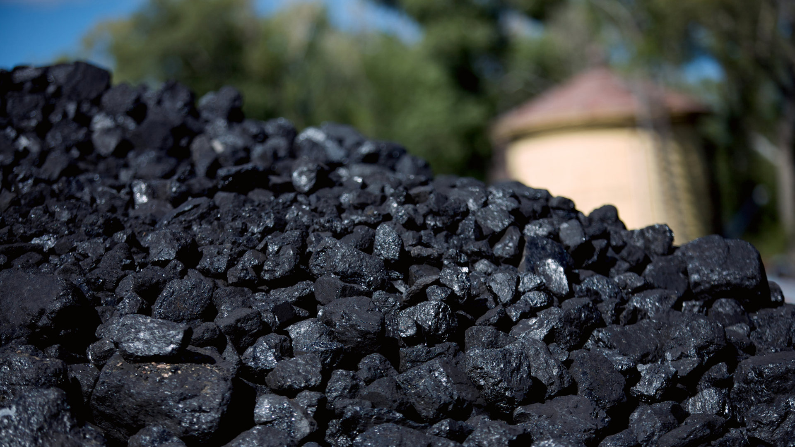
Fortuity
Allegations:
Defendants went to great lengths to understand and research hazards associated with extraction, promotion, and sale of fossil fuel products, including resulting injuries and damages
Defendants knew or should have known of dangers associated with sale of their fossil fuel products as early as the 1950s
Defendants continued to extract, promote, and sell fossil fuel products without revealing the risks
Photos by SaidMammad, eyecrave, and Upyanose/Canva Pro; used with permission.

Slide 22
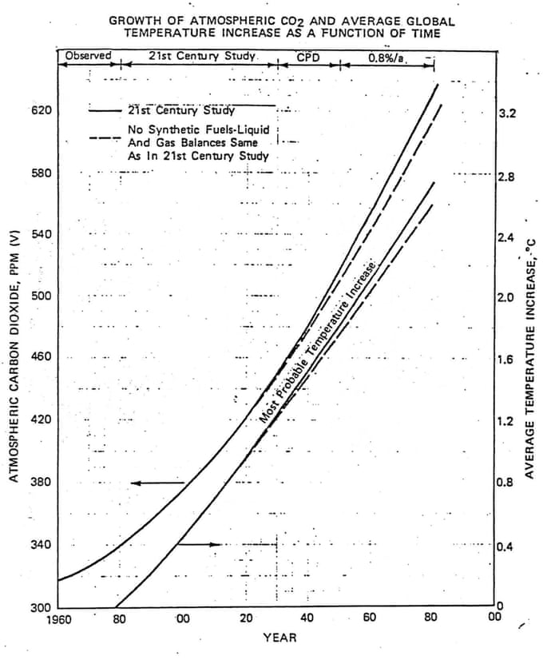
Fortuity
Photo InsideClimateNews; used with permission.
1982: Fossil fuel major privately predicts 2°C temp raise by 2060
Nov. 12, 1982, memo titled CO₂ “Greenhouse” Effect from M.B. Glaser, Manager of Exxon’s Environmental Affairs Programs, to Exxon management

Slide 23
Fortuity
1988: Another fossil fuel major privately recognizes prediction of 2°C temp raise by 2030
May 1988 Memo The Greenhouse Effect prepared for Shell Environmental Conservation Committee
Mathematical models of the earth’s climate indicate that if this warming occurs then it could create significant changes in sea level, ocean currents, precipitation patterns, regional temperature and weather. These changes could be larger than any that have occurred over the last 12,000 years. Such relatively fast and dramatic changes would impact on the human environment, future living standards and food supplies, and could have major social, economic, and political consequences.

Slide 24
Fortuity (Occurrence)
AES
Only one case has reached a decision regarding coverage for climate change litigation — AES Corp. v. Steadfast Ins. Co., 725 S.E.2d 532 (Va. 2012).
The court concluded that: “[i]f an insured knew or should have known that certain results were the natural or probable consequences of intentional acts or omissions, there is no ‘occurrence’ within the meaning of a CGL policy.”
No duty to defend or indemnify on basis of no “occurrence” because underlying complaint alleged that the insured acted intentionally and with knowledge when it emitted greenhouse gas pollution that caused the resulting property damage
2007 | 2008 | 2009 | 2010 | 2011 | 2012 | 2013 | 2014 | 2015 | 2016 | 2017

Slide 25
Damage/Injury in Policy Period
Allegations:
Gradual/cumulative
Episodic – e.g., Puerto Rico
Photos by SaidMammad, eyecrave, and Upyanose/Canva Pro; used with permission.

Slide 26
Climate Change Impacts on Catastrophe Events and ILS Disputes

Slide 27
What are ILS?
Insurance-Linked Securities: Financial instruments or contracts whose value is affected by insured loss events.
Example: Industry Loss Warranty (“ILW”)
Reinsurance or derivative contract that pays out when the financial losses experienced by an industry exceed a specified threshold.

Slide 28
Climate Change Impact on Catastrophe Events
With rising global temperatures and sea levels, frequency and severity of natural catastrophe events have increased:
Participants in reinsurance and insurance-linked securities (“ILS”) industries have faced rapidly increasing exposure to severe catastrophe losses.
Climate change has also affected geographic distribution of catastrophe events.
Global Insured Wildfire Losses:
2016
2018
>70%
Highest since 2011
2nd Highest
1980
2000
2020

Slide 29
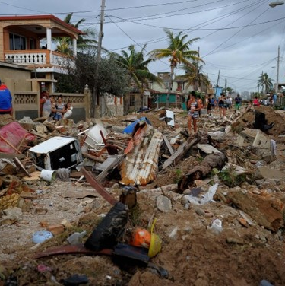
Increasing Legal and Regulatory Volatility
Reinsurers and ILS participants face additional loss volatility from legal/regulatory losses related to major catastrophe events.
Example: Hurricane Irma (2017)
Assignment of Benefits and “Loss Creep”

Slide 30
“Loss Creep” From Hurricane Irma
Significant portion of Irma “loss creep” was paid by retrocessional reinsurers and ILS participants.

Slide 31
Impact of Loss Volatility on ILS Contract Disputes
Rather than stable and predictable returns for retrocessional reinsurance and ILS participants, increasing volatility due to:
Volatility and changing risk profiles have challenged industry’s ability to accurately assess downside exposure.
Changing nature of perils
Frequency
Geo. Spread
Long-tail losses from related legal/regulatory costs

Slide 32
Impact of Loss Volatility on ILS Contract Disputes (cont’d)
Faced with previously unprecedented losses from catastrophe events, ILS participants have turned to previously unprecedented legal tactics.
Increased litigiousness where parties face potential losses—or potential returns—that are meaningfully different from their expectations when entering the transaction.
New transactional uncertainties: With increased loss volatility and loss creep, loss report publishers taking more time to issue final loss estimates, and increased variation from publisher to publisher for the same catastrophe events.
New counterparty risks: Willingness to push the envelope in litigation and take positions previously thought to be untenable.

Slide 33
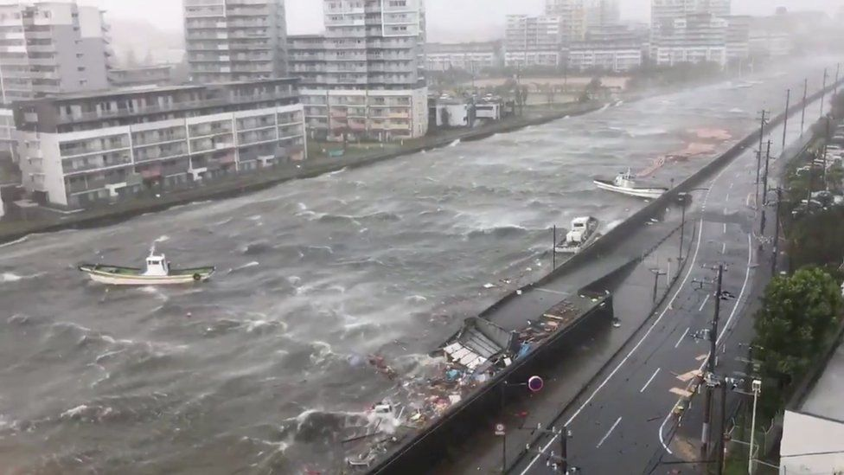
Example: Litigation re: Typhoon Jebi Catastrophe Derivative Transaction
Significant loss creep from Typhoon Jebi: insured losses significantly higher than initially expected.
Loss Report Publisher Loss Estimates
Contractual payment trigger
Designated
Alternative

Slide 34
Difficulties for Managing Transactional Volatility
Loss Modeling
Accuracy of catastrophe modeling firms’ prediction of industry-wide losses has deteriorated in recent years.
Renewed focus on the failure of loss models to capture effects of climate change.
Past attempts to incorporate climate change effects within catastrophe modelling (following the 2004-2005 hurricane seasons) were not well-received or adopted.
Pricing
After previous shocks to reinsurance industry from unexpected catastrophe losses, the market responded through significant reinsurance price increases reflecting changed assumptions about loss exposures.
Some industry analysts believe previous price increases have not been sufficient to keep up with climate change.

Slide 35
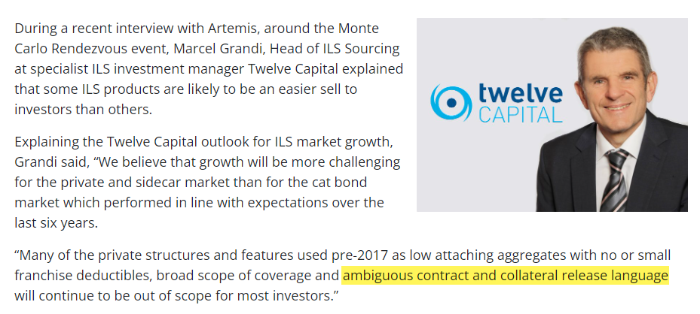
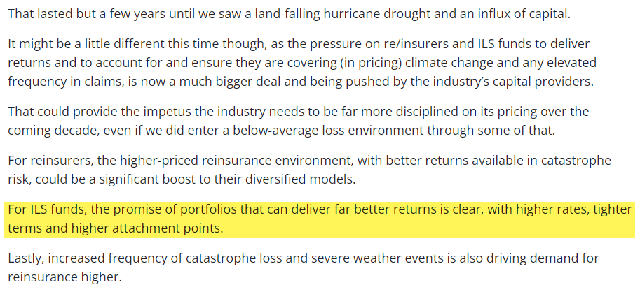
Contract Drafting Key to Managing Legal Volatility
Investors no longer have appetite for “ambiguous contract and collateral release language.”
Marcel Grandi Head of ILS Sourcing Twelve Capital
Legal risks and volatility in retrocessional reinsurance and ILS transactions likely to continue to increase, as parties invoke seldom-used contractual mechanisms to attempt to limit their liability—or gain a windfall.
Parties will need to focus on contract drafting to mitigate counterparty risk.
“For ILS funds, the promise of portfolios that can deliver far better returns is clear, with higher rates, tighter terms and higher attachment points.”
Climate change concerns to support reinsurance pricing Goldman Sachs, Artemis (July 18, 2022)

Slide 36
Questions?

Slide 37
#ARIASUS • www.arias-us.org

