Slide 1

Baltic Re’s Closing Argument
In the Arbitration between Baltic Reinsurance Co., Ltd. and The Atlantic & Pacific Assurance Co.

Slide 2
A&P Violated Its Duty of Utmost Good Faith
No dispute that A&P owes Baltic a duty of utmost good faith
A&P cannot dispute that this includes a duty to provide timely and accurate information to its reinsurers and potential reinsurers
      Not appropriate for a ceding company to play games and wait until the Treaty gets past go to report losses.
Rescission is available where:
      Contract is induced with a false statement, and
      The statement “materially affect[s] the acceptance of the risk or hazard assumed.” (Illinois State Bar Ass’n Mut. Ins. Co. v. Law Office of Tuzzolino & Terpinas, 27 N.E.2d 67, 72 (Ill. 2015)

Slide 3
At the Time A&P Sought Renewal of the Treaty it Had Failed to Disclose Virtually Every Loss in the 2017/2018 Treaty Period
Reported
Actual
00015; 00022

Slide 4
At the Time A&P Sought Renewal of the Treaty it Had Failed to Disclose Virtually Every Loss in the 2017/2018 Treaty Period– Freid Parking
$30M loss occurred on August 14, 2017
First reported under Treaty January 15, 2019
$15M reported under BI Treaty “in error”
Other $15M not reported anywhere
00022

Slide 5
At the Time A&P Sought Renewal of the Treaty it Had Failed to Disclose Virtually Every Loss in the 2017/2018 Treaty Period– Boardwalk Hotel
$35M loss occurred on August 28, 2017
First reported under Treaty March 31, 2020
00010

Slide 6
At the Time A&P Sought Renewal of the Treaty it Had Failed to Disclose Virtually Every Loss in the 2017/2018 Treaty Period– Hasbro
Loss occurred on March 29, 2018
A&P put up $4M in reserves on June 1, 2018
First reported under Treaty January 15, 2019 ($20M loss)
00012; 00022

Slide 7
A&P’s Failure To Disclose Material Facts Justifies Rescission
00015; 00022

Slide 8
A&P’s Misrepresentations Began with the Original Treaty Placement
00002; 00005

Slide 9
A&P’s Misrepresentations Began with the Original Treaty Placement
00005; 00015

Slide 10
A&P Breached the Treaty’s Broad Notice Provision
00034

Slide 11
A&P Breached the Treaty’s Broad Notice Provision
Add screen shot of Park Place explanation
00004

Slide 12
At a Minimum A&P’s Breach Relieves Baltic Re of its Obligation to Pay These Three Claims
Because A&P did not provide Baltic timely notice of the loss, Baltic is not obligated to cover the loss.
Baltic need not show prejudice.
      “[O]nce it is determined that the insurer did not receive reasonable notice of an occurrence or a lawsuit, the policyholder may not recover under the policy, regardless of whether the lack of reasonable notice prejudiced the insurer. Country Mut. Ins. Co. v. Livorsi Marine, Inc., 856 N.E.2d 338, 346 (Ill. 2006).

Slide 13
At a Minimum A&P’s Breach Relieves Baltic Re of its Obligation to Pay These Three Claims
8/14/17: Fire at Freid Parking Garage
8/28/17: Boardwalk Hotel & Casino Destroyed by Fire
3/29/18: Explosion at Hasbro Waterworks
11/18/18: Renewal Package Sent to Baltic Re
12/14/18: Baltic offers to renew for 50% of $45M for two years
1/1/19: Renewal term begins
1/15/19: A&P provides notice to Baltic of Freid Parking loss (16 mo. delay)
1/15/19: A&P provides notice to Baltic of Habro Waterworks loss (9 mo. delay)
3/31/20: A&P provides notice to Baltic of Boardwalk Hotel & Casio Loss (31 mo. delay)

Slide 14
Request for Relief
The Panel should issue an order:
Rescinding the Treaty for both the 2017/18 years and the 2019/2020 years;
In the alternative, finding that Baltic Re is not liable for the $21.5 million in reimbursement sought by A&P for the late-noticed Freid Parking, Hasbro Waterworks, and Boardwalk Hotel & Casino losses;
Awarding Baltic Re attorneys’ fees and costs;
Awarding any additional relief the Panel feels is necessary and warranted.

Slide 15

Atlantic & Pacific Assurance Co.’s
Closing Statement
May 18, 2023

Slide 16


Honorable Engagement

Slide 17
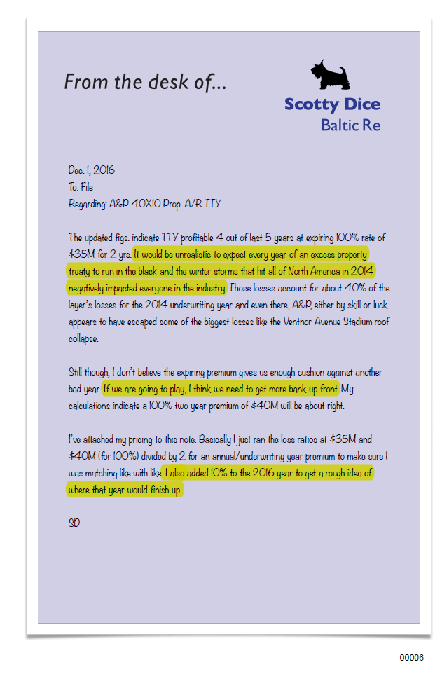
Highlights
It would be unrealistic to expect every year of an excess property treaty to run in the black and the winter storms that hit all of North America in 2014 negatively impacted everyone in the industry.
If we are going to play, I think we need to get more bank up front.
I also added 10% to the 2016 year to get a rough idea of where that year would finish up.

Slide 18
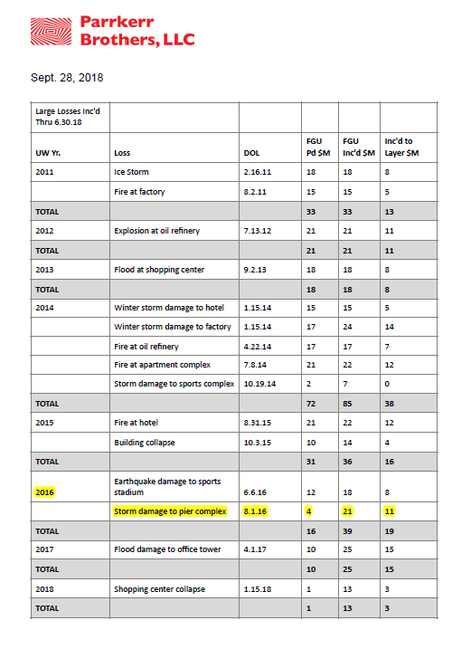



Slide 19
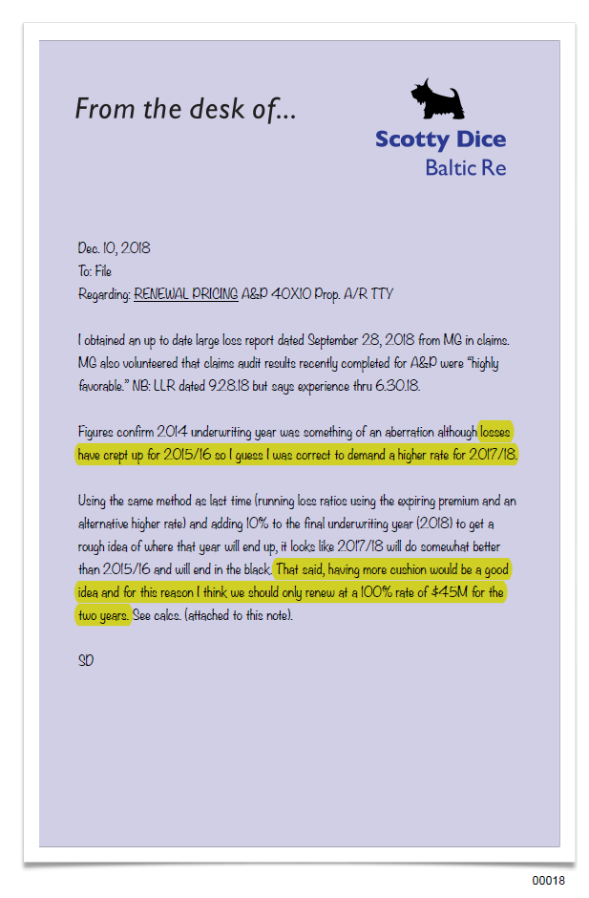
Highlights
losses have crept up for 2015/16 so I guess I was correct to demand a higher rate for 2017/18.
That said, having more cushion would be a good idea and for this reason I think we should only renew at a 100% rate of $45M for the two years.

Slide 20
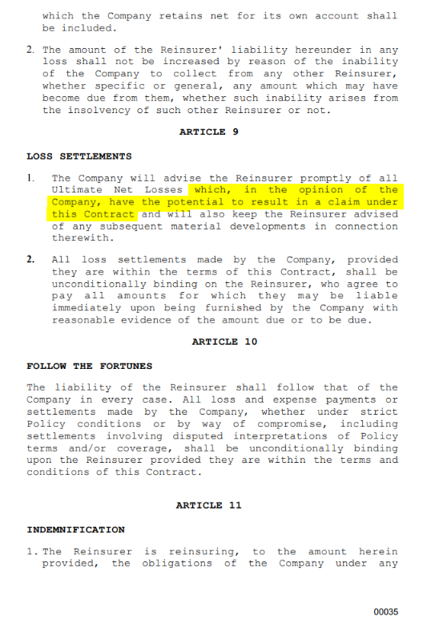
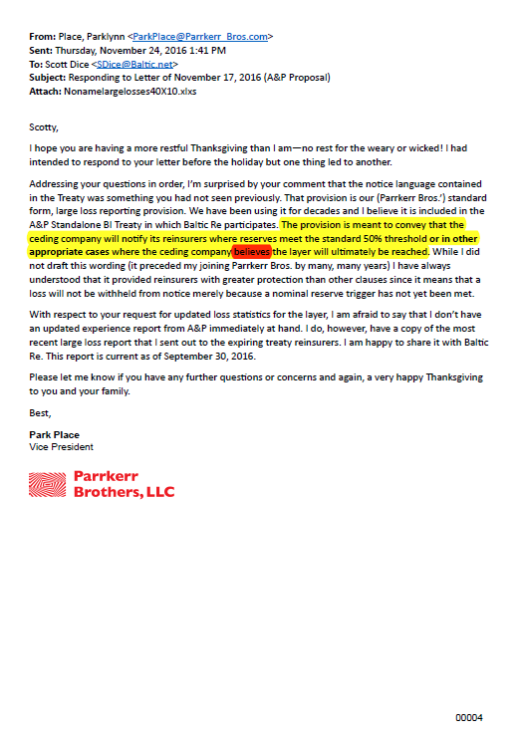
Reflecting back

Slide 21
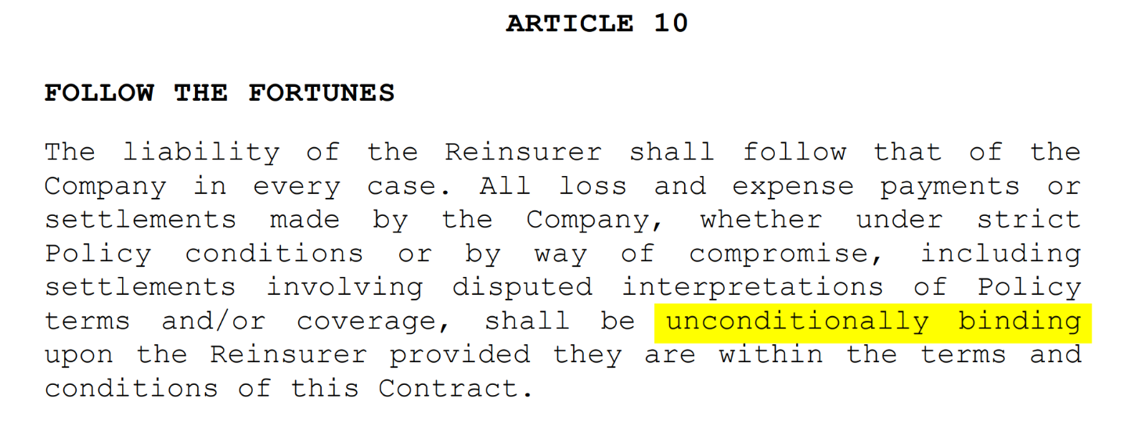
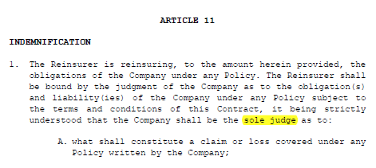
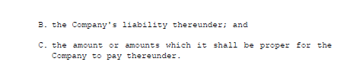
Reflecting back

Slide 22
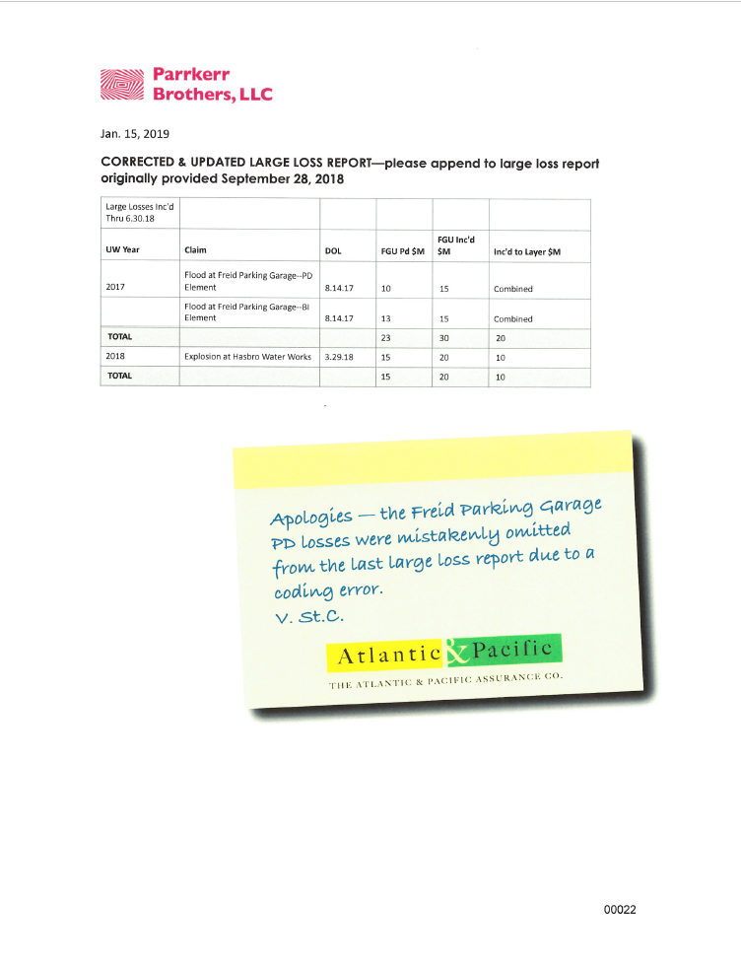
The Freid Parking Garage Claim: A&P Corrects its Large Loss Report Upon Discovering an Error

Slide 23
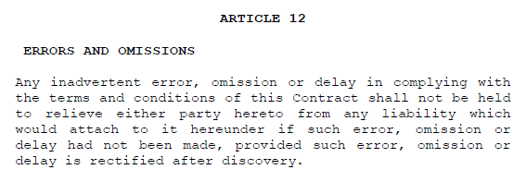

Slide 24
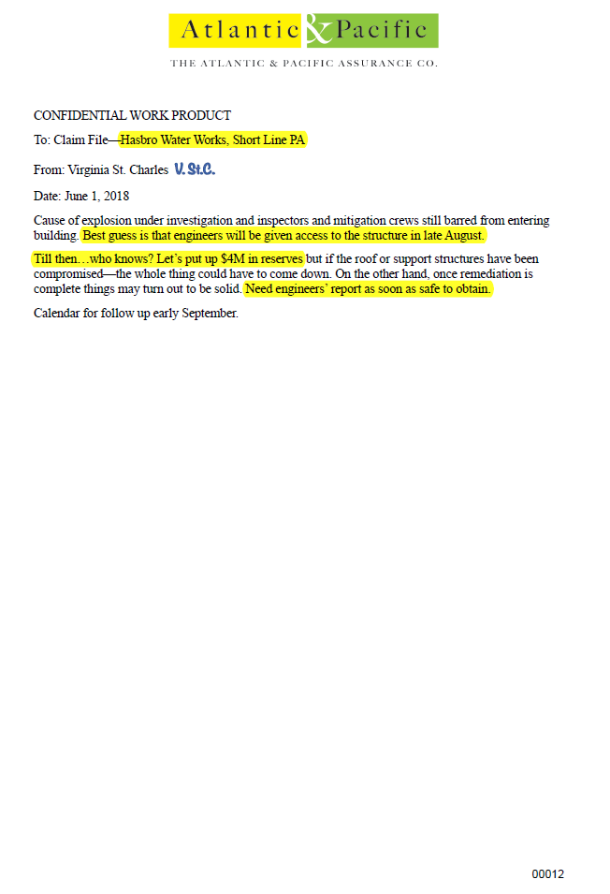
Highlights
Best guess is that engineers will be given access to the structure in late August.
Till then…who knows? Let’s put up $4M in reserves
Need engineers’ report as soon as safe to obtain.

Slide 25
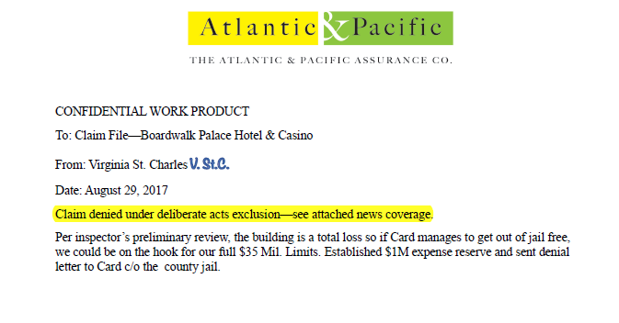
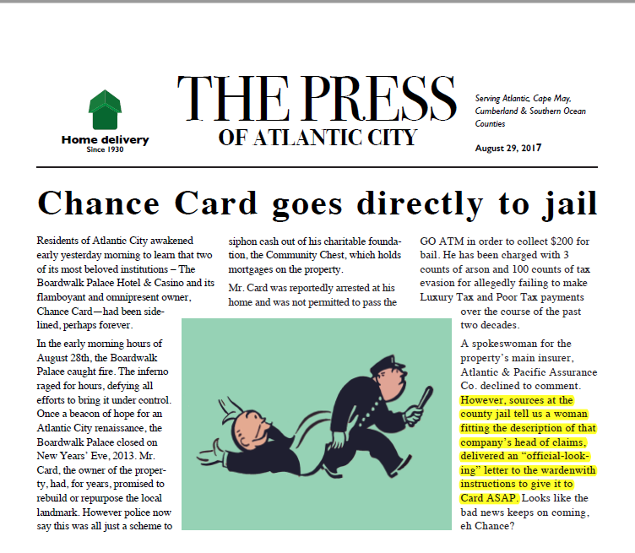
The Boardwalk Palace Hotel & Casino Claim---DENIAL
00010
00011

Slide 26


The Panel should issue an Order:
Denying Baltic Re’s claim for Rescission of the 2017/2018 Treaty years;
Denying Baltic Re’s claim for Rescission of the 2019/2020 Treaty years;
Denying Baltic Re any monetary relief for its alleged late notice claims;
Awarding A&P damages in the amount of $21.5 million plus interest;
Declaring that Baltic Re should pay claims as they come due;
Awarding A&P attorneys’ fees & costs.

Slide 27

Thank you

Slide 28
General Session: Mock Arbitration
In the Matter of the Arbitration Between
Baltic Reinsurance Co., Ltd., and
Atlantic & Pacific Assurance Co.
Polling Questions
May 18, 2023
Neal Moglin, Esq.
Foley & Lardner LLP

Slide 29
Mock Arbitration Session
Polling Questions
Answer when your group is identified
Respond “Yes” to the outcome you believe is most appropriate based upon the evidence you heard today

Slide 30
If you are an Arbitrator—Vote for the most appropriate outcome?
A. Baltic has met its burden and established that it is entitled to rescission of the entire treaty, because A&P withheld or misrepresented material information prior to the inception of the treaty.
B. Baltic has met its burden and established that it is entitled to rescission of the 2019-20 treaty term, because A&P withheld or misrepresented material information prior to the inception of the renewal period, and A&P has failed to establish that it met its contractual duty to provide timely notice for some claims, and as such Baltic does not have to pay its share of those claims in the 2017-2018 treaty term.
C. Baltic has met its burden and established that it is entitled to rescission of the 2019-20 treaty term, because A&P withheld or misrepresented material information prior to the inception of the renewal period, but A&P has met its burden to prove it complied with its contractual duty to provide timely notice for all claims, and as such Baltic must pay its share of all claims.
D. Baltic has failed to meet its burden for rescission, but A&P has failed to establish that it met its contractual duty to provide timely notice for some claims, and as such Baltic does not have to pay its share of those claims.
E. Baltic has failed to meet its burden for rescission, and A&P has met its burden to prove it complied with its contractual duty to provide timely notice for all claims, and as such Baltic must pay its share of all claims.

Slide 31
If you are an Outside Lawyer or Consultant—Vote for the most appropriate outcome?
A. Baltic has met its burden and established that it is entitled to rescission of the entire treaty, because A&P withheld or misrepresented material information prior to the inception of the treaty.
B. Baltic has met its burden and established that it is entitled to rescission of the 2019-20 treaty term, because A&P withheld or misrepresented material information prior to the inception of the renewal period, and A&P has failed to establish that it met its contractual duty to provide timely notice for some claims, and as such Baltic does not have to pay its share of those claims in the 2017-2018 treaty term.
C. Baltic has met its burden and established that it is entitled to rescission of the 2019-20 treaty term, because A&P withheld or misrepresented material information prior to the inception of the renewal period, but A&P has met its burden to prove it complied with its contractual duty to provide timely notice for all claims, and as such Baltic must pay its share of all claims.
D. Baltic has failed to meet its burden for rescission, but A&P has failed to establish that it met its contractual duty to provide timely notice for some claims, and as such Baltic does not have to pay its share of those claims.
E. Baltic has failed to meet its burden for rescission, and A&P has met its burden to prove it complied with its contractual duty to provide timely notice for all claims, and as such Baltic must pay its share of all claims.

Slide 32
If you are an In-House Lawyer or Company Representative—Vote for the most appropriate outcome?
A. Baltic has met its burden and established that it is entitled to rescission of the entire treaty, because A&P withheld or misrepresented material information prior to the inception of the treaty.
B. Baltic has met its burden and established that it is entitled to rescission of the 2019-20 treaty term, because A&P withheld or misrepresented material information prior to the inception of the renewal period, and A&P has failed to establish that it met its contractual duty to provide timely notice for some claims, and as such Baltic does not have to pay its share of those claims in the 2017-2018 treaty term.
C. Baltic has met its burden and established that it is entitled to rescission of the 2019-20 treaty term, because A&P withheld or misrepresented material information prior to the inception of the renewal period, but A&P has met its burden to prove it complied with its contractual duty to provide timely notice for all claims, and as such Baltic must pay its share of all claims.
D. Baltic has failed to meet its burden for rescission, but A&P has failed to establish that it met its contractual duty to provide timely notice for some claims, and as such Baltic does not have to pay its share of those claims.
E. Baltic has failed to meet its burden for rescission, and A&P has met its burden to prove it complied with its contractual duty to provide timely notice for all claims, and as such Baltic must pay its share of all claims.

