Slide 1
Arbitrator Disclosures: Too Restrictive? Too Lax? Just Right?
Elaine Caprio, David Ichel, Sylvia Kaminsky & Cia Moss
May 19, 2023
Notes:
David:
Introduce panel, introduce polling procedure

Slide 2


Our Hypothetical Arbitration. . . .
Chilton Hotels, Inc. v. Purer Insurer LLC
Policyholder seeking coverage under event cancellation insurance policy
Cancellation of conferences and other losses due to Covid-19 restrictions
Notes:
David:
Policyholder Chilton Hotels, Inc. commenced an arbitration against Purer Insurer LLC.
Chilton Hotels seeks coverage under an event cancellation insurance policy for cancellation of numerous conferences and other losses suffered by Chilton Hotels when it was required to severely limit its operations in 2020 as result of Covid-19 restrictions.

Slide 3
Ethics Codes on Arbitrator Disclosures
ARIAS CODE OF CONDUCT, CANON IV
        Any interest or relationship likely to affect arbitrator judgment.
        Any doubt should be resolved in favor of disclosure.
        Relationships with other arbitrators, counsel, parties, witnesses.
        Publications or expert testimony on issues in dispute.
        Past or present involvement in the claims at issue.
Notes:
David:

Slide 4






Ethics Codes on Arbitrator Disclosures
OTHER ARBITRAL ORGANIZATION CODES/ GUIDELINES
Notes:
David
Different Arbitration Associations and administering bodies have codes and guidelines on disclosures – One thing we considered as a panel is how well the ARIAS code compares and we also looked into whether there were any interesting recent developments.

Slide 5
Ethics Codes on Arbitrator Disclosures
LATEST DEVELOPMENTS
UNCITRAL Working Group III’s draft code of conduct for arbitrators
          Art 4: limits on multiple roles
          Art 11: disclosure obligations
IBA Task Force on Guidelines on Conflicts of Interest
          Sub-group on Arbitrator Disclosures
Notes:
David
Latest developments
An evolving area – newest developments
UNCITRAL code of conduct for arbitrators [note: for investment disputes]
In April 2023, UNCITRAL Working Group III just completed its work on a draft code of conduct for arbitrators in international investment dispute resolution. (Has not yet been adopted – expected to be adopted by UNCITRAL in July 2023)
Art 4 details limits on multiple roles, i.e. double hatting -- unless the disputing parties agree otherwise, arbitrators in one case cannot serve as a legal representative or expert witness “in another proceeding involving: (a) the same measure(s); the same or related party (parties); or (c) the same provision(s) of the same instrument of consent.”
Art 11 details disclosure obligations – candidates/arbitrators “shall disclose any circumstances likely to give rise to justifiable doubts as to his or her independence or impartiality”
IBA Task Force on Guidelines on Conflicts of Interest – Arbitrator Disclosures sub-group
IBA has formed a new task force to review its guidelines on conflicts of interest in international arbitration, with amendments expected to be finalized in 2024
Task force is divided into 8 sub-groups, one of which is specifically dedicated to revising guidelines on Arbitrator Disclosures

Slide 6
Polling Question 1
Do you believe that the arbitrator disclosure in the ARIAS cases you have been involved in has been working?
A. Yes — works well
B. No — not enough disclosures are made
C. No — too much disclosure burden on arbitrators
D. No — parties sometimes abuse challenges based on disclosures
Notes:
David

Slide 7
Polling Results

Slide 8

Polling Question 2
Jane Q. Arbitro is appointed as the party-appointed arbitrator by Purer Insurer.
Should she disclose that she knows counsel for the insurer from one-on-one dinners she has had with this counsel at the time of the bi-annual ARIAS meetings?
A. Yes
B. No
Notes:
Cia
One of the points that we often see on umpire questionnaires or other disclosures is that the parties know each other from through ARIAS, but we wondered how much detail should be included? Do you think that Jane Arbitro should disclose that she has one-on-one dinners with counsel?

Slide 9
Polling Results

Slide 10



ARIAS-US Umpire and Neutral Arbitrator Questionnaires Exclude “Industry Conferences and Other Industry Functions”
“Apart from participating in industry conferences and other industry functions, please briefly disclose to the best of your knowledge any business, professional, or social relationships […] .”
How far does this apply?
Firm dinners? Cocktail parties? Golf? Spa?
Notes:
Cia
Comment on results of dinner polling
The umpire questionnaire specifically excludes industry conferences and other industry functions, but it asks for disclosures of “any business, professional, or social relationships that you have had with any individuals you understand to now be or have been employed by or professionally affiliated with the parties, their counsel, and/or their law firms in this matter.”
So, we wondered how far this should apply – is there a difference between a one-on-one dinner and sitting next to someone at a dinner for 20 people? What about a cocktails party where you are not seated next to anyone, what about playing golf, or going to the spa to the spa together?

Slide 11
Guess Who’s Coming to Dinner?
  SHOULD AN UMPIRE ATTEND A DINNER SPONSORED BY ONE OF THE LAW FIRMS
  IN THE PENDING ARBITRATION?
        Only if all three arbitrators are invited?
        Only if all three arbitrators actually attend?
        Is disclosure sufficient, or should the umpire simply decline?
        Is it a different case for the party-appointed arbitrators?
Notes:
Cia
Does the approach change if you are currently sitting as umpire or on a neutral panel in a case? In that circumstance, should you decline a cocktail party, dinner, social invite?
Would your approach change if other panelists are also attending?

Slide 12

Guess Who’s Coming to Dinner? (continued)
Can the three arbitrators have dinner together? Can just two of them have dinner if they invite the third and don’t discuss the case?
Can a party-appointed arbitrator have dinner with her appointing counsel the evening following argument of a summary judgment motion in the case?
Notes:
Cia:
Does the analysis change if we are just talking about the panel?

Slide 13

Polling Question 3
Jane Q. Arbitro is also serving as the Chair/Umpire in an unrelated hurricane coverage arbitration in which an affiliate of Purer, PureWater Insurance, is one of 16 respondents.
Can she serve as Purer’s party-appointed arbitrator in the Covid-19 arbitration if she discloses the two appointments in each arbitration?
A. Yes
B. No
Notes:
Elaine
When Jane Q. Arbitro is nominated by Purer Insurer in the Covid-19 case, she is presently serving as the Chair/Umpire in a totally unrelated hurricane coverage arbitration in which an affiliate of Purer, PureWater Insurance, is just one of 16 insurers on a policy named as respondents.
Can she serve as Purer’s party-appointed arbitrator in the covid-19 arbitration if she discloses the two appointments in each arbitration?

Slide 14
Polling Results

Slide 15

ARIAS Code of Ethics, Canon I (Integrity)
“There are certain circumstances where a candidate for appointment as an arbitrator must refuse to serve: […] where the candidate sits as an umpire in one matter and the candidate is solicited to serve as a party-appointed arbitrator or expert in a new matter by a party to the matter where the candidate sits as an umpire.”
Notes:
Elaine
“Comment 3. . . . There are certain circumstances where a candidate for appointment as an arbitrator must refuse to serve:
f) where the candidate sits as an umpire in one matter and the candidate is solicited to serve as a party-appointed arbitrator or expert in a new matter by a party to the matter where the candidate sits as an umpire.”
Note: The ARIAS-Umpire Questionnaire asks a prospective umpire if she/he agrees not to take on any party-appointments from any of the parties while serving as umpire in the arbitration. See Question 9 D.
Canon 1, Comment 3 list numerous other situations as well where an arbitrator may not serve.

Slide 16
Polling Question 4
John D. Tribunale is Chilton Hotels’ party appointed arbitrator.
How far back in time does he need to go to disclose relationships he once had with with the parties, party affiliates, counsel or witnesses?
A. 5 years
B. 10 years
C. Without limit, if he recalls
Notes:
Sylvia –
How far back must one disclose?

Slide 17
Polling Results

Slide 18

Ethics Codes on Arbitrator Disclosures
ARIAS CODE OF CONDUCT, CANON IV –NO DATE CUT-OFF!
Any interest or relationship likely to affect arbitrator judgment.
Any doubt should be resolved in favor of disclosure.
Relationships with other arbitrators, counsel, parties, witnesses.
A “Party” under the Code includes “affiliates.
Notes:
Sylvia

Slide 19





Ethics Codes on Arbitrator Disclosures (continued)
ARIAS Umpire and Neutral Arbitrator Questionnaires often use a date cut-off for certain questions, but does this negate the Canon IV disclosure obligation?
Other codes: | Cut-off
 | None
 | 3 years for certain questions
 | 5 years for certain questions
Notes:
Sylvia
How does this compare to other organizations:
AAA/ICDR Code of Ethics for Arbitrators – no cut off
ICC practice note 2019 – no cut off
JAMS arbitrators ethics guidelines – no cut off
CPR Code of Ethics for Arbitrators – no cut off
IBA Guidelines – 3 years for some questions e.g. repeat past appointments by the same party or the same counsel beyond a three-year period need not be disclosed
UNCITRAL current draft code of conduct 2023 – e.g. 5 year cut off for any financial, business, professional, or close personal relationship in the past five years with certain parties and non-parties to the proceedings

Slide 20

Polling Question 5
Denise B. Fair is the umpire in the arbitration.
Half-way through the case schedule, Purer Insurer files a notice indicating that it is adding Christine Winner as additional counsel. Ms. Winner was once a partner of Denise Fair in her former law firm and did a lot of work with Fair.
What should Umpire Fair do?
A. Disclose the prior relationship.
B. Suggest to the Panel that they order that Ms. Winner may not join as counsel on grounds of appearance of conflict.
C. Both A & B.
D. Disclose & Recuse
Notes:
David

Slide 21
Polling Results

Slide 22
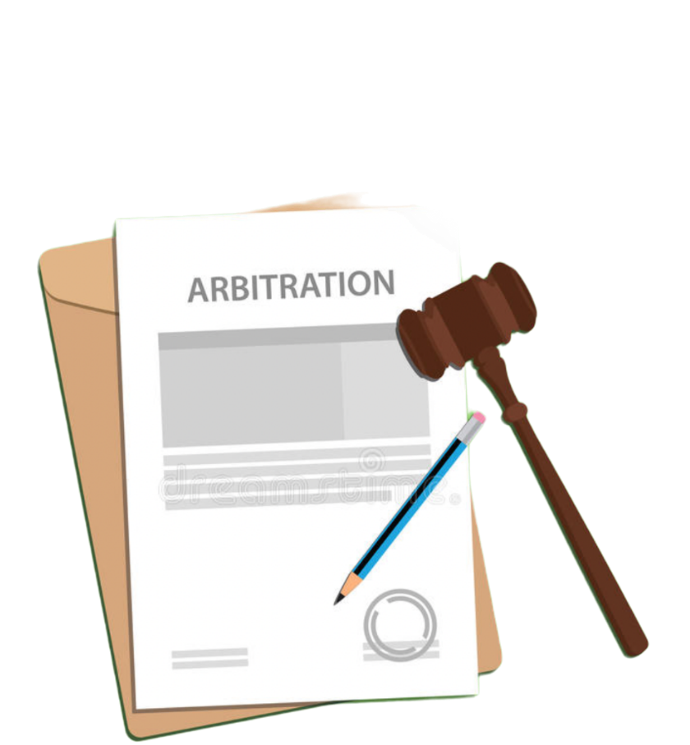

Courts Rarely Vacate Awards based on Non-Disclosure under FAA / New York Convention §10(a) vacatur grounds: evident partiality, corruption, fraud, etc.
EXAMPLES FROM CASE LAW…
Award vacated:
Former attorney-client relationship
          Equicare Health Inc. v. Varian Medical Systems, Inc, case no. 5:21-mc-80183 (N.D. Cal., 2023)
Substantial ownership interest and nontrivial business dealings
          Monster Energy Company v. City Beverages, LLC, 940 F. 3d 1130 (9th Cir. 2019)
Notes:
Cia
Interesting to hear what everyone things are appropriate disclosures and this brings us to the question of what a party can do if they there was improper connection between one of the arbitrators and a party.
Currently, in our ad hoc reinsurance disputes, our only real option is to move to vacate at the end of the proceedings.
Non-disclosure suggests bias but is not decisive, and courts undertake a fact-specific analysis to determine whether there was evident partiality. Case law suggests that the bar to show evident partiality is relatively high, but courts have still ordered vacatur in some circumstances
Equicare Health Inc. v. Varian Medical Systems, Inc, case no. 5:21-mc-80183 (N.D.Cal., 2023): in an order dated 19 April 2023, court vacated $2.1million award in software dispute because one of the arbitrators did not disclose that he had formerly been represented by the lead counsel for one of the parties in a malpractice suit. Court noted that the non-disclosure violated obligations under the AAA rules, California Code of Civil Procedure, and Ethics Standards for Neutral Arbitrators in Contractual Arbitration – while not binding, this is persuasive authority in assessing if there is evident partiality.
Monster Energy Company v. City Beverages, LLC, 940 F. 3d 1130 (9th Cir. 2019): court vacated arbitration award in favor of Monster Beverages where sole JAMS arbitrator failed to disclose that he was a co-owner of JAMS (though he had disclosed that he had an economic interest in the overall financial success of JAMS), and that JAMS had administered 97 arbitration decisions for Monster in the prior five years. Both facts were not disclosed to either party. Undisclosed interests in an entity must be substantial and business dealings must be nontrivial.

Slide 23

Courts Rarely Vacate Awards based on Non-Disclosure under FAA / New York Convention §10(a) vacatur grounds: evident partiality, corruption, fraud, etc.
Vacatur denied:
Trivial business dealings
          Levi Strauss & Co. v. Aqua Dynamics Systems, Inc., 473 F.Supp.3d 1004 (N.D.Cal., 2020)
Concurrent service in other cases
          National Indemnity Company v. IRB Brasil Resseguros S.A., 164 F.Supp.3d 457 (S.D.N.Y., 2016)
Serving as arbitrator with party’s counsel
          Andes Petroleum Ecuador Limited v. Occidental Exploration & Prod. Co., 2021 WL 5303860 (S.D.N.Y. Nov. 15, 2021) (appeal pending)
Party-appointed arbitrator in reinsurance arbitration
          Certain Underwriting Members of Lloyds of London v. Fla., Department of Financial Services, 892 F.3d 501 (C.A.2, 2018)
Already reviewed by arbitral institution
          Telecom Business Solution LLC v. Terra Towers Corp., 2023 WL 257915 (S.D.N.Y. Jan. 18, 2023) (appeal pending)
Notes:
Cia
But cases also show just how high the vactur standard is and that
Cases where vacatur was denied
C.f. Levi Strauss & Co. v. Aqua Dynamics Systems, Inc., 473 F.Supp.3d 1004 (N.D.Cal., 2020): denied vacatur, distinguished from Monster Energy as business dealings here were trivial – two of the JAMS arbitrators had some ownership interest in JAMS, which was substantial, but JAMS only handled 6 mediations (lower financial incentives) and 1 arbitration over 10 years for Levi’s.
National Indemnity Company v. IRB Brasil Resseguros S.A., 164 F.Supp.3d 457 (S.D.N.Y., 2016): vacatur denied. Arbitrator's alleged untimely disclosure, in arbitration involving insurer's alleged obligation to reinsure losses suffered by a Brazilian company in Brazil, of his role as party-arbitrator in another arbitration involving related entity of insurer, which was represented in the other arbitration by the same attorney as insurer in the instant arbitration, did not constitute “evident partiality”. Noted that ARIAS guidelines are not binding but nonetheless, they do not prohibit a party-arbitrator from accepting a simultaneous assignment as umpire in an unrelated arbitration involving the same party
Andes Petroleum Ecuador Limited v. Occidental Exploration & Prod. Co., 2021 WL 5303860 (S.D.N.Y. Nov. 15, 2021) (appeal pending): After his appointment in this case, one of the arbitrators accepted an appointment in an unrelated ICC case whereby he sat on the tribunal with claimant’s counsel, but did not update his disclosures. The court held that this nondisclosure did not establish that the arbitrator was partial.
Certain Underwriting Members of Lloyds of London v. Fla., Department of Financial Services, 892 F.3d 501 (C.A.2, 2018): claim of evident partiality on part of party-appointed arbitrator was subject to heightened standard for determining whether failure to disclose either violated the qualification of disinterestedness, or had a prejudicial impact on the award (not the usual reasonable person standard). In a reinsurance arbitration, party-appointed arbitrators are expected to espouse the view or perspective of the appointing party – different standards for evident partiality apply vis-à-vis neutral arbitrators.
Additionally, for institutional arbitration, first instance determinations by arbitral institutions are usually conclusive, and courts generally accept their conclusions when deciding a motion for vacatur based on arbitrator bias
Telecom Business Solution LLC v. Terra Towers Corp., 2023 WL 257915 (S.D.N.Y. Jan. 18, 2023) (appeal pending): vacatur denied for failure to disclose arbitrator’s nomination to another case by party adverse to Respondents in an unrelated case. ICDR’s Administrative Review Council, created to rule on objections to arbitrator service, already rejected losing party’s attempts to disqualify Chairman and their own party-appointed arbitrator. Court emphasized that the ICDR had already reviewed and rejected the arbitrator challenges, and that parties agreed to abide by AAA Commercial Arbitration Rules, so the ICDR’s decision is conclusive.

Slide 24

Institutional procedures to remove arbitrators
Organization | Body | Procedure
 | ICDR / AAA Administrative Review Council | Council Review Standards; AAA Rule 19 / ICDR Rule 15
 | National Arbitration Committee | JAMS Rule 15
 | Challenge Review Committee | CPR Rule 7; Challenge Protocol
 | ICC Court | Art 14 ICC Rules
 | LCIA Court | Art 10 LCIA Rules
Notes:
Cia
AAA and ICDR have Administrative Review Councils, make certain administrative decisions arising in cases administered by AAA/ICDR.
JAMS National Arbitration Committee decides issues of controversy including claims of conflict.
CPR resolves arbitrator challenges using its Challenge Review Committee – a 3 member committee will be convened with respect to a particular arbitration proceeding upon receipt of a challenge
ICC Court decides on admissibility and merits of arbitrator challenges for ICC arbitrations (Art 14(3)).
LCIA Court does as well – even has a Challenge Decision Database containing published decisions from 2010-2017 (not updated recently). Link: https://www.lcia.org/challenge-decision-database.aspx
Of the 32 publicly available challenges on the LCIA database, only 20% were successful.
[Note: UNCITRAL –whichever appointing authority is used for that arbitration makes the decision on arbitrator challenges, but Secretary General of PCA can act as appointing authority when the parties so agree. The UNCITRAL Arbitration Rules requires that contested challenges be decided by the appointing authority (Art. 12 of the 1976 Rules; Art. 13 of the 2010 and 2013 Rules). When deciding challenges, the Secretary-General, depending on the circumstances of the case, may make the decision directly or after consultation with a special committee, consisting of three persons, a majority of whom will be of nationalities different from that of any party]
Recent decisions
On 21 April 2023, ICC Court upheld challenge brought by National Iranian Oil Company against arbitrator Laurent Aynès, who was chairing a tribunal hearing its US$32 billion dispute with UAE petroleum company Crescent – he failed to disclose that his firm acted against an affiliate of one of the parties
[This decision is public because it was submitted as an exhibit to an arbitrator challenge before the NY Supreme Court] On 9 February 2023, ICC Court dismissed an arbitrator challenge in Endurance v Horseshoe. One of the grounds was alleged non-disclosure of involvement in a prior, unrelated arbitration which did not involve any of the parties or related entities. That prior arbitration involved only same counsel to a party, and the arbitrator was appointed by a different institution (ARIAS). This was insufficient to support a lack of impartiality.
LCIA – April 2017 decision, one of the latest ones from the database: An arbitrator’s membership of an organisation to which one party’s former lead counsel and a lawyer who acted against the same party also belong is not a circumstance that requires disclosure

Slide 25
Polling Question 6
Should there be an official ARIAS review committee to adjudicate challenges
to arbitrators?
Yes
No
Notes:
Cia
Should there be an official ARIAS review committee, like the AAA/ ICDR Administrative Review Council, to adjudicate challenges to arbitrators ?

Slide 26
Polling Results

Slide 27
Questions? Comments?
ARIAS•U.S. 2023 Spring Conference | May 17-19, 2023 | Amelia Island, FL | www.arias-us.org
Notes:
Sylvia

Slide 28
THANK YOU !
Notes:
David – On behalf of the Panel, thank you everyone, have a great trip home!

