Slide 1
Nuclear Verdicts & the Emerging Liability Landscape
Michael Frantz
Cindy Koehler
Senior Vice President, Head of Claims
Munich Re US
mfrantz@munichre.com
Certified Arbitrator,
Cindy Koehler Consulting
cindy@cindykoehlerconsulting.com
Mark Behrens
Steve McCartan
Partner
Shook, Hardy and Bacon L.L.P.
mbehrens@shb.com
Partner
Shook, Hardy and Bacon L.L.P.
smccartan@shb.com

Slide 2
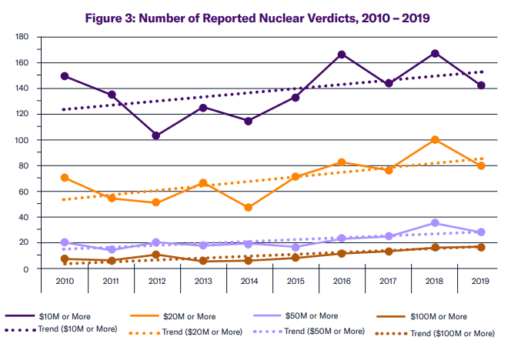
Data on Nuclear Verdicts
Source: U.S. Chamber of Commerce Institute for Legal Reform (Sept. 2022)

Slide 3
Polling Question
A 2022 US Chamber “Institute for Legal Reform” study analyzed verdicts worth $10M or more in state and federal courts from 2010-2019.
How many “nuclear verdicts” did the study report?
257
675
1376
2541

Slide 4
Polling Question
The same study reported an increase in the size of “nuclear verdicts” during the 2010-2019 study period.
By how much, in dollar value, did the median verdict increase?
18.5%
27.5%
38.5%
48.5%

Slide 5
Polling Question
A 73 year-old great grandmother drives to church on a Sunday morning.
She is hit head-on by a “wide-load” truck, with designated “escort cars” – both in front and behind the truck.
Plaintiff killed instantly.
Trucking Company settles prior to trial, so trial proceeds solely against front escort car.
Decedent has no minor dependents, and no conscious pain and suffering.
How much did the Titus County Texas jury award in damages?
$10 million
$75 million
$730 million
$920 million

Slide 6
Polling Question
A 41-year-old male alcohol-detox patient ignores nurse’s orders and goes outside to smoke a cigarette.
He subsequently falls down a flight of stairs, resulting in subdural hematoma and a ruptured spleen.
How much did the local jury award?
Nothing (defense verdict)
$250,000
$8 million
$19 million

Slide 7
Polling Question
For reinsurer or insurer representatives, in how many instances, over the past five years, have you been involved with a trial on which a reinsurer(s) has “associated” in the handling/defense of the case?
None
Once
Two to five times
More than five times

Slide 8
Nuclear Verdicts & the Emerging Liability Landscape
Questions?

