Slide 1
#ARIASUS • www.arias-us.org

Slide 2
Forever Chemicals | PFAS/PFOS
The New Asbestos?
May 19, 2023

Slide 3
Forever Chemicals |
PFAS and PFOS
The New Asbestos?
Frank DeMento, TransRe
Travis Kline, Geosyntec Consultants
Joseph Scully, Day Pitney LLP

Slide 4

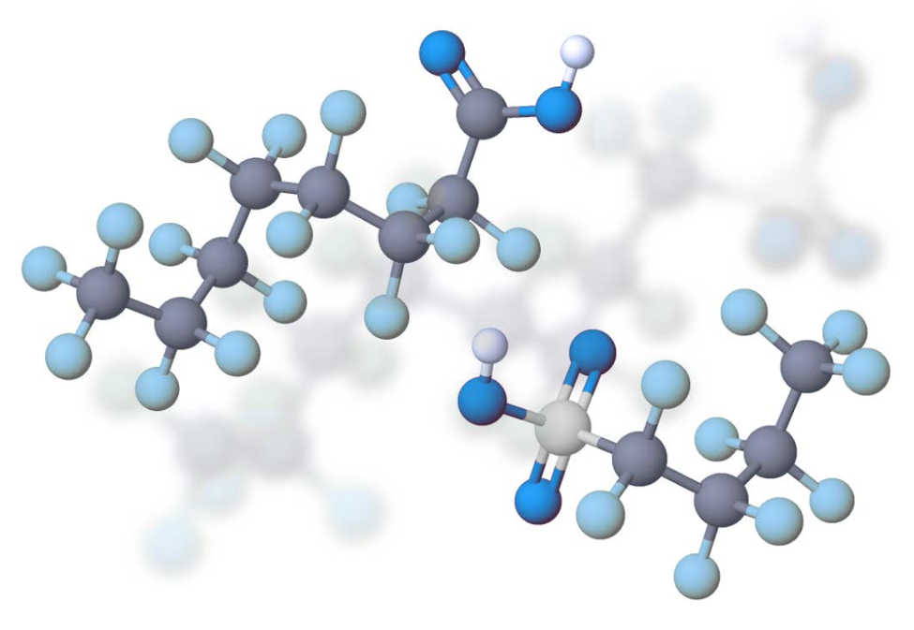
PFAS/PFOS – the Next Asbestos (+PCBs +?)
Science – superficial similarities, but very different on many levels
Tort liability – magnitude and breadth of exposures could rival (or exceed) asbestos
  Several manufactures consider PFAS litigation to be an existential crisis
Coverage issues – many similarities, but still in its infancy
Reinsurance – unknown
?
Notes:
Good morning everyone. I know the title of our talk is The Next Asbestos but I'm not sure I'm 100% on board. When we think about asbestos we’re usually concerned with one particular and idiosyncratic health effect, mesothelioma. With PFAS there are an unknown litany of health effects depending on your lifestage and susceptibility. I don't even think we can equate PFAS challenges with another problematic pervasive bioaccumulative organic like the PCBs, because PFAS doesn’t behave similarly to any other organic class of compounds.
I will leave discussion of tort liability and coverage issues to my esteemed panelists but I would like to take you through a few of the scientific issues at play here as we think about how to manage PFAS in our environment and what extant and future liability looks like.
Very different from asbestos – F&T …
Very different from PCBs – bioaccumulative but not in adipose tissue, but also soluble …

Slide 5
The Science
Travis Kline

Slide 6
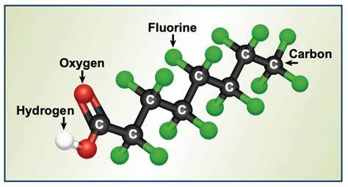
What are they? PFAS/PFOS
Perfluorooctane Sulfonic Acid (“PFOS”) and
Per- and Poly-Fluoroalkyl Substances (“PFAS”)
ISO (the International Organization for Standardization) Definition of PFAS: Commonly used international abbreviation for organic compounds with replacement of most or all hydrogen atoms by fluorine in the aliphatic chain structure
“Forever Chemicals”: Persistent, Mobile, Repel oil and water, Resistant to heat
Notes:
So PFAS are a group of per- and poly-fluorinated classes of compounds with some unique physicochemical characteristics. Among these characteristics are the fact that PFAS compounds are resistant to water and oil and yet they are incredibly soluble in water which exacerbates their fate and transport characteristics considerably. The primary facet of these compounds is the carbon-fluorine bond. It is the strongest in nature and yet these compounds don't exist naturally - they are all manmade and they are incredibly durable, incredibly persistent, mobile, and they don't break down in our environment. The don’t break down in water, or sunlight, or our bodies. In fact, the only effective way to break them down is to superheat them to about 2000°F and this is why they're called the forever chemicals.
No natural sources –
Mobile in groundwater and surface water
Stable molecules - and the C-F bond is the strongest in nature
Resistant to natural biotic or abiotic degradation
Complex mixture
PFAS mixtures
Often mixed with other contaminants
In addition to water transport, atmospheric transport / deposition possible

Slide 7
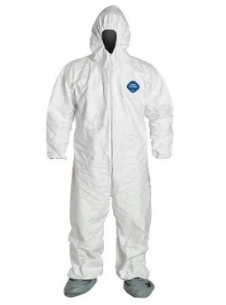





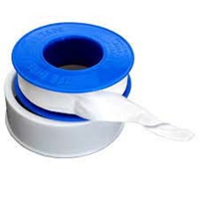



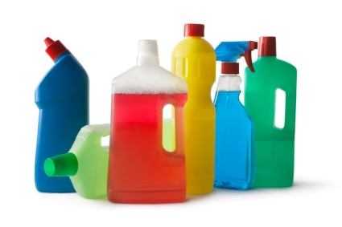
Performance Chemicals and Industrial Uses
PFAS are ubiquitous in commerce, our homes, and the environment
Consumer Products and Industry - Oil/water repellency, heat/friction
Textile, carpet, paper, food, AFFF …
General Population – Bloodstream
Aerospace
Alternative energy
Automotive
Chemical manufacturing
Electronics
Medical supplies
  Fluid resistant clothing
  Implants, patches and grafts
  Low friction coatings
Photolithography
Performance chemicals
  Building and construction – weather resistant coatings
  Hydraulic fluids
  Fuels
  Industrial surfactants
Oil and gas – enhanced recovery
Metal plating and etching
Paints, varnishes, sealants, waxes and polishes
Plastics
  Polymer manufacturing, Resins
Semiconductors
Wire manufacturing and coating
Notes:
As I said, everywhere. This is just a quick slide to list some of the areas of commerce that are dependent on PFAS for function and this list is by no means comprehensive. You've probably heard about PFAS in AFFF, but that's not the primary avenue for our exposure. You may have heard about PFAS in nonstick cookware? The potential for you to incur a significant dose of PFAS from your nonstick cookware is very small. The Teflon coating you’re actually cooking on - that's not PFAS, but because we need to find a way to get Teflon to stick to an aluminum pan, enter PFAS. In this case, it’s the glue allowing nonstick performance. You’ve probably heard about PFAS oil and water stain repellency in carpets and in food containers - there is a reason why your carpet is so easy t clean, does get stained and why your food does stick to its packaging. All these sources add up and contribute to our daily dosage.

Slide 8
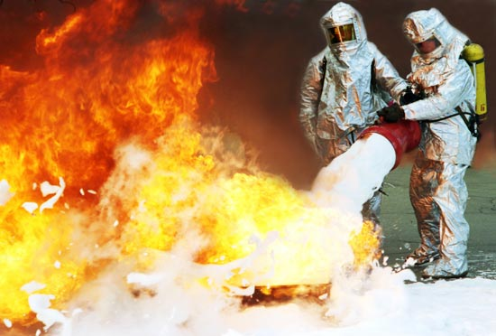
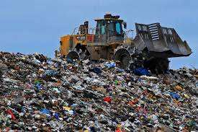
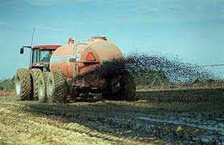


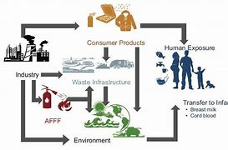
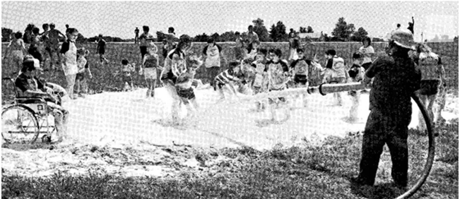
Production and Use
  12,000+ compounds
          2002: 3M ceases PFOA - US
    2015: 8 Cos. cease C8 production – US
    China, India, Russia overwhelm all gains ….
  Widely used in consumer products and industry
  Oil/water, heat/friction
    Textile, carpet, paper, food, AFFF
Release to environment
    Fugitive: Wastewater, stack emissions. Air→Soil→GW
  Landfill leachate
  Wastewater Treatment Plant biosolids
Physicochemical characteristics
  Highly soluble, persistent in the environment (minimal photolysis, hydrolysis)
    Low metabolization
    Bioaccumulative – Although not like other organic PBTs ….
Notes:
So, these compounds have been around since the 1940’s.
And back in probably the 1980’s they started to pop up on our radar, based on where we were finding them. During this time, it wasn't uncommon for family fun days at NASA or firefighter fundraisers to spray up a big cauldron of this stuff for the kids to romp around in. But these compounds started showing up in water everywhere - and in people’s blood streams.
Today, we find PFAS every where we look. Polar ice caps, native populations thousands of miles from any source.
Starting back in 2002 and stretching to about 2016, there was a voluntary phase-out of the two primary C-8 compounds, PFOA and PFOS, but your exposure continues today, chiefly through imported products but also because these chemicals cycle in the environment. If they are released through wastewater, they are very poorly removed by a POTW, so they get into your water supply and just cycle. If they are sequestered in organic material at the POTW, these biosolids are sold as fertilizer and landfarmed. With the first rain event, PFAS compounds are leached out of the solids, migrate through the vadose zone, and back in the drinking water aquifer.
They can be released the to environment through stack emissions and wastewater associated with production or high-volume use along the product supply chain. They can be released in landfill leachate.
They are highly mobile in the environment, with some being volatile, but all are very soluble, and most are bioaccumulative. This is one of the reasons I don't think we an compare the challenge of PFAS with asbestos or PCBs. For most bioaccumulative organics, they are distributed and sequestered in adipose tissue, fat. But PFAS don’t partition to adipose tissue – they partition to the blood stream and cycle in our bodies, building up over time with very low excretion rates.

Slide 9

Health Implications
Liver effects
Immunological effects (decreased vaccination response and efficacy, asthma)
Developmental effects (lowered birth weight)
Endocrine effects (thyroid disease)
Reproductive effects (decreased fertility)
Cardiovascular effects (pregnancy-induced hypertension)
Cancer (testicular, kidney)

Slide 10


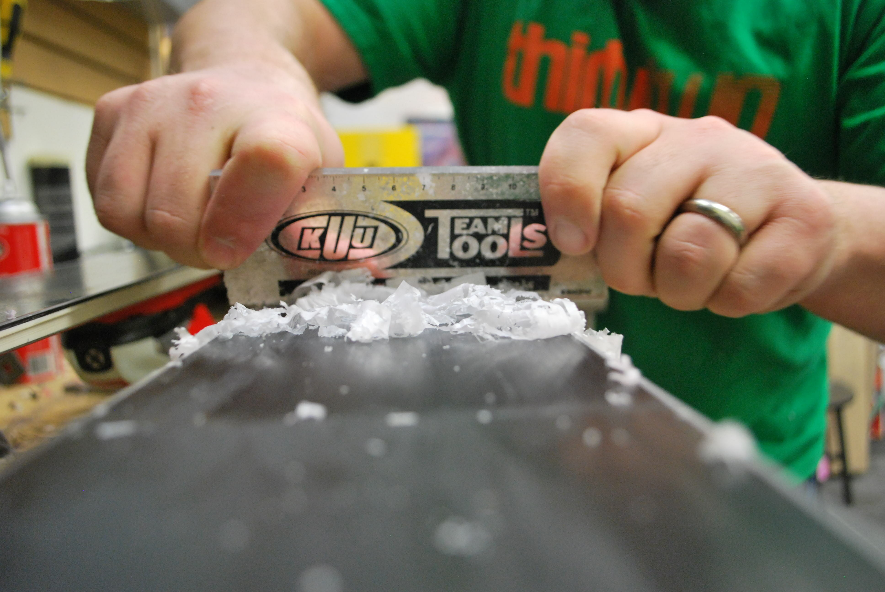
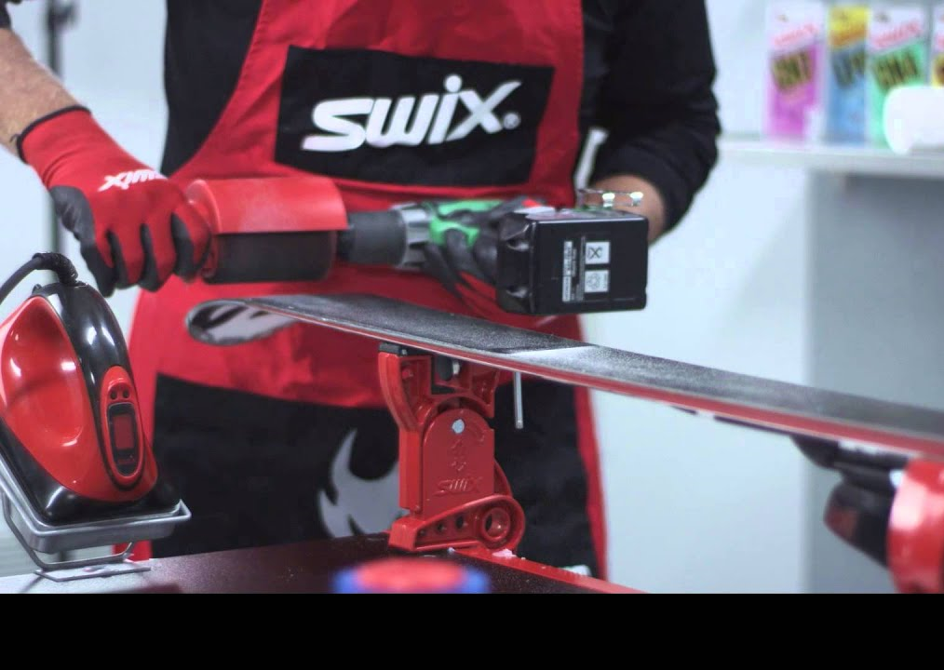
Who is at risk?
Ubiquitous – Blood Serum Levels
      Industrial Workers – PFAS production and manufacturing,
      operations such as such as application of protective coatings
      Firefighters – inhalation related to firefighting foam
      General Public – ingestion – 97% have measurable levels
      Ski Technicians – 4 OoM
Primary Exposure Pathways
  Drinking Water EPA/States focus, but …
  Ingestion – General Public
      PFOS: 80% - 15%
      PFOA: 60% - 25% - 15%
  Inhalation – Workers

Slide 11
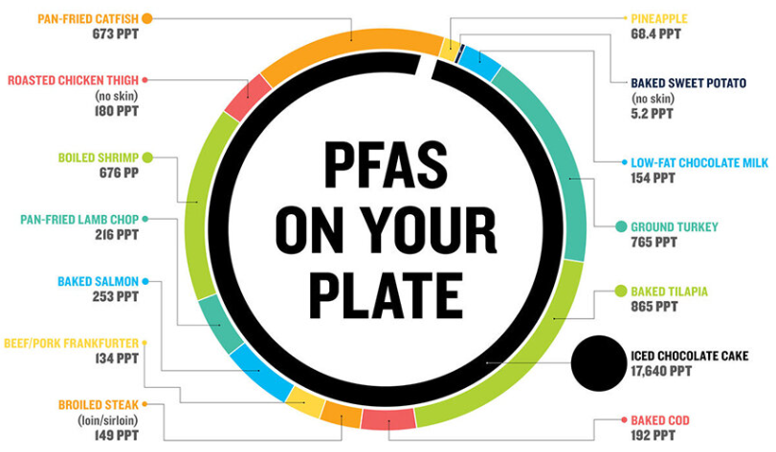
Primary Exposure – General Population

Slide 12


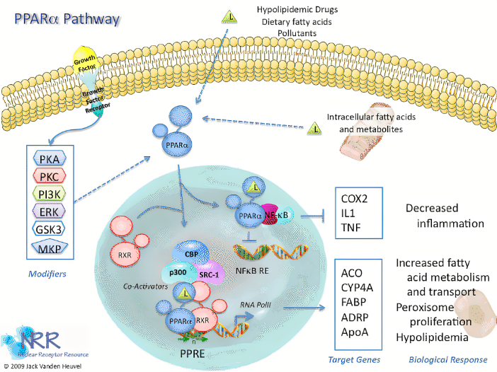

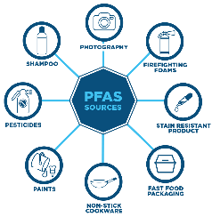
Uncertainties?
Trends in Toxicity Criteria → Prognosis for Compliance Standards
  Liver/Adults → Immunosuppression/Children → ? Development/Fetus
  PFOA RfDo:
    2018: 0.00002 mg/kg/d – HAL = 70 ppt
    2021: 0.0000000015 mg/kg/d – HAL = 0.004 ppt
    2023, ‘24, ‘25: ???
Science v. Pragmatism: Challenges in Assessing Adverse Effects and Exposure
  Human t_{1/2} = 6-9 years; Rat t_{1/2} = 2 hours
  Mechanism of action and relevance to humans?
Interim Health Advisories:
  Human Epi Studies – Immunosuppression
  Decreased serum antibody concentrations, post-vaccination
  Are we really in trouble?
    PFOS – Diphtheria {‘96-’18, <1 case/yr}
    PFOA – Tetanus {~30/yr, in the unvaccinated…}

Slide 13
More Uncertainty …
Occupationally exposed populations:
  PFAS production and manufacturing, operations such as such as application of protective coatings.
  Driven by fugitive emissions and subsequent inhalation of volatiles, aerosols adhered to suspended dust particles and particulate emissions
  Blood serum levels recorded as 1000x higher than Gen Pop for PFOA and 50x higher for PFOS
Only federally-promulgated tox criteria are ingestion-based
  Occupational Inhalation Standards –
  Derive Provisional RfCs from RfDos – via Route-to-Route Extrapolation
  Absorption
  Distribution
  Metabolism
  Portal-of-Entry Effects
  MI, NJ, MN, TX, CA
  NYS: PFOA AGL = 5.3 ng/m³

Slide 14
The Costs/Exposure
Frank DeMento

Slide 15
Why should you care? Costs are enormous
  $5.52B-$62.6B annual disease burden and associated costs in USA
      NYU Grossman School of Medicine, July 26, 2022
  €52B-€84B annual total health impact for European Economic Area
      Nordic Council of Ministers, March 2019
    $333.5M in 2022 to $1.1B in 2030 estimated annual expenditures for PFAS drinking water treatment systems
      Bluefield Research study
    $3.2B estimated costs related to PFAS contamination at Department of Defense installations
      US General Accounting Office
    $10B earmarked under the 2021 Infrastructure Investment and Jobs Act to addressing PFAS and other waterway contaminants

Slide 16
Why should you care?
  June 15, 2022 – EPA issued New Health Advisories for PFAS Compounds. The new advisories apply to four PFAS:
      0.004 parts per trillion (ppt) for PFOA
      0.02 ppt for PFOS
      10 ppt for GenX chemicals; and
      2,000 ppt for PFBS
  March 14, 2023 – EPA announced the proposed National Primary Drinking Water Regulation (NPDWR) for six PFAS. The proposed Maximum Contaminant Levels (MCLs) are as follows:
      4 ppt for PFOA and PFOS
      1.0 on “Hazard Index” for PFNA, PFHxS, PFBS, Gen X chemicals
Notes:
Note: New HAs are meant to be in place until EPA’s issuance of a National Primary Drinking Water Regulation (NPDWR) for PFAS.
Note: 1 ppt = one droplet of water in an Olympic-sized swimming pool
Hazard index = tool that EPA regularly uses, for example in the Superfund program, to understand health risk from chemical mixtures

Slide 17


4 ppt |
5 Olympic-Sized Swimming Pools
Notes:
An Olympic-sized swimming pool has 169,069,710.82 tablespoons. 4 parts per trillion is the equivalent to .00067 tablespoons in an entire Olympic-sized swimming pool. According to the Michigan Department of Environment, 1 PPT is the equivalent of 1 drop of water in 20 Olympic-sized swimming pools. So 4 PPT is the equivalent of 1 drop of water in 5 Olympic-Sized Swimming pools. Source: Michigan Department of Environment, Great Lakes, and Energy. PFAS Statewide Sampling Initiative for Public Water Supplies (Phase I – 2018)

Slide 18

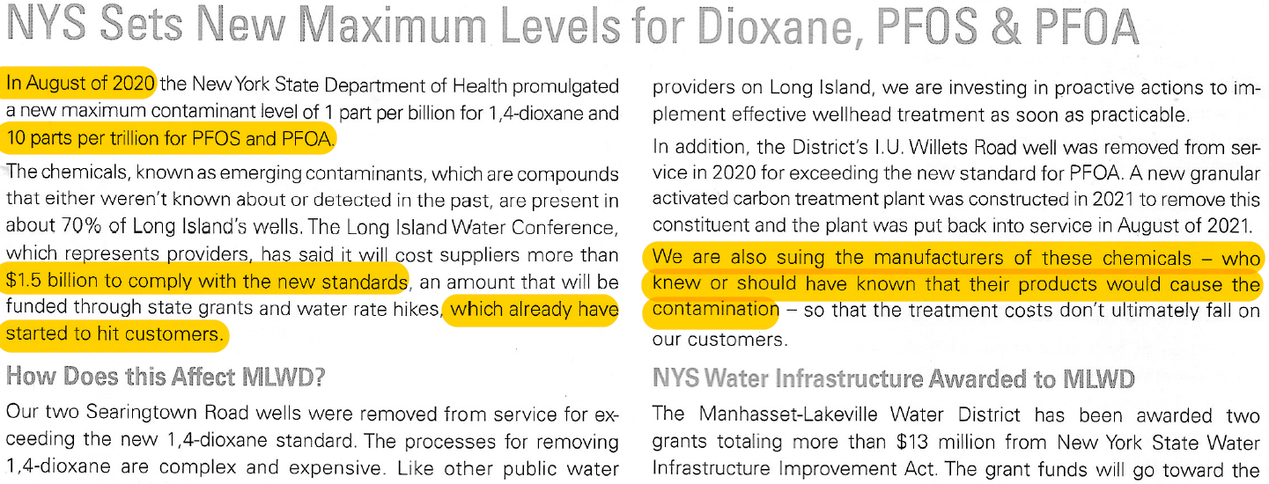
Why should you care?

Slide 19
PFAS Litigation
Thousands of lawsuits in state and federal courts throughout the United States against:
      Manufacturers
      Water providers
      Landfills
      Consumer product retailers – most recent wave of litigation
Theories against consumer product retailers and manufacturers:
      Presence of PFAS in a product renders its labeling false or misleading
      Affirmative obligation to disclose presence of PFAS
Notes:
RE: Consumer Product retailers:
Cosmetics/personal care products – L’Oreal cosmetics, Burt’s Bees (Clorox) lip balm
Fast food restaurants – Burger King, McDonalds, Chick-fil-A
Target – Allegedly mislabeled compostable packaging containing PFAS

Slide 20
PFAS Litigation | Two Significant Actions
    DuPont Class Action | Where the Action Started
      Not the first case – but opens the flood gates
      Settled with creation of C8 Panel
      Handful of cases then went to trial
    C8 Panel
      11 different epidemiologic studies studying 55 health outcomes
      4 reports
      PFOA was “probably linked” to six outcomes: kidney cancer, testicular cancer, ulcerative colitis, thyroid disease, hypercholesterolemia, and pregnancy-induced hypertension
      2020 follow-up study – still inconclusive

Slide 21
AFFF MDL Litigation | Where the Action Is Today
~13,000 case in total
Medical Monitoring
~8,000 Claims
Municipality Claims
(airports, landfills, water treatment facilities)
50+ Claims
States via National Resource Damage Assessment
~10 Claims
Water Providers
~150 Claims
Personal Injury
~4,000 Claims
Judge selects 10 “tier-1 bellwether cases”
Narrows to 3 “tier-2 cases” to go to trial 2023
Decisions used as precedent for personal injury claims
City of Stuart v. 3M Co. selected as first trial

Slide 22
Why should you care? Litigation
  Awards Against Manufacturers for Environmental Pollution
Year of Settlement | Amount | State
2018 | $850 million | MN
2018 | $4 million | AL
2019 | $2.7 million | MN
2019 | $35 million | AL
2020 | $55 million | MI
2020 | $113 million | MI
2021 | $17.5 million | SC
2021 | $11.9 million | MI
2021 | $99 million | AL
2021 | $30 million | VT

Slide 23
Why should you care? Litigation
  Awards Against Manufacturers for Bodily Injury
Citizens in Parkersburg, West Virginia v. Dupont
      C8 Science Panel: Found probable links between exposure and kidney and testicular cancer, ulcerative colitis, thyroid disease, pregnancy-induced hypertension, and high cholesterol
Case # | Alleged Injury | Compensatory | Punitive
1 | Kidney Cancer | $1.6 million | $0.0
2 | Testicular Cancer | $5.1 million | $0.5 million
3 | Testicular Cancer | $2.1 million | $10.5 million
3,500 Pending | Various | $670 million | $0.0

Slide 24
Why should you care? Litigation
  Awards Against Manufacturers for Bodily Injury
  Post-Settlement Cases
  Dupont Escrow Agreement
      Pre-July 1, 2015, liabilities
      Escrows $1 billion for future legacy PFAS liabilities
      Aggregate cap of $4 billion in escrow contributions and expense payments
Case # | Alleged Injury | Result
1 | Kidney Cancer | Mistrial
2 | Testicular Cancer | $50 million
3 | Various | $83 million

Slide 25
Coverage Issues and Cases
Joe Scully

Slide 26
Coverage Issues
  Occurrence – What is the occurrence?
      “Cause” jurisdictions – each separate PFAS?
      “Effect” jurisdictions – what exposures count?
  Expected or Intended
      In re Aqueous Film-Forming Foams Products Liability Litigation, 2022 WL 4291357 (D. S.C. Sept. 16, 2022)
        Court rejected certain defendants’ government contractor immunity defense
        Court found that 3M knowingly withheld material information regarding the risks associated with AFFF and misrepresented that PFOA was biodegradable and had no adverse environmental impacts
.
Notes:
Government contractor immunity defense: shields contractors from liability for products manufactured in accordance with government specifications, if the contractor warned the United States about any hazards known to the contractor but not to the government.

Slide 27
Coverage Issues
  Bodily Injury or Property Damage
      The Medical Monitoring claims
        Brown v. Saint-Gobain Performance Plastics Corp., 2023 WL 2577257 (N.H. Mar. 21, 2023)
          Not a coverage case, but could prove useful in coverage litigation
          “[T]he possibility that injury may result from an act or omission is sufficient to give the quality of negligence to the act or omission; but possibility of injury is insufficient to impose liability or give rise to a cause of action.”
          Plaintiffs’ contention that they may, in the future, develop a disease caused by PFOA exposure is insufficient
      PFAS Accountability Act – would create a federal cause of action for victims to bring claims against manufacturers and polluters
.
Notes:
Medical Monitoring Costs Issue – not all states allow for medical monitoring costs as a separate cause of action.
Brown v. Saint-Gobain: NOT a coverage case, but may have impacts on coverage litigation. The court concluded that the plaintiff’s contention that they are at an increased risk of harm (i.e., in the future, they may develop an illness or disease caused by PFOA exposure) is not sufficient under New Hampshire law to constitute a legal injury for purposes of stating a claim for the costs of medical monitoring.
PFAS Accountability Act – Bill proposed in 2021 which would create a federal cause of action for victims to bring claims against manufacturers and polluters, and allow courts to award those victims access to medical monitoring and studies at the polluters’ expense.

Slide 28
Coverage Issues
  Policy Period - Trigger/Allocation
      The science continues to evolve
        Bodily injury – no consensus on what constitutes sufficient evidence of bodily injury, let alone, when it occurs
        Property damage – new regulations require remediation of PFAS contamination above certain levels, but when did the property damage occur
      Trigger and Duty to Defend
        Crum & Forster Specialty Ins. Co. v. Chemicals, Inc., No. H-20-3493, 2021 WL 3423111 (S.D. Tex. Aug. 5, 2021)
          Complaints alleging bodily injury claims asserted in AFFF MDL did not allege periods of exposure
          Court held that insured had demonstrated that the claims were potentially within the scope of coverage
.
Notes:
Crum & Forster Specialty Ins. Co. v. Chemicals, Inc., No. H-20-3493, 2021 WL 3423111 (S.D. Tex. Aug. 5, 2021). Chemicals sought defense against bodily injury claims asserted in AFFF Litigation. The complaints did not allege periods of exposure. Applying Texas law, court held that insured had demonstrated that the claims in the underlying action were potentially within the scope of coverage. The plaintiffs in the underlying AFFF Litigation alleged exposure and injury from work generally performed during the policy periods.

Slide 29
Coverage Issues
    Duty to defend
      PFAS litigation is costly to defend
        Cases present an existential threat for some manufacturers
        Extensive discovery costs
        Expert-driven defense issues such as chemical identification
        Insureds will likely select top-tier law firms and specialists to lead their defense
      Carrier cost share arrangements – insures should identify all other carriers that should be participating in the defense of a particular insured
      Duty to indemnify
      Liability may be determined by chemical identification
      Certain insureds may assert governmental immunity defenses
      Remediation costs and settlement values are increasing
.

Slide 30
Coverage Issues – Pollution Exclusions
    Total Pollution Exclusion, Absolute Pollution Exclusion, Time Element Pollution Exclusion
      May be upheld for PFAS claims in traditional environmental contexts
        Tonoga, Incorporated v. New Hampshire Insurance Company, No. 532546, 2022 N.Y. App. Div. LEXIS 105 (App. Div. 3rd Dep’t Jan. 6, 2022)
          Court upheld the application of the pollution exclusion and found no duty to defend in connection with PFAS claims at a manufacturing facility
        Grange Ins. Co. v. Cycle-Tex, Inc., No. 4:21-cv-147-AT (N.D. Ga. Dec. 5, 2022)
          Court reached a similar conclusion applying absolute pollution exclusion
      Majority rule – pollution exclusion may be applicable in traditional environmental exposures versus where pollution is caused by product failure
.
Notes:
Grange: First, the court noted that “there c[ould] be no doubt” that PFAS chemicals were “pollutants” within the meaning of the policy. Second, the damages in the underlying action were “‘loss[es], cost[s], or expense[s]’ that arose out of a request, demand, or statutory or regulatory requirement to ‘clean up, remove, contain, treat, detoxify or neutralize or in any way respond to’ PFAS chemicals from the City[’s] . . . water supply.”

Slide 31
Coverage Issues – Pollution Exclusions
    Pollution Exclusions
However, Courts have failed to uphold the application of the pollution exclusion in other contexts.
    Colony Insurance v. Buckeye Fire Equipment, 2020 U.S. Dist LEXIS 194709 (W.D.N.C. Oct. 20 2020)
      “[A]n insurer may not deny coverage to an insured based on a pollution exclusion, or any variation thereof, if the occurrence and the resulting personal injury and property damage allegedly suffered by [underlying plaintiffs] are . . . not the prototypical environmental harms that a pollution exclusion clause is generally intended to protect against.”
      Direct contact with pollution is not “traditional environmental pollution”
Notes:
Colony: The court held that the hazardous materials exclusion at issue applied only to traditional environmental pollution, which did not include bodily injury from direct contact with a pollutant. Therefore, the exclusion did not apply to the underlying claims in the AFFF litigation, and the court ruled that the insurance company owed a duty to defend its policyholder.

Slide 32
Coverage Issues – Pollution Exclusions
    Sudden and Accidental Pollution Exclusion
      Courts are split on the application of the sudden and accidental exception
      Strict temporal interpretation – NY, CA
      A mere reiteration that the damages are unintended and unexpected – NJ, IL, WV, WI
    In the PFAS context, policyholders argue that this exception applies
  The coverage analysis may center on the details of the specific source and temporal nature of the contamination
      Wolverine World Wide v. American Insurance, 2021 U.S. Dist. LEXIS 200978 (W.D. Mich. June 15, 2021)
        Court found, in the PFAS context, the S&A exception at least precluded a denial under the duty to defend standard
.
Notes:
Wolverine: The insured used Scotchgard in its operations. Insurer argued that the S&A pollution exclusions policies applied. The policyholder argued that any release of PFAS was sudden and accidental. The Court found in the PFAS context that the sudden and accidental exception to the pollution exclusion at least precluded a denial under the duty to defend standard and thus that insurers had a duty to defend.

Slide 33
Coverage Issues | Prior Settlements
    How good is your site release, environmental release, etc.?
.

Slide 34

Reinsurance Issues

Slide 35


