Slide 1

What happens when the corporate transaction goes bad: Elon Musk v. Twitter and Reps & Warranties (Re)insurance
Panel: Allen Burton & Oderah Nwaeze
Moderated by Jennifer Cavill
November 4, 2022

Slide 2

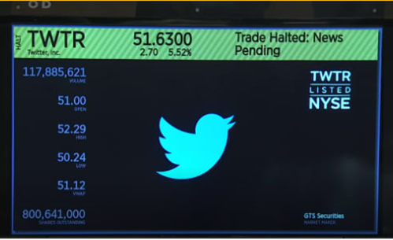
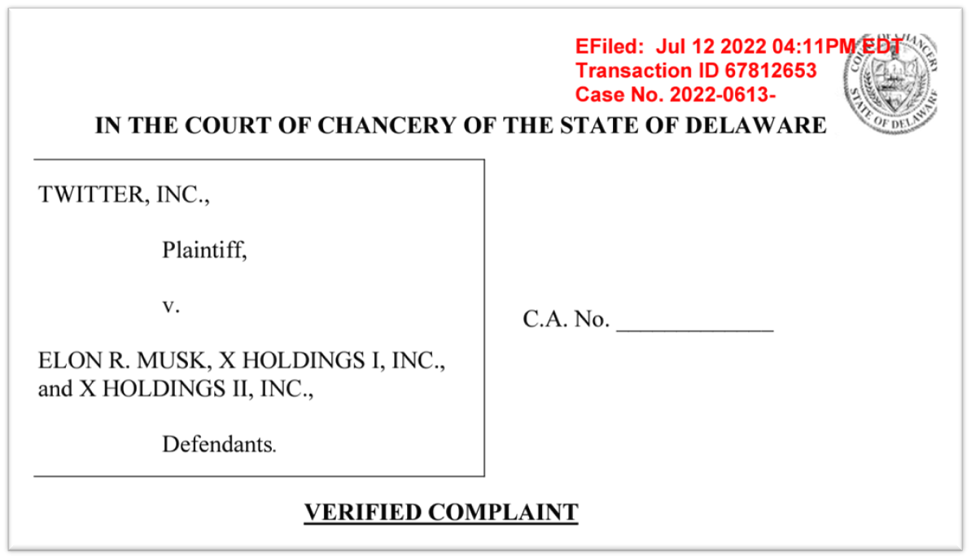

Slide 3
Elon Musk/Twitter – The Build Up to the Merger
January 2022 – Musk starts quietly building up his Twitter stake
March 2022 – Musk discloses that he owns a large stake in Twitter. He starts making pointed statements about how the platform should change.
March 26 – Musk reaches out to Jack Dorsey - Board offers Musk a seat, but later backs off.
March 31 – Musk states that he wants to rid Twitter of the “[c]rypto spam” he views as a “major blight on the user experience.”
April 14 – Musk publicly offers to buy the company at $54.20 per share, his “best and final.” The Board adopts a poison pill and questions Musk’s financing.
April 25 – The merger is announced. The price is $44B - a 38% premium over Twitter’s share price.

Slide 4
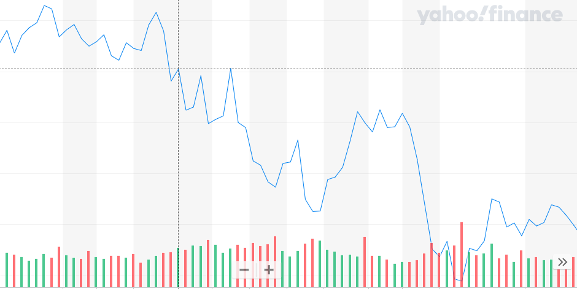
What else is going on at the time:
DJIA – March to July 12, 2022 (the vertical line is April 25)

Slide 5
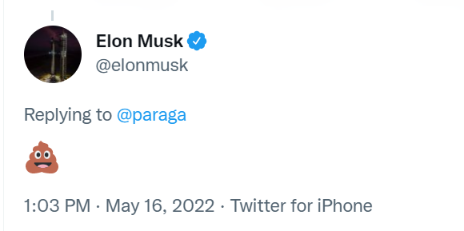
Elon Musk/Twitter – The Interim Period
May 13 – Musk tweets that the deal is on hold, linking to a Reuters report about the amount of spam and fake accounts.
May 16 – Twitter carefully explains how Twitter attempts to combat and measure spam accounts, asserting that “less than 5%
of its users are spam or fake accounts.
Musk responds as follows:
June 6 – Musk threatens to walk, alleging that Twitter “is actively resisting and thwarting his information rights” as outlined by the deal.
July 9- Musk moves to terminate the acquisition agreement. His lawyer says that Twitter is “in material breach of multiple provisions” of the deal.

Slide 6
Twitter sues Musk in Delaware
July 12, 2022 - Twitter sues Musk in Delaware’s Court of Chancery.
The 62-page lawsuit, sprinkled with memes, tweets and the famous poop emoji, effectively highlighted the bizarre spectacle of the deal from the start. The company paints Musk as a non-serious potential owner — alleging at one point that he has “disdain” for the company, and at another saying, “Musk’s strategy is … a model of bad faith” — while seeking to compel him to become its owner.
Twitter places great emphasis on the notion that Musk should be treated like every other party subject to Delaware contract law.

Slide 7
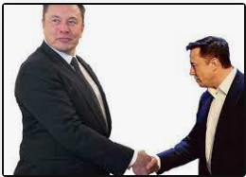
And nothing has changed . . .
September 13 – Twitter shareholders vote to approve the original $44B deal.
October 4 – Musk proposes to close the deal in accordance with the original merger agreement.

Slide 8
Agenda
Why is this in Delaware?
Issues regarding the Delaware Forum
Types of M&A Claims
Insurance/Reinsurance Issues

Slide 9
Why Delaware?

Slide 10

The Diamond State
The leading corporate home for an overwhelming number of U.S. and international corporations
More than 1,000,000 business entities have made Delaware their legal home
  Over 50% of all publicly-traded companies in the United States
  64% of the Fortune 500

Slide 11
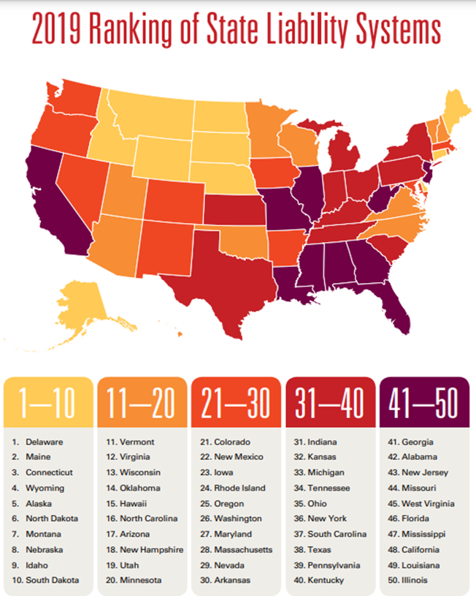
The #1 Ranking of Delaware’s Judicial System
2019 Lawsuit Climate Survey, Ranking the States prepared on behalf of the U.S. Chamber Institute for Legal Reform
#1 in every year survey conducted (2019, 2015, 2012, 2010, and 2008 except one (2017))

Slide 12
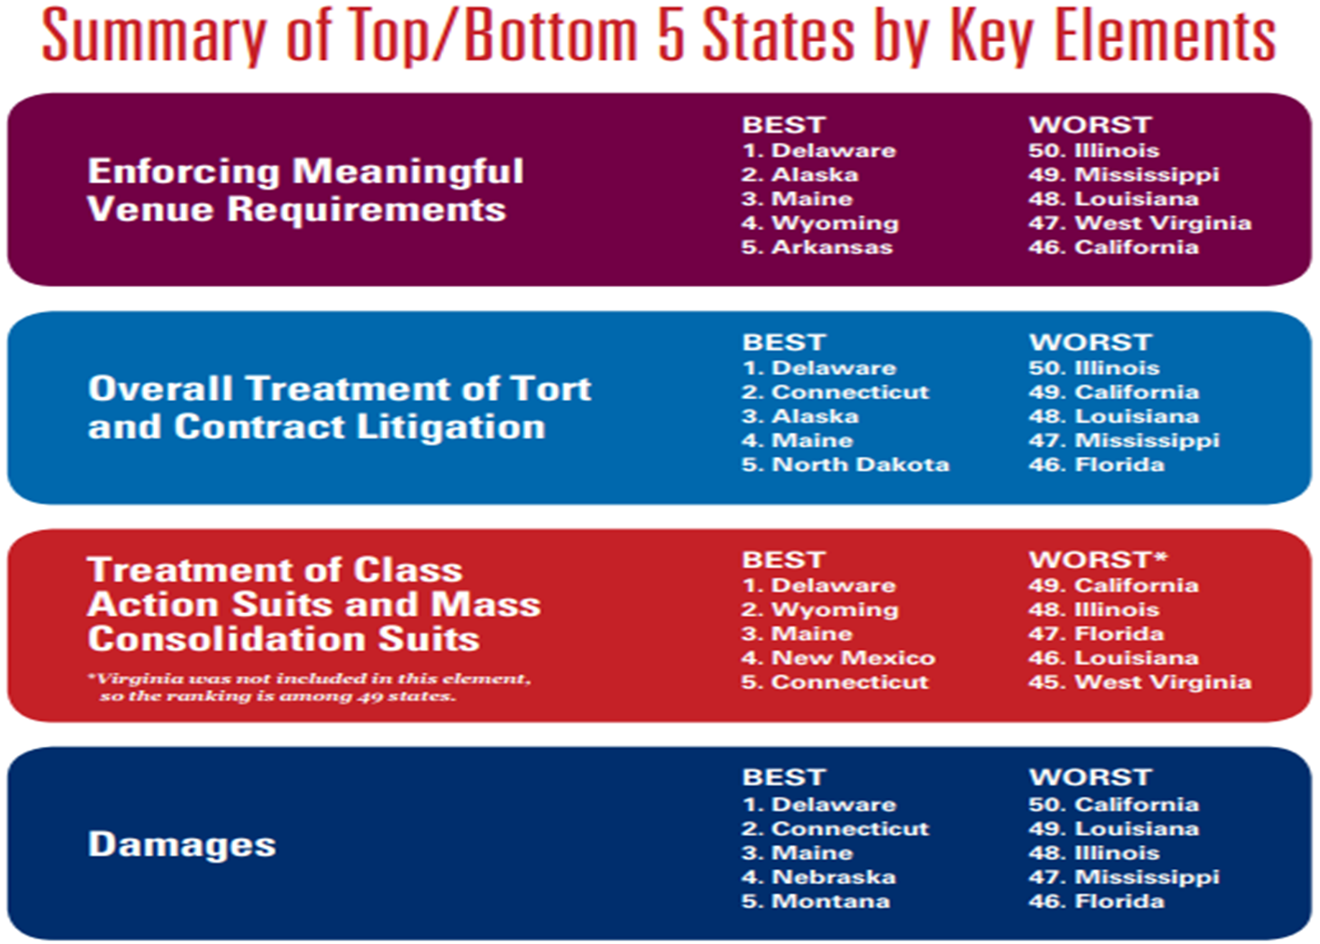

Slide 13
The Court of Chancery
Cases are decided by sophisticated judges with business knowledge, not juries. They are nominated by the Governor and confirmed by the state senate for 12-year terms.
    1 Chancellor
    6 Vice Chancellors
    2 Masters in Chancery

Slide 14
The Court of Chancery, cont’d
  The Court of Chancery hears matters and causes in equity.
    the chief remedy is not monetary or there is an absence of an adequate legal remedy;
  Injunctions relief in the context of corporate transactions;
  fiduciary rights and obligations;
  trusts and administration of estates;
  declaratory judgment actions;
  enforcement of arbitration awards; and
  specific performance.
See §§ 341 and 342 of DGCL

Slide 15
M&A Disputes: Buyer’s Remorse or Bait-and-Switch?

Slide 16
M&A Litigation Landscape
Several Types of Disputes Can Arise in the M&A Context:
  Shareholder Lawsuits Challenging Proposed Transactions
  Disputes Between Parties to an M&A Deal

Slide 17
Disputes Between Parties
Pre-Closing
  Compliance with pre-closing covenants
  Material Adverse Effect clauses
  Obtaining financing
  Common law frustration of purpose
Post-Closing
  Inaccuracies of R&Ws
  Fraud
  Price adjustment mechanisms

Slide 18
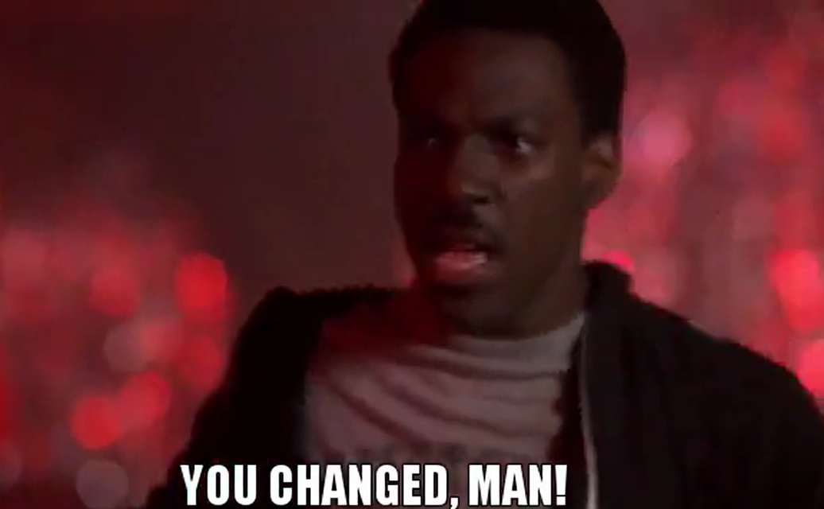
Breach of Covenants
Common pre-closing covenants include:
  Operation of business between signing and closing, including operating in the “ordinary course”
  Obtaining regulatory and third-party consents
  Notification of certain matters
  Confidentiality and non-disclosure agreements
Buyers seek to ensure that the company they pay for at closing is what they agreed to buy at signing.

Slide 19

Breach of Covenants
Snow Phipps Grp., LLC v. Kcake Acquisition, Inc., No. 2020-0282-KSJM, 2021 WL 1714202 (Del. Ch. Apr. 30, 2021)
Buyers (Kcake) lost their appetite for the deal as government entities issued stay-at-home orders and seller’s (DecoPac) weekly sales declined precipitously. In response, DecoPac undertook cost saving measures and drew down on its line of credit.
No breach of covenants. Cost-cutting measures were consistent with past practices.
Award of specific performance.

Slide 20
Breach of Covenants Scenario: Downward Dog
Level 4 Yoga, LLC v. CorePower Yoga, LLC, No. CV 2020-0249-JRS, 2022 WL 601862, at *1 (Del. Ch. Mar. 1, 2022)
CorePower Yoga (Buyer) invoked the APA’s MAE clause and “ordinary course” covenant to declare it was no longer obligated to complete the transaction to purchase yoga studios of its franchisee, Level 4 (Seller).
Court: by following the directions of its franchisor, as it always has done, Seller operated its yoga studios in the ordinary course.
Stay tuned: On October 19, 2022, Buyer went to the Delaware Supreme Court seeking reversal of the order. Buyer argues that the actions taken by Seller—including requesting rent adjustments and mass layoffs —went beyond even the government closure mandates, and the covenant defined “ordinary course” as the way Seller functioned prior to 2019.

Slide 21
Material Adverse Effect Clauses
A MAE (or MAC) clause permits the buyer to avoid closing based on material negative effects in the financial condition, assets, liabilities, business, or operations of the target firm.
Subject to heavily negotiated exceptions.
Delaware courts exceedingly reluctant to allow buyers to invoke MAE clauses to escape from M&A deals.

Slide 22

Material Adverse Effect
Bardy Diagnostics, Inc. v. Hill-Rom, Inc., No. 2021-0175-JRS, 2021 WL 2886188 (Del. Ch. July 9, 2021)
Hill-Rom, Inc. (“Buyer”) agreed to acquire Bardy Diagnostics, Inc. (“Seller”), a medical device startup. Between signing and closing, the Medicare program announced that the rates Medicare would pay for Seller’s only product on the market would be dramatically reduced.
Court: Buyer did not prove that Seller suffered an MAE given its failure to prove the durational significance of the Medicare rates. Also, even if an MAE occurred, the rates were carved out from the definition of MAE.
Award: Specific performance and prejudgment interest.

Slide 23
Post Closing: Representations and Warranties

Slide 24


Breach of Representations & Warranties
Swipe Acquisition Corp. v. Krauss, No. CV 2019-0509-PAF, 2020 WL 5015863, at *3 (Del. Ch. Aug. 25, 2020)
Sellers told Buyers (Swipe) that Amazon was the largest indirect buyer of the Company’s products.
Before closing, Sellers learned that Amazon was going to move its business to one of the Company’s competitors.
Court: Motion to dismiss claims for breach of contract and fraud denied.

Slide 25
Reps & Warranties Insurance

Slide 26
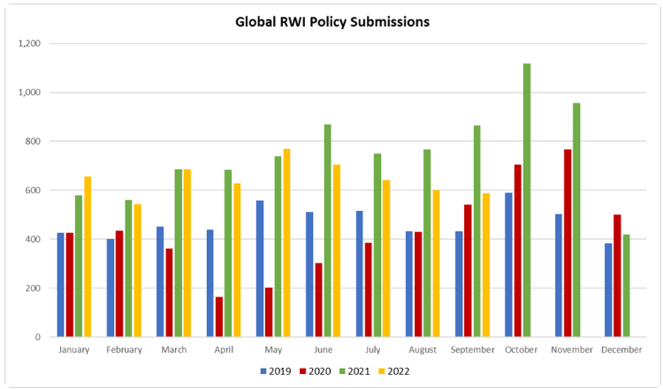

Source: Euclid Transactional R&W/W&I Insurance October 2022 Update

Slide 27
What is RWI?
  R&W Insurance is basically a breach of contract coverage. It stands in the shoes of the indemnification given by the seller to the buyer.
  Protects against financial losses from certain unintentional and unknown breaches of the seller’s representations and warranties made in the acquisition or merger agreement.
  Includes costs associated with defending claims brought by third parties.
  Measure of Damages: Benefit of the Bargain. Put the parties in the position as if the Breach had not occurred.

Slide 28
How do Underwriters Assess the M&A Risk?
When drawing up the R&W policy, the underwriters evaluate:
The nature of the terms and conditions of the Purchase Agreement.
The nature of the specific warranties being given in the context of the transaction.
  Environmental
  Compliance
  Employment
  Condition of Assets
  Financial Condition
The quality of the due diligence. Underwriters wish to provide coverage for the unknown, so they are looking to “diligence the diligence.”

Slide 29
What’s covered?
The policy is essentially stapled onto the Purchase Agreement and covers certain (but not all) reps and warranties contained therein.
The policies contain standard exclusions:
Forward looking warranties
Purchase price adjustments
Known Issues/Conduct Exclusions
Net Operating Losses and Tax Credits
Sensitive coverage issues, such as union activity, wage and hour violations, etc.
Deal Specific Exclusions (such as Medicare/Medicaid in healthcare or FCPA in construction)

Slide 30
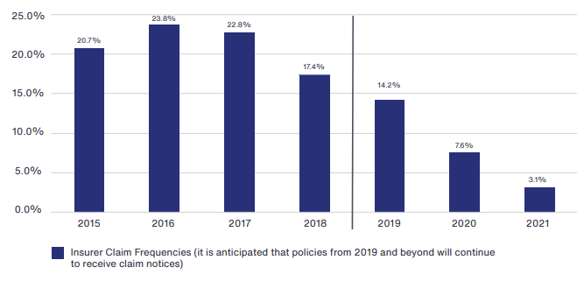
Frequency of Claims
Source: Aon Transaction Insurance Claim Study 2022

Slide 31
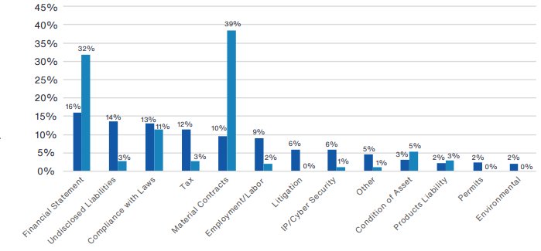
Type of Breach: Frequency v. Total Claim Payments
Source: Aon Transactional Insurance Claim Study

Slide 32
RWI Claim Processing
Through 2021, R&W insurers have paid more than $560 million to Aon clients in North America and an additional $60 million on W&I policy claims in EMEA.
21% settled within the retention
13.7% resulted in a payment by the insurer
4% have been denied (outright denials are rare)
49% remain active
12% became inactive over time

Slide 33
Reinsurance in RWI

Slide 34
Reinsurance of RWI
Mostly Quota Share per-risk contracts.
Some Financial Institution Treaties may cover some RWI losses.
They generally provide for dispute resolution via arbitration.

Slide 35
Thank you!

