Slide 1
#ARIASUS • www.arias-us.org

Slide 2
How to Best Defend Your Company from Regulators and Litigators After a Breach
Kimberly Klinsport, Partner, Foley & Lardner LLP
Eileen Ridley, Partner, Foley & Lardner LLP
Elizabeth Mazzocco, Associate, Foley & Lardner LLP
Nathan Mousselli, Managing Director, Cybersecurity, FTI Consulting
Andrew Whitman, Senior Director, Insurance Risk Management Advisory, FTI Consulting

Slide 3
Agenda
Risk: Cyber Security and Privacy Trends for 2023
Response: Insurance Policies And Internal Practices
Resulting Litigation

Slide 4
Risk: Trends in Cyber And Privacy Threats
Ransomware/Social Engineering Attacks
Continued Threat of State-Sponsored Threat Actors
AI and Start Device (IoT) Vulnerability
Mobile Device Breaches
Remote Work Access Points
Increased Attacks on Cloud-based Services

Slide 5
Cybersecurity Snapshot
Cybersecurity risks are always evolving, but the past year has shown trends in vulnerabilities, exfiltration, and ransoms.
Vulnerabilities
Software vulnerabilities are becoming an increasing root cause of cybersecurity incidents. Attackers can exploit vulnerabilities in programs used by organizations to gain access to their environment and carry out the attack.
Exfiltration
Cybersecurity incidents where the attacker was able to exfiltrate data are on the rise, meaning attackers can remove data from the organization’s environment and store it on a computer system that it controls.
Ransoms
Ransomware attacks continue to be highly prevalent, representing over half of the observed incidents. A majority of organizations have chosen to pay ransoms in the past year.

Slide 6
By the Numbers
Cyber threats are increasingly costly for organizations, presenting significant coverage issues and potential legal liabilities.
$4.35 million: Average total cost of a data breach |  | 45%: Percentage of breaches that were cloud-based from the organizations surveyed
277 days: Average time it takes to identify and contain a breach |  | $4.54 million: Average cost of a ransomware attack, not including the ransom itself
$50 million: Average total cost of a mega breach of more than 1 million records |  | 19%: Percentage of breaches that occurred because of a compromise at a business partner
$4.91 million: Average cost of a data breach with a phishing initial attack vector |  | 25,575: Average size of a U.S. data breach in terms of records
Source: IBM Security Cost of a Data Breach Report 2022

Slide 7
Critical Privacy and Security Issues to Watch
Cybersecurity and privacy risks are constantly changing with the evolution of technology, shifts in the economy, and new regulatory requirements.
Increased Financial Impact of Ransomware Attacks
Cyber attacks are larger and more frequent than ever. Financial impact also stems from loss of business, reputational hits, remediation costs, and potential litigation.
Upticks in M&A Leave Customer Data Vulnerable
Organizations may not be aware of unprotected data or gaps in security systems from other parties involved.
Increased Mobile Device Use for Work Heightens Phishing Risk
It is much harder to preview suspicious links on a phone than a computer, so more employees are falling victim to these attacks.

Slide 8
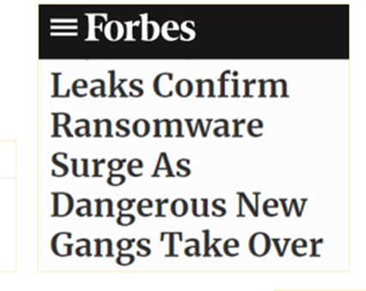
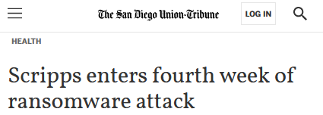
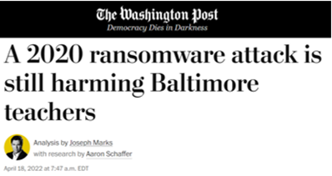
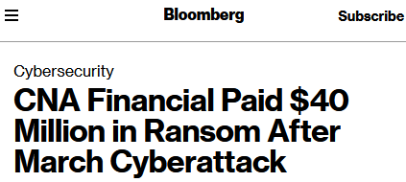
Ransomware on the Rise
Ransomware has rapidly emerged as the most visible cybersecurity risk playing out across our nation’s networks, locking up private sector organizations, critical infrastructure, and government agencies.
There are an estimated 4,000 ransomware attacks each day, globally.
An estimated $550 million+ in Bitcoin has been paid out as ransom in the first half of 2021.
The sums demanded by attackers are increasing, often reaching seven or eight figures.

Slide 9
Cyber Readiness
Building a robust security posture is the best way to prevent a breach from occurring. You cannot control whether you will be the victim of a cyber attack, but you can control how to respond to one. Effective and tailored incident prevention measures can help preserve your corporate reputation, operations, and financial standing.
Prevention Measure | Details
Cybersecurity Program Assessment | Scored assessment of a cybersecurity program to determine overall level of maturity of policies, procedures, technology, staff, and culture
Policies, Procedures, and Gap Analysis | Review of security policies and procedures to understand how security policies, processes, and procedures are implemented, managed, and enforced
Penetration Testing and Red Teaming | Authorized simulated attack on a system to evaluate security of that system
Threat-Hunting Operations | Proactively searching a network to identify threats/malicious actors that have already evaded existing security solutions
Cybersecurity Compliance Preparedness | Clarification of compliance landscape and requirements to close gaps and achieve regulatory compliance
Crisis Simulation and Tabletop Exercises | Live simulated attack to practice and assess readiness
Third Party Audit and Assessments | Due diligence assessments to analyze cyber risk and tailored recommendations for how to mitigate any threats

Slide 10
Response:
Insureds must protect themselves with up-to-date cybersecurity measures geared toward emerging threats
Insurance — types of coverage available
Insights
Cyber insurance pricing continues to climb
Rigorous underwriting due to high losses and difficulty determining exposure; insured internal controls are critical
Increased retention mitigates price increases and provides opportunity for insureds to share in risk

Slide 11
U.S. Composite Pricing
Fifteen straight quarters of price increases
Source: Marsh Global Insurance Market Index
Notes:
UK, APAC, and EMEA are driving global premium rates – US is on the backside of its correction, while those regions are just starting to fire up the rate growth

Slide 12
Global Composite Pricing: Management Lines
Q4 2021 was height of pricing acceleration. Cyber pricing acceleration dovetailed with D&O market curve and stability in 2022
Source: Marsh Global Insurance Market Index

Slide 13
Cyber Written Premiums
Cyber written premiums increased by 74% in 2021 to nearly $5 billion compared with 9% growth for the P/C industry overall
Source: Fitch Ratings, S&P Global Market Intelligence
Notes:
Demand for cyber coverage has increased dramatically post-COVID with the shift to WFH and increasing digitization of almost every facet of life
Standalone and packaged cyber statutory direct written premiums increased by 74% in 2021 to nearly $5 billion compared with 9% growth for the P/C industry overall
Driven by heightened policyholder risk awareness and greater demand for coverage.
Standalone cyber coverage, which represents approximately two-thirds of industry premiums, increased by 92% in 2021.
Standalone coverage will expand further as a proportion of industry cyber premiums as insurers strive to reduce exposure to “silent” cyber risks and minimize any ambiguity in coverage terms.
However, a large portion of cyber risk remains uninsured

Slide 14
Cyber Market Update: Cyber Carriers’ Loss Ratios
Significant increase in loss ratios have in turn driven meaningful pricing increases since 2019
Source: Fitch Ratings, S&P Global Market Intelligence
Notes:
Combined ratios are a measure of profitability – anything over 100% and carriers are losing money, it’s a function of loss costs and expenses
Loss ratio increased by 25 points over 2019
Historically, this loss ratio was 30-40% - today it is over 70%
Aon estimates that combined ratios were near 100% for cyber in 2020
Significant increase in underwriting actions and rate increases – unfortunately, this did not lead to a return to profitability
Testing cybersecurity thesis: "putting a price on risk, insurers will help improve cybersecurity hygiene and reduce the cost of cyberattacks" - which is proving to be true
A sharp increase in 2020 cyber loss ratios promoted substantially higher prices and rapid premium growth in 2021 that exceeded incurred losses, leading to surprising improvement in the cyber direct loss ratios versus the previous year.

Slide 15
Cyber Renewal Premium Rate Change Quarter Over Quarter
Average cyber pricing increased 27% in Q1 2022 and 105% in 2021
Source: Fitch Ratings, Council of Insurance Agents & Brokers
Notes:
For standalone cyber coverage, direct incurred losses and defense and cost containment (DCC) expenses expanded by over 300% since 2018.

Slide 16
Change in U.S. Cyber Limits at Renewal
Purchasing trends are trying to keep pace as a mix of companies increase or decrease limits to right-size coverage and cost
Source: Marsh Q2 2022 Market Update

Slide 17
Change in U.S. Cyber Retentions at Renewal
Increases to retention, however, are in line with rate and market pressures
Source: Marsh Q2 2022 Market Update

Slide 18
Digital Footprint Cybersecurity Scans and Ratings
Carriers rely on cybersecurity scans and ratings, such as BitSight or Security Scorecard, as part of their underwriting process
These reviews provide an objective, quantitative view of cybersecurity posture and are produced using publicly available data without sharing sensitive data
Often, it can be difficult to correct or remediate these reports or their findings shortly before binding
Take efforts in advance of the submission to optimize your digital footprint rating during the underwriting process

Slide 19
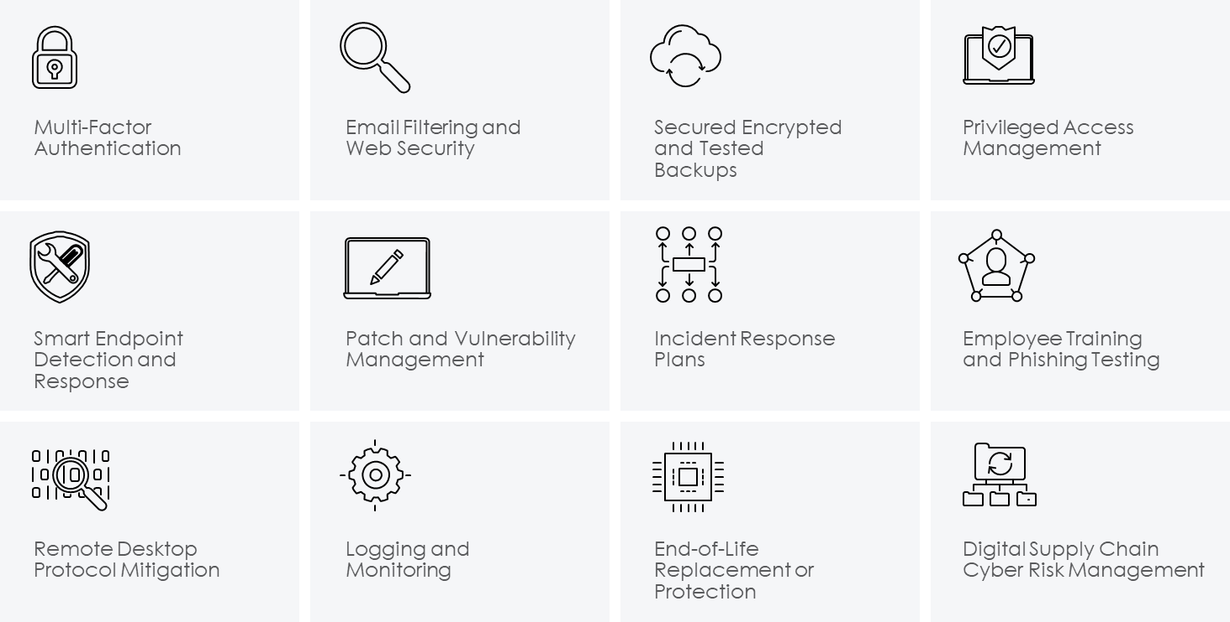
Key Controls for Cyber Insurance Renewals
Carriers have identified a correlation between certain controls and corresponding cyber hygiene. Highlighting the following controls during the renewal process is paramount to achieving cyber terms.
Source: Marsh Q2 2022 Cyber Update

Slide 20
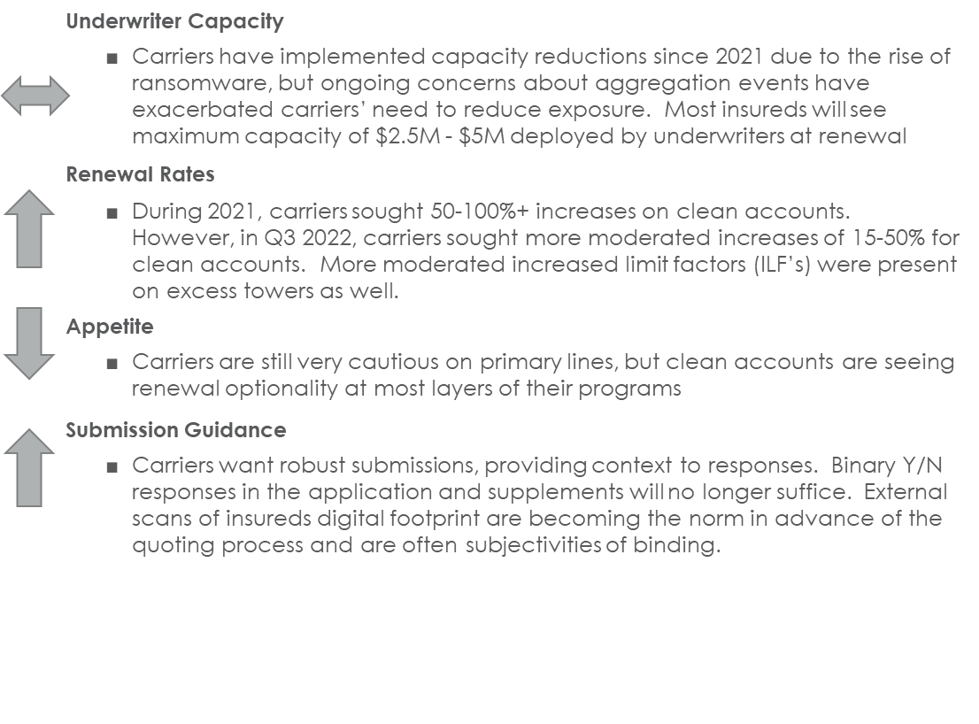
Cyber Market Dynamics
While still a challenging market, Q3 2022 indicates stability if forthcoming as insureds implement carrier-mandated controls
Cyber market is hardening at a rapid pace driven by pervasive rise of ransomware attacks and associated losses
Vulnerability aggregation events such as SolarWinds, Kaseya, Microsoft Exchange, and Log4j have exacerbated hardening trend
Carriers have deployed significant measures to deal with claims
Increased underwriting scrutiny
Reduced capacity and appetite
Restricted terms and conditions
Increased pricing and retentions
Minimum security standards must be shown to secure quotes, including:
MFA for all email, privileged accounts, and remote connections
Smart endpoint detection
Effective and tested backup
Source: Lockton Companies

Slide 21
Tactical Renewal Advice
Start Early Evaluate risk tolerance and engage senior leadership Develop a clear strategy and with ample timelines and strict milestones are essential Make a formal assignment on your IS/IT team to be an insurance liaison Renewal strategy meeting Data collection Applications UW meetings Follow-up questions | Best-in-Class Insurance Underwriting Submission Underwriting calls are expected to clarify carrier questions, particularly around controls and any professional services Carriers want robust submissions, providing context to responses Binary Y/N responses in the application and supplements will no longer suffice Be prepared to respond to external scans of digital footprint in advance of the quoting process | Post-Loss Vendor Tree Engage post-incident providers and pay retainers so they are at the ready in event of a loss Schedule preferred providers and rates with carriers, including: Forensics firm Breach notification Credit monitoring Public relations and/or communications form Legal defense | Stay Vigilant Tell your story and explain your IS/IT model/methodology directly to underwriters Listen to underwriter feedback Use the included carrier loss control resources Ride herd on brokers and carriers to deliver quotes on a timely basis Stay flexible when results come back, be prepared with back-up plans crafted during strategy process
Notes:
https://static2.ftitechnology.com/docs/media-mentions/FTI+Briefing+-+The+Lawyer.pdf

Slide 22
Resulting Litigation
Key Statutes:
Federal privacy laws (e.g., ECPA, COPPA, FCRA, VPPA, etc.)
New Trends: Video Privacy Protection Act (18 USC § 2710) and Wiretapping Statutes
State privacy laws (e.g. CCPA & CPRA, etc.)
Industry-specific laws (e.g., HIPAA, GLBA, etc.)
New Trend: Biometrics (e.g., BIPA in Illinois)
Cross-Border considerations (e.g., GDPR, PIPEDA, etc.)

Slide 23
Resulting Litigation
Regulatory Basis:
SEC disclosure rules
CISA proposed rules
Office of Foreign Assets Control (OFAC) Sanctions Program
Federal and State AG investigations
Federal and State notification requirements
CAFA notices — class actions
Industry standards (e.g., NIST, etc.)

Slide 24
Resulting Litigation
Litigation Trends:
Class action claims
CAFA notices — class actions
Use of common causes of action (e.g., negligence, fraud) — product liability theories
Use of equitable claims — unfair business practices
Issues regarding the privileged nature of breach investigations (discovery)

Slide 25
Resulting Litigation
Litigation Trends (cont’d.):
Article III Standing Defense (actual damage analysis and speculative claims of “future harm”)
Ramirez v. Transunion, 141 S. Ct. 2190 (2021)
Follow-on litigation regarding market effect
Consumer price inflation claims due to poor security
Shareholder claims — failure to protect company assets

Slide 26
Important Proposed Data Breach Rules to Have on Your Radar
U.S. state data breach notification laws
SEC proposed disclosure rules
CISA proposed rules
Office of Foreign Assets Control (OFAC) Sanctions Program
NY DFS proposed rules

Slide 27
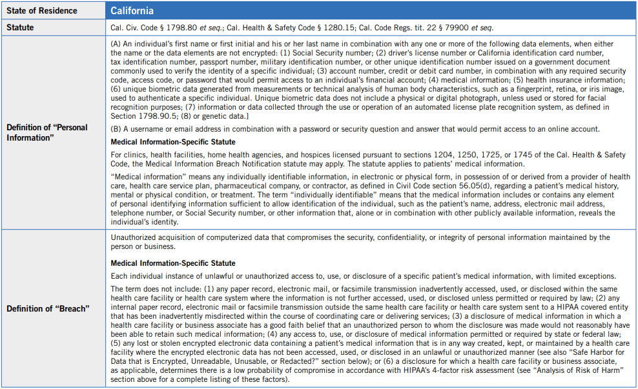
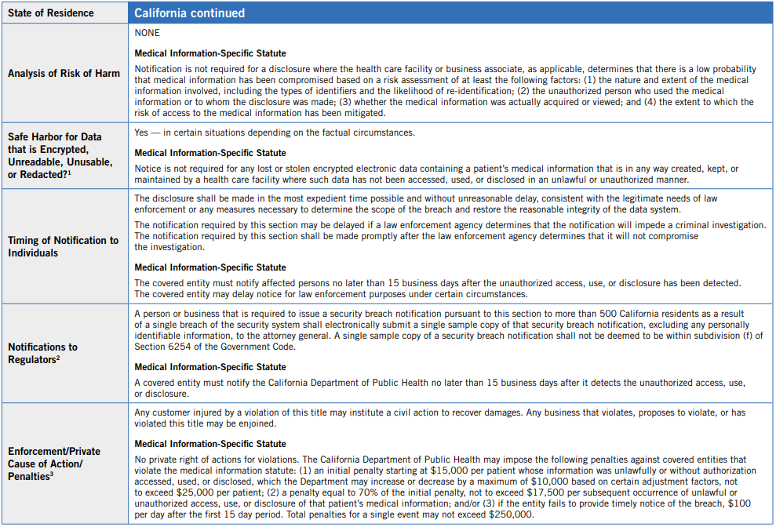
U.S. State Data Breach Notification Overview
Full chart available for download at: www.foley.com/state-data-breach-notification-laws

Slide 28
Proposed SEC Disclosure Rules
Disclosures to the SEC (*not yet in effect and subject to change)
Trigger: An unauthorized occurrence on or conducted through information resources owned or used by Company, including physical or virtual infrastructure controlled by those resources, or components thereof, organized for the collection, processing, maintenance, use, sharing, dissemination, or disposition of Company’s information to maintain or support its operations (“information systems”) that jeopardizes the confidentiality, integrity, or availability of Company’s information systems or any information residing therein
Deadline to Notify: Within four (4) business days of the date Company determines that a cybersecurity incident is material (not the date the cybersecurity incident is discovered)

Slide 29
SEC Notification Content Requirements
Minimum Required Content to Include in the Disclosure (*if known at the time of filing)
When the incident was discovered and whether it is ongoing;
A brief description of the nature and scope of the incident;
Whether any data was stolen, altered, accessed, or used for any other unauthorized purpose;
The effect of the incident on the registrant’s operations; and
Whether the registrant has remediated or is currently remediating the incident

Slide 30
SEC Notification Content Requirements (cont’d.)
Non-Exhaustive List of Examples of Cybersecurity Incidents
(*that might trigger the reporting requirement to the SEC, if deemed material)
An unauthorized incident that compromises the confidentiality, integrity, or availability of data, a system, or a network, or violates Company’s security policies or procedures;
An unauthorized incident that causes degradation, interruption, loss of control, damage to, or loss of operational technology systems;
An incident in which an unauthorized party accesses (or a party exceeds authorized access) and alters, or has stolen, sensitive business information, personally identifiable information, intellectual property, or information that has resulted, or may result, in a loss or liability for Company;
An incident in which a malicious actor demands payment to restore Company data that was stolen or altered

Slide 31
Disclosures to the Cybersecurity and Infrastructure Security Agency (CISA) of the U.S. Department of Homeland Security
Triggers: (*not yet in effect and subject to change)
A “substantial” cyber incident experienced by a covered entity, which falls within one of the 16 designated critical infrastructure sectors identified in the Presidential Policy Directive (PPD-21), that actually or imminently jeopardizes:
A discrete set of information resources organized for the collection, processing, maintenance, use, sharing, dissemination, or disposition of information, industrial control systems, such as supervisory control or data acquisition systems, distributed control systems, and programmable logic controllers (each, an “information system”); or
Without lawful authority, the integrity, confidentiality, or availability of information on an information system; or
Ransom payment as the result of a ransomware attack.
Notes:
¹ The Cyber Incident Reporting for Critical Infrastructure Act (the “Act”) specifies that rulemaking must include a “clear description of the types of substantial cyber incidents that constitute covered cyber incidents.” What constitutes “substantial” cyber incidents will be defined in subsequent rulemaking, but must include incidents that:
leads to substantial loss of confidentiality, integrity, or availability of such information system or network, or a serious impact on the safety and resiliency of operational systems and processes;
involves a disruption of business or industrial operations, including due to a denial of service attack, ransomware attack, or exploitation of a zero day vulnerability, against an information system or network or an operational technology system or process; or
unauthorized access or disruption of business or industrial operations due to loss of service facilitated through, or caused by, a compromise of a cloud service provider, managed service provider, or other third-party data hosting provider or by a supply chain compromise.

Slide 32
Proposed CISA Disclosure Rules (cont’d.)
Status:
CISA has issued a Request for Information (RFI) soliciting public input on approaches to implementing the cyber incident reporting requirements. The RFI was published in the Federal Register on September 12, 2022, and allows the public 60 days, or until November 12, 2022, to provide their written submissions
Deadline to Notify:
Within 72 hours of a reasonable belief that a covered cyber incident has occurred.
Within 24 hours of making a ransom payment as the result of a ransomware attack.
Notes:
² The Act the act provides guidance that a “‘significant cyber incident’ means a cyber incident, or a group of related cyber incidents … likely to result in demonstrable harm to the national security interests, foreign relations, or economy of the United States or to the public confidence, civil liberties, or public health and safety of the people of the United States.” However, it is unclear if the term “significant” is intended to be used interchangeably with “substantial” for purposes of determining whether a covered cyber incident has occurred for notification purposes.
RFI:
The Cybersecurity and Infrastructure Security Agency (CISA) announced their plans to issue a Request for Information (RFI) soliciting public input on approaches to implementing the cyber incident reporting requirements, pursuant to the Cyber Incident Reporting for Critical Infrastructure Act of 2022 (CIRCIA), which President Biden signed into law in March 2022. The RFI will publish in the Federal Register on Monday, September 12 and provide the public with 60 days to provide their written submissions.
CIRCIA requires CISA to develop and publish a Notice of Proposed Rulemaking (NPRM) for public comment and review, containing proposed regulations for cyber incident and ransom payment reporting. The RFI solicits input from the critical infrastructure community and other members of the public, and that input will inform the agency’s development of the proposed regulations.

Slide 33
CISA Notification Content Requirements
Minimum Required Content to Include in the Disclosure (*if known at the time of filing)
For Covered Cyber Incidents:
A description of the covered incident, including:
Identification and a description of the function of the affected information systems, networks, or devices that were, or are reasonably believed to have been, affected by such cyber incident;
A description of the unauthorized access with substantial loss of confidentiality, integrity, or availability of the affected information system or network or disruption of business or industrial operations;
The estimated date range of such incident; and
The impact to the operations of the covered entity;

Slide 34
CISA Notification Content Requirements (cont’d.)
A description of the vulnerabilities exploited, the security defenses that were in place, as well as the tactics, techniques, and procedures used to perpetrate the incident;
Any identifying or contact information related to each actor reasonably believed to be responsible for the incident; and
The category or categories of information that were, or are reasonably believed to have been, subject to unauthorized access or acquisition;
Information about the impacted entity impacted, including, as applicable, the state of incorporation or formation, legal entity name, trade names, or other identifiers; and
Contact information for the covered entity or its authorized agent (or, where applicable, the service provider of such covered entity acting with the express permission of, and at the direction of, the covered entity to assist with compliance with these requirements)

Slide 35
CISA Notification Content Requirements (cont’d.)
For Ransomware Payments
A description of the attack, including the estimated range of the attack;
A description of the vulnerabilities, tactics, techniques, and procedures used to perpetrate the ransomware attack;
Any identifying or contact information related to each actor reasonably believed to be responsible for the ransomware attack;
The name and other information that clearly identifies the covered entity that made the ransom payment or on whose behalf the payment was made;
Contact information for the covered entity or its authorized agent;
The date of the ransom payment;
The ransom payment demand, including the type of virtual currency or other commodity requested;
The ransom payment instructions; and
The amount of the ransom payment

Slide 36
Office of Foreign Assets Control (OFAC) Requirements: Ransomware Payment Considerations
U.S. Economic Sanctions
Parties subject to U.S. jurisdiction are generally prohibited from engaging in transactions — including ransomware payments — with sanctioned countries or parties:
Any U.S. citizen or legal permanent resident
Any entity incorporated in the United States
Any foreign person on U.S. soil
Any activity involving U.S. territory (including the Cloud)
Any activity involving the U.S. financial system
Comprehensive and government-based sanctions
Cuba, Iran, Ukraine, North Korea, Syria, other Rogue States
List-based sanctions
Parties appearing on sanctions lists administered by the U.S Treasury Department’s OFAC
Any party at least 50% owned by one or more sanctioned parties, even if they don’t appear on actual sanctioned lists

Slide 37
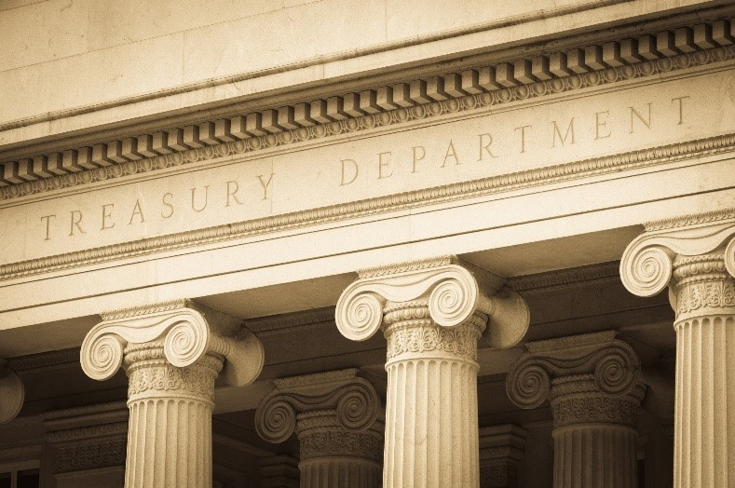
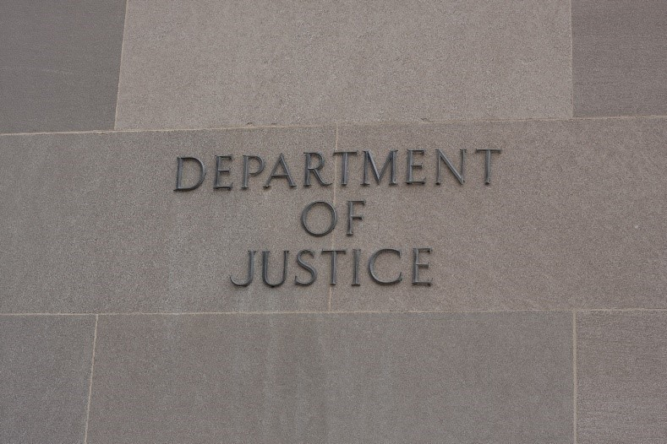
Office of Foreign Assets Control (OFAC) Requirements: Ransomware Payment Considerations (cont’d.)
Penalties Can Be Severe
Civil penalties:
OFAC can hold parties liable for civil penalties if they “knew or should have known” that a ransom payment would violate U.S. economic sanctions
Penalties can be up to approximately $307,000 or twice the value of the ransom payment, whichever is higher (per violation)
Criminal penalties:
The U.S. Justice Department can seek fines up to $1 million per violation, plus up to 20 years incarceration for natural persons
Officer and Director liability matters

Slide 38
New York State Department of Financial Services (NYDFS): Cybersecurity Regulation (23 NY CRR 500)
The New York Department of Financial Services (NYDFS) Cybersecurity Regulation came into effect on March 1, 2017, and created a governance framework for cybersecurity programs, set minimum standards for data protection, including requiring that covered entities implement a cyber security program, and established strict breach notification obligations
Applicability: The NYDFS Cybersecurity Regulation apply to “covered entities,” including persons or entities licensed or registered to operate under New York banking, insurance, or financial services laws
What information is covered? Electronic, Nonpublic Personal Information (“NPI”) that the tampering with which would cause a materially adverse impact on business; information concerning an individual that can be used to identify such individual in combination with elements such as SSNs, driver’s license numbers or financial account numbers or codes; or information relating to a person’s health or health care
Notes:
Full Goals as provided on Governor Cuomo’s original PR Announcement:
“Controls relating to the governance framework for a robust cybersecurity program including requirements for a program that is adequately funded and staffed, overseen by qualified management, and reported on periodically to the most senior governing body of the organization;
Risk-based minimum standards for technology systems including access controls, data protection including encryption, and penetration testing;
Required minimum standards to help address any cyber breaches including an incident response plan, preservation of data to respond to such breaches, and notice to DFS of material events; and
Accountability by requiring identification and documentation of material deficiencies, remediation plans and annual certifications of regulatory compliance to DFS.”
Goals as provided by DFS PowerPoint: The goal of the regulation is to prevent cyber-attacks. Two main principles:
Provide minimum standards to prevent cybersecurity threats
Strong governance of Covered Entities in the area of cybersecurity in the ordinary course of business
The regulation provides an exemption for organizations with:
Fewer than 10 employees
Less than $5 million in gross annual revenue for three years, or
Less than $10 million in year-end total assets

Slide 39
Current Notification Requirements: 23 NY CRR 500.17
72-hour notification timeline
In addition to requiring that covered entities create a comprehensive security framework, the NYDFS requires that covered entities report cybersecurity events within 72 hours of their discovery
When is notification required?
When the cybersecurity event has a reasonable likelihood of materially harming any material part of the normal operation(s) of the covered entity; or
When the cybersecurity event triggers a separate obligation of the Company to report to a government body, self-regulatory agency, or any other supervisory body
Annual notice to the Superintendent
Covered entities must also submit to the DFS Superintendent an annual certification of compliance with all the requirements of the NY DFS Cybersecurity Regulation
Certification must be submitted on or before April 15

Slide 40
Highlights of Proposed Amendments to NYDFS Cybersecurity Rules
On July 29, 2022, the NYDFS released proposed amendments to its Part 500 Cybersecurity Rules, which include new notifications obligations for all covered entities and creates additional obligations for “Class A” companies
The amendments are expected to take effect in 2023
Proposed new notification obligations for all covered entities
The requirement to notify the NYDFS within 72 hours of any unauthorized access to privileged accounts or deployment of ransomware within a material part of the company’s information systems
A new 24-hour notification obligation for any extortion payment connected to a cybersecurity event, as well as a 30-day reporting requirement explaining why payment was necessary, alternatives that were considered, and sanctions diligence that was conducted
Notes:
New “Class A” Company classification includes covered entities with: (1) Over 2,000 employees; or
(2) Over $1 billion in gross annual revenues averaged over the last three years from all business operations of the Company and its affiliates.
Class A companies will be subject to several additional cybersecurity obligations, including, but not limited to:
Audits. An independent audit of the company’s cybersecurity program must be conducted at least annually.
Vulnerability assessments. Systematic scans or reviews of information systems must be conducted at least weekly, and any material gaps found during testing must be documented and reported to the board and senior management.
Password controls. A password vaulting solution must be implemented for privileged accounts, along with an automated method of blocking commonly used passwords.
Monitoring. An endpoint detection and response solution must be implemented to monitor anomalous activity, including lateral movement, as well as centralized logging and security event alerting.

Slide 41
What is Reasonable Security?
Unfortunately, there is no uniform standard across industries
Really, it depends on your industry, information assets, services and products, and risk tolerance For guidance, look to:
Laws, frameworks, and regulatory guidance
Security frameworks/technical controls
Security by design
Risk assessment findings
Case law and enforcement actions
Contractual requirements
Table top exercises

Slide 42
Source of Potential Liability/Costs for Inadequate Security Measures
FTC and other applicable industry-specific agency enforcement
State attorneys general/other consumer protection agencies enforcement
Class action and other lawsuits
Contractual liability
Data breach remediation and related costs
Reputational costs
Loss of competitive advantage/profits
Ransomware
International data supervisory authorities
Notes:
Can possible provide the NYDFS Carnival Cruise fine (See notes in slide 28) as an example here.

Slide 43
Why Case Law is Relevant to Help Companies Prepare for a Data Breach
Case law educates us and serves as a critical opportunity to take advantage of other entities’ “lessons learned”
The dollar amounts at issue are persuasive evidence to highlight the importance of compliance and taking cybersecurity measures seriously
Penalties and settlements for lawsuits arising out of incidents are hefty and underscore the need to focus on prevention and response
e.g., the ~ $700 million Equifax settlement finalized in February 2022
Notes:
My points here are that for security professionals, case law is useful to see what others did wrong and what the government/judiciary thinks should have been done instead, or what factors/actions are important when considering culpability and liability.
The high dollar values at issue in settlements (both historic and recent) and potential penalties are a persuasive tool that the security professional can use to convince non-security professionals, executives, and decision-makers to take cybersecurity measures seriously. For instance, it is ultimately a better business decision (and cheaper!) to invest in cybersecurity training for employees, the development of a comprehensive incident response plan, and even running through a table top exercise than to pay a large fine, fund a massive class action settlement, and the legal fees that will be incurred to defend against such lawsuits. Moreover, many of the settlements with the government require the implementation of a security program (or a more robust one!) and post-settlement information security assessments which require the company to submit to evaluations of its implementation of the agreed upon information security program. In other words, the costs and headaches associated with a incident don’t end immediately after a fine is paid or a monetary settlement is reached.
“PROFITABILITY OVER PRIVACY”

Slide 44
Putative Class Action Still Proceeding Against Park Mobile LLC Over Data Breach
In August 2022, a federal judge in Georgia declined to dismiss a class action lawsuit against ParkMobile arising out of a data breach that allegedly compromised the personal information of 21 million app users.
The complaint alleges that ParkMobile was negligent in its handling of user data, which led to a data breach exposing users’ license plate numbers, email addresses, telephone numbers, passwords, and other mobile app account information. The complaint asserts that ParkMobile failed to prioritize cybersecurity and that the breach could have been prevented had the company implemented “reasonable” security measures.
Although the court did dismiss some of the plaintiffs’ claims, the court ultimately held that ParkMobile did have a legal duty to protect at least some of the user data that was compromised and it was too early in the proceedings to simply accept ParkMobile’s representation that sensitive information was not exposed.
Baker v. ParkMobile LLC, Case No. 1:21-cv-02181-AT, N.D. Georgia)
Notes:
ParkMobile argued that the negligence claim should be dismissed because the company did not have a duty to protect consumer data under Georgia law, and no personal information was affected. ParkMobile also argued that plaintiffs failed to adequately plead whether the stolen data contained the type of information covered under the CCPA and therefore, their purported claims under the CCPA were subject to dismissal.
The Court dismissed the CCPA claim, but shortly after the ruling, plaintiffs filed a motion for reconsideration as to that issue as well as a Second Amended Consolidated Class Action Complaint.
The motion for reconsideration pushes back that the prior iteration of the Complaint adequately described and pled that the information stolen fell within the protections of the CCPA.
The SACCAC now lists several types of CCPA covered data that was allegedly stolen in the breach and the CCPA claim for a sub-class for CA residents seeking actual damages from $100 - $750 per consumer per incident and an injunction requiring ParkMobile to put in place reasonable data security measures and practices to prevent future breaches.
There are also other proposed class actions pending in GA and CA against ParkMobile stemming from the breach incident.
One important thing to note is that the plaintiffs complain that ParkMobile attempted to downplay the breach and understated the potential damage its negligence caused to consumers by saying that only “basic” information was accessed (and later sold or made available on the dark web). Plaintiffs assert that ParkMobile had inadequate data security measures that didn’t meet FTC standards.
These are all just ALLEGATIONS at this stage since discovery has not yet been conducted, but it serves as a warning that a large part of what the Court (and greater public) will be looking at is what actions did ParkMobile take prior to and after the breach and how quickly and accurately did they respond to try to protect customers’ data and remediate the issues.

Slide 45
Pennsylvania AG’s $8 Million Settlement With Wawa Due to Data Breach
On July 26, 2022, the Pennsylvania Attorney General, Josh Shapiro, announced an $8 million agreement with Wawa arising from a December 2019 data breach that compromised approximately 34 million payment cards
The AG’s investigation concluded that Wawa failed to employ reasonable security measures, which allowed hackers to gain access to Wawa’s network
The settlement agreement identified and compelled Wawa to implement the following data security practices:
To maintain a comprehensive information security program designed to protect consumers’ sensitive personal information;
To provide resources necessary to fully implement the company’s information security program;
To provide appropriate security awareness and privacy training to all personnel who have key responsibilities for implementation and oversight of the information security program
To employ specific security safeguards with respect to logging and monitoring, access controls, file integrity monitoring, firewalls, encryption, comprehensive risk assessments, penetration testing, intrusion detection, and vendor account management; and
Consistent with previous state data breach settlements, Wawa was required to undergo a post-settlement information security assessment which in part will evaluate its implementation of the agreed upon information security program
Notes:
While there may not be a uniform “reasonable security” standard, recent data breach settlements can shed light on expectations and potential liabilities.
Important to note that the post settlement security assessments are designed to look at whether a company’s security program is actually working - and to look at how well it is working or where there are still areas of improvement.

Slide 46
$5 Million Settlement Between NYDFS and Carnival Corp. Related to Cybersecurity Events
On June 24, 2022, the NYDFS announced a $5 million settlement with Carnival for violations of the Cybersecurity Regulation in connection with four cybersecurity events, including two ransomware events, which resulted in the exposure of customer information, including names, addresses, dates of birth and passport numbers, as well as employees’ names, addresses, phone numbers, Social Security numbers, private health information, and credit card numbers
Although Carnival had certified compliance with the Cybersecurity Regulation at the time of the incidents, NYDFS found that Carnival’s attestation of compliance was improper
In its consent order, the NYDFS noted that Carnival had failed to implement basic protocols to prevent data breaches. The NYDF specifically identified that Carnival failed to:
Report the incident to the NYDFS for ten months,
Conduct adequate cybersecurity training for its personnel, and
Implement multi-factor authentication within its internal email policy
In addition to the monetary penalty of $5 million, NYDFS also accepted Carnival’s surrender of its insurance producer license, thus prohibiting Carnival from selling insurance in New York
Notes:
Another potential example to discuss is a recent, June 24, 2022, $5 Million fine imposed by NYDFS on Carnival Cruises related to four cybersecurity events between 2019 and 2021, including two ransomware events, and violations of the Cybersecurity Regulation (23 NYCRR Part 500)
See: https://www.huntonprivacyblog.com/2022/07/01/nydfs-imposes-fine-of-5-million-on-carnival-for-cybersecurity-breaches/
DETAILS:
Specifically, between August 2020 and March 2021, Carnival reported three additional incidents, including two ransomware attacks and a phishing email where a threat actor deployed malware, accessed and encrypted certain internal information systems, and exfiltrated certain data files. These incidents led to the exposure of customers’ names, addresses, dates of birth and passport numbers, as well as employees’ names, addresses, phone numbers, Social Security numbers, private health information and credit card numbers.
Although Carnival had certified compliance with the Cybersecurity Regulation at the time of the incidents, NYDFS found that Carnival’s attestation of compliance was improper. In addition to the monetary penalty of $5 million, NYDFS also accepted Carnival’s surrender of its insurance producer license; thus, Carnival has ceased selling insurance in New York.
BASIS FOR FINE:
In its consent order, the Department noted that the cybersecurity events had caused the exposure of a substantial amount of sensitive personal data belonging to Carnival’s customers, including those residing in New York. Since Carnival was licensed by the Department to sell insurance in NY State, it was treated as a covered entity under the Cybersecurity Regulation. NYDFS also found that Carnival had failed to implement basic protocols to prevent data breaches. The first cyber attack took place through a phishing email or password spray attack where unauthorized third parties gained access to 124 employee accounts and used that access to send a series of phishing emails. Although the first attack resulted in exposing certain data such as names, addresses and government identification information of consumers and employees, Carnival failed to
(1) report the incident to the NYDFS for 10 months,
(2) conduct adequate cybersecurity training for its personnel, and
(3) implement multi-factor authentication within its internal email policy.

Slide 47
$500 Million Settlement Reached in T-Mobile Case
In August 2021, T-Mobile announced that it was investigating a potential breach in data security. Later that year, they disclosed in an SEC filing that around 76.6 million people’s names, birthdates, SSNs, ID information, and addresses were compromised.
Over 40 class actions were filed and ultimately consolidated in federal court in the Western District of Missouri. Some consumers had been notified by third-party monitoring companies that their personal information was available on the dark web.
In July 2022, T-Mobile agreed to pay $350 million toward a settlement fund to end multiple class action lawsuits, as well as spend an additional $150 million on cybersecurity through the end of 2023.
In re T-Mobile Customer Data Security Breach Litigation, Case No. 4:21-md-03019 (W.D. Missouri)
Notes:
CNN reported the following on July 25, 2022:
During its initial disclosures surrounding the breach, T-Mobile had said it believed a hacker had stolen information on about 53 million current, former or prospective customers. The company began investigating the breach in August 2021 after Vice reported claims made on an underground online forum offering T-Mobile customer data for sale.
If approved, T-Mobile's $350 million will go into a fund covering payments to class members, as well as legal and administrative fees.
*Notably, the proposed class action settlement estimates damages to consumers based on how much time they spent responding to the incident. As an alternative, consumers can seek fixed payments of $25 per person, or $100 for individuals in California, because the CCPA provides that plaintiffs can recover statutory damages of $100 to $750 per incident, or actual damages, whichever is greater.
As for the $150M to be spent on bolstering the company’s cybersecurity, T-Mobile created a "cybersecurity transformation office" reporting directly to CEO Mike Sievert and hired cybersecurity firm Mandiant as well as consulting firms Accenture and KPMG "to design strategies and execute plans" to improve its cybersecurity posture.

Slide 48
Thank You! Questions?

