Slide 1
Earth,Wind, and Fire Property Catastrophe Treaties
Tim Aman, AnnMarie Staehnke, Nick Tuttle, Peter Cridland, Ann Field

Slide 2
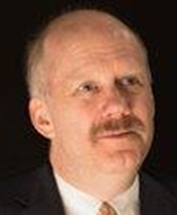
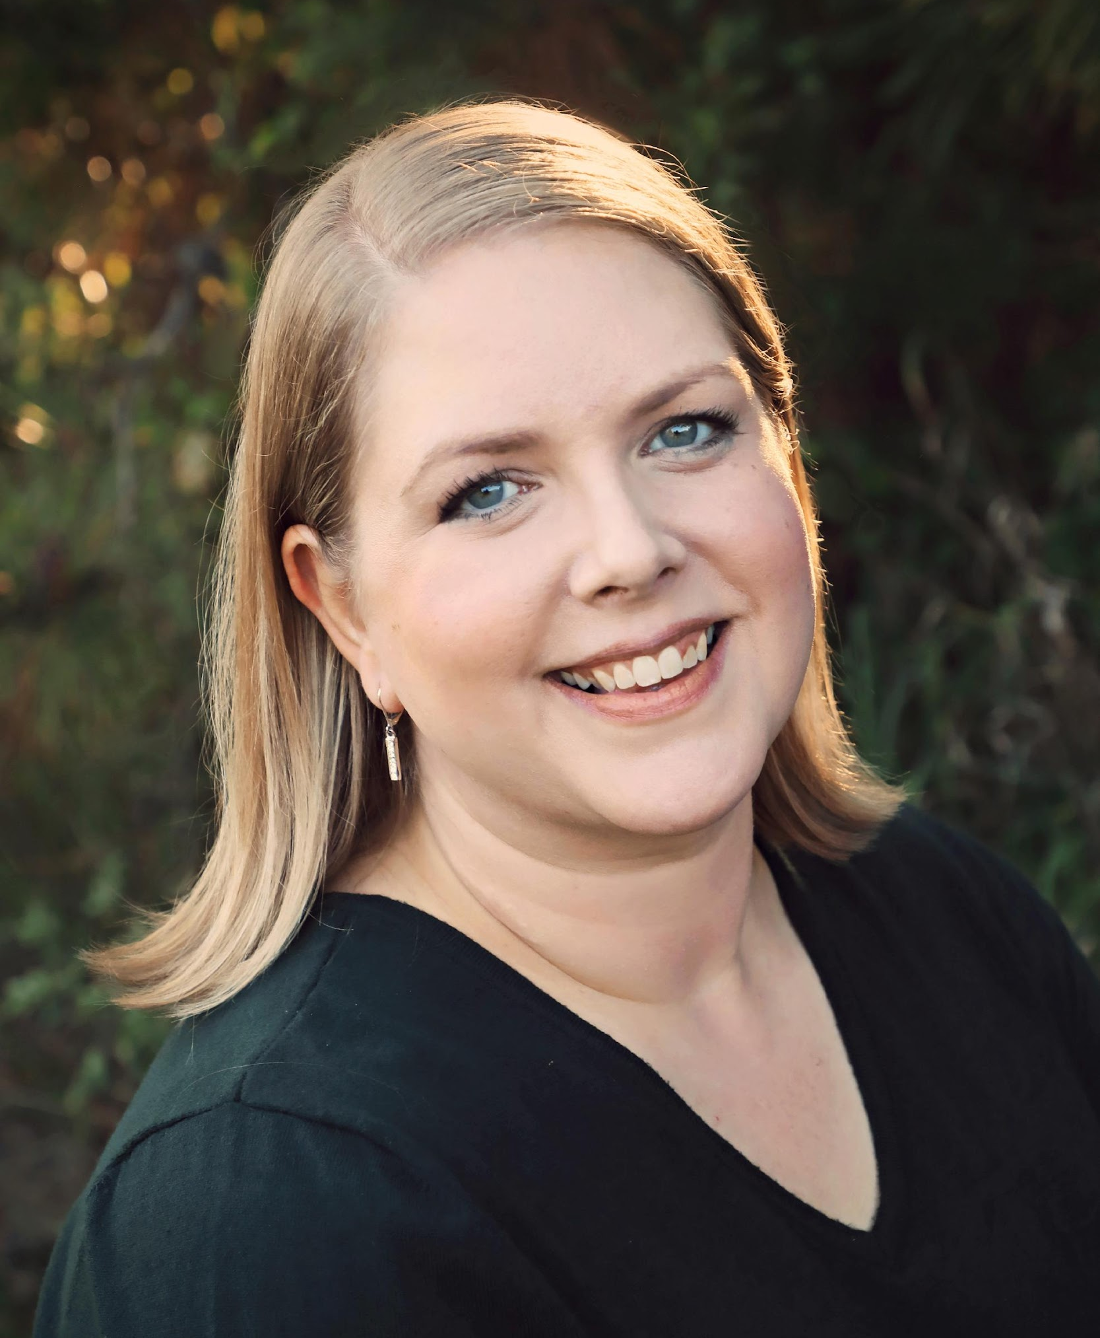
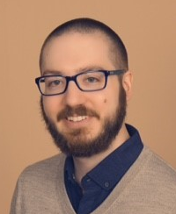
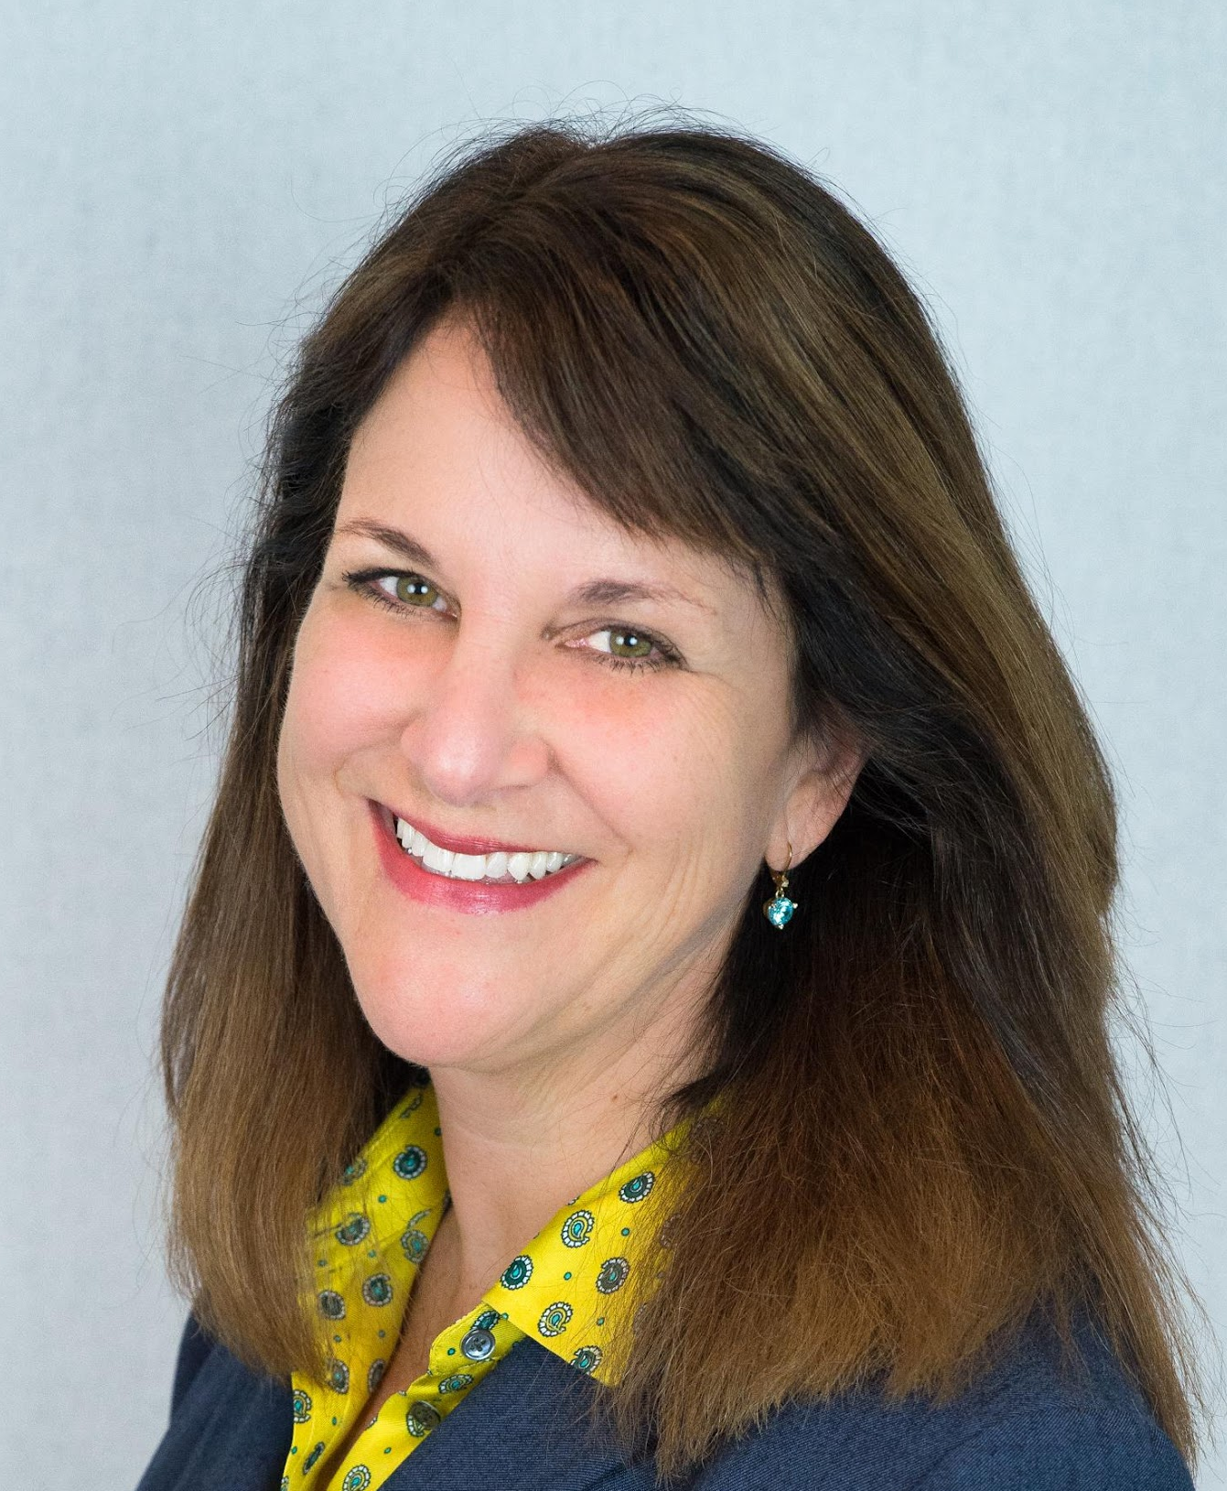
Earth, Wind, and Fire: Property Catastrophe Treaties
Speaker Bios
Tim Aman
Reinsurance, US Actuarial Lead, Aon
Tim Aman leads Aon Re’s US actuarial team. Tim joined Aon in Sep 2021; prior to joining Aon, he was Chief Risk Officer, reinsurance buyer, and head of actuarial and catastrophe modeling most recently for Aspen and before that for Montpelier. Tim is a qualified actuary with 33+ years of experience in the global re/insurance market.
AnnMarie Staehnke
Executive Vice President Catastrophe Analytics, Gallagher Re
AnnMarie Staehnke, Executive Vice President in Gallagher Re’s Catastrophe Analytics department, is an experienced Catastrophe Risk Analyst with over 15 years of experience. AnnMarie collaborates closely with brokers, actuaries, claims specialists, primary insurance companies, and reinsurers through all parts of the treaty reinsurance placement. AnnMarie models real-time events and provides insureds with information on potential exposure and losses to prepare them for quick action after an event.
Nick Tuttle
Reinsurance, Director of Contracts, Aon
Nick Tuttle is a Director in Contracts for Aon’s Reinsurance Solutions team based in the Minneapolis office. He joined Aon as a drafter in the Contracts department in January of 2014. Nick’s primary responsibilities include drafting, reviewing, and providing general support/analysis related to contractual issues tied to various U.S. and global clients. Nick graduated summa cum laude from the University of Saint Thomas (Saint Paul, Minnesota).
Peter Cridland
Vice President, TransRe
Peter Cridland is a Vice President with TransRe, overseeing all U.S. Cyber claims and managing the Property, Marine, Aviation, and Surety claims group. He works with underwriting and claims teams globally on a variety of issues including risk tolerances, underwriting goals, and claims projections. Peter works with reinsureds to help them stay ahead of the curve on claims handling, loss prevention, and loss mitigation strategies.
.
Ann Field
Reinsurance, Head of Client Services and Advocacy, Aon
Ann Field is Aon Reinsurance Solution’s Head of Client Services in North America and Head of Advocacy for the Americas. In her role, Field oversees over 100 Claim and Accounting Advocates, managing all premiums, claims and accounting for Aon’s diverse segments and clients. Field has an extensive background in all lines of property and casualty and is an ARIAS•US certified arbitrator.

Slide 3
Earth, Wind, and Fire: Audience Polling Questions
First Question
1. What is your role in property catastrophe treaties (click all that apply):
a. Underwriting
b. Actuarial
c. Catastrophe Modeling
d. Contract Drafting
e. Claims
f. Disputes
g. Not Applicable
h. Other

Slide 4
Earth, Wind, and Fire: Audience Polling Questions
Second Question
2. How often have you personally been involved with a disputed property catastrophe claim?
a. Never
b. Less than 5 times
c. 5-9 times
d. 10-19 times
e. 20 or more times

Slide 5
Earth, Wind, and Fire: Audience Polling Questions
Third Question
3. What percentage of your day involves interpretation of property catastrophe contracts?
a. None
b. Less than 5%
c. 5-9%
d. 1- 19%
e. 20% or more

Slide 6
Earth, Wind, and Fire: Audience Polling Questions
Fourth Question
Did you learn something during this panel about property catastrophe treaties that you did not know before? Yes / no

