Slide 2
California Wildfires
Insurance & Reinsurance Issues
April 30, 2025

Slide 3
Elliott R. Feldman, Partner, Cozen O'Connor
Spencer Y. Kook, Partner, Hinshaw & Culbertson LLP
Jeffrey M. Rubin, ARIAS•U.S. Certified Arbitrator
Teresa Snider, Partner, Porter Wright Morris & Arthur LLP

Slide 4
Today’s Topics
Overview of LA Fires and Insured Losses
Impact on California Homeowners Market
Insurance and Reinsurance Issues
Subrogation Claims

Slide 5

Los Angeles Fires Overview
Presented by: Teresa Snider
Porter Wright Morris & Arthur LLP

Slide 6
Palisades Fire
Began morning of Jan. 7, 2025 in Santa Monica Mountains, LA County
Hurricane-force Santa Ana winds spread fire to Pacific Palisades, Topanga, and Malibu
24 days before full containment on Jan. 31, 2025
23,707 acres (37 square miles)
Killed12 people
Destroyed more than 6,500 buildings
Source: https://www.nbcnews.com/weather/wildfires/palisades-eaton-fire-la-contained-rcna188338

Slide 7
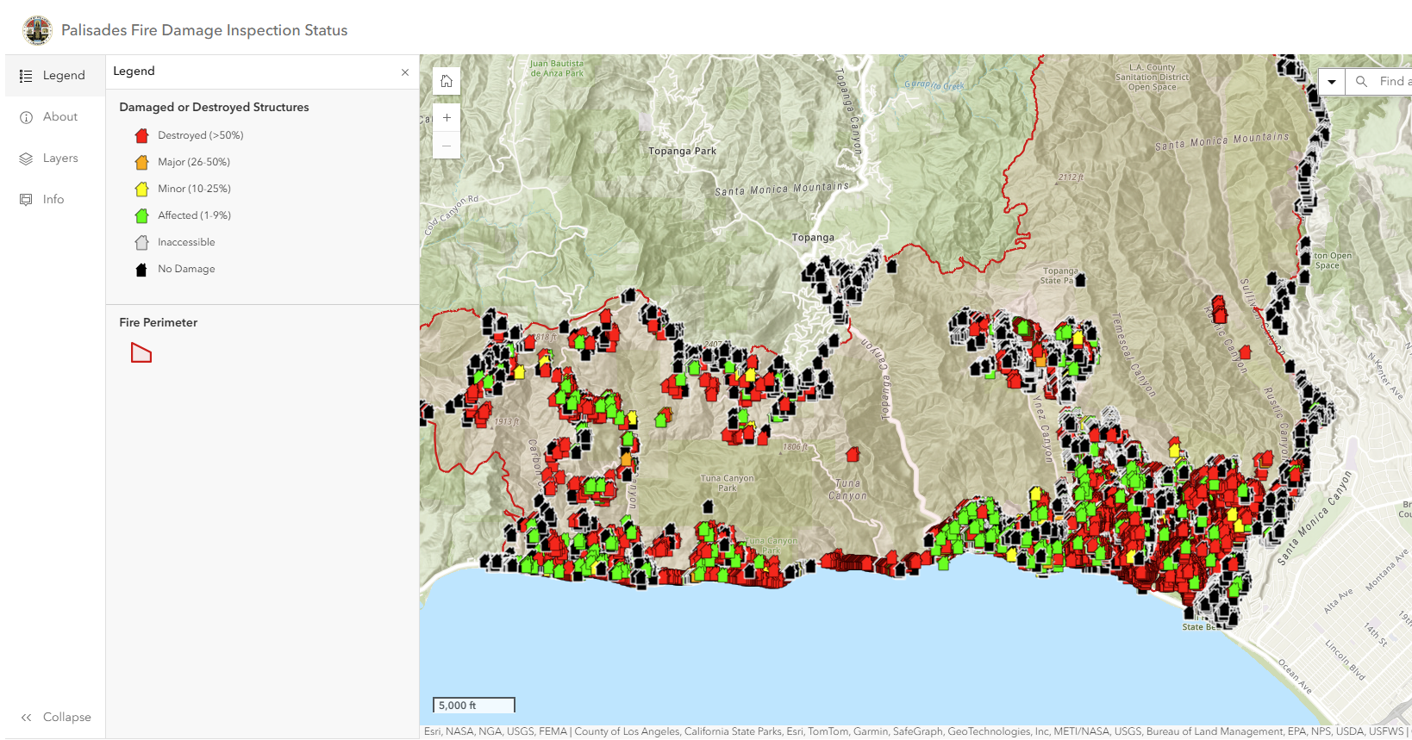

Palisades Fire
Source: https://recovery.lacounty.gov/palisades-fire/

Slide 8
Eaton Fire
Began evening of Jan. 7, 2025 in Eaton Canyon in San Gabriel Mountains, LA County
Hurricane-force winds spread fire to Altadena and Pasadena
24 days before full containment on Jan. 31, 2025
14,021 acres (21.8 square miles)
Killed17 people
Destroyed more than 9,000 buildings
Source: https://www.nbcnews.com/weather/wildfires/palisades-eaton-fire-la-contained-rcna188338

Slide 9
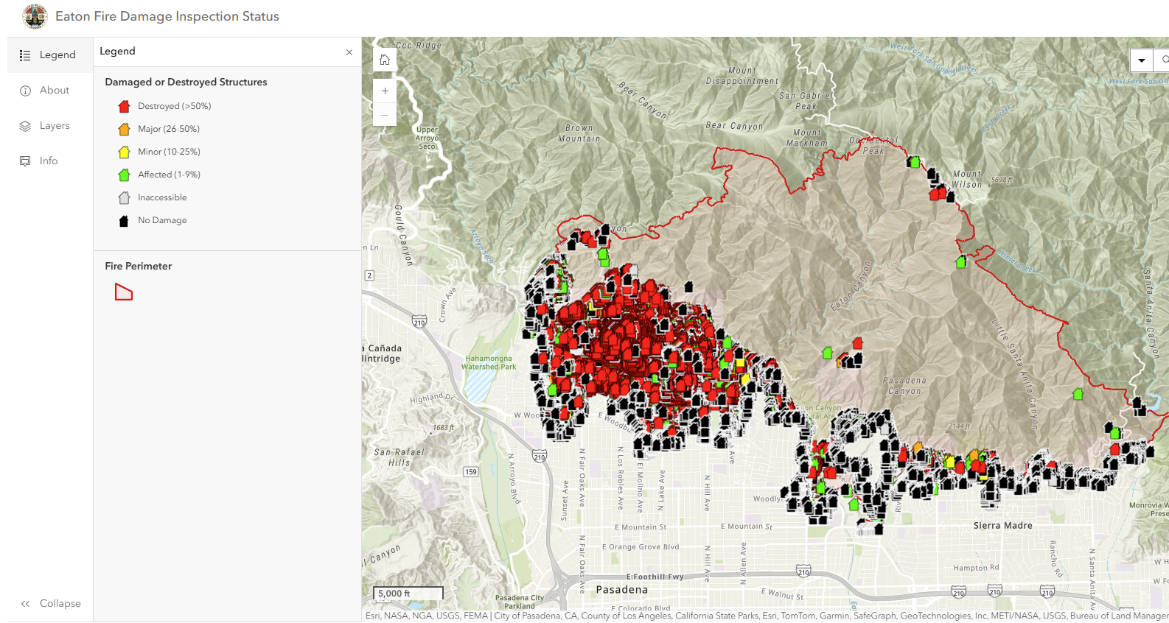
Eaton Fire
Source: https://recovery.lacounty.gov/eaton-fire/

Slide 10
Other Jan. 2025 California Fires
Riverside: Jan. 7 – 7 (San Bernadino County)
Bert: Jan. 7 – 7 (L.A. County)
Hurst: Jan. 7 – 16 (L.A./Ventura Counties)
Olivas: Jan. 8 – 8 (Ventura County)
Lidia: Jan. 8 – 11 (L.A. County)
Sunset: Jan. 8 – 9 (L.A. County)
Sunswept: Jan. 8 – 8 (L.A. County)
Kenneth: Jan. 9 – 12 (L.A./Ventura Counties)
Lilac: Jan. 21 – 22 (San Diego County)
Hughes: Jan. 22 – 30 (L.A./Ventura Counties)
Laguna: Jan. 23 – 26 (Ventura County)
Border 2: Jan. 23 – 30 (San Diego County)

Slide 11
Insured Loss Estimates for Palisades and Eaton Fires
Verisk: $25 billion to $35 billion (not including losses from smoke damage)
  Source: https://www.verisk.com/company/newsroom/verisk-estimates-industry-insured-losses-for-the-palisades-and-eaton-fires-will-fall-between-usd-28-billion-and-usd-35-billion/
Milliman: $25.2 billion to $39.4 billion
  Source: https://www.milliman.com/en/insight/industry-insured-losses-for-los-angeles-wildfires
Estimates do not include LAE or losses from other fires

Slide 12
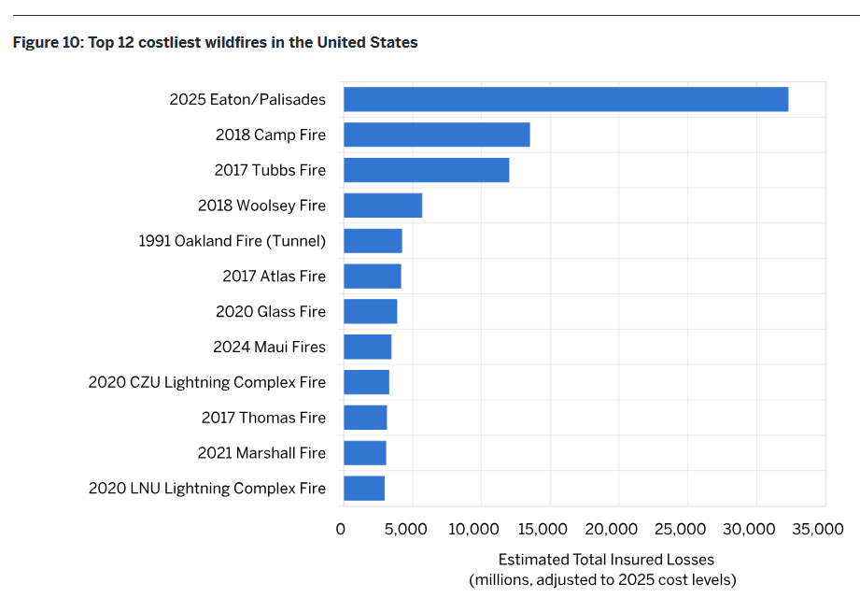
Insured Loss Estimates for U.S. Wildfires
Source: https://www.milliman.com/en/insight/industry-insured-losses-for-los-angeles-wildfires

Slide 13
Impact on California Homeowners Market
Presented by: Spencer Y. Kook
Hinshaw & Culbertson LLP

Slide 14
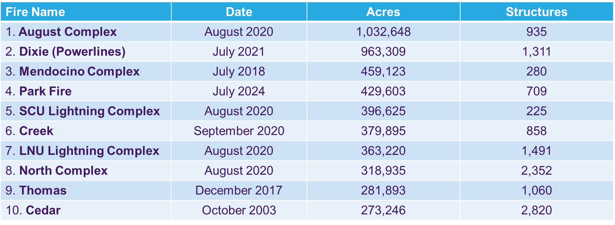

California’s New Normal
Top 10 Largest California Wildfires
Source: Cal Fire: https://34c031f8-c9fd-4018-8c5a-4159cdff6b0d-cdn-endpoint.azureedge.net/-/media/calfire-website/our-impact/fire-statistics/top-20-largest-ca-wildfires.pdf?rev=097f901c128347149e2614f2fca4f546&hash=27DDE83DFEF9A69E67C73765892A2B75

Slide 15
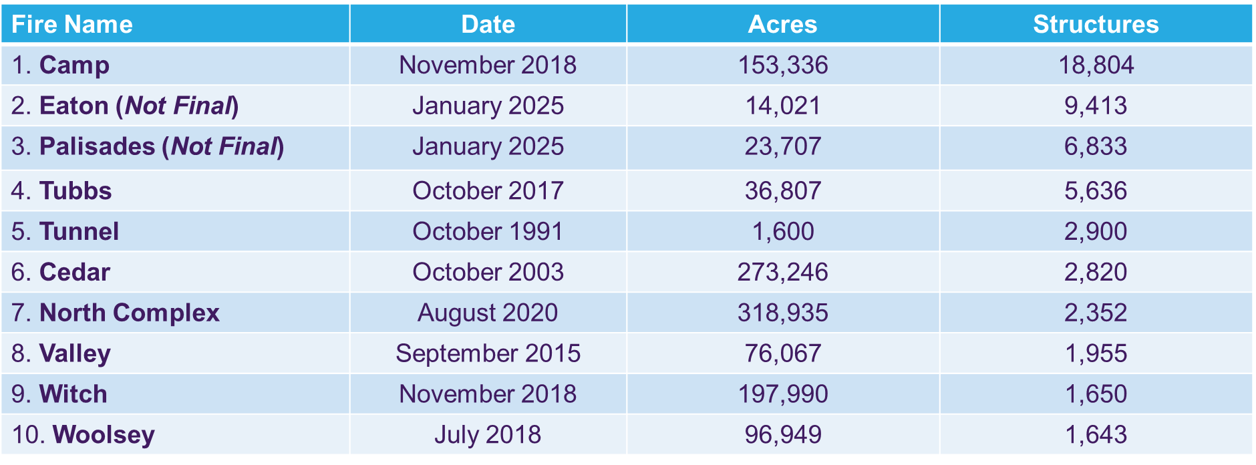
California’s New Normal
Top 10 Most Destructive California Wildfires
Source: Cal Fire: https://34c031f8-c9fd-4018-8c5a-4159cdff6b0d-cdn-endpoint.azureedge.net/-/media/calfire-website/our-impact/fire-statistics/top-20-largest-ca-wildfires.pdf?rev=097f901c128347149e2614f2fca4f546&hash=27DDE83DFEF9A69E67C73765892A2B75

Slide 16
Impact on the CA HO Market
Tightening of the Voluntary HO Market
  New Business Pause
  Increased non-renewals and more rigorous u/w guidelines
  Carrier departures
Significant Growth of the California FAIR Plan
  Dwelling Fire PIF Growth
    9/21 - 234,277 || 9/22 – 264,013 || 9/23 – 320,581 || 9/24 – 451,799
    12/24 501,379
    [Source: https://www.cfpnet.com/key-statistics-data]

Slide 17
Sources of Availability Issues
Development into Wildland Urban Interface (WUI)
Increased scope, frequency and severity of wildfires
  The 2017 and 2018 wildfire seasons depleted more than twice the total u/w profits that CA homeowners’ insurers accumulated in prior 32 years. [Source: Environmental Defense Fund]
Rate Depressive Effects of CA Rate Regulatory Regime
  Lag to Market with Approved Rates and Limits of Regulatory Formula and Intervenor Process

Slide 18
CA Regulatory Response - 1
Expansion of “Basic Property Insurance” Offering by FAIR Plan
  Order 2019-2 (Ordering FAIR Plan HO-3 Policy) (denied by writ petition)
  Order 2021-2 (Ordering FAIR Plan Novel “Homeowner’s Policy”) (subject of pending appeal)
Increasing of FAIR Plan Policy Limits
  Businessowners Policy
    Building coverage and business personal property coverage increased from $4 million and $2 million to $20 million at one insured location; additional limits increased from $600,000 to $1 million per occurrence, and liability from $1.2 million to $3 million [Order 2023-1]
  Commercial Property
    Combined Coverage limits of $20 million per location to $20 million per structure with total aggregate limit of $100 million per location (Order 2024-2)

Slide 19
CA Regulatory Response - 2
Non-Renewal Moratoriums
Promulgation of Rate Regs to Address WF Risk
  Mitigation in Rating Plans and Wildfire Risk Models Regulation (Oct. 2022)
  Catastrophe Modeling and Ratemaking Regulation (Nov. 2024)
  Net Cost of Reinsurance and Ratemaking Regulation (Dec. 2024)

Slide 20
Tipping Point?
Departure of carriers from California property market increases pressure upon others to follow suit. In addition to losses directly incurred and covered under their policies, California property insurers are secondarily exposed through assessments by an increasingly growing FAIR Plan.
  By statute, the FAIR Plan may assess property carriers in California if it is unable to cover its losses and costs. This just happened following the Jan 2025 wildfires by way of a $1 billion assessment.
Responsibility for assessments is proportional to a carrier’s market share
  Meaning, as carriers leave the market, remaining carriers will bear an increased risk.

Slide 21
Reinsurance of Fair Plan policies
As of Feb. 11, 2025, Fair Plan met $900 million deductible and accessed $350 million in reinsurance.
Can access additional layers of reinsurance up to a $5.78 billion limit, which includes varying percentages of co-reinsurance subject to certain conditions.
To access all layers of available reinsurance, the FAIR Plan is responsible for paying up to approximately $3.5 billion, including the $900 million deductible, and copays.
https://www.cfpnet.com/california-fair-plan-takes-steps-to-access-funds-to-pay-la-fire-disaster-claims/

Slide 22
Other Insurance and Reinsurance Issues
Presented by: Jeffrey M. Rubin, ARIAS•U.S. Certified Arbitrator &
Teresa Snider, Porter Wright Morris & Arthur LLP

Slide 23
Coverage and Exclusions
Real and Personal Property
  Has there been damage to real/personal property
  What was the cause?
    Fire versus smoke versus water
    Earth movement
Damage/debris removal
Living expenses

Slide 24
Additional Living Expense (ALE)
  Advance Payment: Insurers must immediately pay policyholders a minimum of 4 months' additional living expenses (e.g., rent) if they are completely displaced (Cal. Ins. Code § 2061(a))
  Time Limit: Minimum of 24 months, plus 12 month extension if reconstruction delay beyond their control (up to policy limits) (Cal. Ins. Code § 2060(b)(1))

Slide 25
Termination of ALE if “Habitable”
Exposure to fire debris and ash may pose significant threats to public health – inhalation of dust/contamination of drinking water
Insurance Commissioner Lara:
  Whether a residence is uninhabitable is not limited to situations where power, water, or sewer systems are disrupted
  A home may be deemed to be uninhabitable for health and safety reasons
  Policyholders in impacted areas should continue to receive ALE coverage while Advisory in effect unless policyholder chooses to inhabit their residence

Slide 26
Personal Property Coverage
Payment of Contents Without Inventory - Insurers must immediately pay policyholders 1/3 of estimated value of personal property or contents, amounting to no less than 30% of policy’s dwelling limit, up to $250,00, without requiring an itemized claim filing (Cal. Ins. Code § 10103.7(b))
Subsequent Full Documentation: After advance payment, policyholder can fulfill documentation requirements to recover full value of personal property/contents (as long as within policy limits)

Slide 27
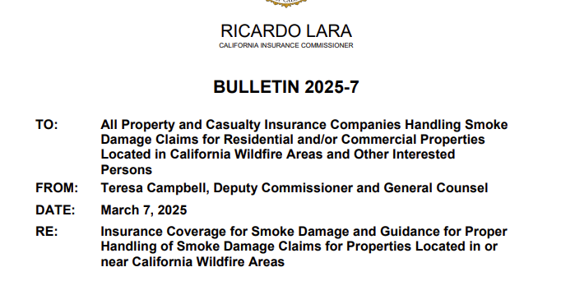
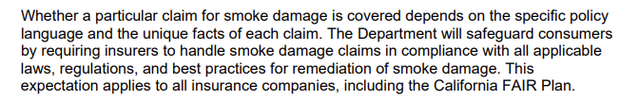

Slide 28
Smoke Damage Losses
Another Planet Entertainment, LLC v. Vigilant Ins. Co., 15 Cal. 5th 1106, 1117 (2024) (Covid-19)
“Under California law, direct physical loss or damage to property requires a distinct, demonstrable, physical alteration to property. The physical alteration need not be visible to the naked eye, nor must it be structural, but it must result in some injury to or impairment of the property as property.”

Slide 29
Smoke Damage Losses
Gharibian v. Wawanesa Gen. Ins. Co., 108 Cal. App. 5th 730 (2025)
Policy “insure[s] against direct physical loss to property”
Debris but no fire damage to plaintiff’s home
Smoke smell had dissipated
Wildfire debris was easily cleaned or removed from the property and did not constitute direct physical loss to property

Slide 30
Smoke Damage Losses
Bottega, LLC v. Nat'l Sur. Corp., 2025 U.S. Dist. LEXIS 5666, *12 (N.D. Cal. Jan. 10, 2025) (North Bay Fire)
“We will pay for the actual loss of Business Income you sustain due to the necessary suspension of your operations during the period of restoration. The suspension must be caused by direct physical loss of or damage to property… caused by or resulting from any Covered Cause of Loss.”
“Whereas a virus is more like dust and debris that can be removed through cleaning… smoke is more like asbestos and gases that physically alter property”

Slide 31
Howell v. State Farm Fire & Cas. Co., 218 Cal. App. 3d 1446 (1990) (overruled in part on other grounds)
Landslide/Fire Losses
Insurance claim for landslide damage following heavy rains
State Farm denied claim because policy excluded coverage for earth movement and water damage
Owner presented expert testimony that landslide occurred due to a fire, which was covered under the policy and which destroyed vegetation on the slope the prior summer
Court found triable issue of fact as to whether fire was the efficient proximate cause of the mudslide

Slide 32
Efficient Proximate Cause Doctrine
California Insurance Code § 530:
    An insurer is liable for a loss of which a peril insured against was the proximate cause, although a peril not contemplated by the contract may have been a remote cause of the loss; but he is not liable for a loss of which the peril insured against was only a remote cause
Enacted in 2018 following Montecito mudslides
Result: Insurers may not exclude losses caused by flooding, mudflow, debris flow, mudslide, or landslide, if the facts establish that a wildfire (a covered peril) was the efficient proximate cause of the flood, mudflow, etc.

Slide 33
Reinsurance Issues:
Loss occurrence definition and number of occurrences

Slide 34
Event Clause
“Loss Occurrence” means an accident or occurrence or series of accidents or occurrences arising from a single event.

Slide 35
What Is the Event?
Arson/Ignition
Santa Ana winds
Decision by Los Angeles not to clear brush and debris
PCS Designation
  PCS has designated the Palisades and Eaton fires as separate events
Other theories?

Slide 36
Hours Clause
Occurrence will mean all losses occasioned by wildfire during any continuous period of 168 hours

Slide 37
Radius Clause
As regards firestorms, brush fires and other fires or series of fires, irrespective of origin and how the fire or series of fires spread, all individual losses sustained by the Company during any period of 240 consecutive hours and are within a circle with a 150 mile radius, the center of which is selected by the Company, may be included in the Company’s Loss Occurrence.

Slide 38
Radius Clause
Permits aggregation even where there are multiple sources of causation
Losses must be sustained within the hours period

Slide 39
Alternative Radius Clause
As regards firestorms, brush fires and any other fires or series of fires, irrespective of origin, which spread through trees, grassland or other vegetation, all individual losses sustained by the Company which commence during any period of 168 consecutive hours within a 150-mile radius of any fixed point selected by the Company may be included in the Company’s “loss occurrence.” However, an individual loss subject to this subparagraph cannot be included in more than one “loss occurrence.”

Slide 40
Alternative Radius Clause
Permits aggregation even where there are multiple sources of causation
Losses must commence within the hours period
Some clauses provide the fixed point must be the site of a loss covered under the reinsurance agreement

Slide 41
Hours Clause permitting division into two or more Loss Occurrences
With respect to natural disasters, if the Loss Occurrence is of greater duration than 168 consecutive hours, then the Company may divide that Loss Occurrence into two or more Loss Occurrences provided no two periods overlap and no individual loss is included in more than one such period and provided that no period commences earlier than the date and time of the happening of the first recorded individual loss to the Company in that Loss Occurrence.

Slide 42
PCS Event = Loss Occurrence
However, if the Property Claims Service classifies a wildfire as a separate event, the Company may, at its option, treat each PCS event as a separate Loss Occurrence.

Slide 43
Reinsurance Issues
Timing of losses (e.g., fire versus mudslide)
Ex gratia payments [Insurance commissioner directions versus policy language, documentation]
Hours clause permitting division into two loss “Occurrences” if Event exceeds 168 hours
  Where definition of Occurrence is all losses within a 168 hour period
  Do the loss Occurrences have to be concurrent 168 hours periods or can they be less than a168 hour period

Slide 44
Reinsurance Issues
Radius Clause
  Must the selection of the center of the circle be reasonable?
  Can the circles with 150 mile radius overlap?
  If the fires are temporally and spatially close to one another, can you draw two circles or only one?
Can the ceding company aggregate losses as arising out of one event, and reinstate the limit and aggregate losses within a 150 mile radius based on geography and hours under the Wildfire Extension?

Slide 45
Reinsurance Issues
Palisades Fire (event) and Palisades and Easton Fires (Radius)
Wind-Only losses
  Siding/shingles torn off structures
  No smoke damage
  Can you combine wind losses with fire losses?

Slide 46

Subrogation Claims
Presented by: Elliott R. Feldman
Cozen O’Connor

Slide 47

Considerations in
Trading Subrogation Claims
Real Party in Interest Rules: FRCP 17(a)
Coordination with Claims of Insureds (Potential Consumer Class Actions)
Coordination with other Subrogating Insurers.
April 30, 2025
Elliott R. Feldman
Cozen O‘Connor

Slide 48
Liability Issues
Fault based theories
Inverse condemnation
Statutory vs. Common Law remedies
April 30, 2025
Elliott R. Feldman
Cozen O‘Connor

Slide 49
Measure of Damages
State law measures of damages vs. contractual measures
Rights to recover functional equivalent of RCV vs. ACV
Payment of true-ups
April 30, 2025
Elliott R. Feldman
Cozen O‘Connor

Slide 50

California Wildfire Fund
AB 1054 and AB 111
Purpose of Fund is to provide monetary reimbursement of eligible claims arising from a covered wildfire caused by a utility company that participates in the Fund by assisting in capitalizing the fund and performing other obligations
Participating Utilities: San Diego Gas & Electric; Southern Cal Edison; PG&E
April 30, 2025
Elliott R. Feldman
Cozen O‘Connor

Slide 51
California Wildfire Fund (continued)
Funded currently to $14B
Capitalization structure establishes multiple revenue streams with objective of providing about $21B in claim paying capacity to cover eligible claims arising from covered wildfires
Capitalization comes from contributions from the three utilities, and surcharges on investor operated utility non-exempt rate payers
April 30, 2025
Elliott R. Feldman
Cozen O‘Connor

Slide 52


Teresa Snider
Co-Chair, Reinsurance Arbitration & Litigation
Practice Group
Porter Wright Morris & Arthur LLP
321 South Clark Street, Ste. 400
Chicago, IL 60654
P: 312-756-8493
E: tsnider@porterwright.com
Presenter Contact Information
Spencer Y. Kook
Partner
Hinshaw & Culbertson LLP
350 South Grand Ave., Suite 3600
Los Angeles, CA 90071
P: 213-614-7359
E: skook@hinshawlaw.com
Jeffrey M. Rubin
ARIAS•U.S. Certified Arbitrator
P: (203) 570-9142
E: jmrubin1@outlook.com
Elliott R. Feldman
Co-Chair, Subrogation & Recovery Department
Cozen O’Connor
One Liberty Place
1650 Market Street, Ste. 2800
Philadelphia, PA 19103
P: 215-665-2071
E: efeldman@cozen.com
California Wildfires Insurance and Reinsurance Issues
April 30, 2025

Slide 53
QUESTIONS?

Slide 54
ARIAS•U.S. and the Presenters offer these materials for general information purposes only. The content of these materials is not intended as legal advice for any purpose, and you should not consider it as such advice or as legal opinion on any matters. This content does not necessarily reflect the views of ARIAS•U.S, the Presenters, their firms, and/or companies ( the “PRESENTERS”) as to any particular matter or those of their clients.
The information provided herein is subject to change without notice, and you may not rely upon any such information with regard to a particular matter of set of facts. Further, the use of these materials does not create, and is not intended to create, any attorney-client relationship between you and the PRESENTERS or any individual lawyer affiliated with any of the PRESENTERS. Use of these materials is at your own risk. We make no warranties of any kind regarding the accuracy or completeness of any information in these materials, and we make no representations regarding whether such information is reliable, up-to-date, or applicable to any particular situation. The PRESENTERS expressly disclaim all liability for actions taken or not taken based on any or all of the contents of materials, or for any damages resulting from your viewing and use thereof. The use of any trademark, copyright, or individual or company name or image in this presentation is for educational purposes only and does not imply any association, sponsorship or endorsement by or with that individual or company. All trademarks and copyrights are the sole and exclusive property of their original owners.
DISCLAIMER

