Slide 2
Making Sense Out of War & Terrorism
May 1st, 2025
Elizabeth Mazzocco, JD
Marnie Hunt, JD

Slide 3
Agenda
TRIA Overview & Application
Recent Events: Civil War or Riot?
Cyber
Domestic Terrorism

Slide 4
Terrorism Exclusions
Within 3 months of the 9/11 attacks, the London markets issued broad terrorism exclusions to be used on most reinsurance contracts.
Both direct and indirect losses were excluded, and anticoncurrent causation was used.
Excluded were acts “designed to influence the government … or in pursuit of political, religious, ideological or similar purposes.”
Notwithstanding any provision to the contrary within this Contract or any amendment thereto, it is agreed that this Contract excludes loss, damage, cost or expense directly or indirectly caused by, contributed to by, resulting from or arising out of or in connection with any act of terrorism, as defined herein, regardless of any other cause or event contributing concurrently or in any other sequence to the loss.
An act of terrorism includes any act, or preparation in respect of action, or threat of action designed to influence the government de jure or de facto of any nation or any political division thereof, or in pursuit of political, religious, ideological or similar purposes to intimidate the public or a section of the public of any nation by any person or group(s) of persons whether acting alone or on behalf of or in connection with any organization(s) or government(s) de jure or de facto, and which:

Slide 5
Terrorism Exclusion
Either violence to another person or damage to property is required.
This version specifically includes a cyber event.
This version provides a writeback for person lines as long as it is not an NBCR event.
1. Involves violence against one or more persons, or
2. Involves damage to property; or
3. Endangers life other than the person committing the action; or
4. Creates a risk to health or safety of the public or a section of the public; or
5. Is designed to interfere with or disrupt an electronic system.
This Contract also excludes loss, damage, cost or expense directly or indirectly caused by, contributed to by, resulting from or arising out of or in connection with any action in controlling, preventing, suppressing, retaliating against or responding to any act of terrorism.
Notwithstanding the above and subject otherwise to the terms, conditions, and limitations of this Contract, in respect only of personal lines, this Contract will pay actual loss or damage (but not related cost and expense) caused by any act of terrorism provided such act is not directly or indirectly caused by, contributed to by, resulting from or arising out of or in connection with biological, chemical, or nuclear pollution or contamination.
N.M.A. 2930b
12/19/01

Slide 6
TRIA - History
Reinsurers’ exclusion of terrorism led many insurers to exclude terrorism from their primary policies leading to an availability and affordability problem.
Such position created the fear of wider economic impact since insurance is required for a variety of transactions (e.g. real estate).
A federal backstop could prevent an economic slowdown by ensuring businesses could get insured.
Congress passed TRIA at the end of 2002 in response to these conditions.
TRIA was initially a 3-year program intended to provide a backstop for the P&C industry.
TRIA required insurers to offer terrorism coverage in certain types of policies to interested policyholders.
The Act was meant to be a temporary solution until the private insurance market could develop better models to handle terrorism risk independently.

Slide 7
TRIA - History Continued
Because the private market was arguably slow to take over terrorism risk, Congress had to reauthorize TRIA multiple times to keep the federal backstop in place.
Each renewal aimed to gradually shift more financial responsibility to the private sector while maintaining government support for catastrophic losses.
Congress extended TRIA in 2005, 2007, 2015 and 2019 with the Terrorism Risk Insurance Program Reauthorization Act (TRIPRA) extending through 2027.
Among other things, the Terrorism Risk Insurance Program Reauthorization Act of 2007 removed the requirement that an act of terrorism could only be certified if it was committed by a person or persons "acting on behalf of any foreign person or foreign interest.“ TRIA now applies to both domestic and foreign acts of terrorism.
If a certified terrorism event occurs (as determined by the U.S. Treasury and other officials), insurers cover losses up to a certain deductible.
Once industry-wide losses exceed a threshold, the government covers 80% of additional insured losses

Slide 8
TRIA – Defined
Certification by the Secretary of the Treasury, in consultation with the Secretary of Homeland Security and the U.S. Attorney General to be:
    An act of terrorism;
    A violent act or dangerous to human life, property or infrastructure;
    To have resulted in damage within the U.S. or outside of U.S. involving an air carrier, vessel or U.S. mission; and
    To have been committed to coerce the U.S. civilian population, or to influence the policy or affect the conduct of the U.S. government by coercion

Slide 9
TRIA - Limitations
Limitation:
The event shall not be certified by the Secretary as an act of terrorism if P&C losses in the aggregate from the event do not exceed a $5,000,000 industry-wide total.
To note:
TRIA will not actually pay out until the aggregate industry-wide losses exceed another threshold during the calendar year which is $200,000,000 currently (was $100,000,000 initially)
There is a cap on TRIA payments for aggregate losses during any one calendar year which is $100,000,000,000
An insurer’s TRIA recoveries often run parallel to any terrorism recoveries under the reinsurance contract for commercial business – until the insurer could begin to “double recover”

Slide 10
TRIA - Covered Classes of Business
TRIA covers commercial lines of property and casualty insurance, including excess insurance, Workers Compensation, and Directors and Officers liability
TRIA does NOT cover:
Personal lines
Health or life insurance
Flood insurance
Reinsurance
Commercial auto
Professional liability

Slide 11
Examining a “TRIA Exclusion”
Loss, damage, cost or expense directly or indirectly caused by, contributed to by, resulting from or arising out of or in connection with any "act of terrorism," as defined in the Terrorism Risk Insurance Act of 2002 and any subsequent amendments or extensions thereof (together the "Act").
Since this exclusion is based on TRIA, both foreign and domestic terrorism are excluded.
Some reinsurance contracts do not use TRIA as the terrorism definition and instead only exclude “foreign” terrorism (i.e., "acting on behalf of any foreign person or foreign interest).
In 2015 in San Bernadino, CA, a health department employee attended a holiday party during the day at his place of employment. He had an altercation there and left the event. He later returned with his wife and killed 14 co-workers.
    FBI and Homeland Security investigation revealed that the couple had been radicalized over the last several years; they were reportedly inspired by foreign terrorist groups like ISIS, but such groups did not direct them to commit the act
    The husband was an American-born U.S. citizen of Pakistani descent, and his wife was a Pakistani-born lawful permanent resident of the U.S.

Slide 12
Examining a “TRIA Exclusion”
Is this foreign or domestic terrorism?
Could it have been classified as work-place violence instead?
If TRIA does not renew, would events not be called terrorism because of a lack of terrorism insurance?
Former President Obama’s initial remarks that the Boston Bombing was terrorism called into question whether commercial business owners would have coverage under their policies if it was classified as terrorism.
  Boston Bar Journal, January 7, 2014
What if TRIA doesn't renew?
  Would insurers still offer terrorism coverage?
  Who would determine if an act qualified as “terrorism?”
  Contracts would likely need to divide more clearly between terror, SRCC, and war.

Slide 13
Renewal of TRIA?
TRIA did expire in 2015, but Congress quickly passed a bill retroactively covering the time during which it had been expired.
  Exclusions just mirrored the expiring TRIA language.
  Reinsurers that issued terrorism with the expectation that TRIA would inure had a significant change in exposure briefly
Currently little indication of where the new administration would fall on this issue. President Trump signed renewal in 2019 despite half of his party voting “no” in Congress.

Slide 14
Riot Definition
“Riot” means a public disturbance involving
(1) an act or acts of violence by one or more persons part of an assemblage of three or more persons, which act or acts shall constitute a clear and present danger of, or shall result in, damage or injury to the property of any other person or to the person of any other individual or
(2) a threat or threats of the commission of an act or acts of violence by one or more persons part of an assemblage of three or more persons having, individually or collectively, the ability of immediate execution of such threat or threats, where the performance of the threatened act or acts of violence would constitute a clear and present danger of, or would result in, damage or injury to the property of any other person or to the person of any other individual.
Federal Riot Act, 18 US Code Section 2102

Slide 15
Civil War Definition
Non-international armed conflicts defined as a ‘situation of violence involving protracted armed confrontations between government forces and one or more organized armed groups, or between such groups themselves, arising on the territory of a State.’
International Committee of the Red Cross (ICRC)
Because of the significant overlap in the definitions of war, terror, and SRCC, many contracts have a writeback for SRCC and terrorism in a standard war exclusion.
Both riot and civil war are not typically defined in reinsurance contracts.

Slide 16
Burden Of Proof
If there is an exclusion, the burden of proof falls on the reinsurer to prove a loss is excluded (i.e., meets the definition of terrorism, civil war, or riot).
Reinsurers initially tried to switch that burden to the company in early NMA terrorism exclusions, but that burden is now back on the reinsurer.

Slide 17
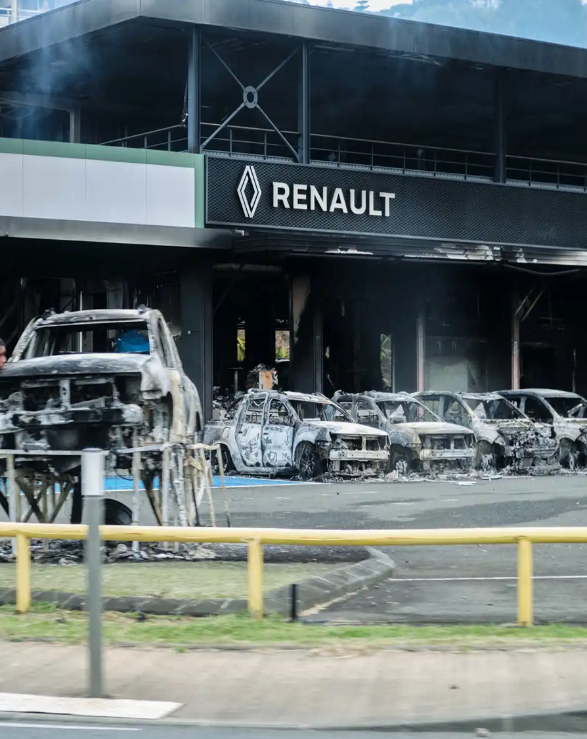
Caledonian: Riot or Civil War?
Timeline:
1980s: Tension between Indigenous Kanaks and French settlers morphed into violence that almost led to a civil war
  Kanak people have wished to break free from France after suffering from segregation policies and discrimination yet settlers want to remain part of France
1988: A peace deal was reached between two communities
1990s: France vowed to give more political power and autonomy to New Caledonia and Kanak people
  Continued discrimination and unfair practices
05/13/24: President Emmanuel Macron introduces proposals for voting reform to give local voting rights to non-Indigenous residents of New Caledonia
  Macron declares state of emergency (05/16), 13 people were killed, and nearly 3,000 people were arrested since this day
  State of emergency gave authorities powers to ban gatherings and forbid people from moving around the island
  TikTok was also banned as it was thought to have aided in a bout of riots which took place in France’s mainland last summer
June 2024: Seven detained individuals were flown 10,500 miles away from home to prisons in mainland France for pretrial detention which triggered renewed rioting across the archipelago
06/12/24: Macron sidelines voting reform and dissolved the Parliament, calling for early legislative elections
09/19/24: French police shot and killed two men in New Caledonia during a security operation
09/24/24: Sept 24 is a symbolic day for Kanak people as it is the anniversary of French takeover
12/15/24: Likely date for new Prime Minister Michel Barnier’s decision on whether to hold or postpone provincial elections in New Caledonia
Why It Started:
Currently, only Kanaks and those who arrived from France before 1998 can cast their ballots in elections
However, about 40,000 French citizens have moved to New Caledonia since 1998.
Both houses of the French parliament adopted a change to France’s Constitution that would give local voting rights to a number of non-Indigenous residents of New Caledonia
  The Kanak people who are native to New Caledonia are worried this will dilute Indigenous votes, especially after the three referendums for independence failed
In 2020, 47% of New Caledonian people favored independence from France
Who Was Involved:
Indigenous Kanak people on New Caledonia
French authorities and police
French government
Losses Occurring:
  Targets on municipal vehicles and institutions
  Businesses and cars looted and burned
  Schools closed, stay in place orders, roadblocks

Slide 18
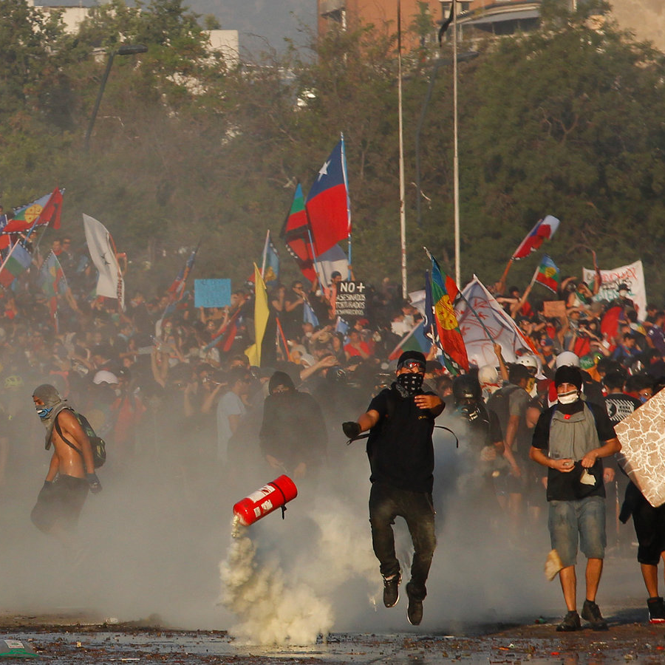
Chilean Unrest: Riot or Civil War?
In 2019, protests, civil disturbances and riots broke out across Chile, and was initially caused by increased costs of transport in Santiago.
The protests spread across the country and culminated in people from various industries and regions striking or protesting for a diverse range of reasons.
The protests included episodes of violence and looting that damaged commercial property and transport infrastructure. Total insured losses were estimated at $3-5bn.
Because the events went on for an extended period of time, reinsurers argued that the unrest constituted multiple separate events and/or an ongoing state of affairs.

Slide 19
Cyber
Merck & Co., Inc. v. ACE American Insurance Co.
The trial court had held that the insurer could not rely on the war exclusion in the policy for cyber loss from the NotPetya attack because the war exclusion did not specifically mention cyber war. The Superior Court, Appellate Division affirmed.
Before the Supreme Court of New Jersey was scheduled to hear oral arguments in ACE American Insurance Company's appeal, the parties reached an undisclosed settlement in early January of 2024.
Since Merck, insurers have seen an increase in reinsurers requiring both a cyber exclusion and a war exclusion on cyber reinsurance contracts.
TRIA is currently silent on:
Cyberterrorism (Treasury Department did release guidance on the topic in December 2016) (additionally, the 2019 extension mandated a study and report to be conducted by the Comptroller General of the United States analyzing vulnerabilities that could result in cyber damages, whether these risks can be adequately priced in the private market, whether TRIA is appropriate in connection with cyber terrorism events, etc.)

Slide 20
Domestic Terrorism Concerns
In 2021, the White House stated that domestic terrorism has evolved into the most urgent terrorism threat faced by the U.S.
In January 2022, FBI officials testified that the number of FBI investigations of suspected domestic violent extremists had more than doubled since the spring of 2020.
In 2021, The Secretary of DHS has stated that domestic violent extremism poses the "most lethal and persistent terrorism-related threat."
From fiscal years 2013 through 2021, the FBI’s number of open domestic terrorism-related cases grew by 357%.

Slide 21
FBI Domestic Terrorism Classification
Since 2019, the US Government uses the following five threat categories to understand the DT threat:
Racially or Ethnically Motivated Violent Extremism
Anti-Government or Anti-Authority Violent Extremism
Animal Rights or Environmental Violent Extremism
Abortion-Related Violent Extremism
All Other Domestic Terrorism Threats

Slide 22
Charlottesville 2017 Car Attack
A white supremacist rally, called Unite the Right, was held for two days in Charlottesville.
The organizers stated goal of the rally was the "Unification of the white nationalist movement" and protesting the removal of a statue of Robert E. Lee.
The perpetrator drove to the rally from Ohio, where he used his vehicle as a weapon to kill a counter-protester and injure 35 others.
Ex-schoolmates and former teachers described the perpetrator as highly sympathetic towards Nazism and the Confederacy. He was also spotted holding a shield with symbols from a neo-Nazi organization the morning of his attack.
Federally, he was charged with 1 count of a hate crime act resulting in death, 28 counts of hate crime acts causing bodily injury and involving an attempt to kill, and 1 count of racially motivated violent interference with a federally protected activity.
The FBI has defined a hate crime as a criminal offense against a person or property motivated in whole or in part by an offender’s bias against race, religion, disability, sexual orientation, ethnicity, gender, or gender identity.

Slide 23
2025 Tesla Vandalism
In early 2025, global protests have emerged against Elon Musk for his support for Donald Trump, his role in the Department of Government Efficiency, and perceived drift from Tesla's climate values
The protests have erupted in 250+ cities and 13 countries.
FBI and ATF have formed a task force; classified acts as domestic terrorism.
Widespread vandalism has been inflicted on individual Tesla owners. Cars have been keyed, spray-painted, and smashed.
Over 50 dealerships have experienced at least one of the following: cars set ablaze, fire damage to interior or exterior of property, gunfire into empty showrooms, graffiti, broken windows, defaced signage, slashed tires, scratched vehicles, and temporary closures.
Tesla charging infrastructure has also experienced graffiti and arson.

