Slide 1
Rapid Fire Key Case Presentations
ARIAS Spring Conference - May 2, 2025
Moderator: Michael Carolan, Troutman Pepper Locke LLP
Presenters:
Tricia Duffy, Saul Ewing LLP
Josh Shettle, Enstar Group
Maggie Burnside, Troutman Pepper Locke LLP
Stephen Turner, Dentons US LLP
Gabrielle Siskind, Zelle LLP

Slide 2



Each presenter gets 5-10 minutes to present their case and convince you why it is the most important
The audience will have a chance to ask questions
Then we take it to a vote

Slide 3
“Wait, Haven’t We Done This Before? No, It’s Arbitration!”
Tricia Duffy
Saul Ewing LLP

Slide 4

What You Need to Know
Nat’l Cas. Co. v. Cont’l Ins. Co., 121 F.4th 1151 (7th Cir. 2024)
1. Continental (insured), National Casualty, and Nationwide (reinsurers) were parties to three reinsurance agreements that were in effect between 1969 and 1975.
2. The agreements contain identical provisions requiring arbitration for “any dispute [that] shall arise between [the parties] with reference to the interpretation of [the agreement] or their rights with respect to any transaction involved.”
3. The agreements further provided that arbitration awards are “final and binding on both parties.”
Notes:
- The Reinsurance Agreements are what the insurance industry refers to as excess of loss reinsurance; meaning that a retention must be satisfied per “loss occurrence” before the coverage attaches.

Slide 5

How We Got Here:
2017 Dispute
Nat’l Cas. Co. v. Cont’l Ins. Co., 121 F.4th 1151 (7th Cir. 2024)
A dispute arose over whether Continental’s billing methodology complied with a “Loss Occurrence” provision in the reinsurance agreements.
Continental initiated separate arbitration proceedings against the insurers.
Both arbitration panels adopted the insurer’s interpretation of the reinsurance agreements and issued final awards.
Two federal district courts entered orders confirming those awards.
Notes:
Loss Occurrence language:
The Reinsurers shall pay to the Reassured [CNA] for any loss covered by this Contract whenever the Reassured has paid or advanced … an amount in excess of … $500,000 ultimate net loss as the result of any one loss occurrence and the sum recoverable hereunder shall be the amount of ultimate net loss in excess of $500,000 each and every occurrence, subject to a limit of $1,000,000 any one such occurrence.
The term “loss occurrence”, as used in this Contract, shall mean, except as otherwise provided in this Article, each and every accident, disaster, casualty or happening or series of accidents, disasters, casualties, or happenings arising out of one event. However, all losses having a common origin and traceable to the same act, omission, mistake or occurrence shall be considered one accident, disaster, casualty or happening.
Under this language, multiple accidents, disasters, casualties or happenings arising out of one event are one “loss occurrence”and are subject to a single retention.

Slide 6
How We Got Here:
2023 Dispute
Nat’l Cas. Co. v. Cont’l Ins. Co., 121 F.4th 1151 (7th Cir. 2024)
Another billing dispute arose where the parties disagreed over whether Continental’s billing methodology was consistent with the “Loss Occurrence” provision.
The reinsurers maintained that the prior arbitration awards resolved the dispute.
Continental disagreed and demanded that the new dispute go to arbitration.
Rather than submit to arbitration, the reinsurers filed suit in federal court.

Slide 7
How We Got Here:
Parties’ Positions
Nat’l Cas. Co. v. Cont’l Ins. Co., 121 F.4th 1151 (7th Cir. 2024)
The reinsurers asserted that the prior arbitration awards precluded a new arbitration proceeding, and also sought declaratory and injunctive relief.
Invoking the reinsurance agreements’ arbitration clauses, Continental moved to compel arbitration and dismiss the action, contending that the issue of claim preclusion must go to arbitration.
The district court agreed, granted Continental’s motion to compel, and the Insurers appealed.

Slide 8



Arbitrators Decide Preclusive Effect of Arbitration Awards, But Why?
Nat’l Cas. Co. v. Cont’l Ins. Co., 121 F.4th 1151 (7th Cir. 2024)
Seventh Circuit precedent says so
Supreme Court says so
The FAA does not require a different result
Notes:
Seventh Circuit precedent: Our case law establishes that the preclusive effect of an arbitral award is an issue for the arbitrator to decide, not a federal court. In no uncertain terms, we have held that “[a]rbitrators are entitled to decide for themselves those procedural questions that arise on the way to a final disposition, including the preclusive effect (if any) of an earlier award.” *1154 Trustmark Ins. Co. v. John Hancock Life Ins. Co., 631 F.3d 869, 874 (7th Cir. 2011); accord, e.g., Consolidation Coal Co. v. United Mine Workers of Am., 213 F.3d 404, 407 (7th Cir. 2000) (“[T]he question of the preclusive force of the first arbitration is, like any other defense, itself an issue for a subsequent arbitrator to decide.”); Indep. Lift Truck Builders Union v. NACCO Materials Handling Grp., Inc., 202 F.3d 965, 968 (7th Cir. 2000) (“[I]t ... is well-established that ‘the preclusive effect of the first arbitrator's decision is an issue for a later arbitrator to consider.’ ” (quoting Bhd. of Maint. of Way Emps. v. Burlington N. R.R. Co., 24 F.3d 937, 940 (7th Cir. 1994))).
Supreme Court precedent: These cases align with Supreme Court precedent. Indeed, the Court has repeatedly instructed that, under the FAA, arbitrators presumptively decide procedural issues that “grow out” of an arbitrable dispute and “bear on its final disposition.” Howsam v. Dean Witter Reynolds, Inc., 537 U.S. 79, 84, 123 S.Ct. 588, 154 L.Ed.2d 491 (2002) (quoting John Wiley & Sons, Inc. v. Livingston, 376 U.S. 543, 557, 84 S.Ct. 909, 11 L.Ed.2d 898 (1964)). Preclusion is one such procedural issue that can grow out of an arbitrable dispute. See Trustmark Ins. Co., 631 F.3d at 874 (“Arbitrators who have been appointed to resolve a commercial dispute are entitled to resolve ancillary questions that affect their task.” (citing Howsam, 537 U.S. at 84, 123 S.Ct. 588)).
To their credit, National Casualty and Nationwide acknowledge that our precedent addresses and resolves the preclusion issue. They can ask our full court to revisit our position or seek Supreme Court review. But, as a panel, our only course is to affirm the district court's conclusion that the preclusive effect of the prior arbitral awards is itself an arbitrable issue.
Section 13 of the FAA likewise gives us no reason to doubt our precedent. That provision, by its terms, clarifies that a district court's order confirming an arbitral award “shall have the same force and effect, in all respects as, and be subject to all the provisions of law relating to, a judgment in an action.” 9 U.S.C. § 13. As other circuits have explained, § 13 “says nothing about which forum or who determines the effect of the judgment.” Chiron Corp. v. Ortho Diagnostic Sys., Inc., 207 F.3d 1126, 1133 (9th Cir. 2000) (emphasis in original); see Emps. Ins. Co. v. OneBeacon Am. Ins. Co., 744 F.3d 25, 29 (1st Cir. 2014) (explaining that § 13 “simply means that the federal court will protect its judgments within their proper bounds”). To our knowledge, no court has ever interpreted *1155 § 13 to require federal courts to determine the preclusive effect of arbitral awards.

Slide 9
Why Does it Matter?
Nat’l Cas. Co. v. Cont’l Ins. Co., 121 F.4th 1151 (7th Cir. 2024)
“Serial re-arbitration”
“Because I said so!” – Arbitrators
Contrary to intent of the parties or, at a minimum, not contemplated by the parties
Could be viewed as conflicting with Section 13 of the FAA
Question of whether arbitrators can ensure the same consistency and finality as federal courts
Notes:
FAA argument: Congress enacted Section 13 for the purpose of allowing arbitration awards to attain the same status as a judgment entered in an action

Slide 10

Alabama Municipal Insurance Corp. v. Munich Re Reinsurance America, Inc.
“You Did It Wrong How Many Times?”
Josh Shettle
Enstar Group

Slide 11
Reinsurance Structure
Parties:
Cedent: AMIC, a municipal pool
Reinsurer: Munich Re
R/I Contract Type:
Casualty XOL Treaty R/I
$350k retention
Written on annual basis for 10 years
Reinsured Policies:
Public Official Liability Policies AMIC issued to Alabama’s municipalities and corporate entities
Notes:
Parties to the dispute were AMIC and Munich Re.
AMIC, a non-profit insurance company wholly owned by Alabama municipalities, issued Public Official Liability Policies to cities and towns throughout the state. It then purchased Casualty Excess of Loss reinsurance from Munich Re. This was a fairly longstanding relationship, with Munich issuing reinsurance to AMIC for about 10 years, from 2005 through 2015.

Slide 12
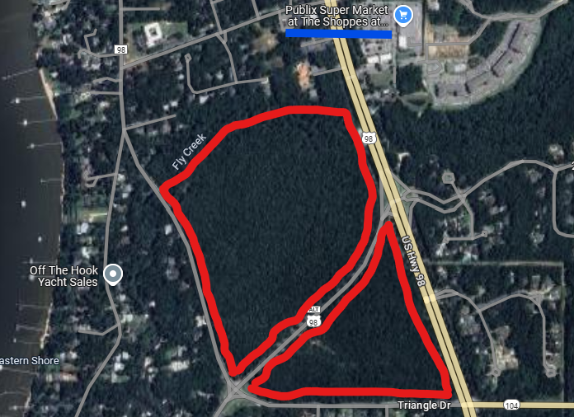
Underlying Claim
Dyas family owns 108-acre Unimproved Property in Fairhope
Seeking to develop property for decades
Notes:
Fairhope = City of 25k on Mobile Bay, off the Gulf of Mexico.
By the time the underlying lawsuit at issue was filed in 2008, there had been decades of disputes between Dyas and the city dating back to 1972, with the city refusing various requests by Dyas to commercially develop the land.
The Dyas property is just north of the city’s downtown and is 108 acres of undeveloped land, marked in red in this picture.
As you can seen, there is development all around the property, including, and as cited by Dyas in the lawsuit, a Publix supermarket similar to plans the Dyas’ had previously proposed, but were rejected, by the City.

Slide 13
Underlying Claim
Two Alleged Wrongful Acts:
    2006 zoning approval
    2008 approval of traffic flow alterations
    Two AMIC Policies Potentially Implicated:
    2006
    2008
    BUT, there is only…
    One Lawsuit with Unifying Theme Unifying: City’s acts in both 2006 and 2008 discriminated against Dyases to prevent development of their property.
Dyas v. Fairhope Lawsuit Filed 2008
Notes:
They Dyas were owners of a neighborhood village center in Fairhope.
The Dyas v. Fairhope action involved claims by the Dyas that the City breached a settlement agreement they had previously reached on two occasions: First, in 2006, when the city approved a zoning proposal to develop a nearby property into a competing village center. And second, in 2008, when the city approved measures to alter traffic flow around the Dyas’ property. They Dyas alleged each breach impaired the market value of their property.
The matter was ultimately settled pursuant to a settlement in which City agreed to purchase the property for $8.75m.
Relevant here, AMIC disputed its coverage obligations to the City for the Dyas suit and filed a DJ. In 2014, the parties settled, with AMIC agreeing to pay circa $1.1m of the City’s $1.6m in costs defending the Dyas suit.

Slide 14
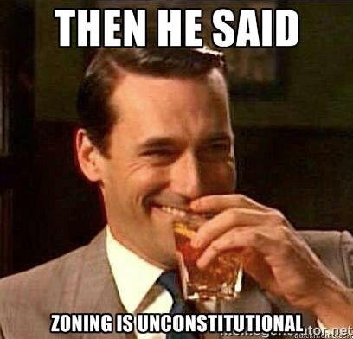
AMIC Position: Single Wrongful Act
Bills ~$1.1m as one loss under the 2008 treaty and asserts single $350k retention applies.
AMIC argues:
              “that ‘All Claims’ and ‘All Damages’ arising from related Wrongful Acts are treated as arising from ‘one Wrongful Act.’” (emphasis added)
        AMIC asserts 2006 zoning approval and 2008 approval of traffic flow alterations are “related” Wrongful Acts because both arise from Fairhope’s “policy, practice, or scheme of discriminating against the Dyases … to prevent development of their property.”
Notes:
In 2017, AMIC billed Munich Re for defense costs in excess of a single $350k retention, billing the loss under the 2008 treaty only.
Munich Re disagrees, asserting the loss constitutes two separate Wrongful Acts that must be allocated across two underlying policies and two r/I treaties, and that two $350k retentions therefore apply.
AMIC sues Munich Re in federal court in Alabama, and Munich Re moves for SJ.
AMIC argues [see slide]
AMIC also argues, in the alternative, that the 2006 and 2008 actions both breach a single settlement agreement between the City and Dyases, and this breach is further support for this being a single wrongful act.
Image source: https://www.planningpeeps.com/aicpmemes.html

Slide 15
"Wrongful Act means any actual or alleged error [or] misstatement or act [or] omission or neglect or breach of duty ... by you in your official capacity.... All Claims and Damages arising out of the same or substantially same or continuous or repeated Wrongful Acts will be considered as arising out of one Wrongful Act."
Policies’ Definition of “Wrongful Act”
Notes:
Before we get to Munich Re’s response, let’s look at what the treaty’s definition of a Wrongful Act…

Slide 16

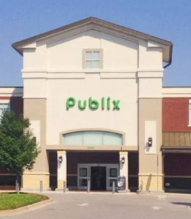
Munich Re Position: Two Wrongful Acts
Two wrongful acts under two AMIC policies, each under separate R/I treaty with separate retention:
Fairhope’s 2006 and 2008 decisions cannot be read as a single “Wrongful Act” under the AMIC policies
In alternative:
Even assuming they are a single Wrongful Act, damages are limited to those that fall within the policy periods.
Notes:
Munich disputed the billing and took the position that 2 retentions apply, because the wrongful acts triggering AMIC’s duty to defend occurred under two different AMIC policies, each of which was reinsured under a separate Munich Re treaty with a separate $350k retention.

Slide 17

Federal Court’s Ruling
Two “Wrongful Acts”:
Word “related” does not appear in policies’ definition of “Wrongful Act.”
Proper inquiry under the policy language is whether Fairhope’s 2006 and 2008 actions were “the same” or “substantially the same.”
Approval of a village center and approval of new traffic patterns are not “the same” or “substantially the same” acts.
Rejects AMIC’s “common purpose” argument.
Notes:
POLICY LANGUAGE MATTERS!
AMIC is fundamentally misreading their policies. The policies speak to similar acts, not objectives. As a result, common purpose does not equal common or “substantially the same” acts.
Court gives a few examples:
Going swimming and quitting smoking – both lower cholesterol, but are in no sense the same act
Hitchhiking and taking a flight – both can get you from Alabama to Washington, D.C., but are not the same act
For the same reasons (i.e. common purpose irrelevant under “substantially the same” policy language), disregards AMIC’s argument that both 2006 and 2008 acts breached a single settlement agreement with Dyases.
Notable aside re: bad faith: AMIC had brought bad faith claim against Munich Re. In a separate ruling, court dismissed bad faith cause of action, holding Alabama law does not extend the tort of bad faith to the reinsurance context.

Slide 18
Reminder that POLICY (and Reinsurance Contract) LANGUAGE MATTERS!
Why is this Case Important?
Notes:
Courts, and arbitration panels, will review the specific language in both the policies and reinsurance contracts at issue, and this specific language is key to determining whether coverage is available and on what terms.
It’s also a reminder that if the language is clear and unambiguous, courts are not going to read words into policies or reinsurance contracts.

Slide 19
Truck Insurance
“Are We Talking Art or Arbitration?”
Maggie Burnside
Troutman Pepper Locke LLP

Slide 20

Background
1968: The Gentlemen Agree…
1980s: Asbestos litigation,
the claims start coming in…
1984-1999: Memorandum of
Understanding
2023: New phone, who dis?

Slide 21

Ceding company demands payment
Defendants demand arbitration
Ceding company files action in California state court seeking declaratory relief as to the interpretation of the MOU
Defendants remove the case to federal court (CDCal) and file a motion to compel arbitration under the reinsurance agreement

Slide 22

The Declaratory Judgment Ask:
The MOU does not prevent the cedent from billing the underlying asbestos claims to Defendants in the manner in which they were actually billed
Defendants may not rely upon the MOU to reject the reinsurance billings

Slide 23
The MOU:
“…the [parties] have reached the following Understanding as to the applicability of the aforementioned Casualty Excess Reinsurance Contracts to the asbestos-related bodily injury claims brought against [Kaiser]. Both [Plaintiff] and [Defendants] fully reserve all their rights as to all issues of coverage herein and agree that no activity by either party nor the Understanding set forth herein shall ever be argued or deemed to constitute a waiver of the contractual rights of the parties or their rights under the law in the event of future applicable legislation, case law decision or participation by [Plaintiff] in the Asbestos Claims Facility.”
Truck Ins. Exch., U.S. Dist. LEXIS 240808 at *3

Slide 24
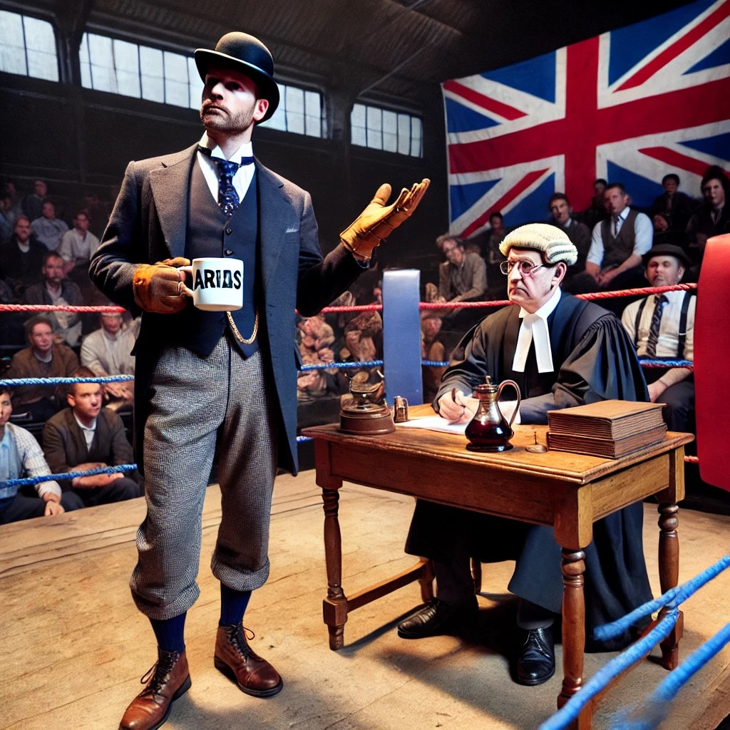
The Reinsurance Agreement:
“if any dispute shall arise between [the parties] with reference to the interpretation of this Contract or the rights with respect to any transaction involved, the dispute shall be referred to binding arbitration.”
Truck Ins. Exch., U.S. Dist. LEXIS 240808 at *2

Slide 25
The Outcome…
ARIAS Certified Arbitrators: 1
Truck Insurance Exchange: 0

Slide 26
The Outcome…
“Plaintiff artfully seeks declaratory relief interpreting one sentence of the MOU that has relevance only because it impacts Plaintiff’s ability to recover payment under the reinsurance contract—the subject of the broader dispute the parties are arbitrating. On this record, the Court finds that the parties’ dispute about the meaning of the MOU is a dispute “with reference to . . . the [parties’] rights with respect to” the reinsurance contract, and therefore falls within the scope of the arbitration agreement.”
Truck Ins. Exch., U.S. Dist. LEXIS 240808 at *9

Slide 27
“Tell Me Before You Know About It!”
Stephen M Turner
Dentons US LLP

Slide 28
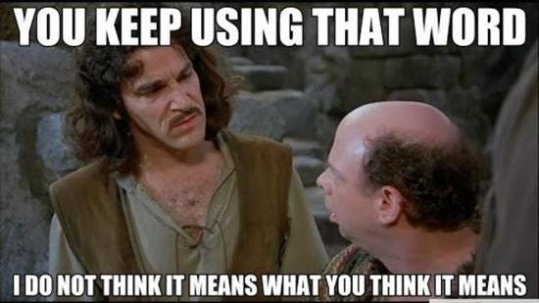
The Legal Dispute
Unified, the cedent, argued that USF, the reinsurer, had breached the reinsurance treaty at issue by failing to pay Unified its share of a settlement agreement
USF argued that Unified had breached the reinsurance treaty by failing to provide “prompt” notice of the claim.
The Court, thus, analyzed whether Unified had provided “prompt” notice such that it was entitled to payment

Slide 29

The Underlying Claim
Charles Butler purchased a Unified STM Policy in February 2016 and six months later received a cancer diagnosis;
In April 2017, Butler sued Unified that they had discounted his medical bills to lower than “reasonable and customary charge[s]” and later amended the complaint to add class allegations in December 2018;
The District Court ultimately granted class certification in September 2019;
Unified sought interlocutory review from the Ninth Circuit, which was denied on November 21, 2019

Slide 30
The Underlying Claim
Unified notified USF of the Butler litigation and the class claims in December 2019. Importantly, to that point Unified had not retained any experts. USF contributed to the defense after notice.
In March 2021, the District Court denied a motion for reconsideration filed by Unified and noted: (1) Unified should have put forward the expert testimony earlier; but (2) that had it done so it likely would not have made a difference.
Shortly after this ruling, the case settled for $8 million.
Unified sought payment from USF and USF refused to pay. USF initiated a DJ in Texas federal court in April 2022 arguing that it need not pay based on late notice.

Slide 31
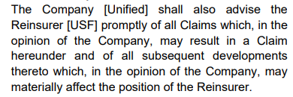
The Disputed Notice Provision
On Summary Judgment, Unified argued that the notice provision provides a purely subjective standard
USF disputed that the treaty created an entirely subjective standard and that Unified’s notice was unreasonably late.
Specifically, it argued, against the plain wording, that if read the way Unified suggested that it would have “unfettered discretion” and would read out the notice provision from the treaty.

Slide 32


Court’s Ruling
A subjective standard was applied, meaning that notice was required when Unified subjectively believed the Butler claim would result in a reinsurance claim
The evidence showed Unified did not believe a reinsurance claim would result until after the class certification appeal, so notice within 30 days was proper.
Even if it were late, the Court also ruled that USF failed to show actual prejudice caused by Unified’s late notice.

Slide 33

Why Does It Matter?
This is seemingly the first case in Texas (albeit a federal one) addressing the standard for late notice to a reinsurer, so going forward a reinsurer in Texas will likely need to show:
          That notice was late based on the plain wording of the notice provision; and
          That it suffered actual prejudice as a result of late notice to avoid reinsurance payments.
For notice provisions giving considerable discretion to a reinsured, a reinsurer should note that Texas courts will likely apply a subjective, not objective standard
Notes:
Note that other jurisdictions apply an objective standard even in the face of similar language. See, Zenith Ins. Co. v. Employers Ins. of Wausau, 141 F.3d 300, 305 (7th Cir. 1998)(“t is true that the language of this policy requires us to reconcile the objective meaning of the word “promptly” in part V with the apparently subjective reference to Wausau's own judgment a few words later. *306 But we cannot stretch the latter language as far as Wausau would like without completely eviscerating the contractual obligation to give prompt notice. Any time Wausau chose, it could elect to give no notice at all, if the paragraph as a whole is read the way Wausau urges us to view it. Such a reading would read out of the contract the obligation to give “prompt” notice of the claim.”)

Slide 34
Gartner, Inc. v. HCC Specialty Underwriters, Inc., et al.
“Common Interests, You Say? Isn’t Common A Rapper?”
Gabby Siskind
Zelle LLP

Slide 35

Facts
Gartner sued its Insurers in SDNY for losses incurred due to COVID-19 related event cancellations.
Gartner also sued its broker, Aon, for losses not covered by the policies with Insurers.
During discovery, documents were submitted to the Court for in-camera review.
Gartner and Aon argued that Insurers waived any work product protection by disclosing the documents to their reinsurers (among others).

Slide 36

Work product doctrine applied to all documents:
  Post-dated litigation;
  Reflected mental impressions, opinions, and conclusions; and
  Prepared in anticipation of or because of litigation.
Insurers did not waive work product protection by sharing documents or communicating with reinsurers.
Holding

Slide 37

Considerations
“[C]ommunications with ‘third-party’ reinsurers can waive any work product protection, ‘unless there was a common interest shared by the reinsurer and [the insurer].”
  To show a common interest, there must be a common legal interest, rather than a mere commercial one.
Then, party claiming work-product protection must show communications were made “in the course of formulating a common legal strategy.”

Slide 38

Takeaways
For Insurers:
  Be cautious when communicating with reinsurers both during the claim and litigation.
  While a good result here, oftentimes not the outcome.
  May be difficult to establish the parties have a “common legal interest.”

Slide 39

Takeaways
For Reinsurers:
  Be cautious when communicating with insurers both during the claim and litigation.
    This is particularly true when requesting documents pertaining to legal strategy.
  While a good result here, oftentimes not the outcome.
    If court finds privilege has been waived, could implicate reinsurer in litigation.

Slide 40
Rapid Fire Case Presentations:
Significant Recent Cases
Questions For Any Of Our Panelists?

Slide 41
Rapid Fire Case Presentations
Arbitrator Vote:
(1) National Casualty Co. v. Continental Insurance Co.
(2) Alabama Municipal Insurance Corp. v. Munich Re Reinsurance America, Inc.
(3) Truck Insurance Exchange v. Certain Underwriters at Lloyd’s
(4) United States Fire Insurance Company v. Unified Life Insurance Company
(5) Gartner, Inc. v. HCC Specialty Underwriters, Inc., et al.

Slide 42
Rapid Fire Case Presentations
Outside Counsel Vote:
(1) National Casualty Co. v. Continental Insurance Co.
(2) Alabama Municipal Insurance Corp. v. Munich Re Reinsurance America, Inc.
(3) Truck Insurance Exchange v. Certain Underwriters at Lloyd’s
(4) United States Fire Insurance Company v. Unified Life Insurance Company
(5) Gartner, Inc. v. HCC Specialty Underwriters, Inc., et al.

Slide 43
Rapid Fire Case Presentations
Company Representative Vote:
(1) National Casualty Co. v. Continental Insurance Co.
(2) Alabama Municipal Insurance Corp. v. Munich Re Reinsurance America, Inc.
(3) Truck Insurance Exchange v. Certain Underwriters at Lloyd’s
(4) United States Fire Insurance Company v. Unified Life Insurance Company
(5) Gartner, Inc. v. HCC Specialty Underwriters, Inc., et al.

Slide 44
THANK YOU!

