Slide 2
The Science of Settlement
Psychology and Mediation

Slide 3
Learning Objectives
Analyze how psychology tactics improve mediation outcomes, discussing various theories from widely-referenced books about mediation and negotiation.
Contrast the roles and recommended behavior at mediation of the mediator, the attorneys, and the party representatives.
Compare the litigation mindset with the mediation mindset, and how applying the wrong mindset can derail a favorable outcome.
Evaluate common mediation roadblocks and offer practical psychology-based solutions.
Apply theoretical negotiation and mediation strategy to real-life mediation scenarios.

Slide 4


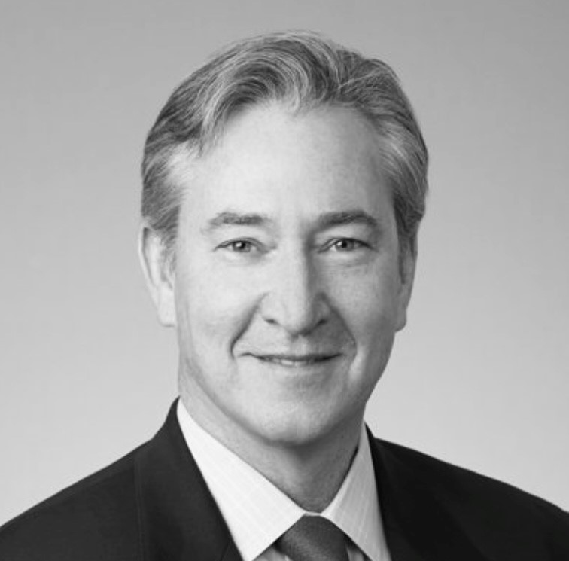
Katherine Koener, Esq.
Partner/Business Unit Leader
Kelley Kronenberg
Attorneys at Law
Anne Kevlin, Esq.
Mediator | Arbitrator
Kevlin Mediation PLLC
Founder and CEO
SheResolves
Daniel Hargraves, Esq.
Executive Vice President
Global Head of Litigation
AmTrust Financial Services Inc.
Nora Deveau, Esq.
Executive Vice President Deputy Chief Claims Officer
Arch Insurance Group, Inc.

Slide 5
The Arbitration Mindset
Focus on POSITION
(versus focus on SOLUTIONS)
Focus on WINNING
(versus focus on NEEDS)

Slide 6
The Mediation Mindset
Using the wrong mindset at the wrong time = POOR RESULTS!
*Examples*

Slide 7
The Mediation Mindset
Creative Solutions:
Going Beyond BATNA and WATNA

Slide 8
The Mediation Mindset
Mediator as TRUSTED PARTNER
Sharing information with mediator: What? When? Why?

Slide 9
The Mediation Mindset
Argument at mediation:
How? When? Why?
How to Help Your Mediator Accomplish What You or Your Client Need

Slide 10
Common Obstacles to
Settlement
Focus on POSITION and being right.

Slide 11
Common Obstacles to
Settlement
Anger
Frustration
Aggression

Slide 12
Common Obstacles to
Settlement
Negotiation “Spoilers”

Slide 13
Common Obstacles to
Settlement
Party will not listen or engage
Party will not meaningfully negotiate

Slide 14
Holding the Calm
By Hesha Abrams
Adapting your Message to the Listener
Gratitude vs Validation; Sympathy vs Empathy
Listening to What Is Not Said
The Magic of Silence

Slide 15
Holding the Calm
By Hesha Abrams
Using Heightened Emotions and Problems to Find Solutions
Holding the Calm While Being Attacked
Identifying Everyone’s Self-Interest to Solve Problems

Slide 16
Holding the Calm
By Hesha Abrams
Focusing on Creative Solutions
Using Humor and Distraction to Change the Tone
Using Politeness, Civility, and Professionalism to Your Advantage

Slide 17
Holding the Calm
By Hesha Abrams
Be Curious, Not Reactive
The Power of Asking for Advice
Avoiding a Loss = A Win
The Sandwich Technique

Slide 18
The Art of Persuasion
By Bob Burg
Making People Feel Important
Everything is Negotiable
Dealing with Difficult People

Slide 19
Getting to Yes
By Robert Fisher and William Fury
Separate the PEOPLE From the PROBLEM
Focus on INTERESTS not POSITIONS
WORK TOGETHER to Find Creative and Fair Options

Slide 20
Getting to Yes
By Robert Fisher and William Fury
Principled Negotiation:
Ask for the Principled Justification
Know Your BATNA and WATNA
Know When to End Negotiation
Verbal Judo

Slide 21
Never Split the Difference
By Chris Voss
Counterpoint to Getting to Yes
Use TRUE ACTIVE LISTENING to disarm your counterpart
Slow. It. Down.
FM DJ Voice (Or, Oprah Winfrey)
Mirroring

Slide 22
Never Split the Difference
By Chris Voss
Label the Pain or Your Counterpart
Tactical Empathy
Neutralize the Negative by Reinforcing the Positive
Label the Fears
Accusation Audit

Slide 23
Never Split the Difference
By Chris Voss
Pause. Silence as Negotiation Tool.
Do Not Rush. Time as Negotiation Tool.

Slide 24
Listening As a Martial Art
Chris Voss refers to this as “Tactical Empathy.”

Slide 25
Managing Emotions
The “hijacked amygdala” and the prefrontal cortex
Affect Labeling
Acknowledging Difficulty

Slide 26
Probing Assumptions and Calibrated Questions
Why asking leading or advocacy questions backfires
Examples of Probing Assumptions
Examples of Calibrated Questions

Slide 27
Moving From Positional Negotiation to Principled Negotiation
Separate the Person from the Problem
Reactive Devaluation: Steps to Avoid

Slide 28
Moving From Positional Negotiation to Principled Negotiation
Interest Analysis: develop understanding of true interests rather than positions.
Positions are the “What.”
Interests are the “Why.”

Slide 29
Moving From Positional Negotiation to Principled Negotiation
Analyze BATNA and WATNA
Use Objective Criteria

Slide 30
The “Influence Equation”
Influence =
Persuasion/Resistance

Slide 31
The “Influence Equation”
Resistance tends to increase
as persuasion intensifies

Slide 32
The “Influence Equation”
Interests: Met vs. Unmet
Relationship: Trust vs. Distrust
Reasoning: Logical to Other Side
vs. Illogical to Other Side

Slide 33
Lessons Learned? Questions?
???

Slide 34
THANK YOU

