Slide 2

1. How important is it to a fair arbitration that the arbitrators apply the rules of evidence?
Very important.
Rules of evidence are not important and do not need to be followed.
Arbitrators should use the rules of evidence more as guidelines than strict requirements for admission.

Slide 3
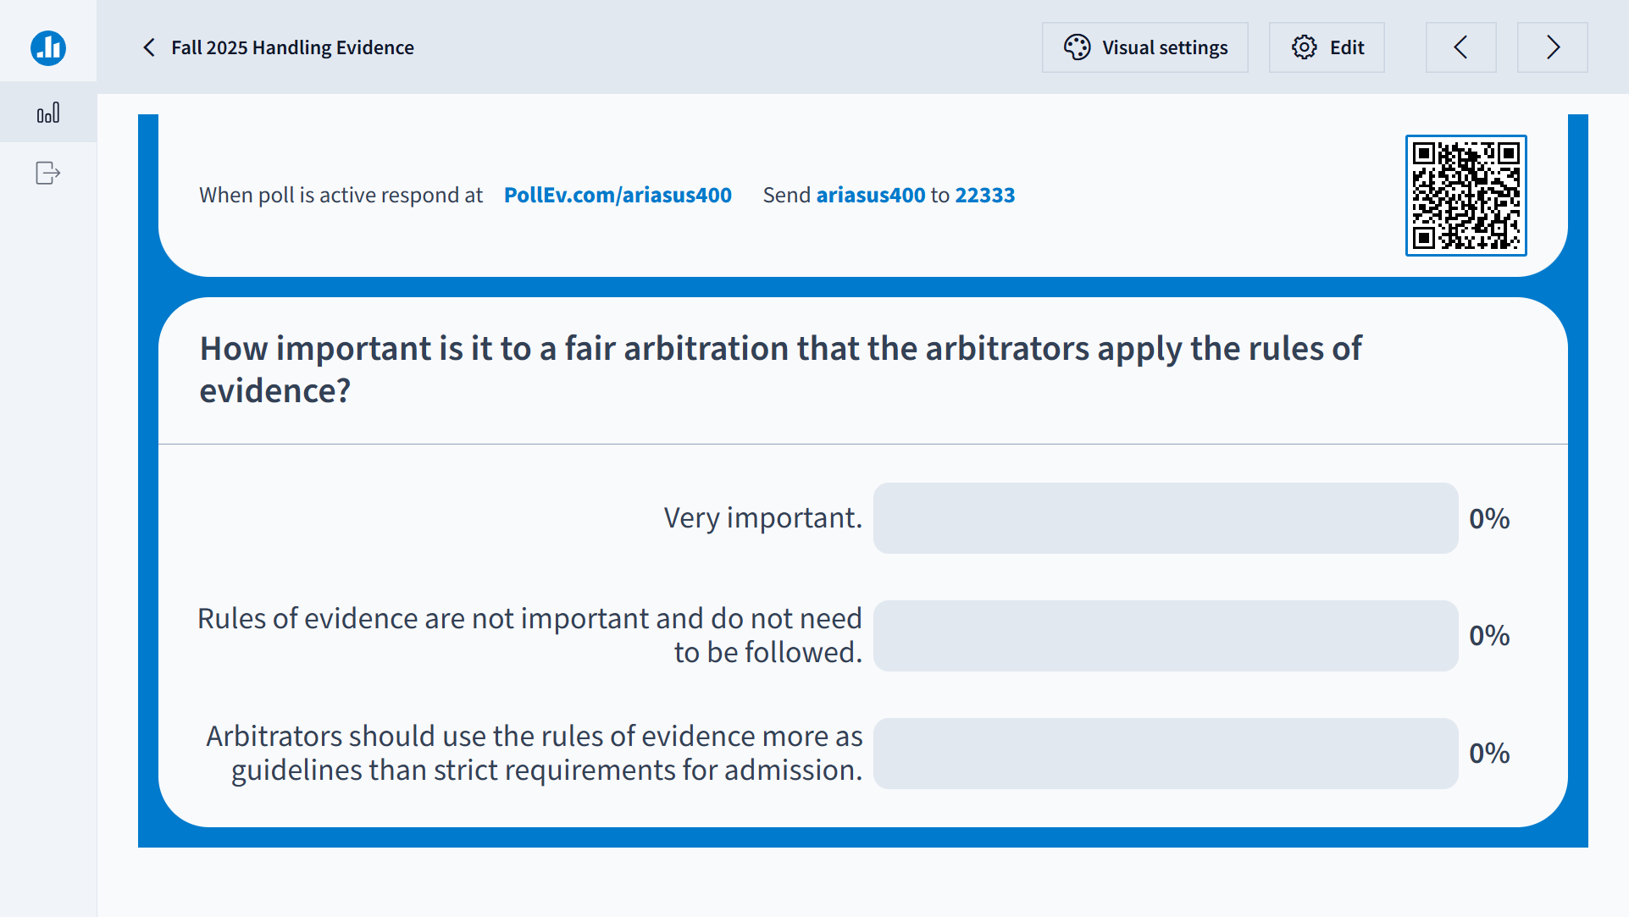

Slide 4
Overview
Setting Reasonable Expectations
Rules of Evidence vs. Custom & Practice
Planning for Evidentiary Issues

Slide 5

Rules of Evidence: Which should apply?
The Arbitration Agreement
The Tribunal Rules
Federal Statutes (F.A.A.)
Federal Rules of Evidence
Applicable State Statutes
International Bar Association − IBA

Slide 6
2. Is a discussion about motions in limine useful?
At the Organizational Meeting.
At a later pre-evidentiary hearing/status conference.
Never, just deal with the evidentiary issues at the hearing.

Slide 7
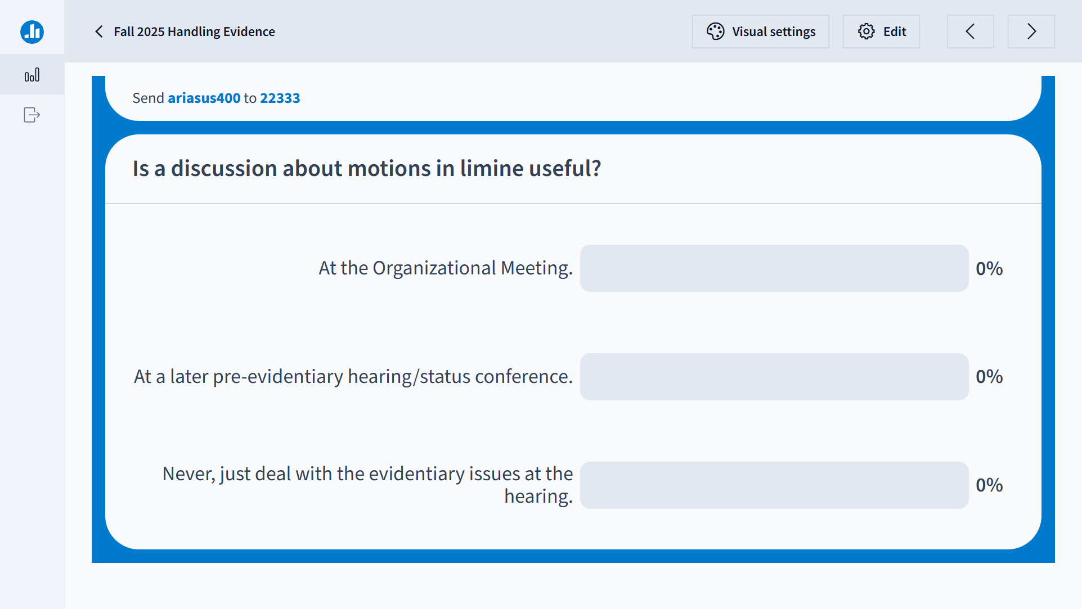

Slide 8
Pre-Hearing Evidentiary Considerations
The Value of Motions in Limine
Causes Early Focus on Evidentiary Issues
Raise at Organizational Meeting
Early evidence rulings can dramatically affect discovery
Stipulations of Fact − save time, money and effort.
Stipulate to what you cannot realistically dispute.
Stipulate to exhibits that are authentic and admissible.

Slide 9
3. How helpful is laying a foundation for testimony or to get an exhibit admitted?
It is a waste of time.
Useful, because it provides credibility to the witness or exhibit being offered.
I am not sure what laying a foundation means.

Slide 10
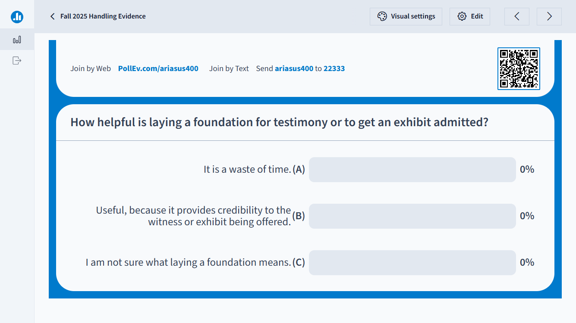

Slide 11
Getting Evidence Admitted
Direct
Form of the question – simple, one question at a time – give witness prompts to tell their story
Laying foundation for testimony – how is witness competent to talk about elicited fact
Laying the foundation for exhibits:
authenticate how witness knows what exhibit is
stipulation as to authentication vs. admissibility
get advance ruling on objections to admissibility
Avoid hearsay objection – by knowing the rule!
Cross
Control the witness with “Yes” or “No” questions

Slide 12
4. Should arbitrators apply the hearsay rule in admitting or excluding evidence?
No. All hearsay evidence should be admitted and accorded its due weight.
No. Hearsay is confusing and most people do not understand it anyway.
Yes, because it is unfair to consider testimony or evidence of statements that cannot be cross-examined.

Slide 13
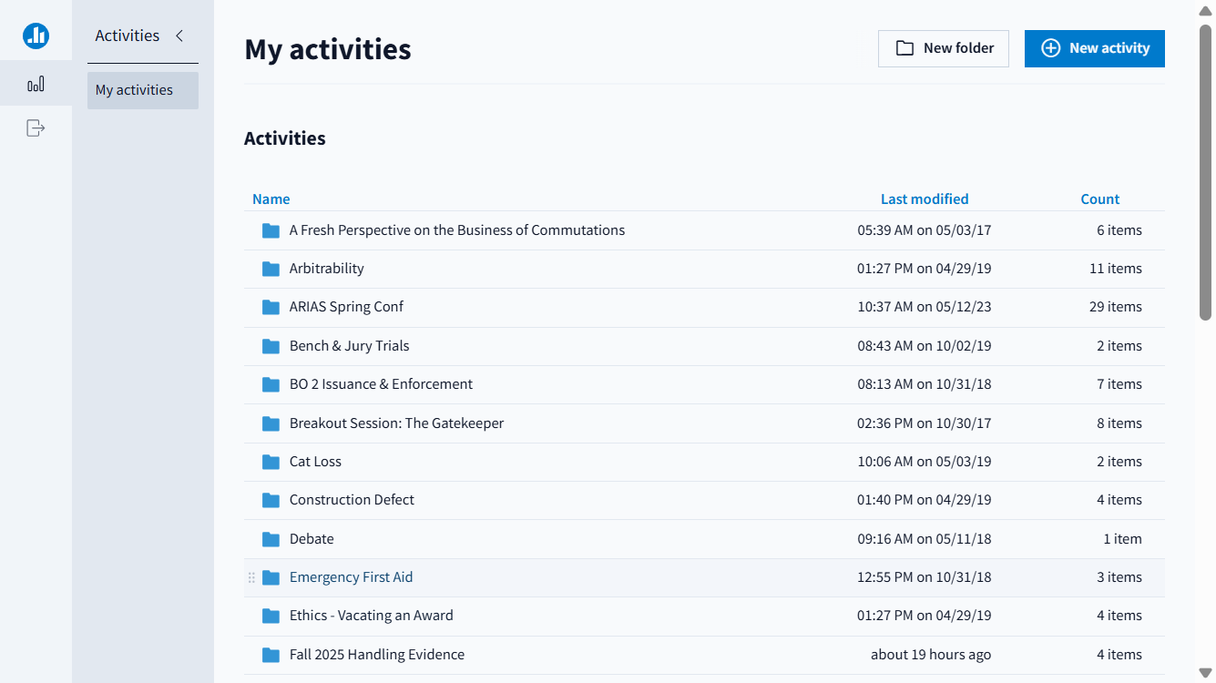

Slide 14
Types of Objections
Objections to form of the question:
Vague, ambiguous, unintelligible
Compound
Leading
Asked and Answered
Substantive Objections:
Lack of Relevance
Lack of Foundation – easiest objection to be sustained because it can be cured
Speculation
Assumes fact not in evidence
Hypothetical
Calls for Hearsay
Settlement Compromise Not Evidence of Liability--Rule 408
Improper Opinion
Argumentative
Attorney-Client Privilege/Work Product Doctrine

Slide 15
Knowing When Hearsay Is a Problem
If a witness offers testimony of what someone else said outside of the hearing and offers it to prove the truth of that statement − it is hearsay. (FRE 801)
Why is hearsay inadmissible? Because the witness cannot be cross-examined since he is not the one who made the statement (i.e., the perception, memory and credibility of the missing declarant cannot be challenged on cross-examination of the witness)
The following are not hearsay if the statement: (FRE 801)
is an admission of a party opponent or its manager or agent
is the witness’s prior statement under oath
if the out-of-hearing statement is not offered for its truth
Exceptions: (1) business record made in regular course of business (FRE 803 (6),(7)); (2) statement against one’s interest (FRE 804 (b)(3))

Slide 16
Dealing with Objections
Arbitrators
A fair hearing is the ultimate objective.
Rules of evidence are used to ensure fairness.
When in doubt let the evidence in.
Then, determine weight, if any, to be given evidence.
Protect the record from an unfair exclusion of evidence (e.g., FAA Rule at 9 U.S.C. § 10(a)(3))
Litigants
Avoid unnecessary objections – substance over form!
Listen to arbitrator and let ruling guide future questions.
If issue on objection is important enough make a record.

Slide 17
Questions & Answers

