Slide 2
Ethical Practice
Creating and Sustaining a Culture of Ethics
November 14, 2025

Slide 3
Moderator:
Suman Chakraborty, Member, Mintz and ARIAS Ethics Committee
Panelists:
Glenn Jones, Chief Conflicts Officer, Simpson Thacher
Jennifer Kenedy, Partner and Chief Risk Officer, Troutman Pepper Locke
Allison Standish Miller, Partner, Steptoe LLP
Why We Are Here

Slide 4
Creating a Culture of Ethics
Ethical Minefields in the AI World
The Duty of Competence
Navigating Conflicts
The Economics of Ethics
Agenda

Slide 5
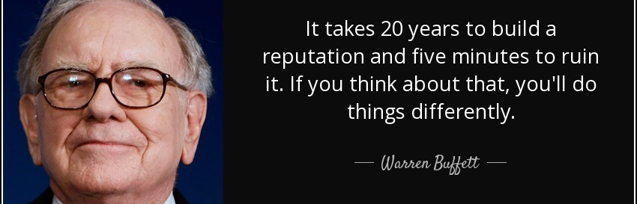
Creating a Culture of Ethics

Slide 6
“A lawyer, as a member of the legal profession, is a representative of clients, an officer of the legal system and a public citizen having special responsibility for the quality of justice.”
Model Rules of Professional Conduct: Preamble (1)

Slide 7

Ethical Minefields in the AI World

Slide 8
When using generative artificial intelligence tools, a lawyer should take into account:
the duty of confidentiality,
the obligation to avoid conflicts of interest,
the duty of competence and diligence,
the duty to supervise both lawyers and nonlawyers,
the duty to consult with clients,
the duty of candor to tribunals,
the limitations on what a lawyer may charge for fees and costs
New York City Bar, Formal Opinion 2024-5
(Partial List Only)

Slide 9

The Duty of Competence

Slide 10
The duty of competence
“A lawyer shall provide competent representation to a client. Competent representation requires the legal knowledge, skill, thoroughness and preparation reasonably necessary for the representation.”
-Model Rule 1.1

Slide 11

Navigating Conflicts

Slide 12
Conflict of Interests
“A concurrent conflict of interest exists if…
(2) there is a significant risk that the representation of one or more clients will be materially limited by the lawyer's responsibilities to another client, a former client or a third person or by a personal interest of the lawyer.”
-Model Rule 1.7

Slide 13
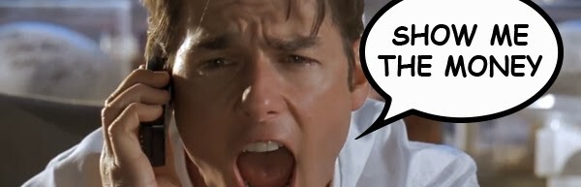
The Economics of Ethics

Slide 14
“While money can't buy happiness, it certainly lets you choose your own form of misery.”
- Groucho Marx

Slide 15
Questions

