Slide 2

ASOPs: Real Lessons, Not Fables
Lisa Kuklinski, MAAA, FSA
Former Member of Actuarial Standards Board Life Committee

Slide 3
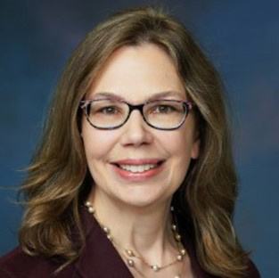
Speaker
with support of the American Academy of Actuaries
Lisa Kuklinski, MAAA, FSA
Member, Life Committee, Actuarial Standards Board (ASB), 2019 – 2025
Chairperson, ASOP No. 10 Task Force
Director, Society of Actuaries
Managing Director, FTI Consulting

Slide 4
Disclaimer
Please note: My statements and opinions are my own and do not necessarily represent the official statements or opinions of the Actuarial Board for Counseling and Discipline (ABCD), Actuarial Standards Board (ASB), any boards or committees of the American Academy of Actuaries, nor any other actuarial organization or employer.

Slide 5
Agenda
About the American Academy of Actuaries
ASB and Professionalism
ASOP No. 1, Introductory Standard of Practice
ASOP 17, Expert Testimony by Actuaries
ASOP 23, Data Quality
ASOP No. 41, Actuarial Communications
ASOP No. 56, Modeling
The ASOP Pipeline
Conclusion

Slide 6
About the American Academy of Actuaries
Founded 1965
Key goal: maintain and promote actuarial professionalism & self-regulation
Membership today: >20,000 individual actuaries
National association for U.S. actuaries & voice on public policy issues
Represents qualified actuaries of all specialties

Slide 7
ASB and Professionalism

Slide 8
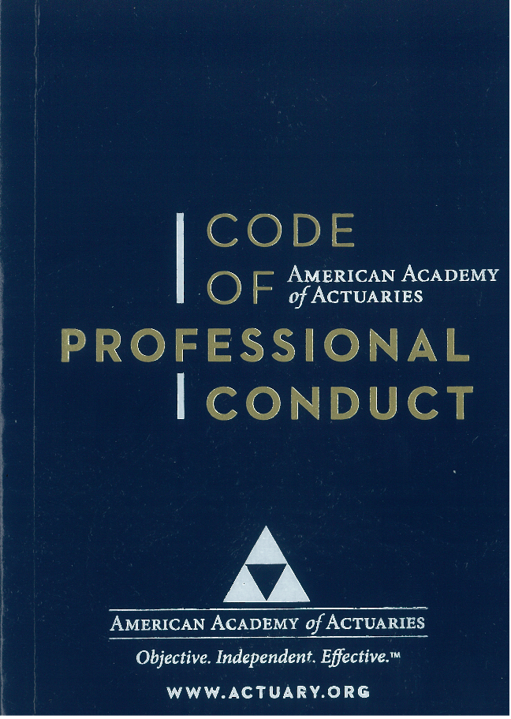
Applicability of Code of Professional Conduct
The Code of Professional Conduct applies to any actuary who is a member of the five U.S.-based actuarial organizations.

Slide 9
5 U.S.-Based Actuarial Organizations
American Academy of Actuaries
American Society of Enrolled Actuaries
Casualty Actuarial Society
Conference of Consulting Actuaries
Society of Actuaries

Slide 10
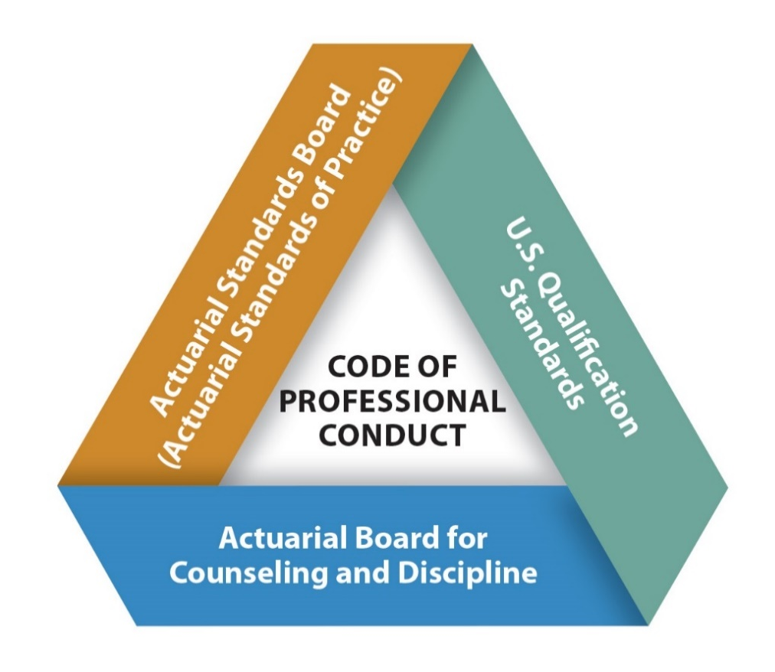
Professionalism: Basis of Self Regulation

Slide 11

ASB Authority
Established by Academy bylaws.
Legally part of the Academy.
Has exclusive authority to promulgate standards.

Slide 12
ASB Rooted in Precept 3 of Code of Professional Conduct
PRECEPT 3. An Actuary shall ensure that Actuarial Services performed by or under the direction of the Actuary satisfy applicable standards of practice.
Purpose of the ASB The Actuarial Standards Board (ASB) sets standards for appropriate actuarial practice in the United States through the development and promulgation of actuarial standards of practice (ASOPs).

Slide 13
Actuarial Standards of Practice

Slide 14
What Is an ASOP?
ASOPs describe the procedures an actuary should follow when performing actuarial services and identify what the actuary should disclose when communicating the results of those services.
Serve to assure the public that actuaries are professionally accountable.
Provide practicing actuaries with a basis for assuring that their work will conform to appropriate practices.

Slide 15
Philosophy of ASOPs
Guidance for appropriate practice
Principle-based
Flexible
Disclosure
Broad applicability
Cannot cover all circumstances
Support profession’s self-regulation
Don’t guarantee good work

Slide 16
ASOP Level of Prescription
General Thoughts (“What ASOPs Can and Cannot Do”)

Slide 17

ASOP Process

Slide 18
Standards-Setting Process
Initial draft
Subsequent draft(s)
Reviews draft ASOP
Reviews draft ASOP
Reviews comments and revises draft ASOP
Reviews draft ASOP
Prepares draft ASOP
Committee
Actuarial Standards Board
Return to Committee
Expose for comment
Reviews draft ASOP
Return to Committee
Adopt final ASOP
Re-expose for comment
Task Force

Slide 19
Structure: ASOPs by Practice Area
19
Cross-Practice ASOPs
ASOP No. 1 Introductory ASOP
ASOP No. 41 Actuarial Communications
ASOP No. 12 | Risk Classification
ASOP No. 17 | Expert Testimony by Actuaries
ASOP No. 21 | Responding to or Assisting…
ASOP No. 23 | Data Quality
ASOP No. 25 | Credibility Procedures
ASOP No. 32 | Social Insurance
ASOP No. 38 | Catastrophe Modeling
ASOP No. 55 | Capital Adequacy Assessment
ASOP No. 56 | Modeling
ASOP No. 58 | Enterprise Risk Management
Practice-Specific ASOPs
Casualty
7, 13, 19, 20, 29, 30, 36, 39, 43, 53
Health
3, 5, 6, 7, 8, 11, 18, 19, 22, 26, 28, 42, 45, 49, 50, Reinsurance pricing
Life
2, 7, 10, 11, 15, 19, 22, 24, 33, 37, 40, 48, 52, 54, 57, Reinsurance pricing
Pension
Pension
4, 6, 27, 34, 44, 51
Green indicates an ASOP under revision and green italics indicates a proposed new ASOP.

Slide 20
ASOP Structure
T. MEMO History of the Standard and Contributors SECTION 1 Purpose, Scope, Cross-References, and Effective Date
SECTION 2 Definitions
SECTION 3 Analysis of Issues and Recommended Practices
SECTION 4 Communications and Disclosures
APPENDIX 1 Background and Current Practices
APPENDIX 2 Comments and Responses

Slide 21
ASOP No. 1, Introductory Actuarial Standard of Practice

Slide 22
ASOP No. 1, Introductory Actuarial Standard of Practice
Provides guidance to actuaries on how to read and interpret the other actuarial standards of practice
Defines or discusses key terms used in the other ASOPs
Defines the purpose and format of the ASOPs
Discusses how ASOPs are binding on actuaries
Provides useful background information in appendices
Carries the same weight and authority as other ASOPs
Applies to all ASOPs and all practice areas

Slide 23
ASOP No. 1—‘Must’ / ‘Should’ / ‘Should Consider’ / ‘May’
Must = ASB does not anticipate that the actuary will have any reasonable alternative but to follow a particular course of action
Should = what is normally the appropriate practice for an actuary to follow
Should consider = used to suggest potential courses of action. The actuary may use professional judgment to determine an action is not appropriate; the action is not required.
May = used to indicate that the course of action described is one that would be considered reasonable and appropriate in many circumstances.
Allowed to deviate if actuary follows ASOP No. 41

Slide 24
ASOP No. 1 — Compliance
Use “good faith” approach: reasonable professional judgment / professional integrity (Precept 1 of the Code)
Strained interpretations are not appropriate
Responsible for determining which ASOPs apply
If it is necessary to deviate from the guidance in an ASOP, it is not a breach if disclosed as described in the ASOP

Slide 25
ASOP No. 17, Expert Testimony by Actuaries

Slide 26
ASOP No. 17, Expert Testimony by Actuaries
Provides guidance to actuaries providing expert testimony
Applies to actuaries “who are qualified as experts under the evidentiary rules applicable in a forum when they provide testimony in court hearings, dispute resolutions, depositions, rate hearings, legislative hearings, or other similar proceedings.”
Reference should also be made to other ASOPs concerned with the actuarial substance of the assignment
Does not discourage reasonable differences of actuarial opinion, or innovation in advancing the practice of actuarial science

Slide 27
ASOP No. 17—Compliance
An actuary providing expert testimony should comply with the requirements of the Code of Professional Conduct
Act honestly, with integrity and competence, in a manner to fulfill the profession’s responsibility to the public
Guidance includes:
Hypothetical questions
Testifying concerning other relevant testimony
Cross-examination
Consistency with prior statements
Discovery of error
Limitation of expert testimony

Slide 28
ASOP No. 17—Disclosures
Guidance covers:
Written reports
Scope, including limitations and constraints
Descriptions and sources of data, actuarial methods, and actuarial assumptions
Appropriate to intended audience
Oral Testimony
Prescribed Statement of Actuarial Opinion
Deviation from Standard

Slide 29
ASOP No. 23, Data Quality

Slide 30
ASOP No. 23, Data Quality
What does ASOP No. 23 apply to when performing actuarial services?
Selecting data
Performing review of data
Using data
Relying on data supplied by others
Other applicability
When selecting or preparing data used by other actuaries
When preparing data, apply guidance as though using data
When making appropriate data quality disclosures
Does not apply to the generation of a wholly hypothetical data set

Slide 31
31
ASOP No. 23—Key Definitions
Data is:
Numerical, census, or classification information
Information derived mathematically from such items
Data is not:
General or qualitative information
Assumptions
What makes data “appropriate”:
Suitable for the intended purpose of an analysis
Relevant to the system or process being analyzed

Slide 32
ASOP No. 23—Limits of Actuary’s Responsibility
The actuary is not required to do any of the following:
Determine whether data or other information supplied by others is falsified or misleading
Compile additional data solely for the purpose of searching for questionable or inconsistent data
Perform an audit of the data

Slide 33
ASOP No. 23—Review vs. Audit
Review
An examination of the obvious characteristics of data to determine if such data appear reasonable and consistent for purposes of the assignment.
Audit
A formal and systematic examination of data for the purpose of testing its accuracy and completeness.
ASOP No. 23 does not require the actuary to perform an
audit of the data (sections 1.2 and 3.8[c])

Slide 34
ASOP No. 41, Actuarial Communications

Slide 35
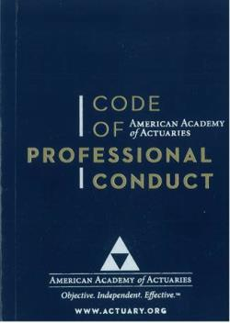
Communication and Disclosure: It All Starts With the Code
“The Code of Professional Conduct sets forth what it means for an actuary to act as a professional. It identifies the responsibilities that actuaries have to the public, to their clients and employers, and to the actuarial profession.”

Slide 36
Communication and Disclosure: Code and ASOP No. 41
Communications and Disclosure
PRECEPT 4. An Actuary who issues an Actuarial Communication shall take appropriate steps to ensure that the Actuarial Communication is clear and appropriate to the circumstances and its intended audience and satisfies applicable standards of practice.
ANNOTATION 4-1. An Actuary who issues an Actuarial Communication shall ensure that the Actuarial Communication clearly identifies the Actuary as being responsible for it.
ANNOTATION 4-2. An Actuary who issues an Actuarial Communication should indicate the extent to which the Actuary or other sources are available to provide supplementary information and explanation.

Slide 37
Communication and Disclosure: Code and ASOP No. 41
Communications and Disclosure
PRECEPT 5. An Actuary who issues an Actuarial Communication shall, as appropriate, identify the Principal(s) for whom the Actuarial Communication is issued and describe the capacity in which the Actuary serves.
PRECEPT 6. An Actuary shall make appropriate and timely disclosure to a present or prospective Principal of the sources of all direct and indirect material compensation that the Actuary or the Actuary’s firm has received, or may receive, from another party in relation to an assignment for which the Actuary has provided, or will provide Actuarial Services for the Principal.

Slide 38
ASOP No. 41—Overview
Section 1.1 Purpose: Provides “guidance to actuaries with respect to actuarial communications”
Section 1.2 Scope: The standard “applies to actuaries issuing actuarial communications within any practice area.” The standard “does not apply to communications that do not include an actuarial opinion or actuarial findings.”

Slide 39
ASOP No. 41—Definitions
Term | Definition
Actuarial Services | Professional services provided to a principal by an individual acting in the capacity of an actuary. Such services include the rendering of advice, recommendations, findings, or opinions based upon actuarial considerations.
Actuarial Finding | The result (including advice, recommendations, opinions, or commentary on another actuary’s work) of actuarial services.
Actuarial Communication | A written, electronic, or oral communication issued by an actuary with respect to actuarial services.
Actuarial Report | The set of actuarial documents that the actuary determines to be relevant to specific actuarial findings that is available to an intended user.

Slide 40
ASOP No. 41—Required Disclosures in an Actuarial Communication
Identification of Responsible Actuary
Identification of Actuarial Documents
Disclosures in Actuarial Reports
List of intended users
Scope and intended purpose of engagement
Acknowledgement of qualifications
Cautions about risk and uncertainties
Limitations or constraints on use or applicability of actuarial findings
Conflicts of interest

Slide 41
ASOP No. 56, Modeling

Slide 42
ASOP No. 56—Scope
Applies to actuary’s own modeling responsibilities
“Designing, developing, selecting, modifying, using, reviewing, or evaluating”
Can be related to entire model or only a small portion
Applies for all types of models
e.g., projection models and predictive/statistical models
Applies when reliance by intended user on model output has a material effect
Does not apply for individual pension benefit calculations and nondiscrimination testing described in ASOP No. 4

Slide 43
ASOP No. 56—Scope
The actuary should use professional judgment to decide:
What is the model
The extent of the actuary’s responsibility
How to apply the ASOP guidance when the actuary is a member of a team working with the model

Slide 44
ASOP No. 56—Model Defined
A simplified representation of relationships among real-world variables, entities, or events.
Consists of three components
Information input component
Delivers data and assumptions to the model
Processing component
Transforms input into output
Results component
Translates the output into useful business information

Slide 45
ASOP No. 56—Intended Purpose
The actuary should understand the model’s intended purpose.
When confirming that the capability of a model is consistent with the intended purpose, the actuary should consider:
The level of detail in the model
The dependencies recognized
The model’s ability to identify possible volatility of output (e.g., expected values)

Slide 46
ASOP No. 56—Reliance on Models Developed by Others
If limited ability to obtain information or understand underlying workings, then the actuary should disclose extent of reliance
However, need to make a reasonable attempt to get basic understanding
Original intended purpose
General operation
Major sensitivities and dependencies
Key strengths and limitations
Make practical efforts to comply with other guidance in ASOP No. 56

Slide 47
Documentation
The actuary should consider preparing and retaining documentation to support compliance with requirements of section 3 and disclosure requirements of section 4
Form of documentation should be such that another actuary qualified in the same practice area could assess the reasonableness of the work
Degree of documentation should be based on actuary’s professional judgment and may vary with the complexity and purpose of the services

Slide 48

The ASOP Pipeline

Slide 49
Questions?

Slide 50
Resources

Slide 51

Academy Professionalism Resources
Professionalism Webpage
actuary.org/content/professionalism
Code of Professional Conduct
ASOPs
U.S. Qualification Standards
Discussion papers
Applicability Guidelines
Professionalism Counts

