Slide 1
Preaching to the Choir
Presenting, Attacking, and Evaluating Expert Testimony on Industry Custom and Practice in Reinsurance Arbitrations
November 13, 2025

Slide 2
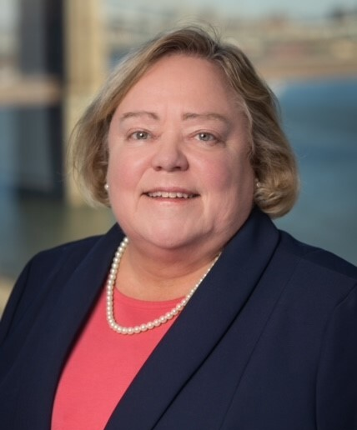
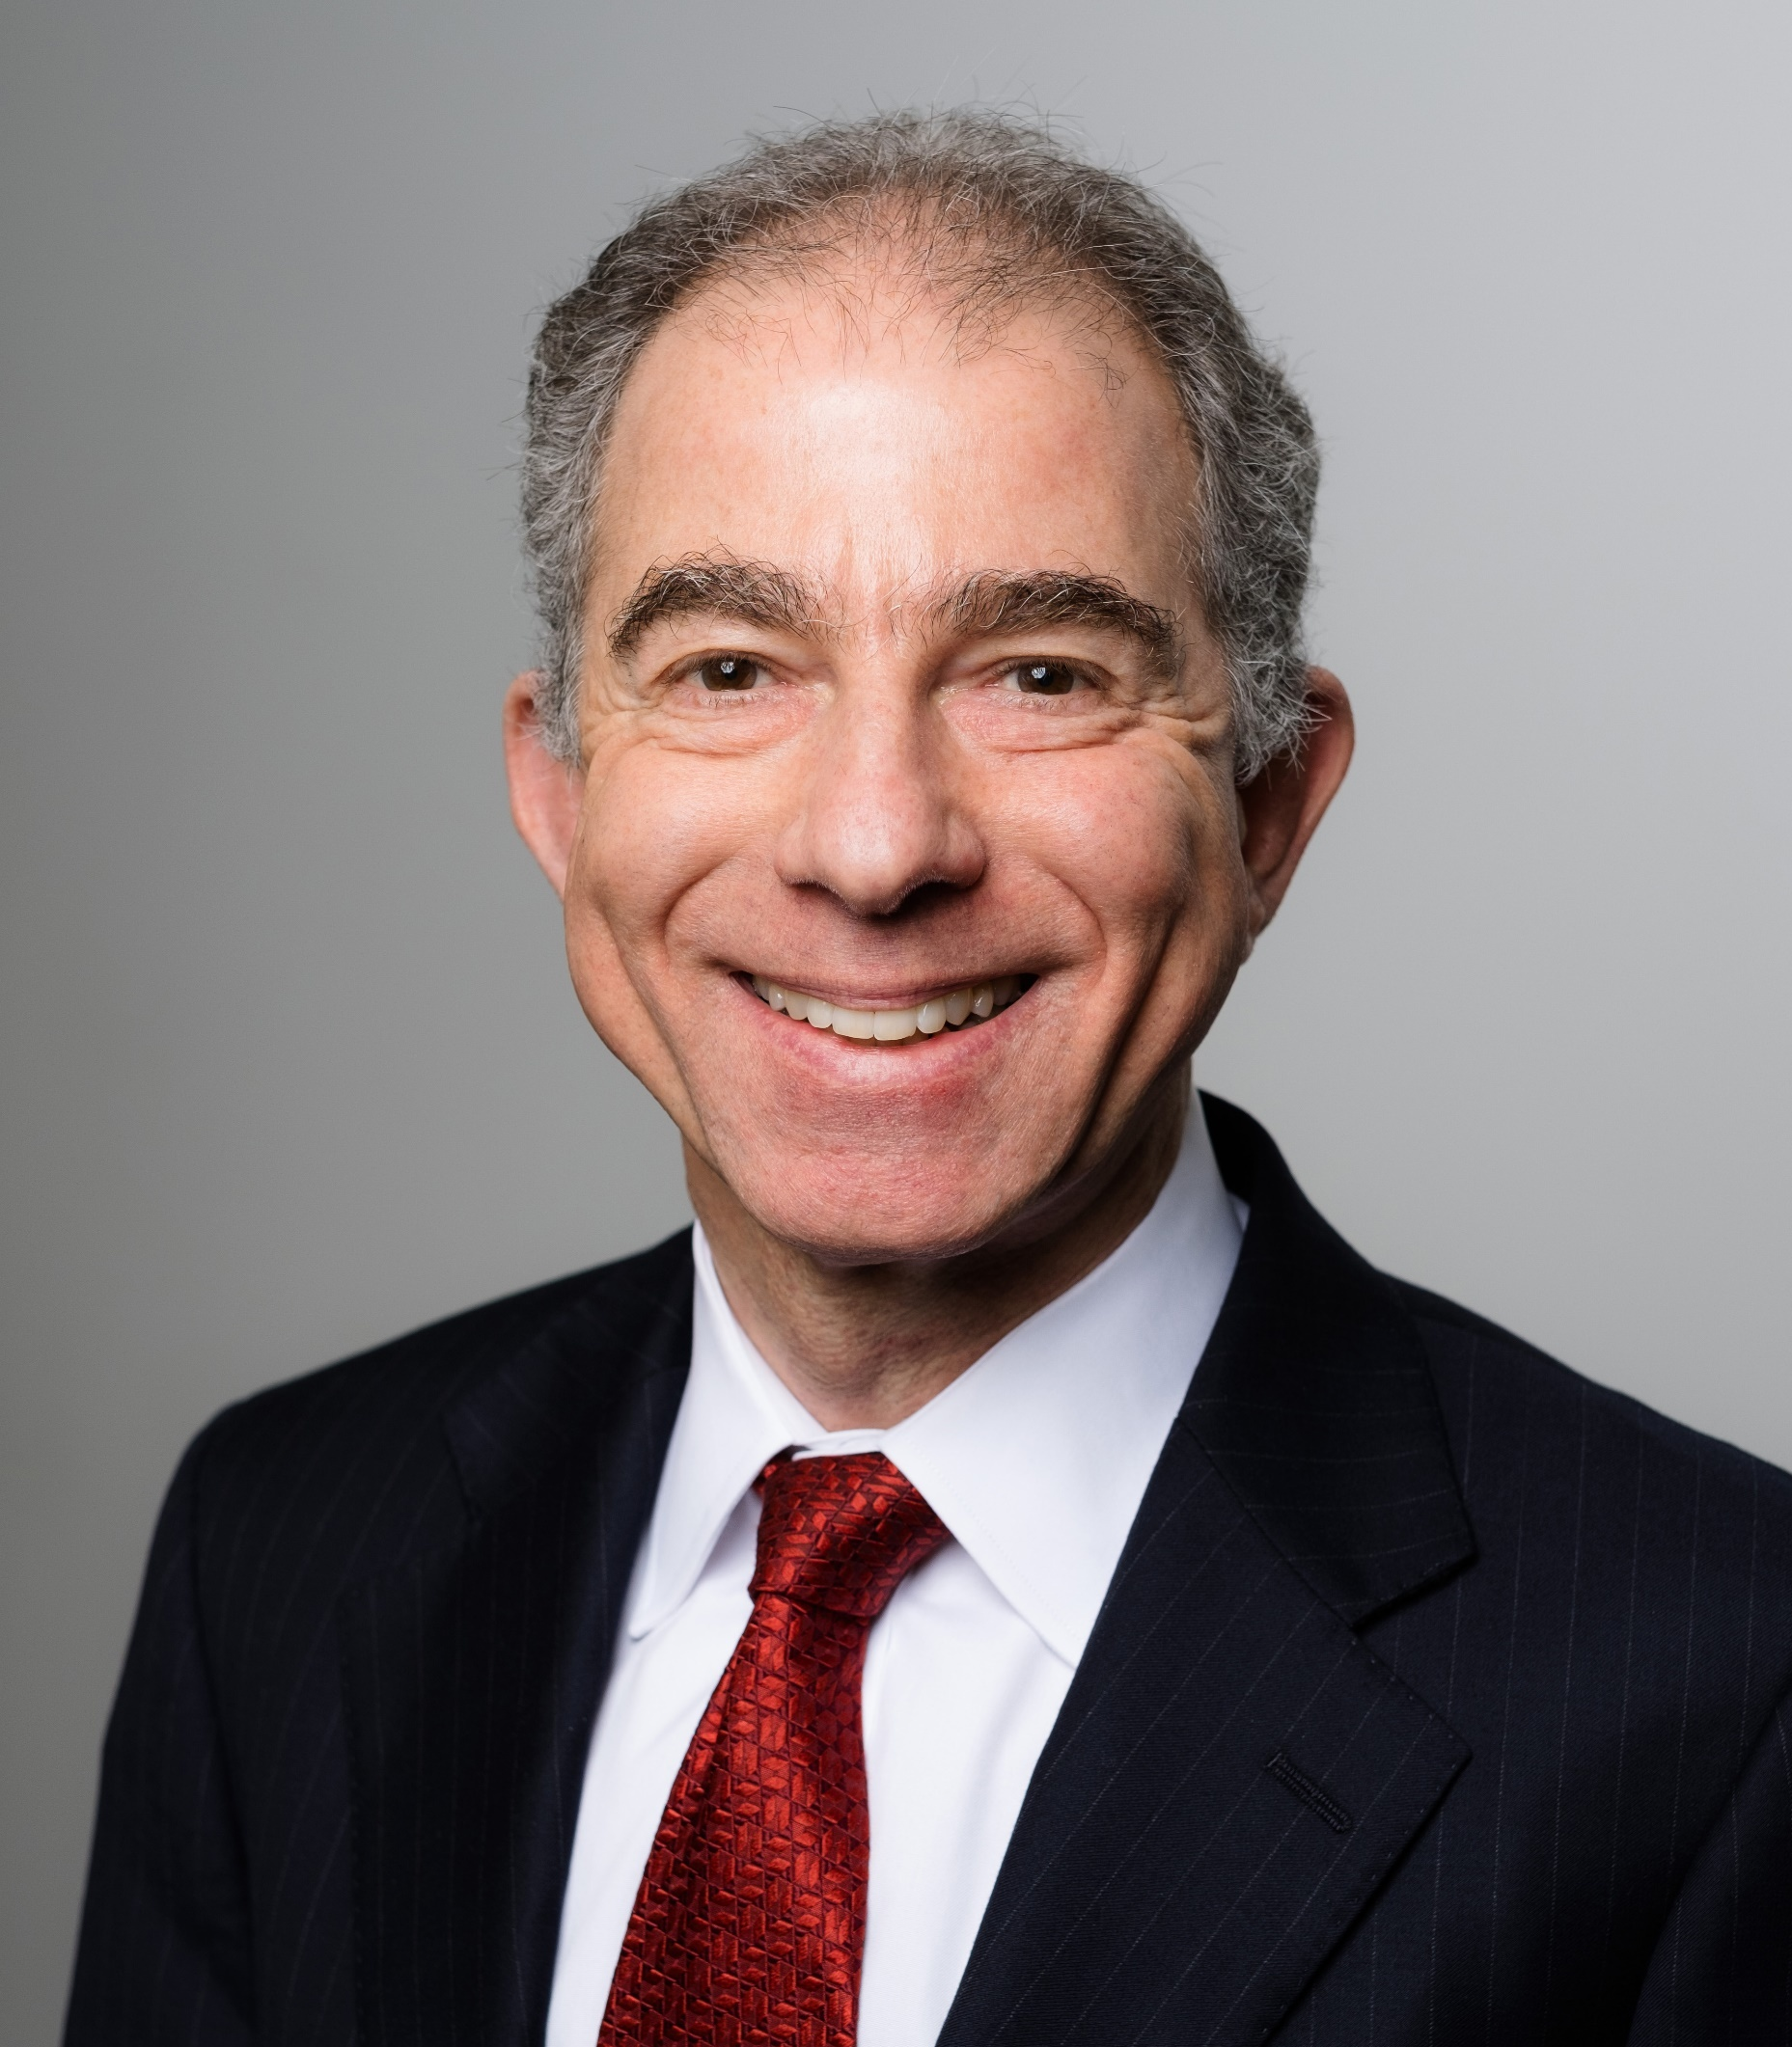
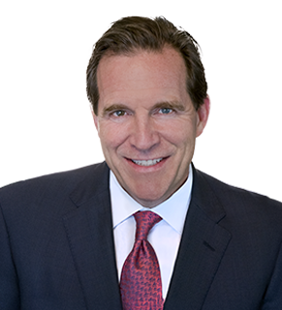
Cynthia R. Koehler
ARIAS Arbitrator
Steven C. Schwartz
Chaffetz Lindsey LLP
Neel Lane
Norton Rose Fulbright LLP

Slide 3
Custom and Practice in Reinsurance Disputes
Reinsurance agreements require that panel members be active or retired executive officers of insurance or reinsurance companies.
May require panel members to have minimum number of years of experience, or experience in a particular area of insurance (e.g., life products).
Typically empower the panel to make its decision considering the custom and practice of the applicable insurance and reinsurance business.

Slide 4
Custom and Practice in Reinsurance Agreements, cont’d
The panel is also commonly relieved from the strictures of judicial formalities or the rules of evidence.
In light of these factors, we consider:
How to present impactful custom, practice and usage evidence to a reinsurance arbitration panel?
How to counter such evidence?
How might panel members evaluate such evidence?

Slide 5
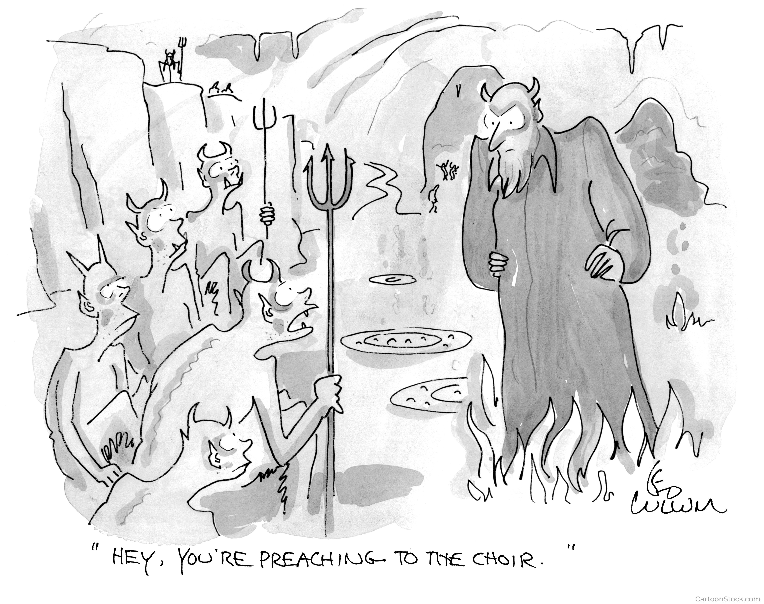

Slide 6
Custom and Practice Evidence in the Courts
Though rules of evidence are not binding on a panel, panels may look to court precedent for guidance in evaluating custom and practice evidence.
Generally, custom and usage evidence is admissible in disputes:
To construe an ambiguous contract term
Christiania Gen. Ins. Corp. of N.Y. v. Great Am. Ins. Co., 979 F.2d 268, 274 (2d Cir. 1992)
To evaluate a party’s conduct against standards
Marx & Co., Inc. v. Diners’ Club, Inc., 550 F.2d 505, 509 (2d Cir. 1977) (citing VII Wigmore on Evidence § 1949, at 66 (3d ed. 1940)

Slide 7
Expert Testimony in the Courts
Daubert v. Merrell Dow Pharmaceuticals, Inc., 509 U.S. 579 (1993)
Courts should act as “gatekeepers” and exclude unreliable expert testimony
Set forth a non-exclusive checklist for assessing reliability:
Whether the expert’s technique or theory can or has been tested
Whether the technique or theory has been subject to peer review and publication
The known or potential rate of error of the technique or theory when applied
The existence and maintenance of standards and controls
Whether the technique or theory has been generally accepted in the scientific community
Kumho Tire Co. v. Carmichael, 526 U.S. 137 (1999) expanded Daubert to apply to non-scientific expert testimony, subject to the particular circumstances of the case at issue.

Slide 8
Expert Testimony in the Courts, cont’d
Federal Rule of Evidence 702 (and its state counterparts) govern conditions under which expert testimony is permitted.
Even if an expert is qualified by experience and training, the witness may testify only if:
The expert’s specialized will help the trier of fact understand evidence or determine a fact in issue
The testimony is based on sufficient facts or data
The testimony is the product of reliable principles and methods
The expert has reliably applied those principles and methods to the facts of the case

Slide 9
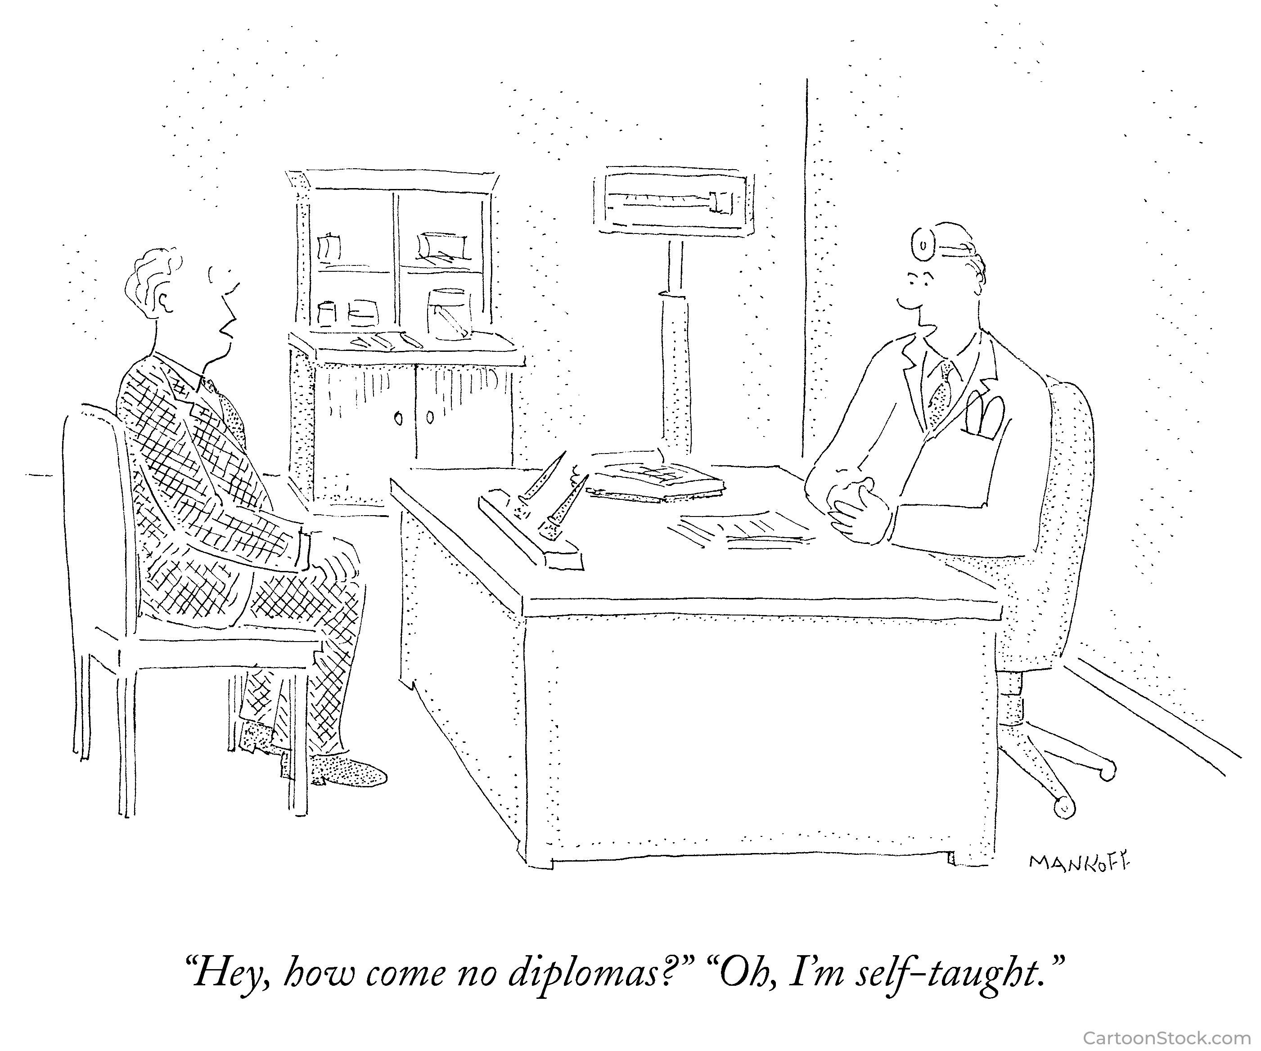

Slide 10
Proposing Custom and Practice Evidence
Engage the expert early to guide strategy and discovery
Credible resume that inspires trust/confidence in opinions on this dispute
Specific, demonstrable experience with specific disputed issue
Experience of a quality and duration that will support existence of custom or practice
Support for expertise is unrestricted by confidentiality terms
Expert must do more than embrace and advocate for an outcome

Slide 11
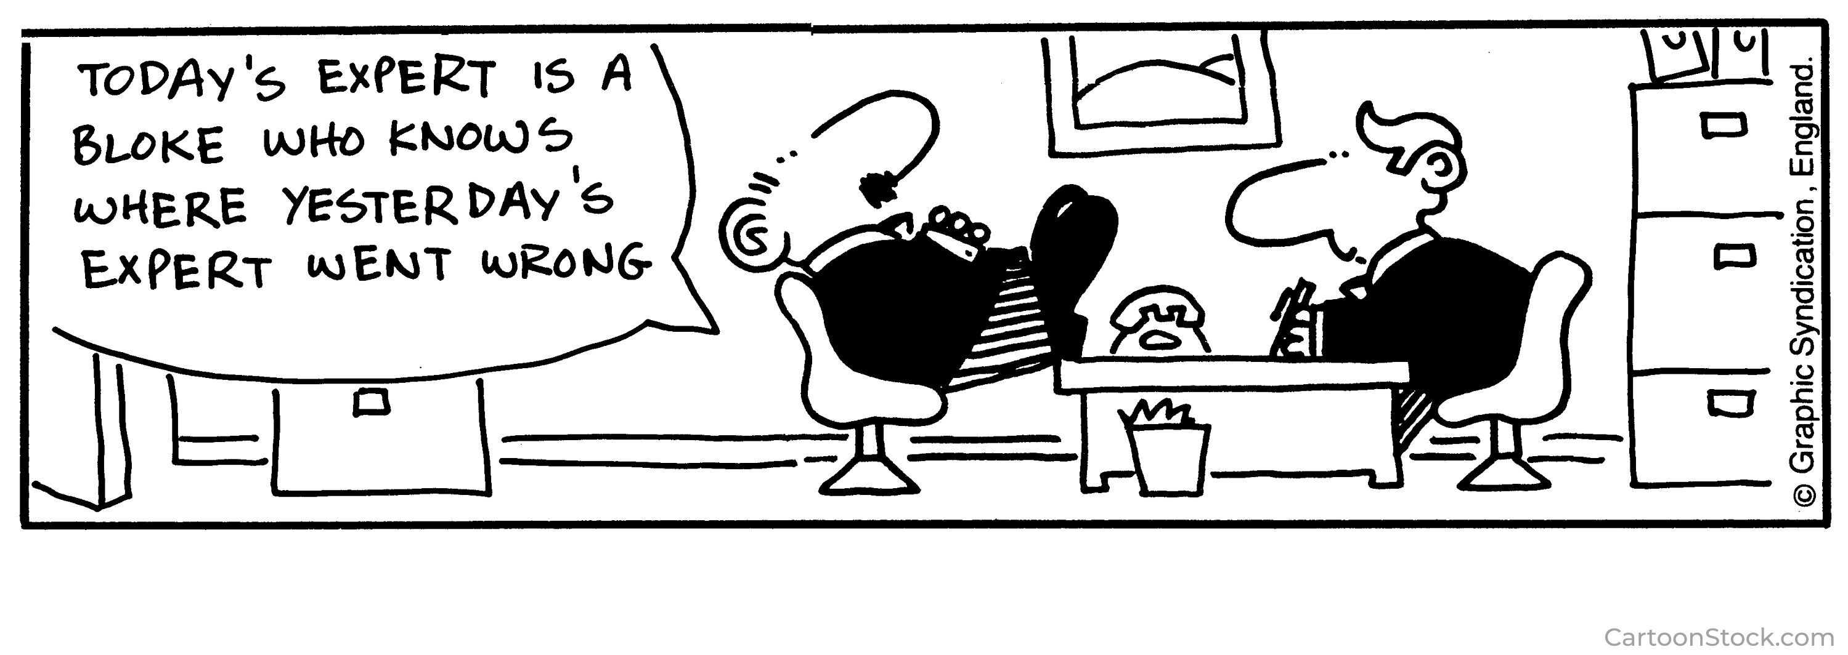
Opposing Custom and Practice Evidence

Slide 12
Opposing Custom and Practice Evidence
Attack applicability of expert’s experience to the dispute
Establish dispute is too rare or unusual to support applicability of custom or practice
Cross-examine with:
Specific examples undermining asserted custom or practice
Contract terms supplanting custom and practice
Elicit admissions that undermine other issues in dispute

Slide 13
View from the Panel Member
What is the expert bringing that is truly beyond the scope of the panel’s experience?
What are the expert’s specific takeaways that will get traction in deliberations?
To what extent is the expert merely testifying as an advocate for the side that hired the expert?

Slide 14
Hypothetical: Panagea Cas. vs. Cantilever Re
Series of wildfires, ignited in three places by the same utility equipment malfunction during high winds, burns over several counties for 14 days days.
Panagea Casualty pays $80 million in losses arising from the fires.
Panagea’s reinsurance agreement with Cantilever Re covers 50 percent of losses, “per loss occurrence,” in excess of a $20 million retention.
The reinsurance agreement does not separately define “loss occurrence.”
Cantilever pays only $20 million of Panagea’s $60 million claim, arguing that the loss comprised three distinct occurrences, only one of which resulted in a loss exceeding Panagea’s retention.
Panagea seeks payment of the remaining $$40 million, contending that, under reinsurance market custom, all fires traceable to one originating cause—the utility malfunction which occurred in multiple locations—should be treated as a single “loss occurrence.”

Slide 15
Panagea’s Expert: Sturgill Filibuster
30 years experience as reinsurance intermediary placing catastrophe coverage
Testifies it is custom and practice in industry for “loss occurrence” to cover all losses traceable to a common cause—here, faulty utility equipment that sparked fires during windstorm
Cites schedule prepared by reinsurer’s claims technician that references Panagea’s fire losses as a single occurrence

Slide 16
The Proponent’s View
Parties may offer evidence of custom or practice to interpret the meaning of an ambiguous contract.
Panel must decide whether language is ambiguous.
“Where terms are used in a contract which are known and understood by a particular class of persons in a certain special or peculiar sense, evidence to that effect is admissible for the purpose of applying the instrument to its proper subject matter.”
Resolution Trust Corp. v. Urban Redevelopment Auth. of Pittsburgh, 638 A.2d 972, 975 (1994)

Slide 17
The Proponent’s View, cont’d
The existence of an industry custom, for purposes of construing the meaning of an ambiguous term in a reinsurance contract, is in the first instance a question of fact.
Reinsurance intermediaries who routinely assist both cedents and reinsurers in reaching agreement on and fashioning the terms of their contracts may be “particularly well-situated to understand the intent” behind reinsurance terms
Aetna Cas. & Sur. Co. v. Home Ins. Co., 882 F. Supp. 1328, 1345 (S.D.N.Y. 1995)

Slide 18
The Proponent’s View, cont’d
Parties working in specialized fields “may understand the argot of their business and see no need to define terms. They may be able to juggle multiple meanings of a term, with no need for explanation.”
Swiss Reins. Am. Corp. v. Airport Industrial Park, Inc., 325 F. App’x 59, 65 (3rd Cir. 2009)
Sturgill opines that “everyone knows” that “single occurrence” as used in the reinsurance agreement would cover all fire losses

Slide 19
The Proponent’s View, cont’d
How parties behave after entering into the agreement may be used cited to interpret ambiguous contract terms.
Sturgill will testify that Cantilever’s internal schedule shows it viewed treated the fires as a single occurrence
The internal Cantilever schedule shows that Cantilever views “loss occurrence” to mean all fire losses should be grouped as a single loss

Slide 20
The Opponent’s View
Filibuster may have 30 years of experience in catastrophe cover, but he cannot point to any single instance where the parties discussed the specific meaning of “single occurrence” as it applies to these facts
“Terms of art in reinsurance agreements are interpreted according industry custom and practice, which must be established by competent evidence.”
Ins. Co. of N. Am. v. Pub. Serv. Mut. Ins., 609 F.3d 122 (2d Cir. 2010)

Slide 21
The Opponent’s Position, cont’d
The custom or usage evidence must be definite or certain, uniform, reasonable, and well known
Here, the expert is essentially expressing his view couched in terms of custom and practice
The expert is little more than an advocate for an outcome
The expert has failed to show that the custom or usage is so well established that it is fair to assume the parties were aware of it

Slide 22
The Opponent’s Position, cont’d
Separately, the expert should not be allowed to cherry-pick evidence from the reinsurer’s files to support an outcome
The schedule the expert relies on was prepared by a claims technician who had no involvement in negotiating the reinsurance agreement
Experts generally may rely on information that would be inadmissible as long as it is the type of information that a professional in the field would typically and reasonably rely upon
E.g., Federal Rule of Evidence 703
Here, a broker would not rely on internal record-keeping documents
Experts should be restricted to their expertise, not permitted to parrot their party’s talking points

Slide 23
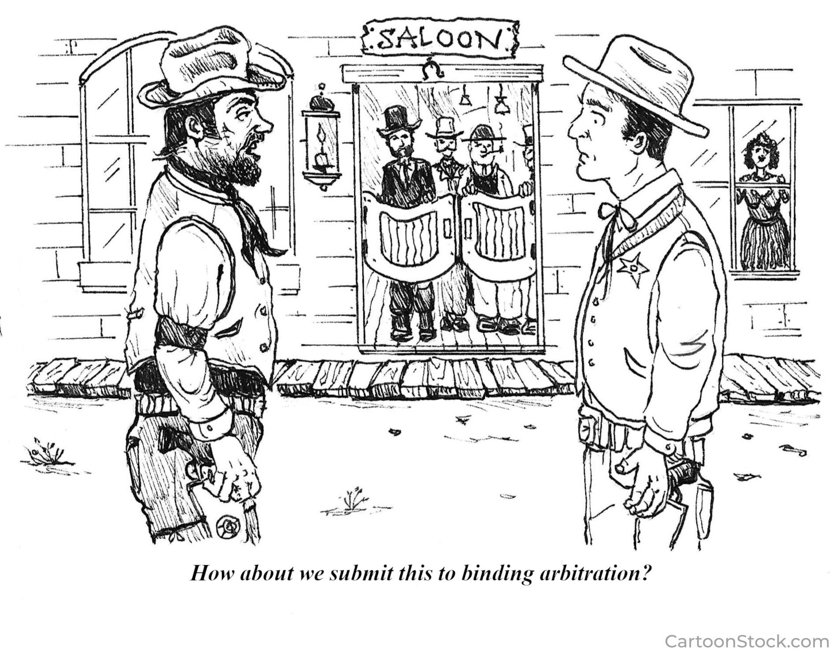
View from a Panel Member

Slide 24
Examples of Custom and Practice Experts on Standard of Conduct
Underwriting of Ceded Risks under Treaty
Treaty Compliance by Cedant
Claims Handling by Reinsurer

Slide 25

Questions?

